Slide 1



Patient Connect: User-Friendly Scheduling and Record Management
Members:
Maria Isabelle Gabucan
Julfelyn Lamo
Mary Rose Domo
Franny Faith Wasil
Jhaber Lidasan

Slide 2

INTRODUCTION
Our system (Patient connect: User-friendly Scheduling and Record Management) simplifies how patients and healthcare providers manage medical records, appointment booking and management. This system offers a secure and user-friendly way to store and access all the health information in one place resulting in better patient care and more efficient resource usage for patients and doctors

Slide 3
Objectives
Patient Connect is a system designed to simplify the way patients and healthcare providers handle medical records and appointments. It provides a secure platform that centralizes health information, making it easier for patients to manage their care and for doctors to access critical medical data. The system streamlines appointment booking and management, improving communication between patients and healthcare providers. By integrating scheduling and record-keeping in one platform, Patient Connect promotes better patient care and more efficient resource management for healthcare facilities.

Slide 4
Scope and Delimitation
The scope of this study focuses on the development and implementation of the PatientConnect systen, encompassing the following key features:
Appointment Booking: Online appointment booking with preferred date slot selection.
User Registration and Login: Account creationg for patients and doctors.
Centralized Medical Records: Secure storage and access to patient health data.
Patient Portal: User-friendly platform for viewing records.

Slide 5
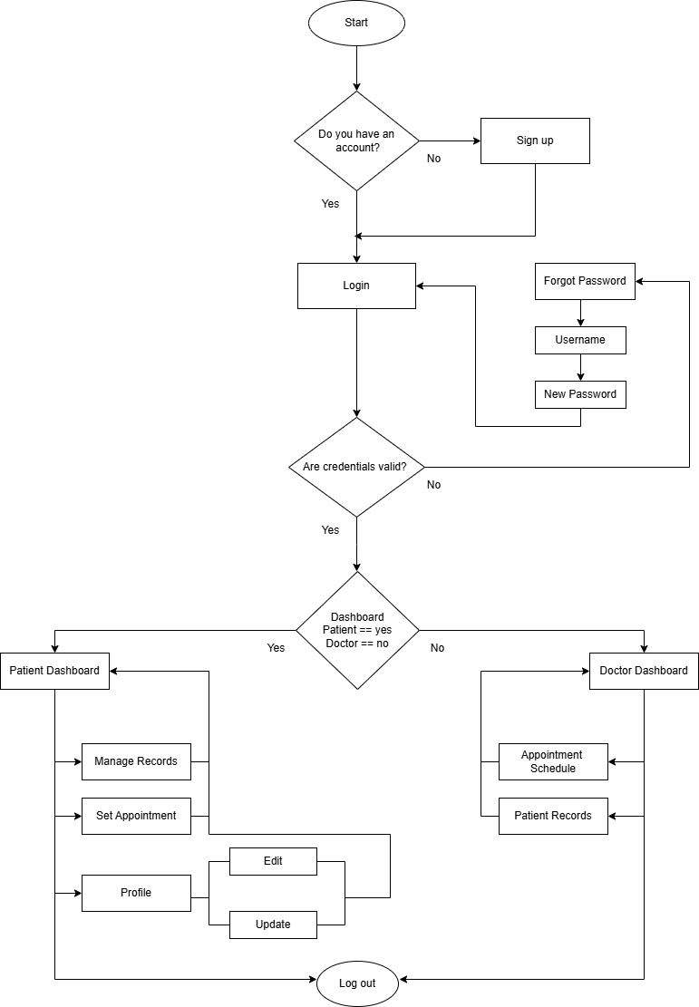
FLOWCHART

Slide 6
GANTT CHART
Description
 | September |  | October |  | November |  | December
Planning
Research
Design Process
Development
Database Implementation
Testing

Slide 7
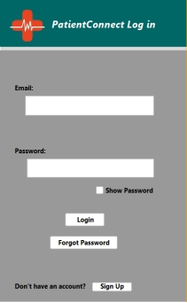
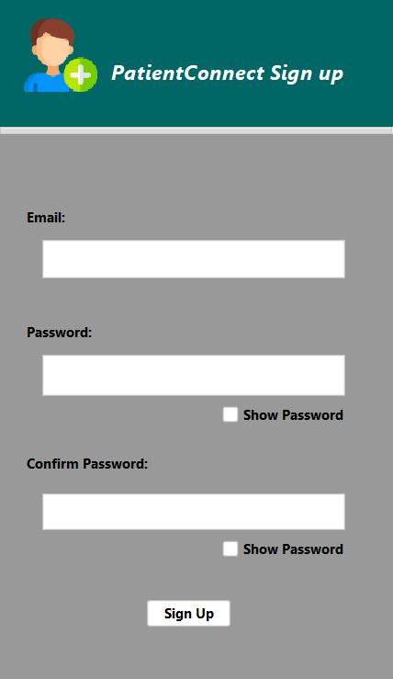
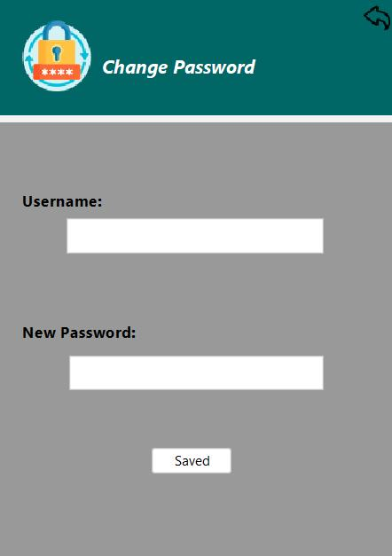
SYSTEM DESIGN
The login page is simple with clear fields for email and password, a “show password” option, and convenient links for changing passwords and it is easy for patients and doctors to access their dashboard.
Sign up page is designed
with clear fields for
email, password, and
password confirmation.
The “show password”
allows users to see the
creating a new account
quick and easy
The change
password interface is
simple. Users can enter
their username and
create a new
password, ensuring
their
account
information
remains protected.

Slide 8
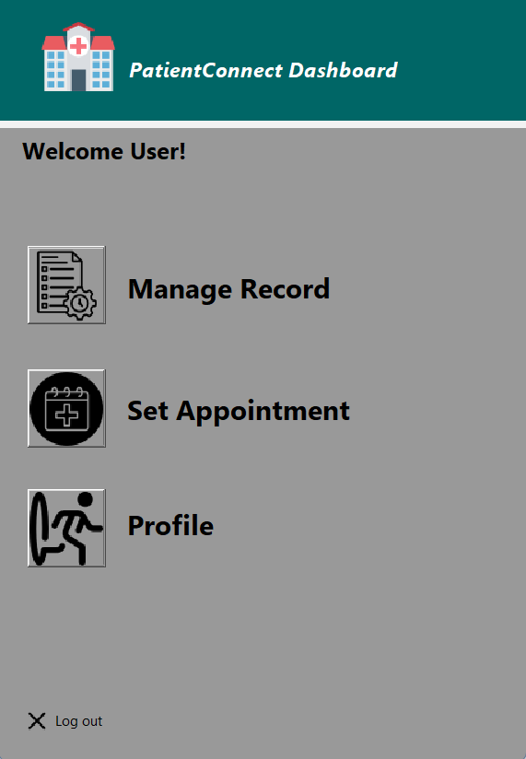
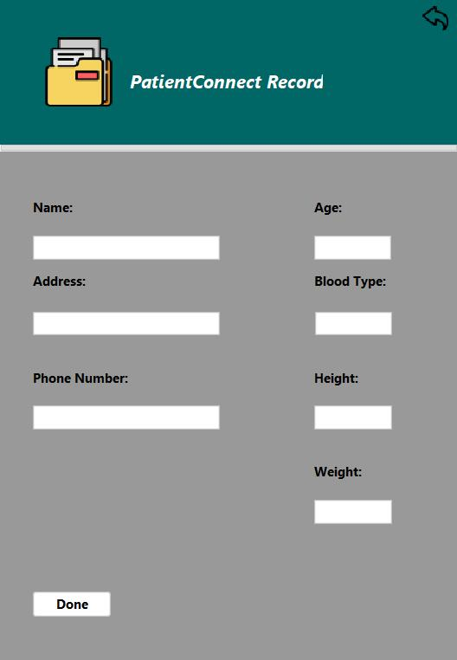
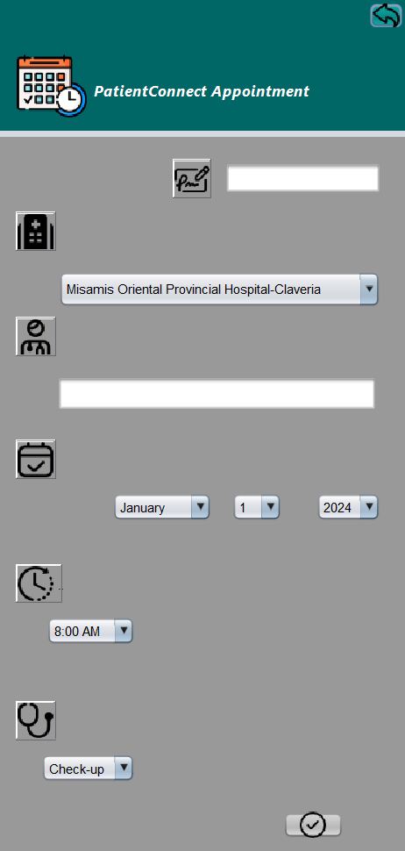
SYSTEM DESIGN
PatientConnect's
dashboard offers
easy access to
manage records,
schedule
appointments, and
access the portal,
with a clear layout
and a prominent
"Log out" button.
This interface designed
is easy to use and efficient for entering patient information. The interface features clear fields for essential details like name, age, address, phone number, blood type, height, and weight. This allows healthcare professionals to quickly and accurately record patient data.
Appointment is
designed to be user
friendly and efficient. It allows
patients to schedule
appointments with
their preferred
doctors at their chosen hospitals, all within the PatientConnect
Platform. This interface is simple with clear drop-down menus for
selecting the hospital, doctors, date, time, and purpose.

Slide 9
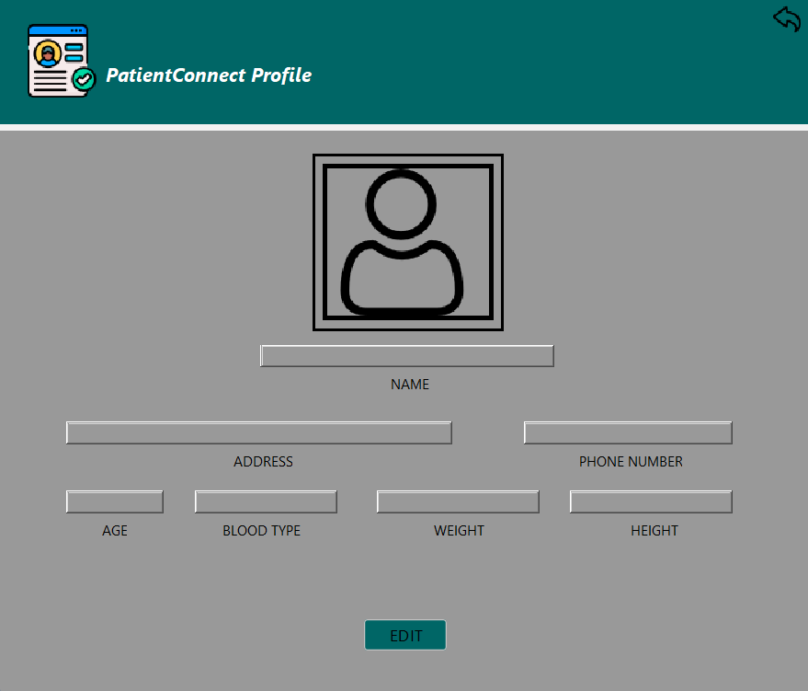
SYSTEM DESIGN
This interface is designed for patients to access their information and they can edit and update.

Slide 10
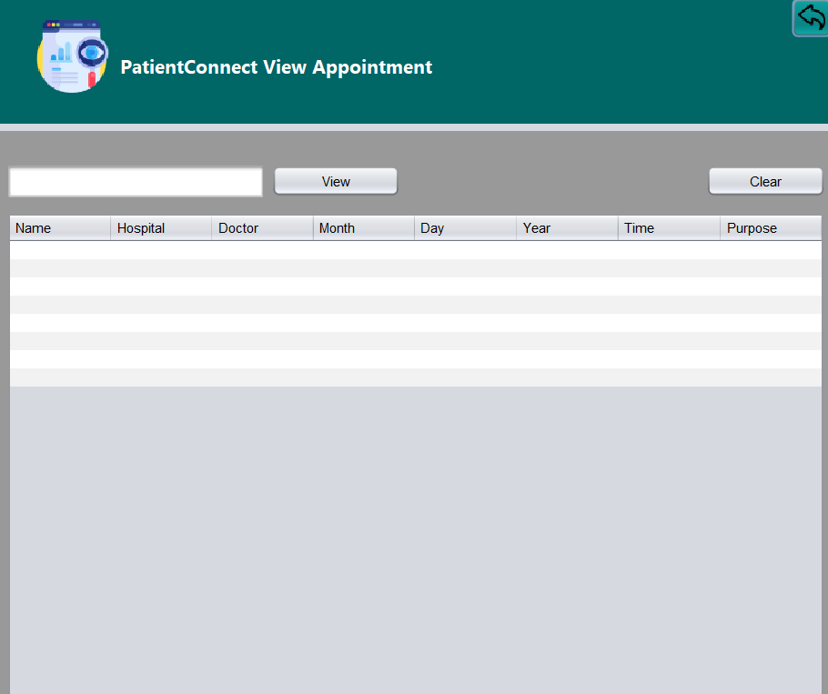
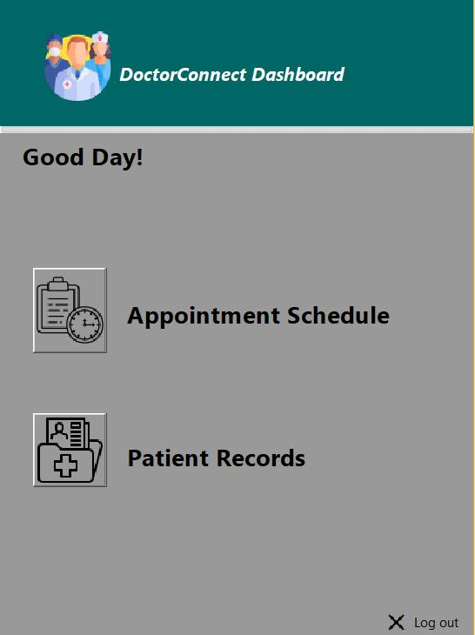
SYSTEM DESIGN
The PatientConnect
system's appointment
view helps doctors
see what appointments
patients have. It
shows things like which
hospital, which doctor, the
date (month, day, and year), the time,
and why the patient
has the appointment.
This makes it easy for
healthcare workers tocheck
their schedules and see
who they're meeting with.
DoctorConnect's dashboard
gives doctors a single
location to retrieve
patient details and
manage their
schedules. The design
is easy to use and
straightforward, with
distinct icons for
"Appointment Schedule" and "Patient Records." This makes it possible for
physicians to find the
information they require quickly, speeding up workflow and increasing
productivity.

Slide 11
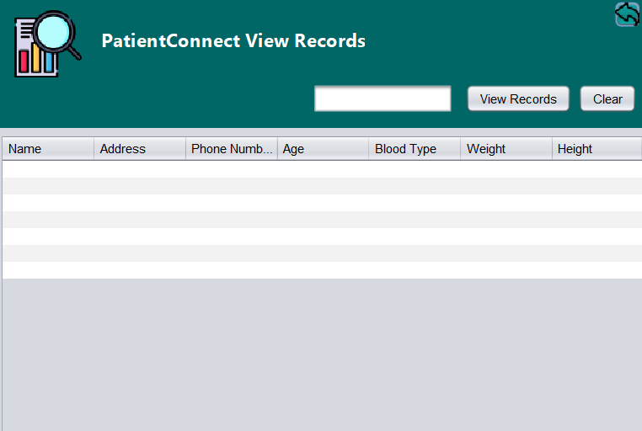
SYSTEM DESIGN
The PatientsConnect View Doctor
Records system, designed to
provide Healthcare professionals
with patient access, includes fields
for name, address, phone number,
age, blood type, height, and weight.

Slide 12
CONCLUSION
The PatientConnect system holds significant potential to transform the healthcare experience by providing a user-friendly and efficient platform for managing medical records and appointments. The system’s features including secure data management, intuitive interfaces, appointment scheduling with notifications, and a centralized patient portal, are designed to enhance patient satisfaction and operational efficiency.
By ensuring seamless access to healthcare information, promoting better care coordination, and enhancing the overall quality of patient care, PatientConnect has the potential to become an invaluable tool for modern healthcare system.

Slide 13
RECOMMENDATION
➢ Reminders: Implement automated reminders for appointments to reduce no-shows.
➢Personalized Experience: Implement features that personalize the user experience based on user preferences and needs. For example, allow users to customize their dashboards and notifications.
➢Accessibility: Consider users with disabilities and make the system accessible to a wider range of users.

