Slide 1
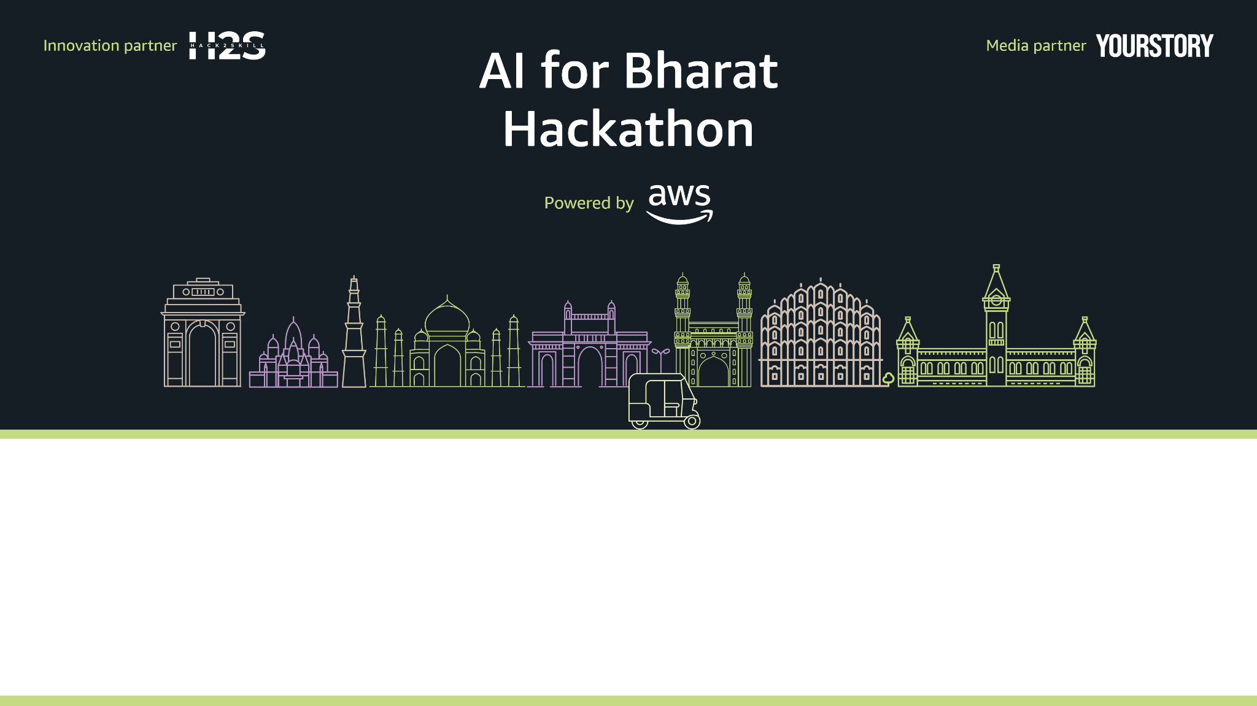
Team Name : KisaanMitra.AI
Team Leader Name : Aditya Mahesh Rane
Problem Statement : AI for Rural Innovation & Sustainable Systems - Build an AI-powered solution that supports rural ecosystems, sustainability, or resource-efficient systems.

Slide 2
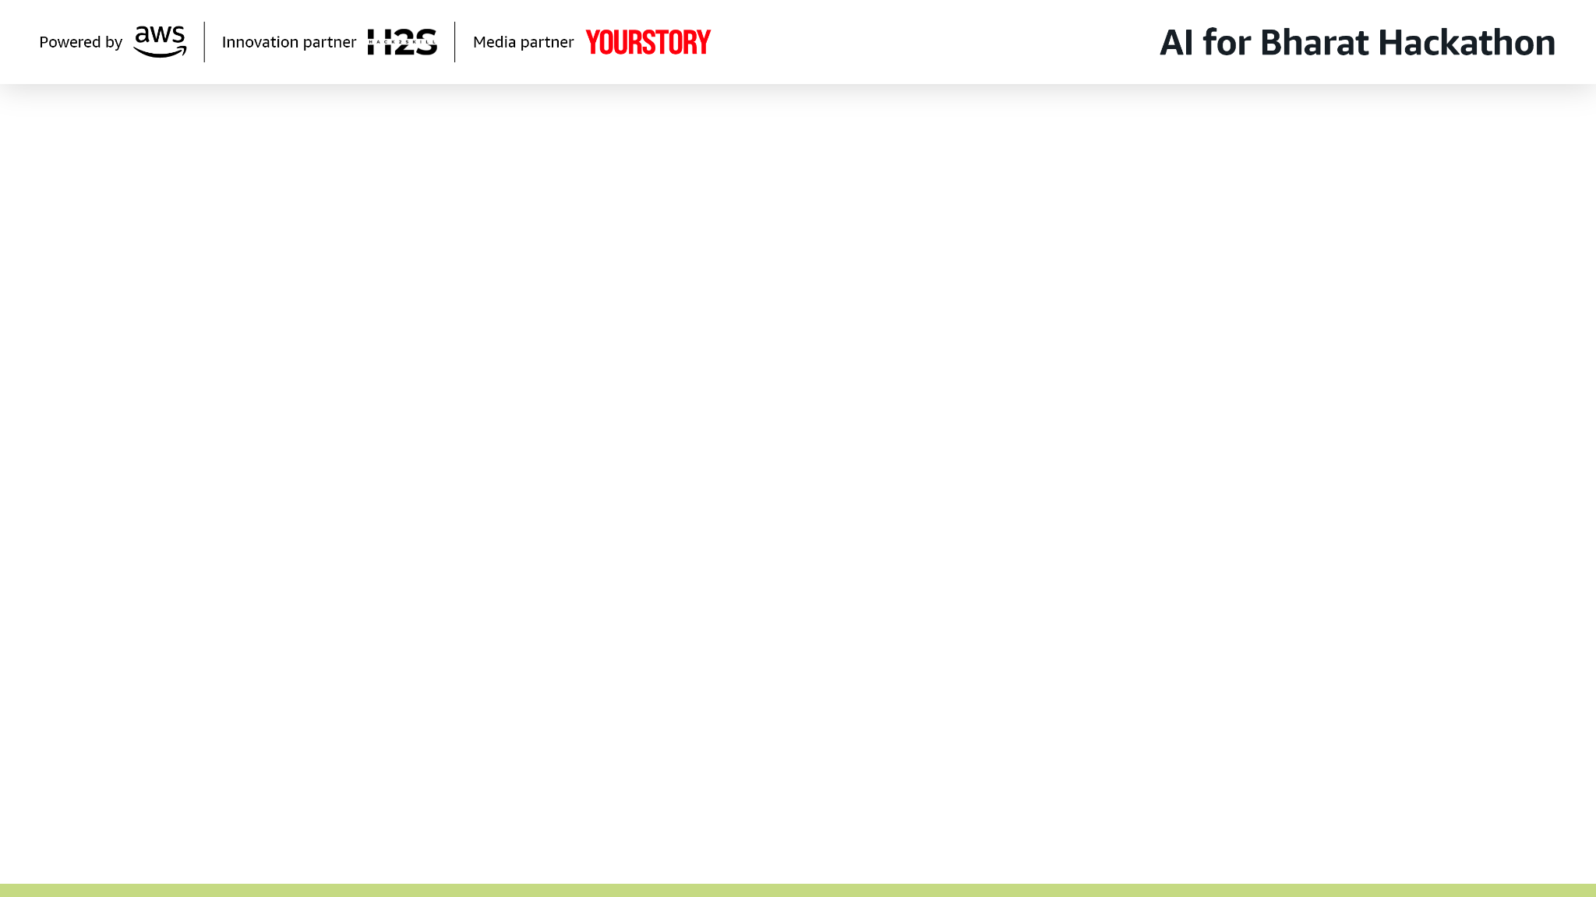

Brief about the Idea:
Problem Statement
India has 146.5 million farming households, of which 86% are small and marginal farmers owning less than 2 hectares (Agriculture Census 2015-16). Over 50% of these households are in debt (NSO 2019), with an average monthly income of just ₹10,218 (NSS 77th Round).
They lack access to timely, hyper-local and integrated decision support across crop management, financial planning and market intelligence — leading to annual post-harvest and pre-harvest losses worth ₹92,651 crore (ICAR-CIPHET), with fruits and vegetables alone losing 5-15% of produce before reaching the market (NABCONS 2022).
Existing information is fragmented, non-personalized and difficult to apply at the village level. 80% of marginal farmers are affected by adverse climatic events (FEED 2024), yet most digital agri-solutions require smartphones, English literacy, and app downloads — excluding the very farmers who need help the most.
Who is Affected - Small and marginal farmers comprising 86% of India’s agricultural households (Agriculture Census 2015-16), with 65% being marginal farmers whose operational holdings cover only 24% of total cultivable land. They face a ₹50,000+ annual income gap due to poor market timing, delayed disease detection, and lack of access to credit and government schemes.
Our Solution
KisaanMitra.AI is a WhatsApp-based multi-agent AI system designed to act as a farmer’s all-in-one intelligent assistant.
It combines three specialized AI agents:
    Crop Agent – Provides hyper-local crop guidance, disease diagnosis, fertilizer and pesticide recommendations and season-specific best practices tailored to the farmer’s village and crop stage.
    Market Agent – Uses demand trends and time-series forecasting to suggest the best crop to grow, optimal harvest timing, and where to sell for maximum profit.
    Finance Agent – Provides end-to-end budget planning for farmers. Helps farmers plan pre-planting budgets, optimize input costs, access relevant government schemes and make informed financial decisions.
The solution also has local language support. It operates in Hindi and regional languages with simple, conversational interaction. Supports text and image inputs to ensure accessibility for farmers with limited digital experience.
Together, these agents deliver personalized, data-driven decisions directly through WhatsApp making advanced agricultural intelligence simple, accessible and actionable for every farmer

Slide 3








Why AI is Required
Farmers speak natural Hindi/Hinglish with typos and slang — only an LLM can understand intent, detect language, and route to the right agent (Crop/Market/Finance) from a single message
Disease diagnosis from crop photos needs multi-modal AI to identify 50+ diseases at 85%+ accuracy and generate treatment + cost estimates instantly
Personalized budgets, price forecasts, and scheme eligibility require multi-step reasoning across each farmer's unique profile, location, and real-time data — impossible with rule-based systems
How AWS Services Are Used
Amazon Bedrock (Nova Pro + Claude Sonnet 4): Core GenAI engine powering Hindi conversations, intent detection, agent reasoning, budget planning, and price forecasting
Lambda + API Gateway + DynamoDB: Serverless compute (4 Lambda functions) with auto-scaling to 1000+ users, sub-millisecond database reads across 5 DynamoDB tables, and secure WhatsApp webhook entry point
S3 + Secrets Manager + CloudWatch: Image storage for crop photos, encrypted API key management (zero hardcoded credentials), and real-time monitoring with error/cost alerts
What Value the AI Layer Adds
Instant expert advice in 2-5 seconds in natural Hindi — replaces expensive consultants with a WhatsApp chat that has zero learning curve
Cross-domain intelligence in one conversation — ask about a disease and get diagnosis + treatment cost + government scheme eligibility + community alerts to nearby farmers, all in a single response
Every response is actionable, not generic — specific pesticide names, exact dosages, rupee costs, mandi names, and step-by-step next actions personalized to the farmer's crops, land, and location

Slide 4





List of features offered by the solution
WhatsApp-Based Multi-Agent AI Assistant
Farmer Onboarding – Gathering Data to Build a Localized Knowledge Graph
Crop Agent
Market Agent
Finance Agent
Hyper-local crop advice (village level knowledge graph)
Disease & pest diagnosis (image + text)
Fertilizer & pesticide recommendations
Best practices from nearby successful farmers
Soil & weather aware suggestions based on local conditions
Live prices from 1000+ mandis, multi-crop comparison
7-day AI price forecast + supply-demand signals
Best sell timing, target price, risk assessment
Best mandi by price vs distance vs transport cost
Custom price alerts on target hit or changes
Full budget: cost breakdown + revenue + profit projection
Auto scheme match (PM-KISAN, KCC, PMFBY, SHC)
Loan advisory: rates, eligibility, docs checklist
Risk scoring: weather, market, disease probability
Input cost optimization + expense tracking

Slide 5





Process Flow Diagram
Onboarding
Pre-Planting
Growing
Harvest
Selling
Farmer sends "Hi“ on WhatsApp
"Kaunsi fasal lagau?"
“Agli baarish kab aa rahi hai?”
"Kab harvest karu?"
"Kab harvest karu?"
Disease Diagnosis:
Detects disease
Suggests correct pesticide & dosage
Weekly Advisory:
Weather/Pest alerts
Irrigation reminders
Fertilizer schedule by crop stage
Cost Control:
Compares local market prices
Cheaper alternatives
Checks subsidy availability
AI collects basic details:
Village name & Location
Current crop & Sowing date
Irrigation type & Budget range
Market Agent:
Demand trends + forecasting → best crop
Finance Agent:
Budget plan + schemes
Crop Agent:
Soil prep + seed variety
Market Agent:
Analyzes mandi price trends
Predicts 2–4 week price movement
Recommends best nearby mandi
Suggests:
Harvest now OR wait
Best nearby mandi
Market Agent:
Where to sell (mandi / private buyer)
Estimated price range
Expected demand analysis
Finance Agent:
Final profit calculation
ROI analysis for the season
Recommendations for next cycle
System creates Farmer Profile + Village Knowledge Graph
"Soybean → 18% higher margin"
Complete cycle: From "Hi" on WhatsApp to profit in bank, powered by 3 AI agents working together

Slide 6
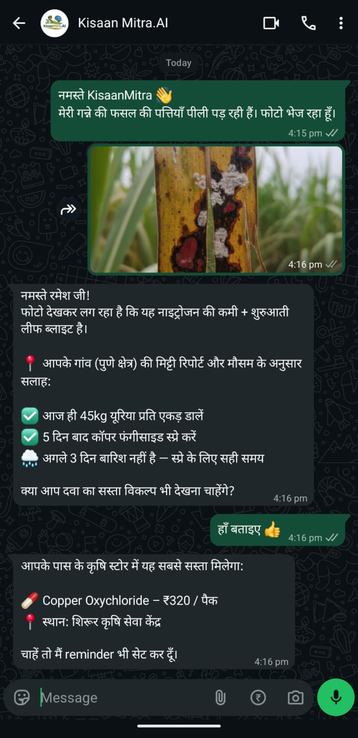
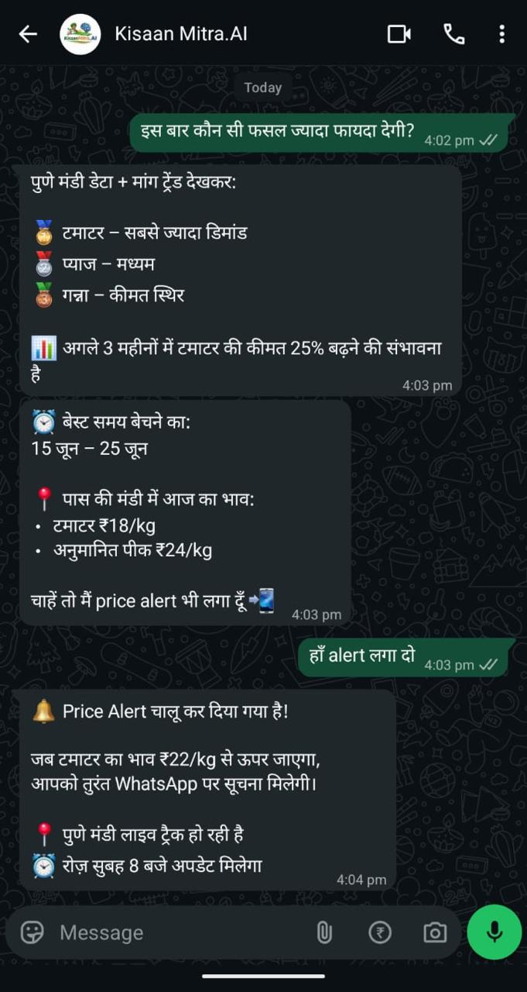
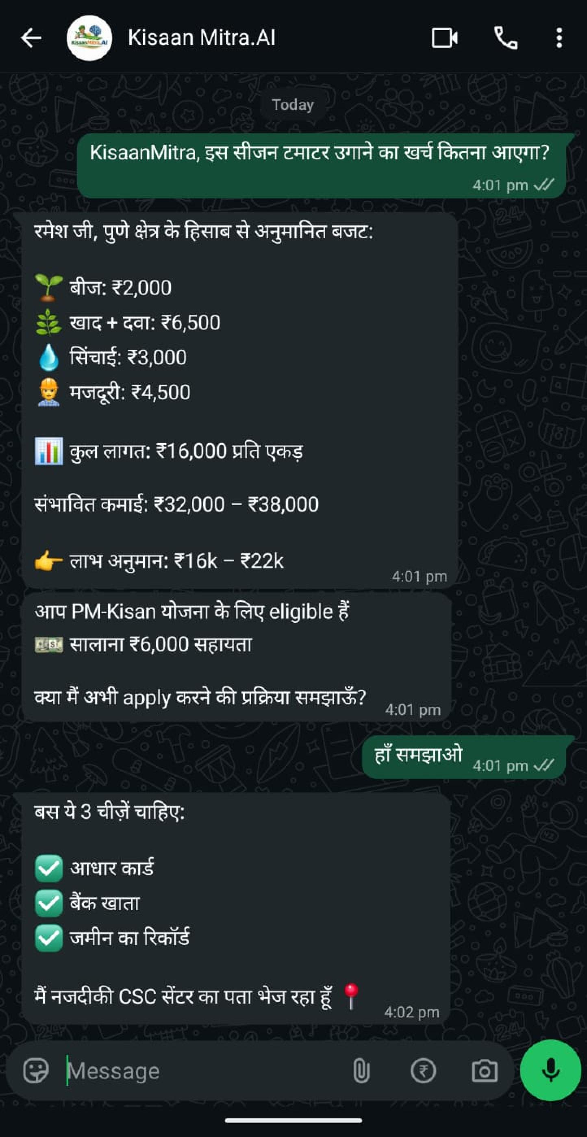


Wireframes/Mock diagrams of the proposed solution
Crop Agent
Market Agent
Finance Agent
Kisaan-Friendly User Experience
Simple via WhatsApp
No app download needed
Works on basic smartphones
Image, text & voice support
Local Language First
Hindi & regional languages
Easy for rural users
Voice-friendly interface
Cost & Efficiency First
Zero Cost Advisory for Farmers
Low-Latency Responses
Concise and Actionable Recommendations

Slide 7
Architecture Diagram
📱 Farmer via WhatsApp
sends "Hi" to begin journey
AWS Services Used
Amazon Bedrock
Nova Pro + Claude Sonnet 4
▼
AWS Lambda (x4)
Orchestrator + 3 Agents
Meta WhatsApp Business API
Webhook · Message Parser · Image Download
Amazon DynamoDB
5 tables, sub-ms latency
▼
Amazon S3
Crop images & documents
AWS API Gateway
Auth · Rate Limit · Secure Entry
API Gateway
Secure webhook entry
Secrets Manager
Encrypted API keys
▼
Lambda Orchestrator
Intent Detection + Agent Routing (Nova Pro)
CloudWatch
Logs, metrics, alerts
🌱 Crop Agent (Lambda)
Disease Detection · Treatment · Alerts
💰 Finance Agent (Lambda)
Budget · Schemes · ROI · Loans
📊 Market Agent (Lambda)
Prices · Forecast · Selling Strategy
External APIs
Kindwise API — Disease detection 85%+
AgMarkNet API — Govt mandi prices
Kindwise API · OpenWeather API
Disease Detection (85%+) · 7-Day Forecast
Amazon Bedrock (Claude Sonnet 4)
Complex Reasoning · Budget Calc · Risk
AgMarkNet API (Govt of India)
1000+ Mandis · Real-time Prices · History
OpenWeather API — 7-day forecasts
AI + Data Layer · DynamoDB (5 tables) | S3 (Images & Docs) | Secrets Manager | CloudWatch (Monitoring)
🤖 Amazon Bedrock LLM — Nova Pro (Primary) + Claude Sonnet 4 (Complex) — Agent Prompts + Multilingual (Hindi · English)
Region: ap-south-1 (Mumbai)
✅ Personalized WhatsApp Response to Farmer

Slide 8
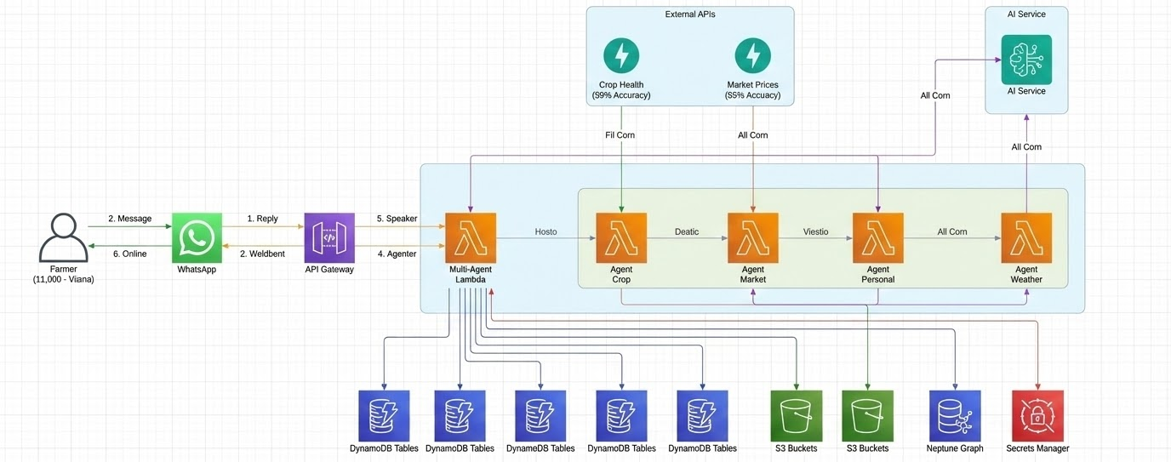
AWS Architecture Diagram

Slide 9












Technologies Used in the Prototype:
🌐 Interface Layer
⚙️ Backend & Agent Orchestration
🧠 AI & ML Layer
WhatsApp Business API
Primary user interface (500M+ users in India)
AWS Lambda
Serverless compute (Python 3.11, 1024MB, ap-south-1)
Amazon Bedrock Nova Pro
Primary LLM (100% routing, 92.86% extraction)
Streamlit Dashboard
Real-time analytics with interactive visualizations
LangGraph
Multi-agent orchestration framework (4 agents)
LangChain
AI framework for agent coordination & context
REST APIs
Webhook integration for message delivery
Python 3.11
Core backend language with boto3 SDK
Kindwise API
Crop disease detection (99% accuracy)
AgMarkNet + OpenWeather
Govt mandi prices + 7-day weather forecasts
📊 Data & Storage
🚀 Deployment & Scale
Amazon DynamoDB
NoSQL database (7 tables, pay-per-request, TTL)
AWS CloudWatch
Monitoring, logging, metrics (2.96s avg response)
Amazon S3
Object storage (images, PDFs, versioning enabled)
Amazon EventBridge
Scheduled automation (daily/weekly updates)
Amazon Neptune (Optional)
Graph database for village knowledge network
AWS Secrets Manager
Secure API key management and rotation
AWS API Gateway
Secure webhook entry, auth, rate limiting
Region: ap-south-1 (Mumbai)
Low-latency serverless for Indian farmers
Built on AWS · Powered by Amazon Bedrock · Serverless · Scalable for 100M+ Indian Farmers

Slide 10




Estimated implementation cost:
1 Village Pilot
Tech Infrastructure
₹6–17K/mo
AI/LLM API • WhatsApp Business API • Cloud Hosting
One-Time Setup
₹28K–40K
Village Data Agent
₹10–12K/mo
Training + Device + Data Setup
1 local agent (₹10–12K/mo) • Training • Smartphone
Data Collection
Monthly Running Cost
One-time
₹19–34K
Govt API integration • Soil testing kits • Farmer surveys
Agent + Tech + Operations
Miscellaneous
₹3–5K/mo
SIM / Data recharge • Travel • Printing materials
~ ₹1.5 – 2.5 Lakhs

Slide 11
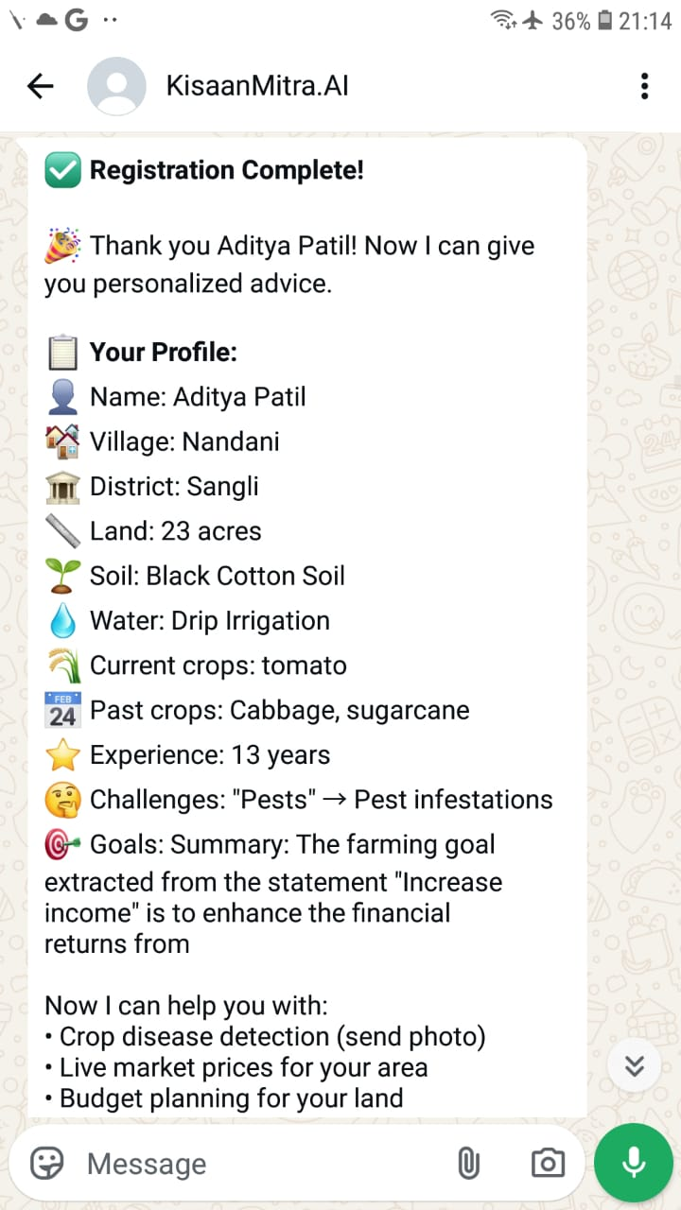
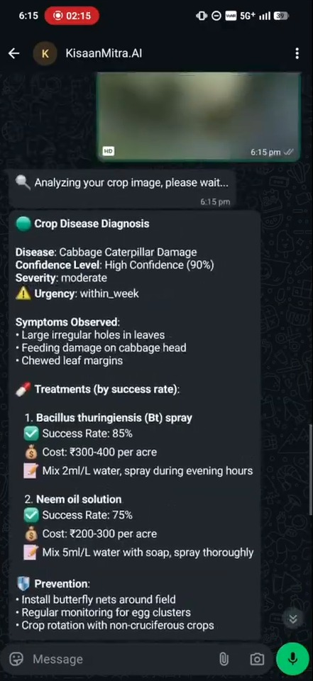
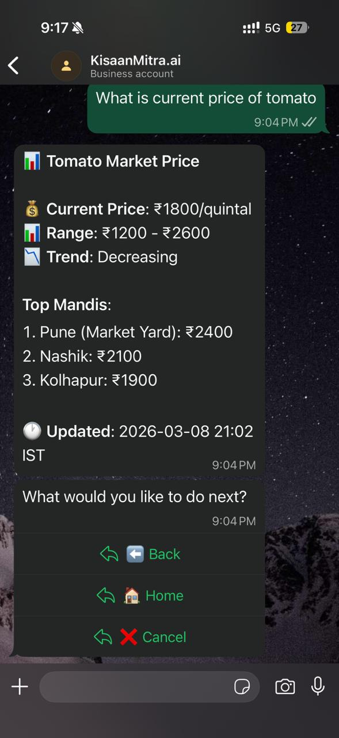
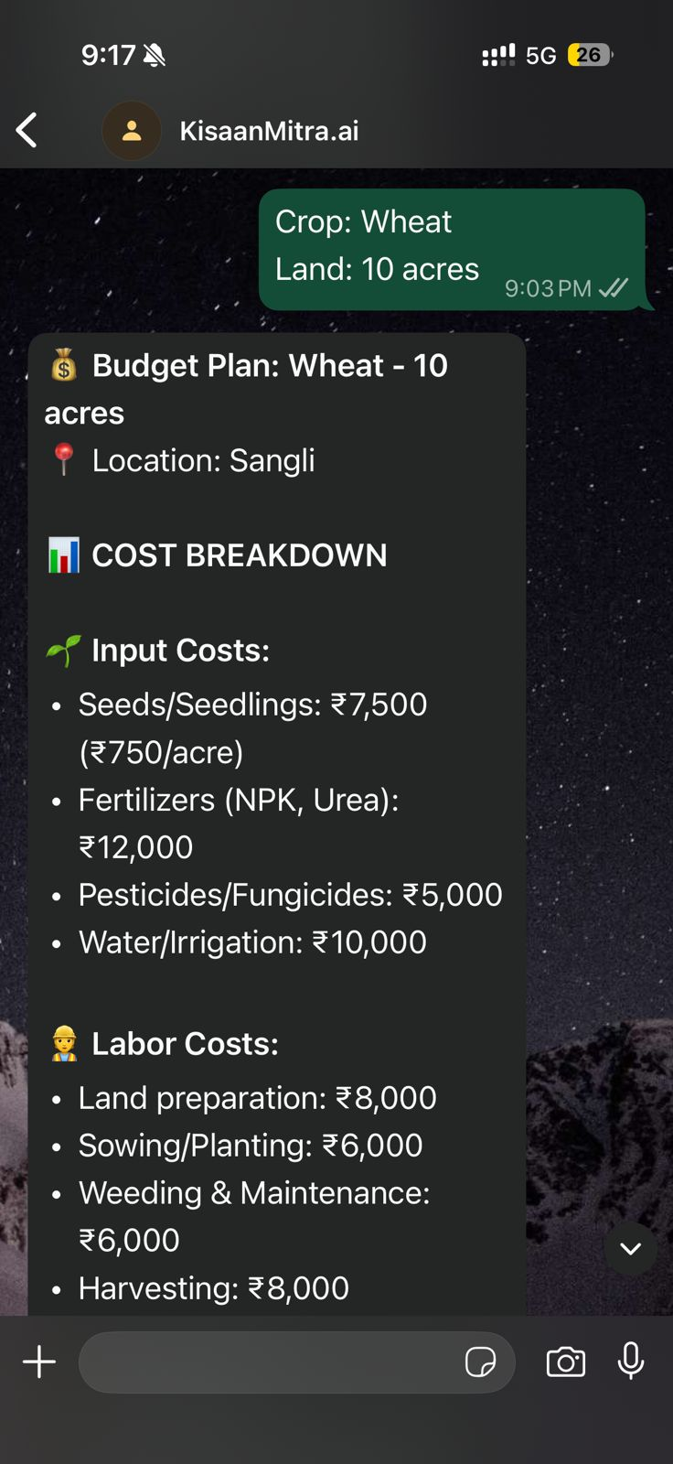
Snapshots of the prototype:
Click here to see the demo video
Onboarding
Crop Agent
Market Agent
Finance Agent

Slide 12
Performance Report & Benchmarking
Verified Metrics (Tested March 7, 2026)
AI Routing Accuracy: 100%
40 Queries
40 queries tested (Hindi + English) with zero misrouting errors across all 4 agents
100% Routing
Crop Name Extraction: 92.86%
14 Queries
Verified across Crop, Market, Finance, and General agents
13/14 queries correctly extracted crop names from Hindi and English farmer messages
Avg Response Time: 2.96 seconds
Greeting: 1.0s | Market: 2.67s | Finance: 3.73s | Crop: 4.46s
Sub-3s Avg
Latency
Bilingual Support: 100%
40 Queries
20 Hindi + 20 English queries tested with perfect accuracy in both languages

Slide 13



Additional Details/Future Development:
Data Moat
Every Recommendation = Revenue
Village-level agricultural data does not exist in India today. Government data stops at district level. Every farmer interaction generates hyper-local data that no competitor can replicate — the longer we operate, the deeper the moat.
Unlike traditional ad models, our AI agents deliver recommendations at the exact moment of farmer need. Every suggestion is a high-conversion touchpoint for partners — not an interruption, but a solution.
Zero Marginal Cost at Scale
Multi-Sided Network Effect
Once AI agents are trained and village data is seeded, adding the next village costs only one field agent (~₹10-12K/month). Tech, AI models, and data pipelines scale at near-zero marginal cost.
More farmers → richer data → better AI → more partners willing to pay → better services for farmers → more farmers. A self-reinforcing flywheel that is hard to disrupt once established.
"We don't just build an AI tool - we build India's first village-level agricultural data infrastructure."

Slide 14
Prototype Assets:
GitHub Public Repository Link
Demo Video Link

Slide 15
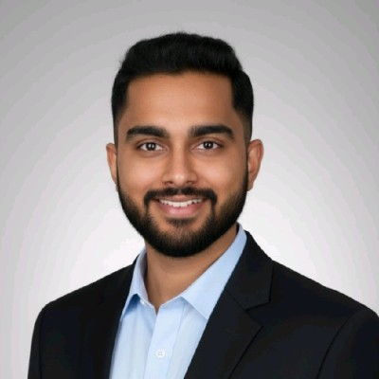
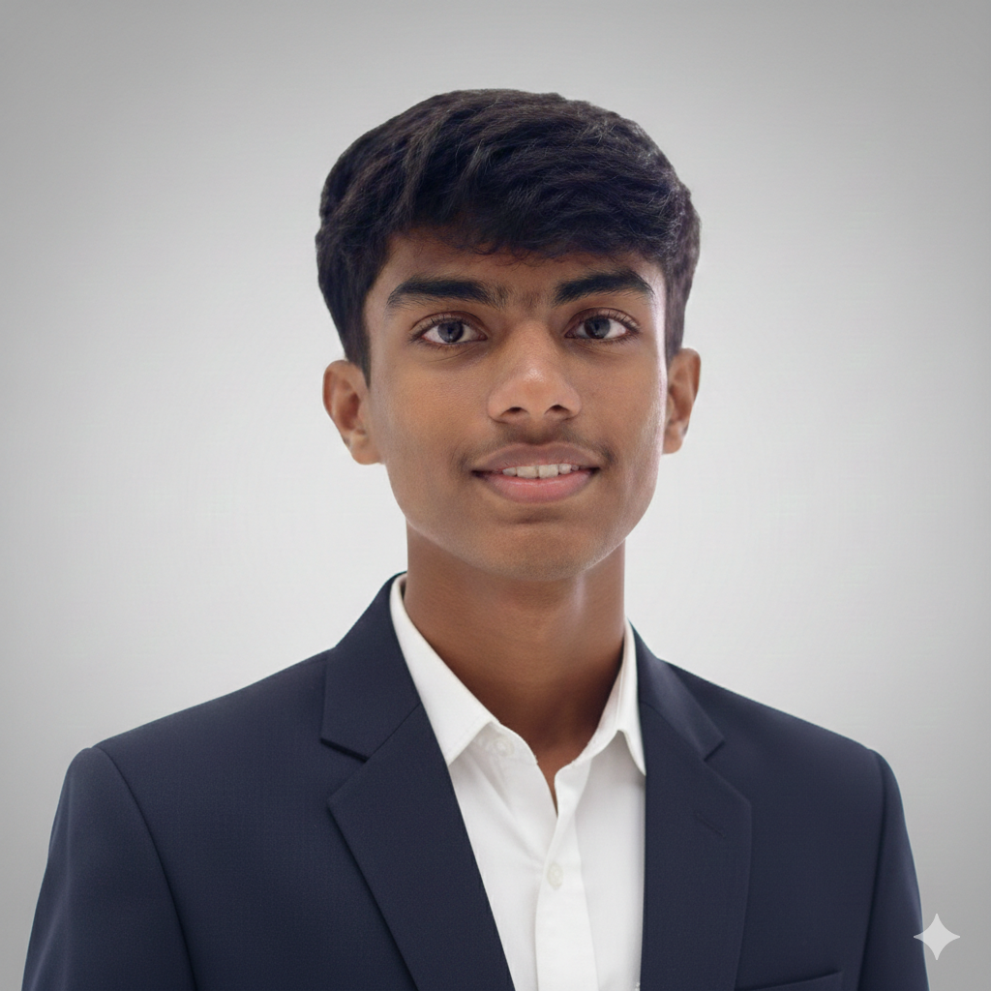
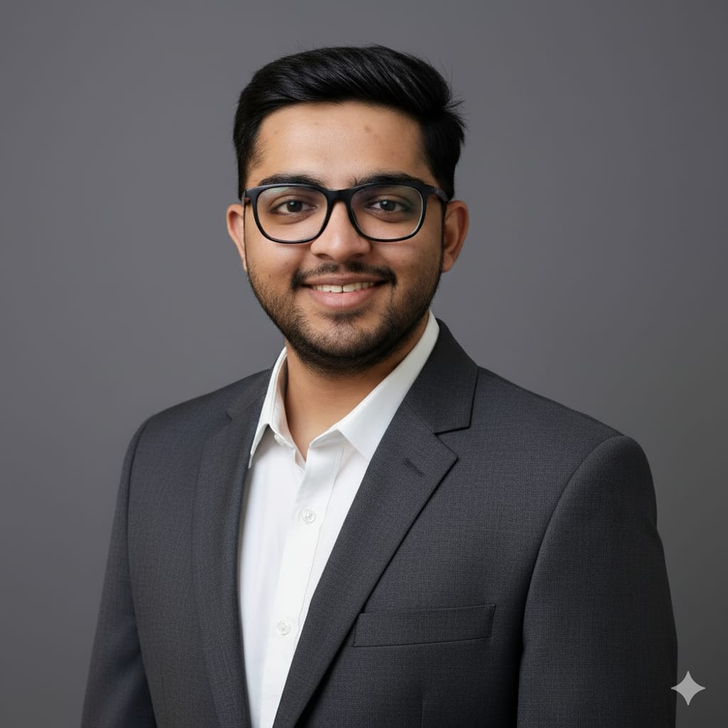
About the Team
Aditya Rane
Vinay Patil
Parth Nikam
Advanced Analytics
Head Robotics and Software Engineer
Project Manager
MiQ
AiTuring
Tracelink
Data Science
Ad-Tech
Agentic AI
Robotics
AI Systems
Computer Vision
Technology
Finance
Business Strategy
Building KisaanMitra.AI — From "Hi" on WhatsApp to Profit in the Bank

Slide 16


