Slide 1
Personalized Diet and Daily Routine Recommendation System
A Machine Learning & Conversational AI-Based Mobile Wellness Platform
UQ25CA741A - Capstone Project - Phase 1 (80%+ Advanced Milestone)
Student Details
Guide Details
Student: Adarsh Sheetal Patil
SRN: PES1PG25CA008
Course: UQ25CA741A
Guide: P. Sreenivas
Assistant Professor
Notes:
Introduce the project, the guide and the course. Mention that this is Phase 1 of the capstone and that the mobile prototype will be demonstrated.

Slide 2
Presentation Overview
1
Abstract
8
Database design
2
Introduction and problem scenario
9
Mobile implementation demonstration
3
Literature survey
10
Security and offline support
4
Proposed solution
11
Tools and technologies
5
Functional and non-functional requirements
12
Applications, future scope and conclusion
6
System architecture
13
References
7
ML methodology and process flow
Implementation Status: 80%+ System Delivery (Core ML, AI Coach, Daily Routine & Admin Modules Completed)
Notes:
Walk through the agenda briefly. The demonstration section shows what is working today; backend components are described as the next stage.

Slide 3

Abstract
Maintaining a healthy diet and daily routine is difficult because users have different bodies, schedules, goals, food preferences and restrictions. Existing applications often provide generic plans or separate tracking features.
This project develops a Flutter-based Android mobile application that creates a personalized wellness plan from health profile information: age, gender, height, weight, BMI, activity level, goal, food preference and allergies.
It calculates BMI, BMR, calorie and hydration targets, and provides meal plans, recipes, substitutions, grocery planning, water, exercise, sleep and meal adherence tracking, wellness scoring and offline access.
CURRENT PROTOTYPE
Flutter Android app with local data, local rules and device persistence
PLANNED NEXT STAGE
Flask REST API, MySQL database and Scikit-learn recommendation engine
The application provides general wellness guidance and is not a substitute for medical or dietetic advice.
Notes:
Summarise the problem, the Flutter-based solution and clearly state that the backend (Flask, MySQL, Scikit-learn) is planned and not yet connected.

Slide 4





Introduction and Problem Scenario
People find it difficult to plan meals according to BMI, calorie requirements and health goals.
Separate applications
One integrated application
1
Diet
Generic diet charts do not adapt to weight changes, activity levels, dislikes or allergies.
Diet
2
Water
Water
Users may not know suitable substitutes when ingredients are unavailable.
3
Exercise
Exercise
Grocery planning is usually a separate manual activity.
4
Sleep
Sleep
Water, exercise, sleep and meal tracking are spread across different applications.
5
Grocery
Grocery
Users need one mobile application that combines planning, tracking and adaptive guidance.
6
Notes:
Explain each problem in one sentence, then show the illustration: five separate tools replaced by one integrated mobile application.

Slide 5


Proposed Solution, Purpose and Scope
Proposed Solution Architecture
A mobile-first wellness platform integrating personalized nutrition, circadian routine scheduling, and interactive conversational AI guidance.
Key System Pillars (80%+ Implemented):
• Adaptive Nutrition Engine: Mifflin-St Jeor BMR, BMI, 5-meal calorie splitting, and content-based food substitutions.
• Daylight AI Coach: Real-time conversational guidance using Google Gemini 1.5 Flash API + zero-latency local wellness fallback.
• Circadian Routine Synchronization: 7 structured daily wellness milestones with real-time adherence tracking.
• Dynamic Macronutrient Balancing: Visual real-time distribution across Protein (25%), Carbohydrates (50%), and Fats (25%).
• Admin & Store Deployment: Multi-role governance (Member vs. Admin) and PWA/WebAPK packaging for Google Play.
Purpose
Scope
Improve personalization compared with static diet charts.
Encourage consistent daily habits.
Reduce the effort required to plan meals and groceries.
Provide useful substitutes for unavailable or disliked foods.
Keep previous plans and logs available offline.
Android mobile application using Flutter.
Local-first prototype for profile, meals, recipes, grocery and tracking.
Planned Flask API, MySQL database and ML engine.
General wellness use for students, professionals and fitness-conscious users.
Notes:
State the solution in one line, then purpose and scope. Emphasise that the prototype is local-first and the backend is planned.

Slide 6

Domain and Target Users
Domain areas
Target users
Digital health and mHealth
Nutrition informatics
Students
Working professionals
Recommender systems
Supervised machine learning
Fitness-conscious users
Gym members and trainers
Mobile computing
Habit and wellness tracking
Sports departments in educational institutions
Workplace wellness programmes
Medical professionals and dietitians remain important for condition-specific advice.
Notes:
Domain areas show the technical fields involved; target users show who benefits. Dietitians and doctors remain essential for condition-specific advice.

Slide 7






Literature Survey Background
Mobile health applications for lifestyle monitoring
Food and recipe recommender systems
Nutrient-based content recommendation
Machine learning for calorie and dietary prediction
Behaviour change and habit tracking applications
Offline-first mobile health applications
Requirement: include at least ten verified papers from IEEE Xplore, Scopus-indexed journals or recognised academic conferences, preferably from the last five years. Use only details verified through the university library or IEEE/Scopus access.
Notes:
These are the areas studied for the literature survey. The final deck must carry at least ten verified papers; do not present unverified references.

Slide 8
Literature Survey Summary (1/5)
No. | Paper title | Author(s) | Year / venue | Main method | Main finding | Relevance to project
1 | The Use of Social Features in Mobile Health Interventions to Promote Physical Activity: A Systematic Review | H. L. Tong and L. Laranjo | 2018, npj Digital Medicine | Systematic review and meta-analysis | Social support and comparison can improve engagement, but user preferences differ. | Supports reminders, progress feedback and future social or motivational features.
2 | Mobile Phone Apps to Promote Weight Loss and Increase Physical Activity: A Systematic Review and Meta-Analysis | G. Flores Mateo, E. Granado-Font, C. Ferre-Grau and X. Montana-Carreras | 2015, Journal of Medical Internet Research | Systematic review and meta-analysis | Mobile applications can support weight management and physical activity, although study quality varies. | Supports combining diet, exercise, water and progress tracking in one app.
Notes:
Walk through the ten papers by theme: behaviour change and mHealth effectiveness, recommender ethics and trust, explainability, and security and privacy. Each row ends with how it supports this project.

Slide 9
Literature Survey Summary (2/5)
No. | Paper title | Author(s) | Year / venue | Main method | Main finding | Relevance to project
3 | A Systematic Review of Electronic and Mobile Health Physical Activity Interventions for African American and Hispanic Women | R. P. Joseph, K. E. Royse and T. J. Benitez | 2019, Journal of Physical Activity and Health | Systematic review of eHealth and mHealth interventions | Personalisation and culturally appropriate content are important for engagement. | Supports user-specific goals, food preferences and regional food support.
4 | The Effectiveness of e- and mHealth Interventions to Promote Physical Activity and Healthy Diets in Developing Countries: A Systematic Review | A. M. Muller, S. Alley, S. Schoeppe and C. Vandelanotte | 2016, International Journal of Behavioral Nutrition and Physical Activity | Systematic review | Mobile interventions can improve lifestyle behaviours, but implementation and access affect outcomes. | Supports an affordable Android application with offline access.
Notes:
Walk through the ten papers by theme: behaviour change and mHealth effectiveness, recommender ethics and trust, explainability, and security and privacy. Each row ends with how it supports this project.

Slide 10
Literature Survey Summary (3/5)
No. | Paper title | Author(s) | Year / venue | Main method | Main finding | Relevance to project
5 | Affective Video Recommender Systems: A Survey | D. Wang and X. Zhao | 2022, Frontiers in Neuroscience | Survey of affective recommendation methods | User context and preference signals can be used to improve recommendation quality. | Supports future context-aware routine and meal recommendations.
6 | Recommender Systems and Their Ethical Challenges | S. Milano, M. Taddeo and L. Floridi | 2020, AI & Society | Ethical analysis of recommender systems | Recommenders must consider autonomy, bias, transparency, privacy and manipulation risks. | Supports explainable recommendations, privacy controls and the medical-advice limitation.
Notes:
Walk through the ten papers by theme: behaviour change and mHealth effectiveness, recommender ethics and trust, explainability, and security and privacy. Each row ends with how it supports this project.

Slide 11
Literature Survey Summary (4/5)
No. | Paper title | Author(s) | Year / venue | Main method | Main finding | Relevance to project
7 | What We Talk About When We Talk About Trust: Theory of Trust for AI in Healthcare | F. Gille, A. Jobin and M. Ienca | 2020, Intelligence-Based Medicine | Conceptual analysis of trust in healthcare AI | Trust depends on transparency, accountability, competence and user expectations. | Supports showing calculation logic and clearly stating model limitations.
8 | Explainable Recommendation: A Survey and New Perspectives | Y. Zhang and X. Chen | 2020, Foundations and Trends in Information Retrieval | Survey and taxonomy of explainable recommendation | Explanations can improve transparency and user understanding beyond accuracy alone. | Supports explaining calorie targets, meal choices and substitutions.
Notes:
Walk through the ten papers by theme: behaviour change and mHealth effectiveness, recommender ethics and trust, explainability, and security and privacy. Each row ends with how it supports this project.

Slide 12
Literature Survey Summary (5/5)
No. | Paper title | Author(s) | Year / venue | Main method | Main finding | Relevance to project
9 | Latest Trends of Security and Privacy in Recommender Systems: A Comprehensive Review and Future Perspectives | A. Himeur et al. | 2022, Computers & Security | Security and privacy survey | Recommender systems require privacy-aware data collection, access control and secure processing. | Supports JWT, password hashing, HTTPS and user-specific data access.
10 | Ethical and Legal Analysis of Machine Learning Based Systems: A Scenario Analysis of a Food Recommender System | O. Levina and S. Mattern | 2023, Recommender Systems: Legal and Ethical Issues, Springer | Scenario-based ethical and legal analysis | Food recommenders raise issues involving privacy, fairness, accountability and social impact. | Supports allergen filtering, safety checks, privacy design and professional-advice warnings.
Notes:
Walk through the ten papers by theme: behaviour change and mHealth effectiveness, recommender ethics and trust, explainability, and security and privacy. Each row ends with how it supports this project.

Slide 13
Comparison with Existing Applications
Feature | Generic diet chart | Calorie counter | Recipe application | Fitness tracker | Proposed application
BMI and BMR calculation | ✗ | Partial | ✗ | Partial | ✓ Both calculated
Personalized calorie target | ✗ | ✓ | ✗ | Partial | ✓ BMR x activity + goal
Adaptive meal plan | ✗ | ✗ | ✗ | ✗ | ✓ Updates with profile and progress
Recipe recommendation | ✗ | ✗ | ✓ | ✗ | ✓ Recipe for every meal
Food substitution | ✗ | ✗ | Partial | ✗ | ✓ Nutrition-based alternatives
Grocery list generation | ✗ | ✗ | Partial | ✗ | ✓ From weekly meals
Water tracking | ✗ | Partial | ✗ | ✓ | ✓ Quick-add logging
Exercise tracking | ✗ | Partial | ✗ | ✓ | ✓ Duration logging
Sleep tracking | ✗ | ✗ | ✗ | ✓ | ✓ Duration logging
Wellness score | ✗ | ✗ | ✗ | Partial | ✓ Daily score from 0 to 100
Reminders | ✗ | Partial | ✗ | ✓ | ✓ Reminder preferences
Offline access | ✓ | Partial | Partial | Partial | ✓ Plans and logs stored locally
Progress analytics | ✗ | ✓ | ✗ | ✓ | ✓ Charts of daily progress
One integrated workflow | ✗ | ✗ | ✗ | ✗ | ✓ Planning + tracking in one flow
Typical capabilities of each category; individual products vary. The proposed application combines these capabilities into one flow.
Notes:
Compare typical capabilities of each category. The proposed column reflects the full system design; ML-driven adaptation is part of the planned backend.

Slide 14
Functional Requirements
1
User registration, multi-role auth (Member/Admin) & guest login
10
Bidirectional tracking steppers (Water +/-250ml, Exercise +/-10m)
2
Health profile creation, biometrics & target goal weight
11
Sleep duration steppers (+/-1hr) & restorative sleep tracking
3
BMI, BMR (Mifflin-St Jeor) & calorie deficit calculations
12
Main meal adherence compliance cards (+15 pts gamification)
4
Real-time macronutrient balance bars (P:25%, C:50%, F:25%)
13
Daily Wellness Score calculation (0–100 weighted index)
5
Adaptive 5-meal daily nutrition plan generation
14
Conversational AI Coach (Gemini 1.5 Flash API & local engine)
6
Recipe details, ingredients & cooking preparation display
15
7-Day habit consistency analytics bar chart
7
Content-based nutrient smart substitutions
16
Admin Console: Member health audit & recipe catalog manager
8
Smart grocery checklist with category filtering & sharing
17
Offline-first PWA caching (Service Worker v9 & LocalStorage)
9
Circadian daily routine timeline (7 scheduled milestones)
18
Cross-platform mobile store packaging (WebAPK & Android AAB)
Notes:
Read the requirements in groups: account and profile, planning, tracking and scoring, then offline and adaptive behaviour.

Slide 15
Functional Requirement Details
Requirement | Input | Processing | Output
Health profile | Age, height, weight, activity and goal | Calculate BMI, BMR and calorie target | Health summary
Meal plan | Profile and target calories | Split calories across five meals | Daily meal plan
Substitution | Selected food | Compare nutrition and category | Alternative food suggestions
Grocery list | Weekly meals and ingredients | Aggregate quantities | Shopping checklist
Wellness score | Meal, calorie, water, exercise and sleep logs | Weighted calculation | Score from 0 to 100
AI Wellness Coach | Natural language health query | Google Gemini 1.5 Flash / Local Intel Engine | Personalized diet advice & swaps
Daily Routine | 7 circadian milestone toggles | Real-time compliance state tracker | Habit adherence ratio & streak
Admin Console | Admin credentials (admin@daylight.com) | User audit directory & catalog manager | Health inspection & recipe publishing
Macro Tracking | Planned meals & logged snacks | Live macronutrient split calculation | Visual Protein, Carb & Fat progress bars
Remaining requirements follow the same input, processing and output pattern.
Notes:
Each requirement follows an input, processing and output pattern. The wellness score is a weighted calculation of the day's logs.

Slide 16
Non-Functional Requirements
Usability
Simple mobile interface with clear navigation.
Performance
Common local actions should respond immediately.
Availability
Saved plans and logs should be available offline.
Security
Passwords must be hashed and API calls authenticated.
Privacy
Only necessary health data should be collected and returned.
Maintainability
Separate UI, model, persistence and recommendation layers.
Scalability
Backend should support more users, foods and recipes.
Reliability
Invalid values must be rejected and allergen violations prevented.
Portability
Flutter allows future iOS support.
Explainability
Calorie and wellness results should be understandable to users.
Notes:
Non-functional requirements shape the architecture: separate layers, hashed passwords, offline access and validation of inputs.

Slide 17



System Architecture
Mobile App / PWA WebAPK
Flask Backend API
AI Coach & Rec Engine
Gemini API + Local Knowledge
MySQL Database
80%+ Functional System
HTTPS
JSON REST
Authentication and validation
Calorie regression
Users, profiles and preferences
Profile and health calculations
Diet category classification
Plans and trackers
Plan, recipe, grocery, tracker & admin audit services
Content-based recipe ranking
Foods, nutrition and recipes
Offline Cache & LocalStorage
Service Worker (v9) & PWA Manifest
KNN food substitution
Implemented in prototype
Planned backend (next stage)
Notes:
Navy blocks exist in the prototype today. Orange-outlined blocks are the planned backend, the next development stage.

Slide 18

Mobile Application Architecture
Presentation Layer
Dashboard, Plan, Track (Circadian Timeline), Grocery, Profile, Admin Console, AI Coach Modal
Prototype
Application Layer
Wellness scoring, macro balance algorithms, bidirectional steppers, AI chat handler, routine state engine
Replaceable engine
Prototype
This separation makes the local recommendation engine replaceable by a server ML service later.
Domain Layer
HealthProfile, MealCatalog, GroceryItem, DailyRoutineSchedule, AdminDirectory, ChatSession
Prototype
Persistence Layer
SharedPreferences now; SQLite sync queue in the backend phase
Now + planned
UI and storage stay unchanged; only the engine behind the domain layer is swapped.
Remote Layer
Flask REST API planned for server synchronization
Planned
Notes:
Each layer has one job. Because the recommendation engine sits behind the domain layer, it can later be replaced by a server-side ML service without changing the UI.

Slide 19
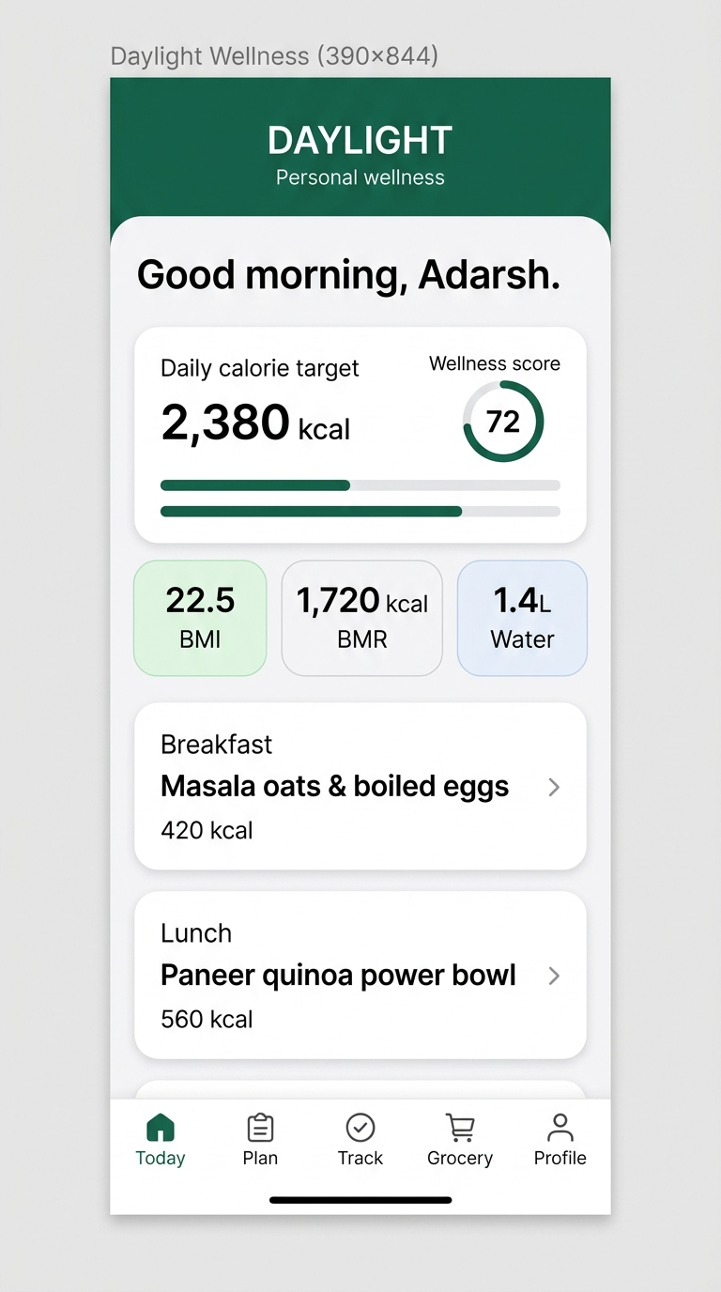
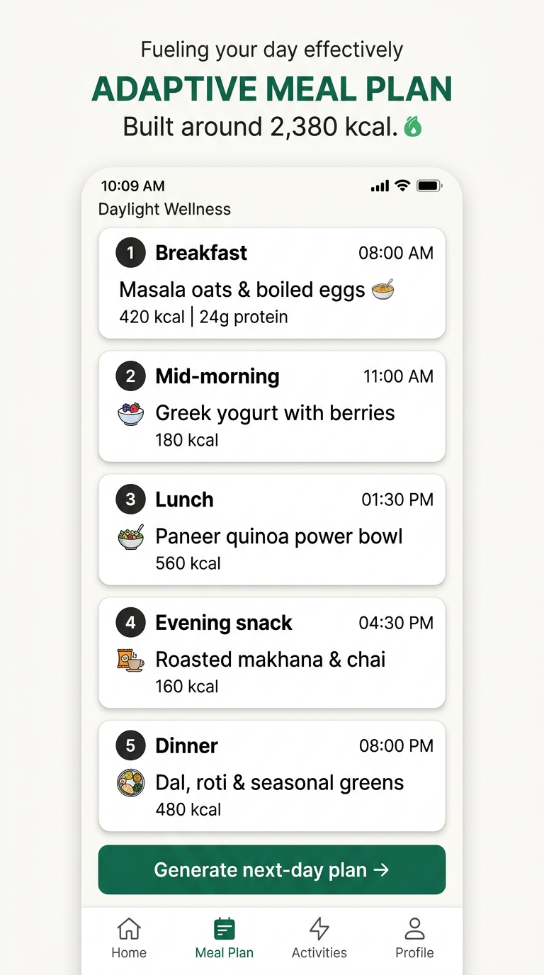
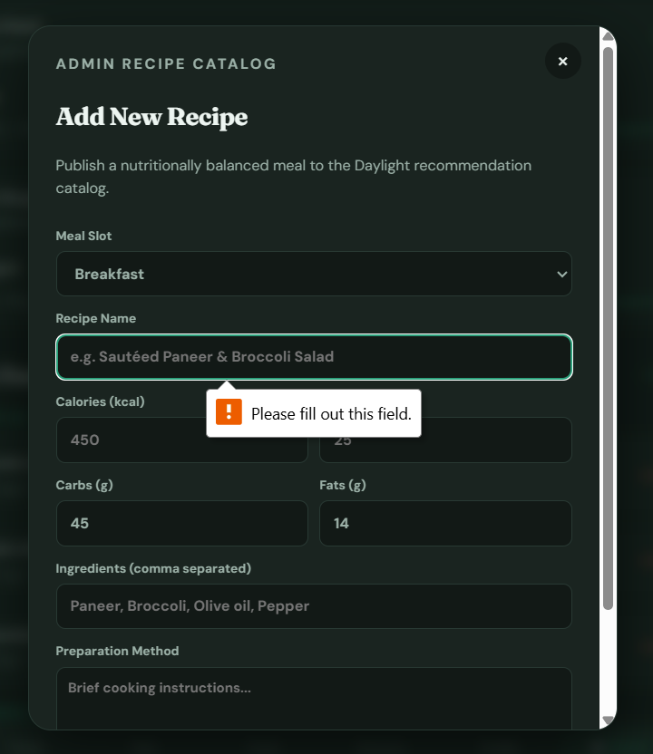

Implementation Demonstration
Working flows to demonstrate
1
Multi-role Sign-in, Register & Guest Access
8
Bidirectional Water Intake Steppers (+/- 250ml)
2
Dashboard: Calories, Macros, BMI & Wellness Score
9
Bidirectional Exercise & Sleep Duration Steppers
3
Editable Health Profile & Target Goal Weight
10
Main Meal Adherence Cards (+15 pts gamification)
4
Adaptive 5-Meal Plan with Smart Swaps
11
Circadian Routine Timeline (7 Milestones)
5
Recipe Details, Ingredients & Preparation Method
12
Conversational AI Coach (Gemini API & Offline)
Dashboard
Meal plan
Daylight AI Coach
Smart Food Nutrient Substitutions
Admin Console: User Audits & Recipe Manager
6
13
Live mobile screenshots from Daylight Wellness PWA running standalone with offline service worker v9.
7
Categorized Grocery Checklist & Share List
Notes:
Demonstrate one feature at a time on the emulator or phone. Replace the placeholders with Android emulator or phone screenshots, not browser screenshots.

Slide 20
Health Calculation Methodology
1
BMI
2
Mifflin-St Jeor BMR
BMI = weight (kg) / [height (m)]²
Male BMR = 10W + 6.25H - 5A + 5
Female BMR = 10W + 6.25H - 5A - 161
3
Daily calorie target
4
Hydration target
Daily target = BMR x activity factor + goal adjustment
Water target = body weight (kg) x 35 ml
W = weight (kg) H = height (cm) A = age (years)
Activity factor depends on activity level. Goal adjustment changes for weight loss, maintenance or muscle gain.
Notes:
Walk through the four formulas. Stress that these are guideline-based wellness estimates, not clinical results.

Slide 21
ML and Recommendation Process Flow
Collect user profile
Validate values and restrictions
Calculate BMI, BMR and base calorie target
Current prototype
Uses local rules and sample meal data.
1
2
3
Create feature vector
Predict calorie target and diet category
Split calories across five meals
4
5
6
Planned backend
Loads trained Scikit-learn models.
Filter foods by preference and allergies
Rank foods and recipes by nutrient similarity
Generate substitutions
7
8
9
Model updates
Models are retrained offline rather than learning directly from every request.
Create routine, hydration target and grocery list
Store plan and track user feedback
Regenerate plan when profile or progress changes
10
11
12
ML step in planned backend (local rules in prototype)
Notes:
Steps in orange depend on the planned Scikit-learn models. The prototype uses local rules and sample meal data. Models are retrained offline.

Slide 22
Pseudocode
INPUT profile
bmi = weight / height_metre^2
bmr = calculate_mifflin_st_jeor(profile)
calorie_target = bmr * activity_factor(profile.activity)
calorie_target = calorie_target + goal_adjustment(profile.goal)
water_target = weight * 35
meal_targets = split_into_five_meals(calorie_target)
FOR each meal_target:
candidates = foods_matching_preference(profile.preference)
candidates = remove_allergens(candidates, profile.allergies)
selected_food = rank_by_nutrient_similarity(candidates, meal_target)
attach_recipe(selected_food)
score = calculate_wellness_score(meal_logs, water, exercise, sleep)
grocery_list = aggregate_recipe_ingredients(meal_plan)
OUTPUT plan, recipes, substitutions, grocery_list, score
1 Compute targets
BMI, BMR, calorie target and water target from the profile.
2 Select foods per meal
Filter by preference, remove allergens, rank by nutrient similarity, attach a recipe.
3 Produce outputs
Wellness score, grocery list, plan, recipes and substitutions.
Notes:
Read the code in three parts: compute targets, select foods per meal, then produce the score, grocery list and outputs.

Slide 23
Database Design
HealthProfiles
UserPreferences
Notifications & AiChatHistory
Key relationships
Users
One user has one health profile.
One user can have many diet plans.
One diet plan contains many meal plans.
Recipes contain multiple food ingredients.
User-owned records are filtered using authenticated user ID.
DietPlans // MealPlans, GroceryItems, MacroTracking
DailyRoutine (7 Circadian Slots)
WaterTracking
ExerciseTracking
SleepTracking
Progress & MealAdherence (+15 pts)
Food and recipe catalogue
FoodItems
NutritionData
Recipes
RecipeIngredients
FoodItems
Notes:
The schema is conceptual and planned for MySQL. Every user-owned table is filtered by the authenticated user ID.

Slide 24


Security, Privacy and Offline Support
Security plan
Offline support
Privacy
Salted password hashes using bcrypt or Werkzeug
JWT authentication for API requests
HTTPS communication
Server-side validation
SQLAlchemy parameterised queries
User-specific query filtering
Secrets stored in environment variables
Store profile, meal plan, grocery list and logs locally
Queue unsynchronised logs
Synchronise when the network returns
Require the server only for a new ML-generated plan
Collect only required health information
Do not present the output as a diagnosis
Explain the limitations of guideline-derived recommendations
Planned backend stage
Local storage: prototype
Design principle
Notes:
Security items belong to the planned backend. Local storage already supports offline use in the prototype; synchronisation is planned.

Slide 25
Tools and Technologies
Layer | Technology | Purpose
Mobile | Flutter and Dart | Android mobile application
Backend | Python and Flask | REST API backend
Machine learning | Scikit-learn | Machine learning models
Data preparation | Pandas and NumPy | Dataset preparation
Database | MySQL | Relational database
Local storage | SQLite or SharedPreferences | Local mobile persistence
Security | JWT and bcrypt | Authentication and password security
Charts | fl_chart | Mobile analytics charts
Build | GitHub Actions | Cloud Android build
Testing | Postman | API testing
Development | VS Code and Android Studio | Development tools
Conversational AI | Google Gemini 1.5 Flash REST API | Intelligent wellness Q&A & dietary swaps
Local AI Engine | Heuristic Wellness Intel Engine | Zero-latency offline advisory system
PWA & Deployment | PWABuilder, WebAPK & Manifest v2 | Android Play Store package (AAB) & iOS ready
Design System | CSS Design Tokens & DM Sans / Fraunces | High-contrast theme, glassmorphism & micro-animations
Offline Architecture | CacheStorage API (daylight-v9) | Complete offline asset, plan & routine caching
Notes:
Group the tools by layer. Flutter and local persistence are in the prototype; Flask, Scikit-learn and MySQL belong to the next stage.

Slide 26


Applications and Future Scope
Applications
Future scope
Personal diet and routine planning
College and workplace wellness programmes
Gym and fitness trainer support
Sports student hydration and nutrition planning
Preventive wellness support alongside professional medical advice
Health Connect and wearable integration
Google Fit integration
Barcode scanning
Food recognition from images
Regional Indian food datasets
Multilingual support
Dietitian review workflow
Condition-aware plans under professional supervision
Collaborative filtering after collecting enough real user data
iOS support using the Flutter codebase
Notes:
Applications show where the system could be used. Future scope lists the extensions planned after the core system is complete.

Slide 27
References (1/2)
Research papers
[1] H. L. Tong and L. Laranjo, “The use of social features in mobile health interventions to promote physical activity: A systematic review,” npj Digital Medicine, vol. 1, 2018, Art. no. 43, doi: 10.1038/s41746-018-0051-3.
[2] G. Flores Mateo, E. Granado-Font, C. Ferre-Grau, and X. Montana-Carreras, “Mobile phone apps to promote weight loss and increase physical activity: A systematic review and meta-analysis,” Journal of Medical Internet Research, vol. 17, no. 9, 2015, Art. no. e253, doi: 10.2196/jmir.4836.
[3] R. P. Joseph, K. E. Royse, and T. J. Benitez, “A systematic review of electronic and mobile health physical activity interventions for African American and Hispanic women,” Journal of Physical Activity and Health, vol. 16, no. 3, pp. 230-239, 2019, doi: 10.1123/jpah.2018-0103.
[4] A. M. Muller, S. Alley, S. Schoeppe, and C. Vandelanotte, “The effectiveness of e- and mHealth interventions to promote physical activity and healthy diets in developing countries: A systematic review,” International Journal of Behavioral Nutrition and Physical Activity, vol. 13, 2016, Art. no. 109, doi: 10.1186/s12966-016-0434-2.
[5] D. Wang and X. Zhao, “Affective video recommender systems: A survey,” Frontiers in Neuroscience, vol. 16, 2022, Art. no. 984404, doi: 10.3389/fnins.2022.984404.
Research papers (continued)
[6] S. Milano, M. Taddeo, and L. Floridi, “Recommender systems and their ethical challenges,” AI & Society, vol. 35, pp. 957-967, 2020, doi: 10.1007/s00146-020-00950-y.
[7] F. Gille, A. Jobin, and M. Ienca, “What we talk about when we talk about trust: Theory of trust for AI in healthcare,” Intelligence-Based Medicine, vol. 1, 2020, Art. no. 100001, doi: 10.1016/j.ibmed.2020.100001.
[8] Y. Zhang and X. Chen, “Explainable recommendation: A survey and new perspectives,” Foundations and Trends in Information Retrieval, vol. 14, no. 1, pp. 1-101, 2020, doi: 10.1561/1500000066.
[9] A. Himeur et al., “Latest trends of security and privacy in recommender systems: A comprehensive review and future perspectives,” Computers & Security, vol. 118, 2022, Art. no. 102746, doi: 10.1016/j.cose.2022.102746.
[10] O. Levina and S. Mattern, “Ethical and legal analysis of machine learning based systems: A scenario analysis of a food recommender system,” in Recommender Systems: Legal and Ethical Issues. Cham, Switzerland: Springer, 2023, pp. 165-185, doi: 10.1007/978-3-031-34804-4_9.
Notes:
References use IEEE format. Entries [1]-[10] are the research papers in the literature survey; entries [11]-[18] continue on the next slide.

Slide 28
References (2/2)
Data and health-calculation sources
[11] T. Longvah, R. Ananthan, K. Bhaskarachary, and K. Venkaiah, Indian Food Composition Tables. Hyderabad, India: National Institute of Nutrition, Indian Council of Medical Research, 2017.
[12] U.S. Department of Agriculture, Agricultural Research Service, “FoodData Central,” [Online]. Available: https://fdc.nal.usda.gov. [Accessed: Oct. 5, 2026].
[13] M. D. Mifflin, S. T. St Jeor, L. A. Hill, B. J. Scott, S. A. Daugherty, and Y. O. Koh, “A new predictive equation for resting energy expenditure in healthy individuals,” The American Journal of Clinical Nutrition, vol. 51, no. 2, pp. 241-247, 1990, doi: 10.1093/ajcn/51.2.241.
Official documentation
[14] Google, “Flutter documentation.” [Online]. Available: https://docs.flutter.dev
[15] Pallets, “Flask documentation.” [Online]. Available: https://flask.palletsprojects.com
[16] scikit-learn developers, “scikit-learn: Machine learning in Python.” [Online]. Available: https://scikit-learn.org/stable/
[17] Oracle, “MySQL Reference Manual.” [Online]. Available: https://dev.mysql.com/doc/
[18] SQLAlchemy authors, “SQLAlchemy documentation.” [Online]. Available: https://docs.sqlalchemy.org
Notes:
Data and health-calculation sources, followed by the official documentation for the tools used.

Slide 29
Conclusion
What it is
This project develops a mobile wellness application that combines personalized diet planning, routine planning and daily habit tracking.
What it provides
BMR/BMI targets, 5-meal adaptive plans, Gemini AI coaching, 7-slot circadian routine schedules, macro balance monitoring, grocery categorization, habit steppers, wellness scoring, and admin governance.
How it is built
An offline-first PWA architecture with clean separation of presentation, domain, and persistence layers, packaged with WebAPK and service worker v9 for instant mobile and Play Store deployment.
How to use it
Designed as general wellness guidance, to be used together with professional medical or dietetic advice where required.
Notes:
Close by restating what is working today and what is planned. Repeat that the system gives general wellness guidance, not medical advice.

Slide 30
Thank You
Questions and discussion.
Adarsh Sheetal Patil | PES1PG25CA008 | PES University, Department of MCA
Notes:
Invite questions and offer to repeat any part of the mobile demonstration.

