Slide 1
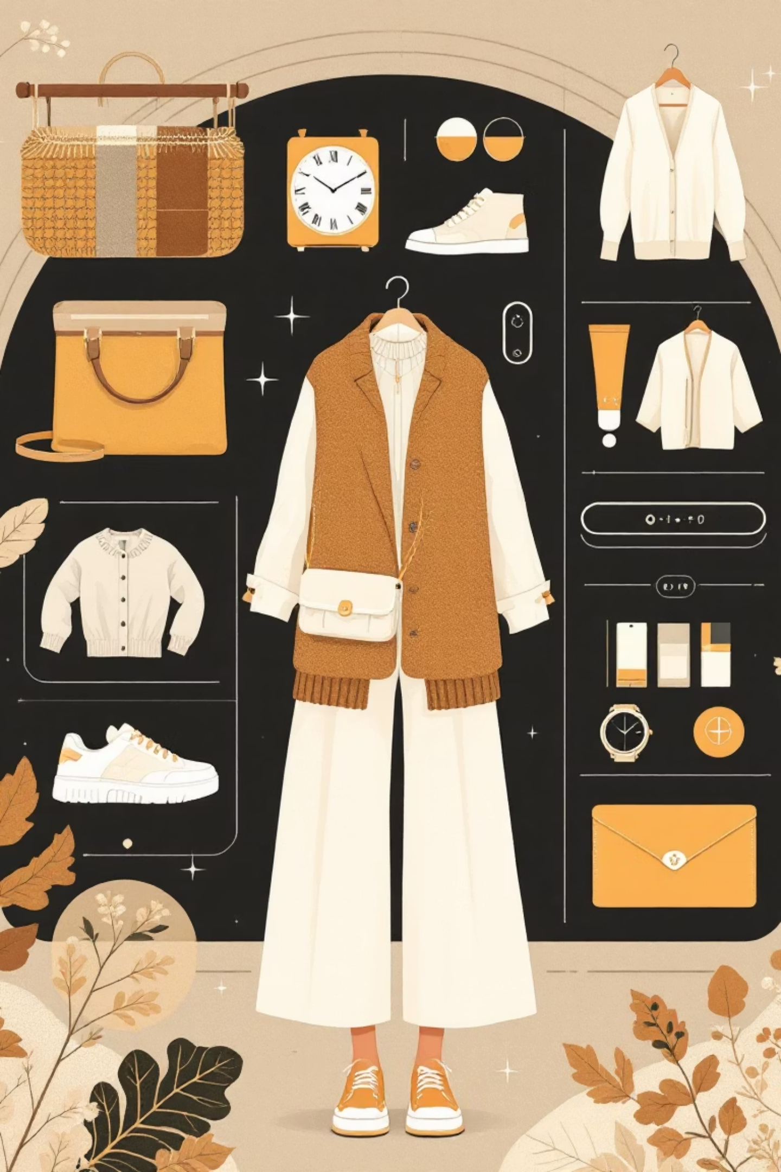
Smart Fashion Advisor
AI-Powered Smart Clothing Recommendation

Slide 2
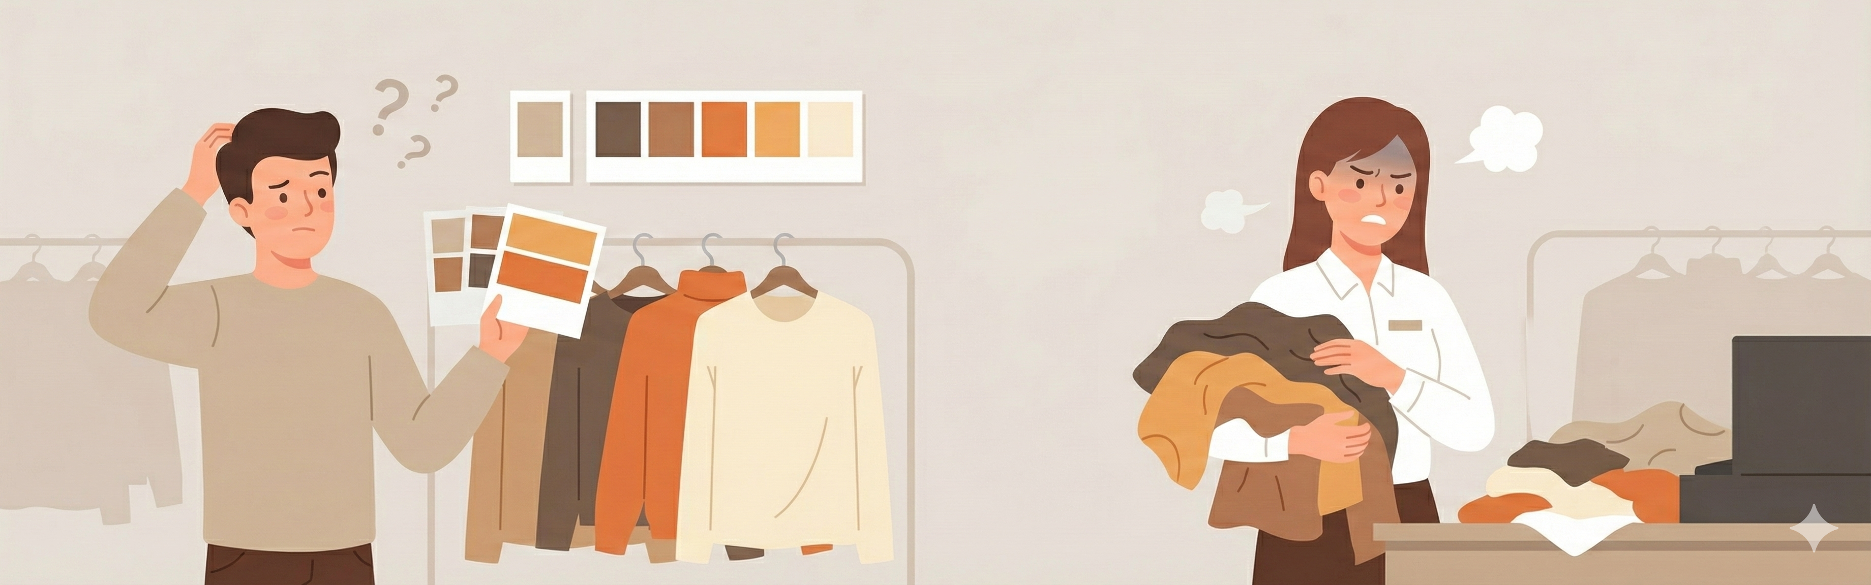

The Problem
Customer Challenges
Retailer Impact
Shoppers struggle to select clothing that complements their unique facial features—skin tone, hair colour, and eye colour. Traditional shopping lacks personalised colour guidance, leading to uncertainty and dissatisfaction.
Fashion retailers face significant challenges in providing scalable, personalised advice to every customer, resulting in lost revenue and increased operational costs.
Limited staff or resources for personalised styling
Higher return rates due to poor colour matches
Higher costs due to frequent product returns
Reduced customer confidence in purchase decisions
Difficulty standing out in a competitive market
Missed opportunities for perfect style coordination

Slide 3

Why This Matters
Enhanced Shopping Experience
Reduced Return Rates
Increased Sales Revenue
AI-driven recommendations deliver personalised guidance at scale, helping customers feel confident about their choices and discover styles that truly suit them.
Accurate colour matching significantly decreases product returns, saving retailers substantial costs whilst improving customer satisfaction and loyalty.
Personalised recommendations drive higher conversion rates and larger basket sizes as customers discover complementary items with confidence.

Slide 4
Project Objectives
01
02
03
Develop Accurate AI Analysis System
Design Intuitive User Interface
Improve User Satisfaction
Build a user-friendly interface enabling effortless photo uploads, customised clothing suggestions, and seamless feedback submission for continuous improvement.
Ensure highly suitable clothing recommendations that enhance user confidence, reduce purchase uncertainty, and elevate the overall shopping experience.
Create an AI-powered platform capable of precisely analysing facial features and skin tone using advanced computer vision and machine learning techniques.

Slide 5
Scope of the Project
Core Functionality
Personalised Recommendations
The Smart Fashion Advisor captures user photos and employs AI-based image processing to detect skin tone with precision, analysing it to determine optimal colour palettes.
Based on comprehensive analysis, the system recommends outfits from inventory that complement the user's natural coloring and personal style preferences.
Target Applications
Project Boundaries
Designed for fashion retail and personal styling services—helping users enhance their appearance and confidence through intelligent guidance.
The system focuses exclusively on personalised fashion suggestions and style guidance. It does not support online purchasing, payment processing, or e-commerce transactions.

Slide 6





Methodology: Step-by-Step Process
Image Capture & Upload
User uploads or captures a photo through the interface. The system validates image format (JPEG/PNG) and file size (≤10MB) before processing.
Skin Tone Detection
Advanced computer vision algorithms convert images to HSV colour space, detect facial regions, extract skin pixels, and classify tone as warm, cool, or neutral.
Colour Palette Analysis
The detected skin tone is matched against predefined colour sets stored in the database, generating personalised palette recommendations optimised for the user.
Outfit Recommendation
The system queries inventory, filters outfits by colour compatibility and user preferences, ranks matches, and displays top recommendations with images and descriptions.
Results Display
Users view their detected skin tone, recommended colour palette, and curated outfit suggestions through an intuitive, interactive interface with detailed product information.

Slide 7
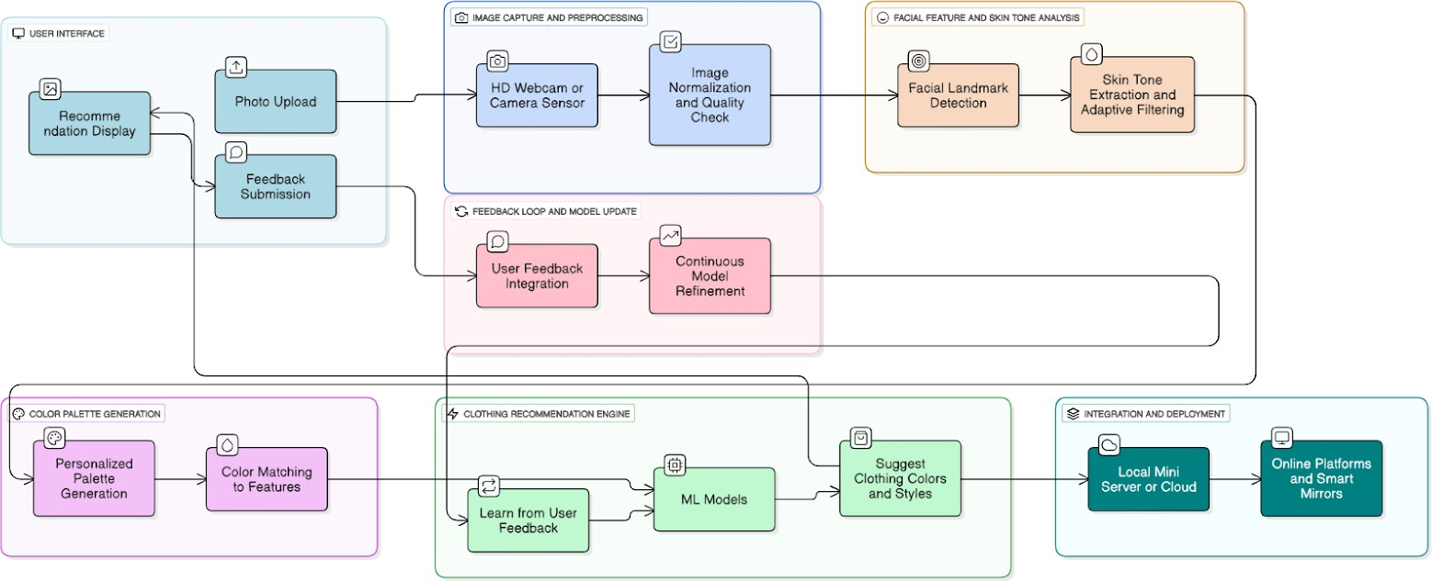
System Architecture

Slide 8

Expected Outcomes & Deliverables
Key Deliverables
Functional AI System
A fully operational AI-powered platform with more than 95% accuracy in skin tone detection and color palette analysis.
User Interface
An intuitive web-based interface supporting photo upload, real-time analysis, and interactive outfit recommendations.
Database Architecture
Structured inventory database with outfit details, colour mappings, and palette classifications for efficient querying.
Documentation
Comprehensive technical documentation including system architecture, algorithms, API specifications, and user guides.

Slide 9
Technology Stack
Python
OpenCV
TensorFlow
Core development language providing robust libraries for AI, machine learning, and web development.
Advanced computer vision library for image processing, facial detection, and colour analysis.
Deep learning framework powering AI models for accurate feature detection and classification.
MySQL
MediaPipe
Flask
Relational database system managing inventory data, colour palettes, and user preferences efficiently.
Google's ML framework providing optimised facial landmark detection and feature analysis capabilities.
Lightweight web framework enabling rapid development of the user interface and API endpoints.

Slide 10
References
Emotion-Based Recommendations
Adaptive Skin-Colour Detection
Research from ScienceDirect (2020) demonstrates how personalised clothing systems can leverage user emotional analysis to enhance recommendation accuracy and satisfaction.
Foundational work (ScienceDirect, 2000) on adaptive skin-colour filters established reliable methods for facial feature detection across diverse populations.
Deep Learning Approaches
CHROMAWEAR System
IEEE research (2023) explores deep CNNs and reinforcement learning techniques for facial feature extraction and tone classification, informing our model architecture.
The CHROMAWEAR AI recommender (SSRN, 2023) pioneered skin tone consideration in fashion technology, validating the commercial viability of our approach.
Customer Decision Support
Machine Learning Models
Elsevier research (2024) on customer models for AI-based fashion e-commerce provides frameworks for personalised recommendation engines at scale.
Recent work in the International Research Journal (2024) validates machine learning approaches for fashion recommendation, supporting our technical choices.

Slide 11
TEAM DETAILS AND ROLE DISTRIBUTION
Divya Patil
Shreyas Mane
Image Processing & Skin Tone Detection
Work on image preprocessing and skin-tone detection using OpenCV/MediaPipe
Improve and test the accuracy of skin-tone extraction
User Interface Development
Design the UI for image upload and displaying results
Connect the frontend pages with the backend modules
Shahuraje Patil
Prerana Walvekar
Color Palette & Recommendation Logic
Work on mapping skin tones to suitable colour palettes
Build the outfit recommendation logic using CSV inventory data
Documentation & System Integration
Prepare project documentation, SRS, and PPT
Combine all modules and ensure smooth system workflow

Slide 12
Thank You..

