Slide 1
Git all commands
From registration

Slide 2
Create folder and see it in git window
We can create any new folder to our any drive and see it on git command prompt.
As well as add that folder to our repository
Using some commands are as follow

Slide 3
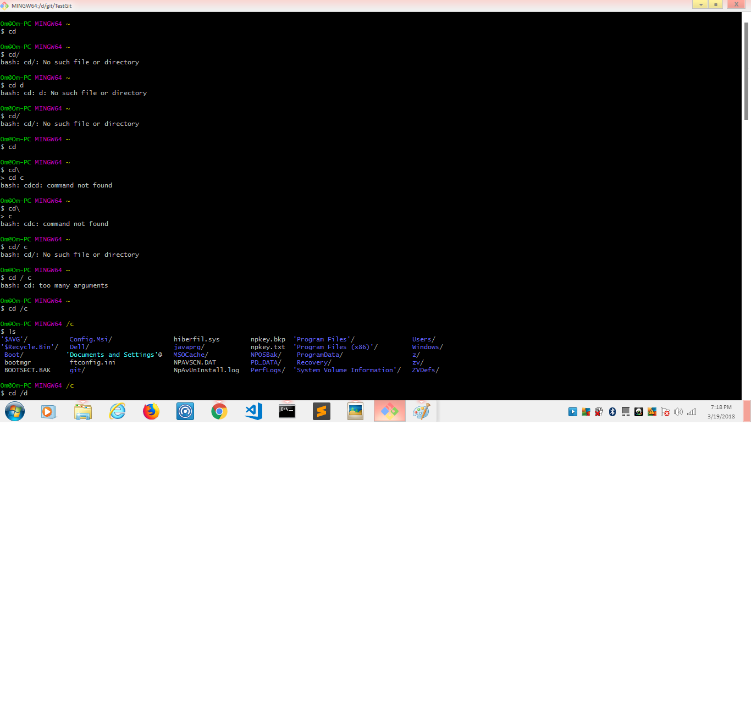
Git commands1

