Slide 1


Micronet
HEAD OFFICE:
Micronet Solutions
# Plot No. 80 K T Nagar, Katol Road
Nagpur-440013
Mob.: 9422104111 | 8446563560
info@micronetsolutions.in

Slide 2



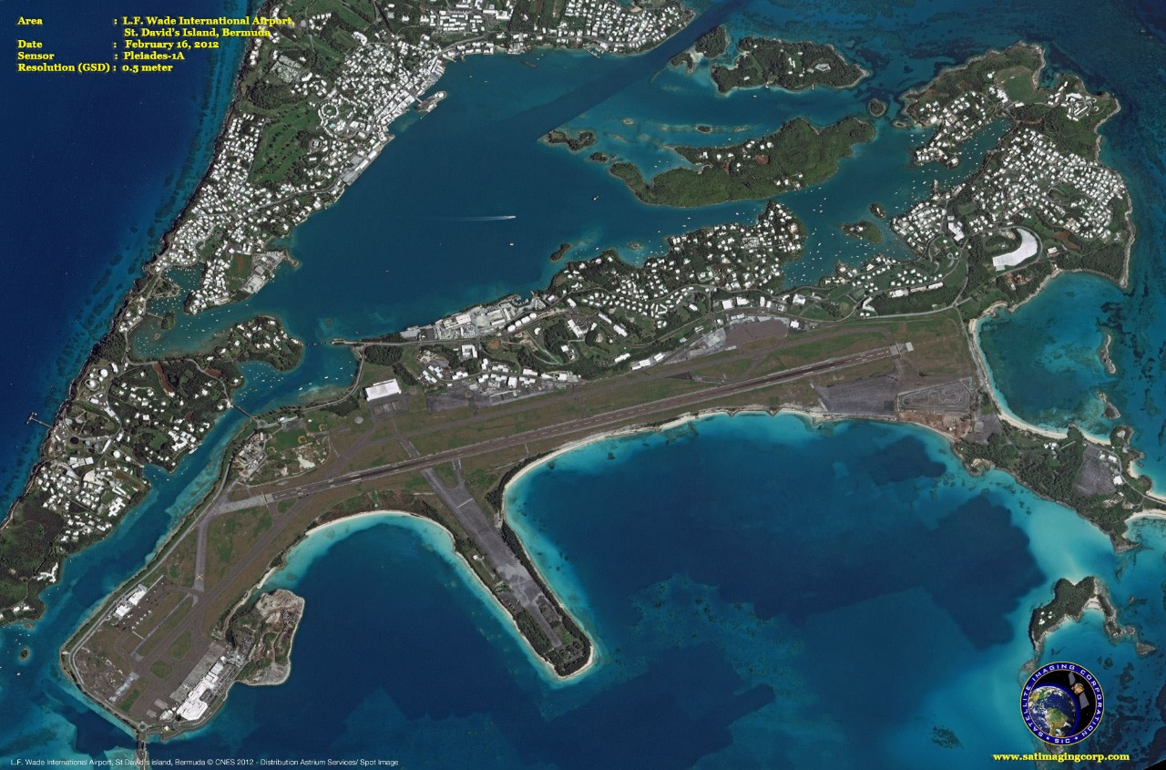
ABOUT OUR COMPANY
We have 15 years of experience in dealing and implementing projects for Various central & State government agencies. Micronet Solutions has line production facilities to handle large volumes of spatial data ensuring timely deliverables and quality outputs. Simplying complex problems for geo-spatial database creation and ensuring industry standard quality benchmarks are our forte.We are authorized Distributors of Airbus Defence and Space (France) for india and Planet labs marketing partner.

Slide 3



Slide 4


Slide 5

HEAD OFFICE:
Micronet Solutions
# Plot No. 80 K T Nagar, Katol Road
Nagpur-440013
Mob.: 9422104111 | 8446563560
info@micronetsolutions.in

