Slide 1
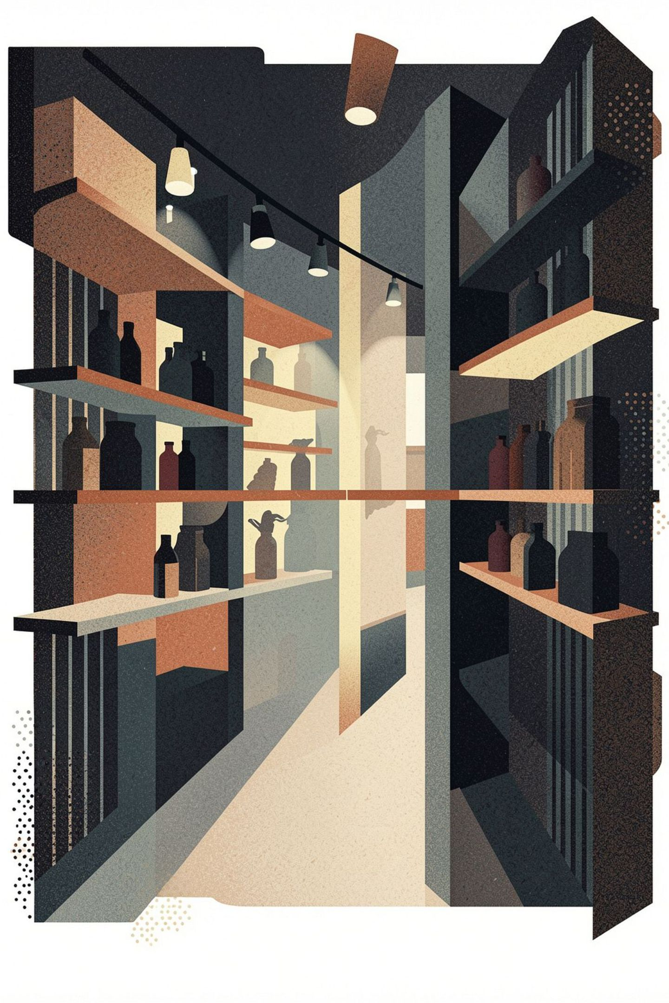
Customer Shopping Behavior Analysis
3,900 transactions · SQL-driven insights · Power BI validated

Slide 2
Dataset: 3,900 Transactions
3,900
18
Transactions
Features
Feature Groups
Demographics — Age, Gender, Location, Subscription Status
Purchase — Item, Category, Amount, Season, Size, Color
Behavior — Discount, Promo, Frequency, Reviews, Shipping

Slide 3
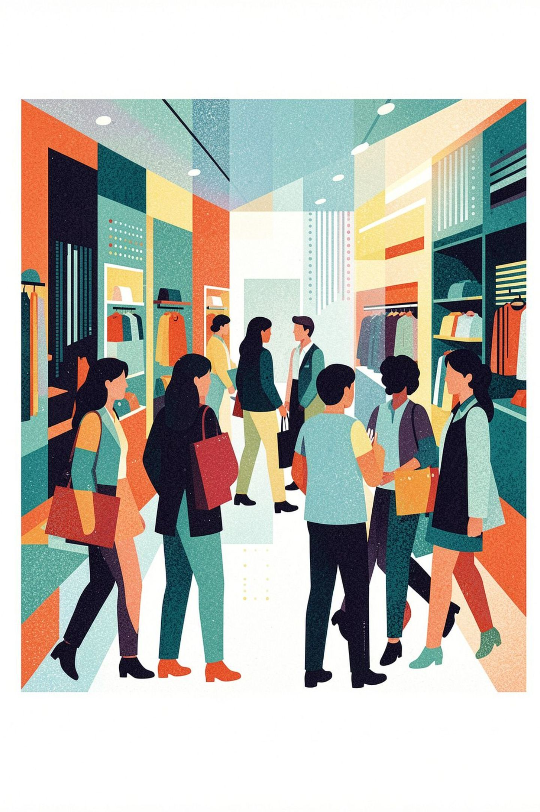
Revenue Split: Male Dominance
Male
$157,890 · 68% of total revenue
Female
$75,191 · 32% of total revenue

Slide 4
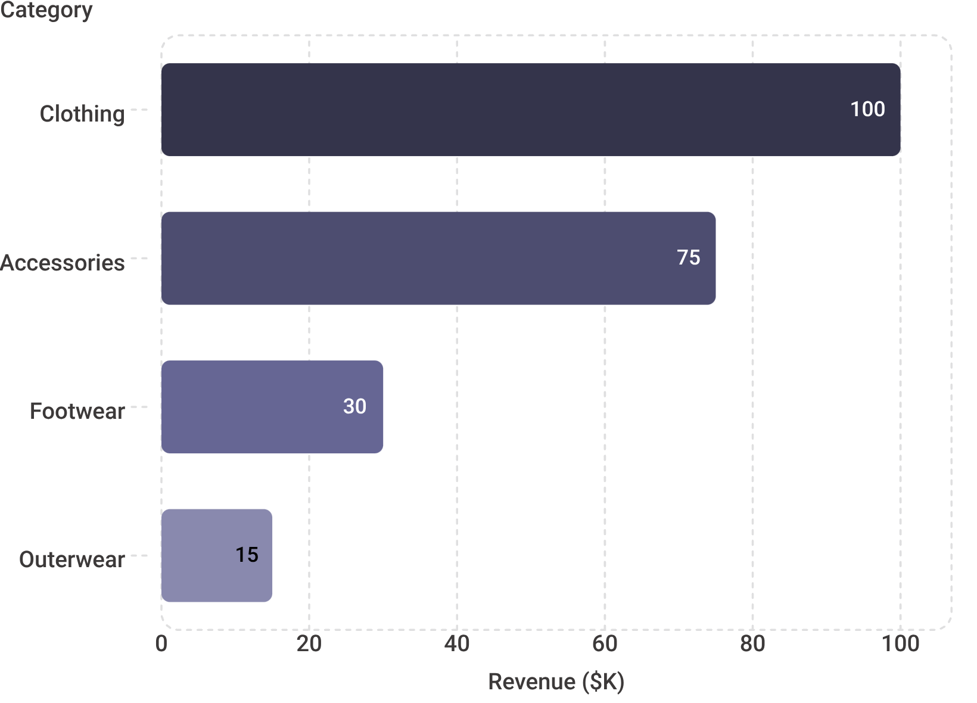
Clothing Drives Revenue
Top Category
Clothing alone accounts for ~$100K — more than Footwear and Outerwear combined.
Accessories at ~$75K are a strong secondary revenue driver worth targeted investment.

Slide 5

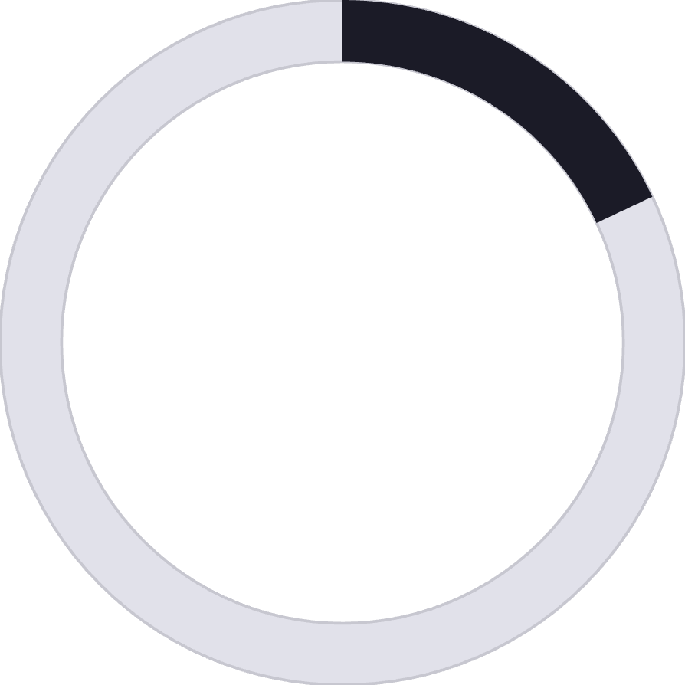

Customer Segments
80%
18%
2%
Loyal
Returning
New
3,116 customers
701 customers
83 customers
Retention is strong — but new customer acquisition is critically low at just 2%.

Slide 6
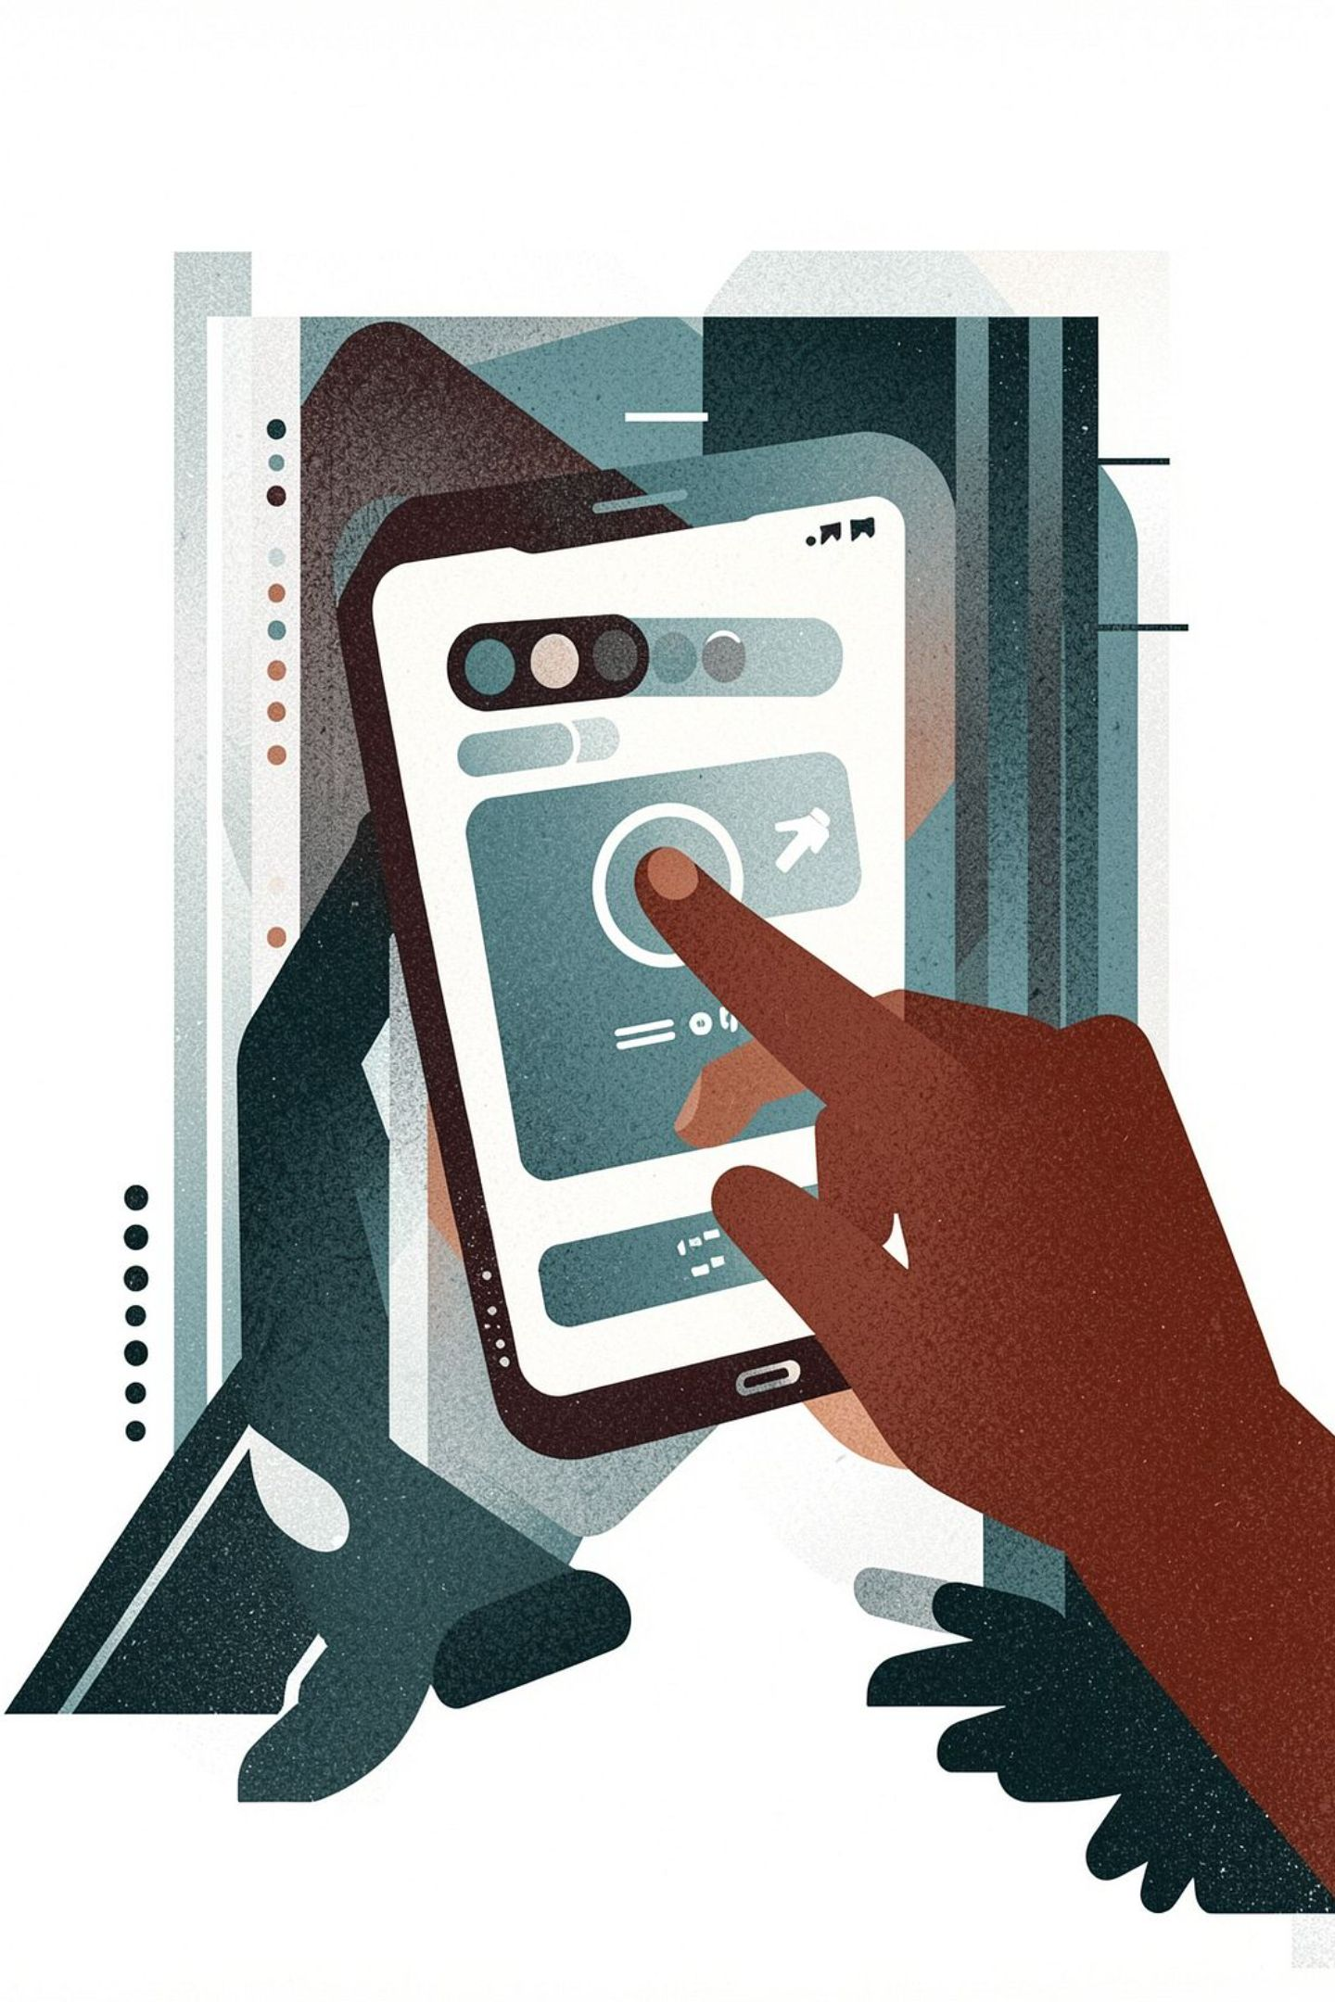
Subscription Opportunity
The Gap
Subscribed
Only 27% are subscribed. Repeat buyers show notably higher subscription rates — a clear conversion lever.
958 customers · 27%
Not Subscribed
2,518 customers · 73%

Slide 7
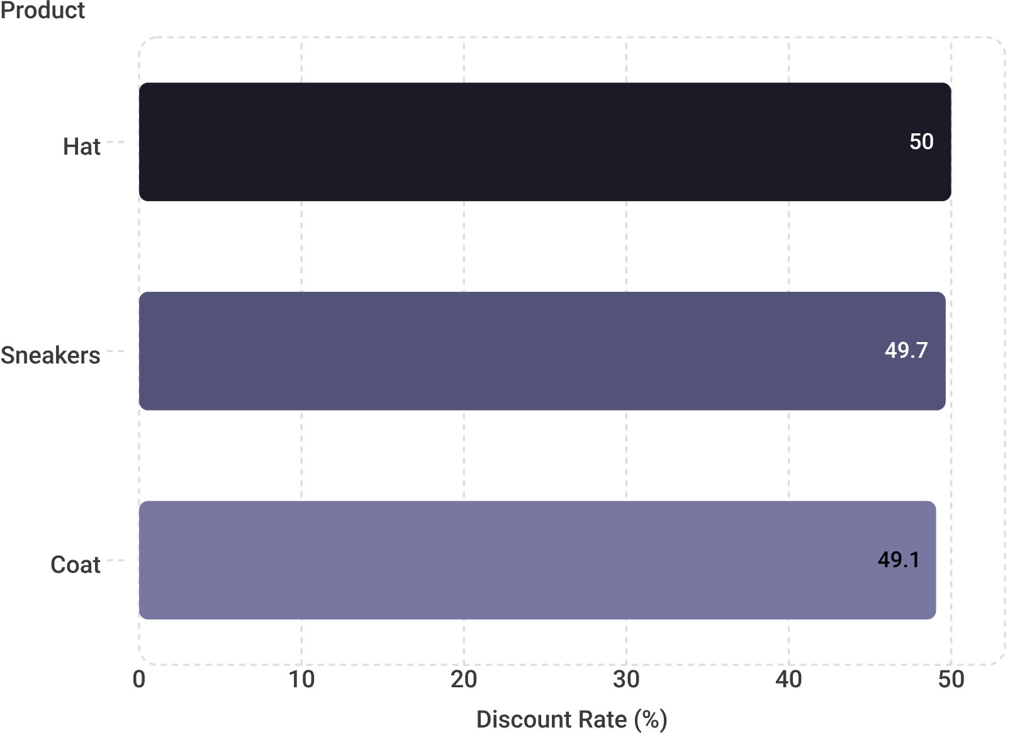

Discount Dependency Risk
Margin Alert
Hat, Sneakers, and Coat are discounted on ~50% of transactions.
High discount dependency signals potential margin erosion and price sensitivity risk.
Rebalancing is urgent — sustained deep discounting trains buyers to wait for sales.

Slide 8
Key Recommendations
1
Boost Subscriptions
2
Strengthen Loyalty Programs
3
Rebalance Discounts
Offer exclusive benefits to convert the 73% unsubscribed — target repeat buyers first.
Reduce discount frequency on Hat, Sneakers, and Coat to protect margins.
80% of revenue comes from loyal customers — reward and retain them proactively.

Slide 9
Sources
Customer Shopping Behavior Analysis.pdf

