Slide 1

Telco Customer Churn: Where We're Losing Revenue
A diagnostic analysis for the Customer Success & Operations team — moving from problem identification to actions you can run this week.

Slide 2


The Scale of the Problem
7,043
26.5%
Customers Analyzed
Overall Churn Rate
$139K
Monthly Revenue at Risk
30.5% of total revenue
Churn isn't random — it clusters around specific, fixable factors. That's the opportunity.

Slide 3
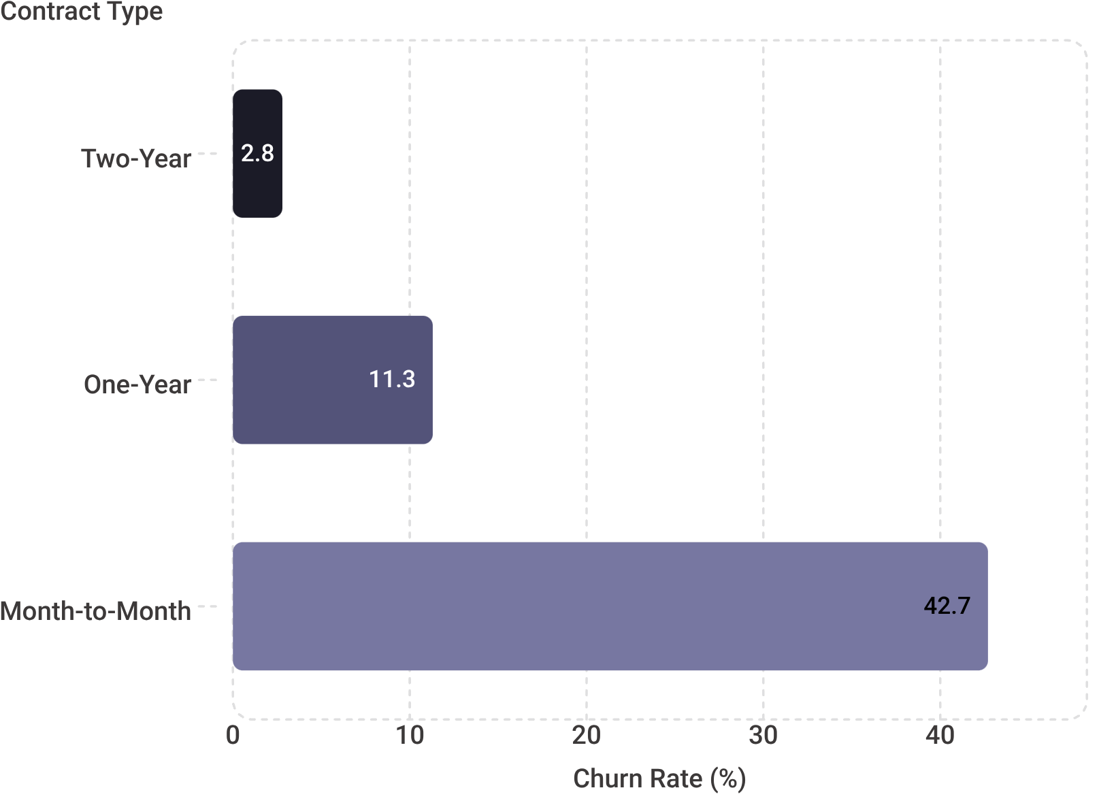
Contract Length: The 15x Difference
No Commitment = No Friction to Leave
Month-to-month customers churn at 42.7% — compared to just 2.8% on two-year contracts. That's a 15x difference driven entirely by commitment level.
Moving even a fraction of month-to-month customers to annual contracts is the single highest-leverage action available.

Slide 4
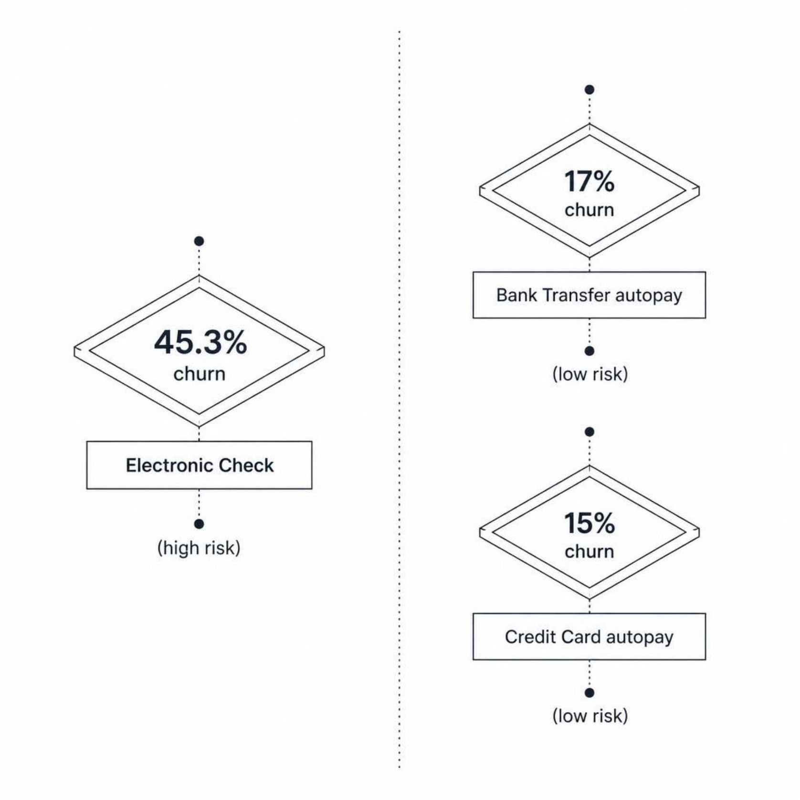
Payment Method Signals Risk
How customers pay tells us how committed they are
Electronic check users churn at 45.3% — the highest risk segment. Customers on autopay (bank transfer or credit card) churn at just 15–17%.
Manual payment behavior correlates with price-conscious, less-committed customers who are already one foot out the door.

Slide 5




The Critical First 90 Days
Month 1–3
Highest churn risk window. Customers haven't yet realized full product value.
Month 4–10
Churn remains elevated. Engagement and support interventions are still critical.
Year 1+
Customers who survive year one are substantially more likely to stay long-term.
Early onboarding and engagement are make-or-break. The first 90 days determine whether a customer becomes a long-term asset or a churn statistic.

Slide 6


Four Actions to Cut Churn Now
Lock In Contracts
1
Incentivize month-to-month customers to commit to one-year contracts. Even modest discounts pay for themselves at current churn rates.
Push Autopay Adoption
2
Offer a small discount to customers who switch to automatic payment. Lower friction, lower churn.
90-Day Onboarding Program
3
Launch a proactive, structured onboarding sequence for all new customers during their highest-risk window.
Fiber Optic Audit
4
Investigate pricing, service quality, and support experience specific to Fiber optic customers.

Slide 7

Next Steps
Here's what the team should move on this week:
1
Contract Incentive Pilot
2
90-Day Onboarding Playbook
3
Fiber Optic Deep-Dive
Prioritize month-to-month segment. Design and launch a targeted offer to convert them to annual contracts.
Schedule a cross-functional review with product and support teams to diagnose and address the Fiber churn problem.
Design the touchpoint sequence — emails, check-in calls, usage milestones — for all new customer onboarding.
These three workstreams address the highest-impact churn drivers identified in the analysis. Start here.

