Slide 1
AI-Based Heart Attack Prediction Using Sensors
A Smart Health Monitoring System
Presented by: Sandesh Patil

Slide 2
Introduction
- Heart attacks are one of the leading causes of death globally.
- Early detection can save lives.
- Idea: Use sensors and AI to predict heart attacks in real-time.

Slide 3
Objectives
- Monitor vital signs using sensors.
- Detect abnormal patterns using AI.
- Alert users and caregivers instantly.

Slide 4
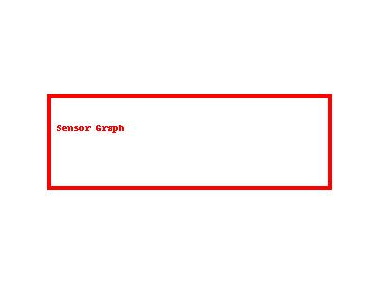
Symptoms of Heart Attack
- Increased heart rate (Tachycardia)
- Irregular heartbeat (Arrhythmia)
- Shortness of breath
- Cold sweat
- Drop in oxygen level
- Chest pain or pressure
- Dizziness or fatigue

Slide 5
Sensors Used
Symptom | Sensor Used
Heart rate | Pulse Sensor, ECG Sensor
Irregular heartbeat | ECG Sensor (AD8232)
Oxygen level (SpO2) | MAX30100 / MAX30102
Sweating | GSR Sensor
Body temperature | Temperature Sensor
Motion/fatigue | Accelerometer
Breathing rate | Piezo/Respiratory sensor

Slide 6
System Architecture
- Sensors collect real-time vitals.
- Microcontroller (Arduino/ESP32) transmits data.
- Data sent to mobile app or cloud.
- AI model analyzes patterns.
- Alert triggered if danger is detected.

Slide 7
AI Model Workflow
1. Data Collection (Sensors or Dataset)
2. Preprocessing & Feature Extraction
3. Model Training (Random Forest, CNN, LSTM)
4. Model Testing & Evaluation
5. Real-Time Prediction & Alert System

Slide 8
AI Model Types
- Classical ML: Random Forest, SVM, XGBoost
- Deep Learning: 1D CNN, LSTM, CNN+LSTM
- Anomaly Detection: Autoencoder + Classifier

Slide 9
Datasets (for model training)
- MIT-BIH Arrhythmia Dataset
- PTB-XL ECG Dataset
- PhysioNet (Multi-parameter ICU data)

Slide 10
Output Example
- Status: ALERT
- Risk Level: High
- Probability: 92.7%
- Recommendation: Seek medical help immediately

Slide 11
Advantages
- Real-time monitoring
- Non-invasive
- Preventive alerts
- Portable and wearable
- Helpful for elderly or heart patients

Slide 12
Challenges
- False positives/negatives
- Noise in sensor data
- Sensor placement issues
- Medical-grade validation required

Slide 13
Future Scope
- Integration with smartwatches
- Cloud-based health monitoring
- Real-time emergency services alert
- Edge AI deployment on low-power devices

Slide 14
Conclusion
- Smart health systems can help detect heart attacks early.
- AI + sensors offer a powerful solution.
- Early prediction can save lives.

Slide 15
Thank You
- Any Questions?
- Contact:patil2004sandesh@gmail.com

