Slide 1

Features of DataNexus On Azure

Slide 2

Revision / Document History
Version | Modification Date | Reviewed Date | Changes By | Reviewed By | Remarks
1.0 | 15 July 2023 | 15 July 2023 | Monisha T M (SX/BSV-TC1) | Rajasankar Radhakrishnan(SX/ETL2) | Initial Version
1.1 | 30 Aug 2023 | 30 Aug 2023 | Monisha T M (SX/BSV-TC1) | Rajasankar Radhakrishnan(SX/ETL2) | Updated details of API data Integration
1.2 | 03 Oct 2023 | 03 Oct 2023 | Monisha T M (SX/BSV-TC1) | Rajasankar Radhakrishnan(SX/ETL2) | Updated details of Kafka data Integration and CICD for PowerBI
1.2 | 04 Dec 2023 | 05 Dec 2023 | Monisha T M (SX/BSV-TC1) | Rajasankar Radhakrishnan(SX/ETL2) | Updated DataNexus Architecture, DataNexus components Table and RDBMS formats
1.3 | 15 Dec 2023 | 18 Dec 2023 | Monisha T M (SX/BSV-TC1) | Rajasankar Radhakrishnan(SX/ETL2) | RDBMS DB types update, New alert mails screenshot update and Reconciliation report screenshot update
1.4 | 06 June 2024 | 06 June 2024 | Monisha T M (SX/BSV-TC1) | Begum Munwari(SX/ETL2) | Data Governance and Lineage Multi-cloud Integration

Slide 3






DataNexus
Cloud
Data Sources
Data Ingestion
Data Storage
Data Distribution Layer
Insights Layer
Consumption
OnPrem/Cloud
Data Processing/ Data Pipelines
OFFICE OF THE PRESIDENT
Enterprise Apps
ERP, CRM
Edge Processed Data
Aggregates
KPIs
CORPORATE SERVICES
Real-time and Near-Real
Batch
Dashboards and Reports
Sales & Purchase
High Frequency & Bulk Transfer
Datawarehouse
DataMart
BUSINESS DEVELOPMENT
Landing Zone
Data Science Platform & Advanced Analytics engine
Asset & Inventory
File Validations
Experiments
Collaboration
I 4.0
OLEDB/ODBC
Advanced Analytics, Data Science and Data Visualization
Bronze Zone
Labeling
Deployment
MES
COMMERCIAL
Files
DQF
API & Endpoint Management
User Generated
xlsx, csv, PDF etc
API Management
Containerization
FINANCE, TECHNOLOGY AND RISK
Silver Zone
Business Logics and Modeling
App Services
Application Gateway
HEALTH, SAFETY, SECURITY AND SUSTAINABILITY
Commodity, Corporate
Commodity Trade and Risk, Corporate Performance and Risk *
Cloud REST APIs
Gold Zone
Real Time
AI Use Cases and Insights
Event Hub and Messaging Layer
Stream Analytics
CORPORATE ATTORNEY
Other Apps
Logs,Audio/Video Managment
OPERATIONS
Logging
CI/CD
Automation and Scheduling
Monitoring and Administration
Auto Reconciliation
Data Security
HUMAN RESOURCES
Streaming Data
DataOps
Self-Service BI
Data Governance and Data Lineage

Slide 4
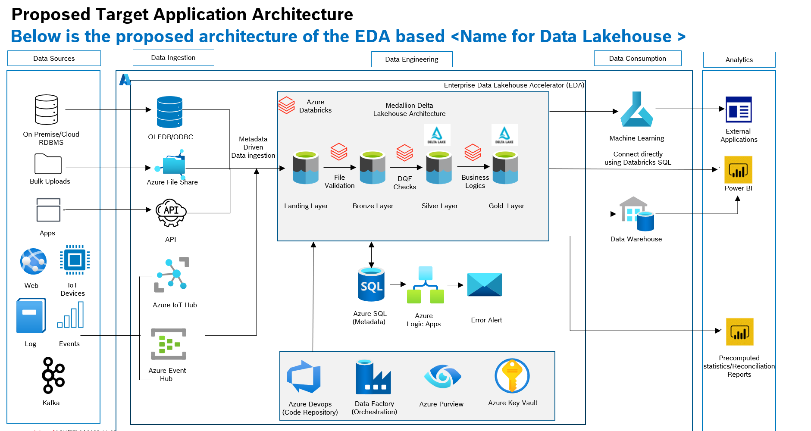
DataNexus Architecture

Slide 5

DataNexus Data Flow
DataOps
MLOps*
Databases and APIs
Data Masking
Data unmasking
Landing Layer
Bronze Layer
Silver Layer
Business logic/ ML model
Gold Layer
File validation
DQF validation
Real-time streams
Logging Layer
Metadata Layer
Governance Layer
Real time
* WIP

Slide 6
DataNexus Components
# | Components | Technical Components | Description
1 | Data Ingestion | Databricks, Spark Azure data factory | Configurable data ingestion enables easier ingestion of data from multiple source systems like Files Structured: csv, txt, json, xml, parquet Unstructured: jpg, jpeg, png, tif,mp4,avi,mp3,wav. For RDBMS, API, Event hub and Kafka direct data ingestion is supported. Supported Types for RDBMS data: MSSQL server, MySQL, PostgreSQL, GCP Bigquery, Snowflake.
2 | Landing Layer | ADLS Gen2 | Landing layer contains data in its raw format and in case of RDBMS data is stored in parquet format. First point of entry for data into the data lake. Data is organized under source system and filename folders. Temporary storage
3 | File Validation | Databricks, Spark Azure Data Factory | Incoming file is validated against the configured file level attributes (Eg: Filename, File extension, size) The files that succeed the validation are moved to Bronze Layer.
4 | Bronze Layer | ADLS Gen2 | Bronze layer contains files that are validated by the Landing to Bronze pipelines. Contains files that has been successfully validated and files that failed the File validation checks. Data is stored in file formats
5 | Data Quality Framework (DQF) | Databricks, Spark Azure Data Factory | Pre-built DQF rules are maintained in the Metadata Layer and can be applied at column level. (Eg: Missing Mandatory values, Value range check, date formats, Datatype checks etc.) Configured checks are validated against the valid files from Bronze Layer.
6 | Masking | Databricks, Spark | Based on configuration relevant columns are masked in the Silver Layer (E.g. ) Ability to mask the data, based on the configuration.

Slide 7
DataNexus Components
# | Components | Technical Components | Description
7 | Silver Layer | ADLS Gen2 | Silver layer contains files that are validated by DQF Data is stored in the form of tables Cleansed data resides in this layer
8 | Business Logics / Model | Databricks, Spark, Data Factory | Data pipelines to be created to process the data from Silver Layer as per the Use cases Use case specific transformation to be performed on the data based on business logic.
9 | Gold Layer | ADLS Gen2 | Data from Silver Layer to be the input for the Use cases / applications proposed. Expected to store computed / aggregated metrics / ML inferences based on business logics / models. Also, stores the master data.
10 | Logging Layer | SQL Server, Databricks | Stores logs and statistics from each of the data pipelines. Data points captured includes statistics of pipeline executions, Files and data processed, exceptions
11 | Metadata Layer | SQL Server | Holds configuration details to support all the functioning of DataNexus
12 | Monitoring Dashboards | PowerBI | PowerBI based reports for monitoring the different aspects of the Data lakehouse such as Job Failures,logs of File validation checks and DQ checks etc.
13 | DataOps | Azure Devops, Spark | Below DataOps Features are part of DataNexus Configurable Alerts in case of deviations / threshold breach House keeping jobs CICD
14 | *MLOps | Azure Machine Learning | For continuous monitoring of deployed models in production to detect data drift and track model accuracy
15 | Data Governance and Lineage | Unity catalog in Databricks | For unified governance layer for data within the Databricks Data Intelligence Platform. Access control mechanism. Provides Column and Row level security.

Slide 8
DataNexus Features
Data Ingestion
Metadata driven data ingestion framework is used in DataNexus . It helps in faster onboarding of new data sources into the Data Lake. Sources include:
For RDBMS, API, Event hub and Kafka
Metadata Layer contains configurations pertaining to the source system such as the source system type, connection specific information and authentication method.
The data pipelines for RDBMS and API dynamically make use of the metadata about the source systems to ingest data from source system into Landing layer in the form of parquet files.
The data pipelines for Event hub and Kafka dynamically make use of the metadata about the source systems to ingest data from source system into Silver in the form of parquet files.
For other Source systems
For other source systems, data is expected to be pushed into the Landing layer in one of the below supported file formats
File formats
csv
json
parquet
xml
Txt
jpg or jpeg
png
tiff
Mp4
avi
Notes:
Configurable

Slide 9
DataNexus Features
Types of data sources
# | Sources | Type | Description | DB Load Types |  |  |  | Batch | stream
 | Sources |  | Description | Full Load | Append | Merge SCD Type-1 | Merge SCD Type-2
1 | RDBMS | Direct Connection | Ability to connect to all databases which supports ODBC/JDBC drivers Azure Cloud based RDBMS, AWS MySQL, Postgres SQL, GCP Bigquery, Snowflake |  |  |  |  |  | ×
2 | Azure EventHub | Direct connection | Ability to load from azure EventHub in real time and store them in silver layer | × |  |  | × | × | 
3 | Structured Data | File push from source system | Ability to organize and categorize data in a systematic manner |  |  |  |  |  | ×
4 | Unstructured Data | File push from source system | Ability to capture and store data in a flexible and unrestricted format | × | × | × | × |  | ×
5 | API | Direct connection | Ability to load data from different types of APIs and store them in silver layer |  |  |  |  |  | ×
6 | Kafka | Direct connection | Ability to load data from Kafka in real time and store them in silver layer | × |  |  | × | × | 
Notes:
Configurable

Slide 10
DataNexus Process Flow
DataOps
MLOps*
Databases and APIs
Data Masking
Data unmasking
Landing Layer
Bronze Layer
Silver Layer
Business logic/ ML model
Gold Layer
File validation
DQF validation
Real-time streams
Logging Layer
Metadata Layer
Governance Layer
* WIP

Slide 11
DataNexus Features
Landing Layer
3.1 Landing Layer’s structure
Landing layer Contains data in its raw format , in case of RDBMS source data is stored in parquet format. It is the first point of entry for data into the data lake. Here the data is organized under source system and filename folders.
Landing Layer is Temporary storage, data here is not persisted.
Files from different source systems are stored in Landing layer as below
/landinglayer/source system1
/landinglayer/source system2
Landing Layer
Source system 1
File1
File2
File-n
..
Source system 2
File1
File2
File-n
..
..
…
Source system N
File1
File2
File-n
..
Files should be made available in landing layer
Notes:
Configurable

Slide 12
DataNexus Process Flow
DataOps
MLOps*
Databases and APIs
Data Masking
Data unmasking
Landing Layer
Bronze Layer
Silver Layer
Business logic/ ML model
Gold Layer
File validation
DQF validation
Real-time streams
Logging Layer
Metadata Layer
Governance Layer
Real time
* WIP

Slide 13
DataNexus Features
File validation pipeline
Metadata such as file level details, scheduling frequency, source system relationship of the different file id are configured in the Metadata Layer.
File validation checks are configured against each file id in Metadata Layer.
Data pipelines dynamically identifies the file validation checks for the file Id of the current execution and performs the validation.

Slide 14
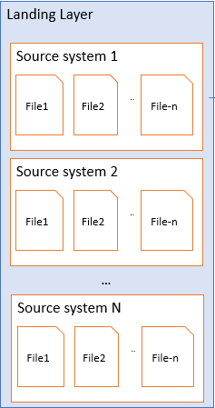
File Validation flow
Bronze
Source System
TRUE
Raw
Valid Files
DQF Validation
File Validation( , )
If File validation Successful
1
2
3
Monitoring Dashboard
Invalid Files
FALSE
Logging
Summary of processing and validation.
Errors and exceptions are Stored.
Ex: File path, attribute mapping id, attribute values
Metadata layer
1. Structured , Semi-Structured Data validation
Unstructured Data validation
2. File validation Mapping
Anonymization & Pseudonymization
1
2
3
File size
Created Time
File Size, Color, Mode (Image), Resolution (Image), Duration (audio, video), Bitrate (audio, video), Frame Dimension (video)
File1 | File size
File2 | Created time, File size
File3 | File size
…...
Hashing
Tokenization

Slide 15
DataNexus Features
4.3 Segregation of valid and invalid files
Files that succeed the file validation are moved to success folder in Bronze layer.
Files that fail the validations are stored in Error folder in Bronze layer.
All the file level metadata and validation results are logged in the Logging layer for each run.
4.4 File Validation- 1 of 3
Structured Data – File Validation Checks
# | Validation | Description | Supported File Formats
 | Validation | Description | Csv | json | txt | parquet | xml
1 | File Size | Checks if file size is greater than predefined size |  |  |  |  | 
2 | Created Time | Checks if file is created within last x days |  |  |  |  | 
4.4 File Validation- 2 of 3
Unstructured Data - Image - File Validation Checks
# | Validation | Description | Supported File Formats
 | Validation | Description | jpg | jpeg | png | tif
1 | File Size | Checks if file size is greater than predefined size. |  |  |  | 
2 | Created Time | Checks if file is created within last x days. |  |  |  | 
3 | Image Color Mode | Checks if file has specific color mode. |  |  |  | 
4 | Image Resolution | Checks if file has specific resolution. |  |  |  | 

Slide 16
DataNexus Features
4.4 File Validation- 3 of 3
Unstructured Data – Video and Audio - File Validation Checks
# | Validation | Description | Supported File Formats
 | Validation | Description | mp4 | avi | mp3 | wav
1 | File Size | Checks if file size is greater than predefined size |  |  |  | 
2 | Created Time | Checks if file is created within last x days |  |  |  | 
3 | Frame Dimension | Checks if file has specific Frame Dimension |  |  | × | ×
4 | Duration | Checks if file has duration between specific predefined Range |  |  |  | 
5 | Bitrate | Checks if file has specific bitrate |  | × |  | 
4.5 Alerts
Email Alerts can be configured at Metadata Layer to check if an expected file has not reached the Landing Layer within an expected time window (configurable).
Email alerts are triggered in case of above event failure to the configured source system owner.
Notes:
Configurable

Slide 17
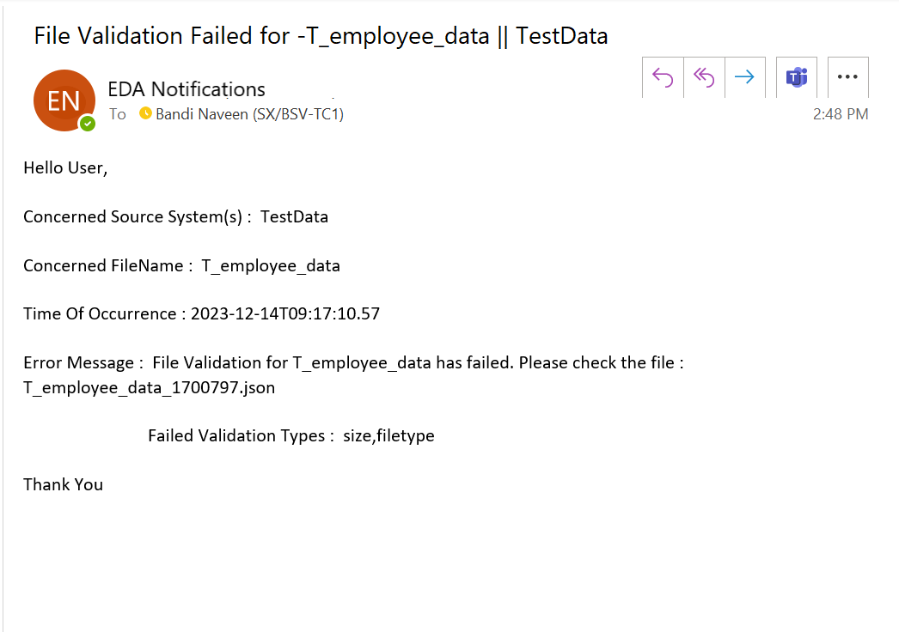
DataNexus Features
4.5 Alerts
4.5.1 Sample email in case of File Validation Failure

Slide 18
DataNexus Process Flow
DataOps
MLOps*
Databases and APIs
Data Masking
Data unmasking
Data Masking
Data unmasking
Landing Layer
Bronze Layer
Gold Layer
Landing Layer
Silver Layer
Business logic/ ML model
File validation
File validation
DQF validation
Real-time streams
Real-time streams
Logging Layer
Metadata Layer
Governance Layer
Real time
* WIP

Slide 19
DataNexus Features
Bronze
5.1 Bronze Layer’s structure
Bronze layer contains files that are validated by the File validation pipelines.
Irrespective of Source system data is stored in File format in this layer
This layer contains logical segregation of files that has been successfully validated and files that failed the File validation checks.
The files that failed file validation checks are not processed further.
The files that are successfully validated are processed further by the File validation pipelines.
Data at this layer is persisted.
Valid and Invalid Files from landing layer are stored in bronze layer as below
/bronzelayer/sourcesystem1/Raw/Success/filetemplate/ year/month/data/hour/
/bronzelayer/sourcesystem1/Raw/Error/filetemplate/ year/month/data/hour/
Bronze Layer
Source System 1
Raw
Success
Error
File Template
File Template
Year
Year
Month
Month
Date
Date
Hour
Hour
File1
File2
…
File-n
File1
File2
…
File-n

Slide 20
DataNexus Process Flow
DataOps
MLOps*
Databases and APIs
Data Masking
Data unmasking
Data Masking
Data unmasking
Landing Layer
Bronze Layer
Gold Layer
Landing Layer
Silver Layer
Business logic/ ML model
File validation
File validation
DQF validation
Real-time streams
Real-time streams
Logging Layer
Metadata Layer
Governance Layer
Real time
* WIP

Slide 21
DataNexus Process Flow
DataOps
MLOps*
Databases and APIs
Data Masking
Data unmasking
Data Masking
Data unmasking
Landing Layer
Bronze Layer
Silver Layer
Business logic/ ML model
Gold Layer
File validation
DQF validation
Real-time streams
Logging Layer
Metadata Layer
Governance Layer
Real time
* WIP

Slide 22
DataNexus Features
DQF Pipelines​
Bronze to Silver pipelines process Valid files from the Bronze layer.
These files are processed and stored in the form of delta tables in Silver Layer.
Metadata from the Metadata Layer are used by pipelines to create this tables considering different aspects such as table name ,database name, encryption technique to be used, partition columns, DQF checks to validated.
Table creation is done by automated scripts based on schema defined in Metadata Layer. This scripts are executed by manual trigger once during setup of DataNexus.
It employs configurable Data Quality framework to perform data quality checks for each row of datasets from Bronze layer and segregates into valid and invalid data in Silver layer.
These pipelines support different data load strategies such as full load, append and merge SCD type 1& 2 onto Silver Layer.

Slide 23
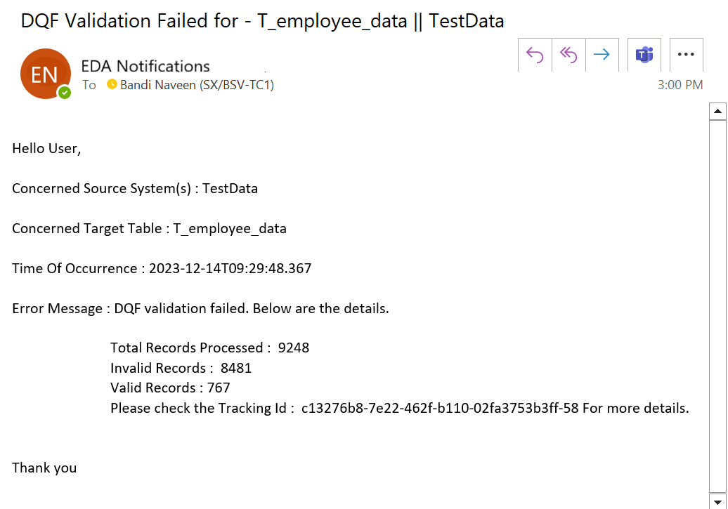
DataNexus Features
Data Quality Framework
Data Quality Framework performs data quality checks on row and column level data based on pre-configured Data quality checks configured
Data pipelines dynamically identifies the relevant data quality functions to be called against the datasets read from Bronze Layer from the configurations.
7.1 Sample email in case of DQF Failure

Slide 24
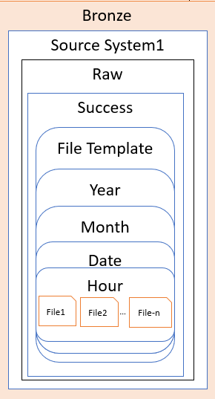
DataNexus Features
Row1
Row2
Row4
Row6
Row7
3
4
7.1 DQF Pipeline Flow
Data Masking
TRUE
Silver
Success
Data unmasking & Business Logic
If all the configured data quality checks are successful
DQF Validations
Tables
For each row
Error
1
2
Monitoring Dashboard
Row3
Row5
Row8
Tables
FALSE
Logging
Summary of data quality checks and validation are Stored.
Summary of DQF validations, Errors and exceptions are Stored.
Ex: Row count, good rows, bad rows, bad data details like failed validation name and column name
Metadata layer
3. Data masking techniques
2. DQF Validations
3
1.DQF Mapping
2
1
columns | DQF Mapping
column1 | Data type, null, length check
column2 | Regex check, length
column3 | Range check
column4 | Multiple column sum
….. | ….
Data Type Check
Null Check
Date Time Format Check
Length Check
Range Check
Regex Check
Multiple column sum Check
String column prefix and postfix Check
Composite key uniqueness Check
Encryption
Shuffling
Tokenization
Replacing
4. Db Load Type
4
Append
Full Load
Merge
SCD Type 2 merge

Slide 25
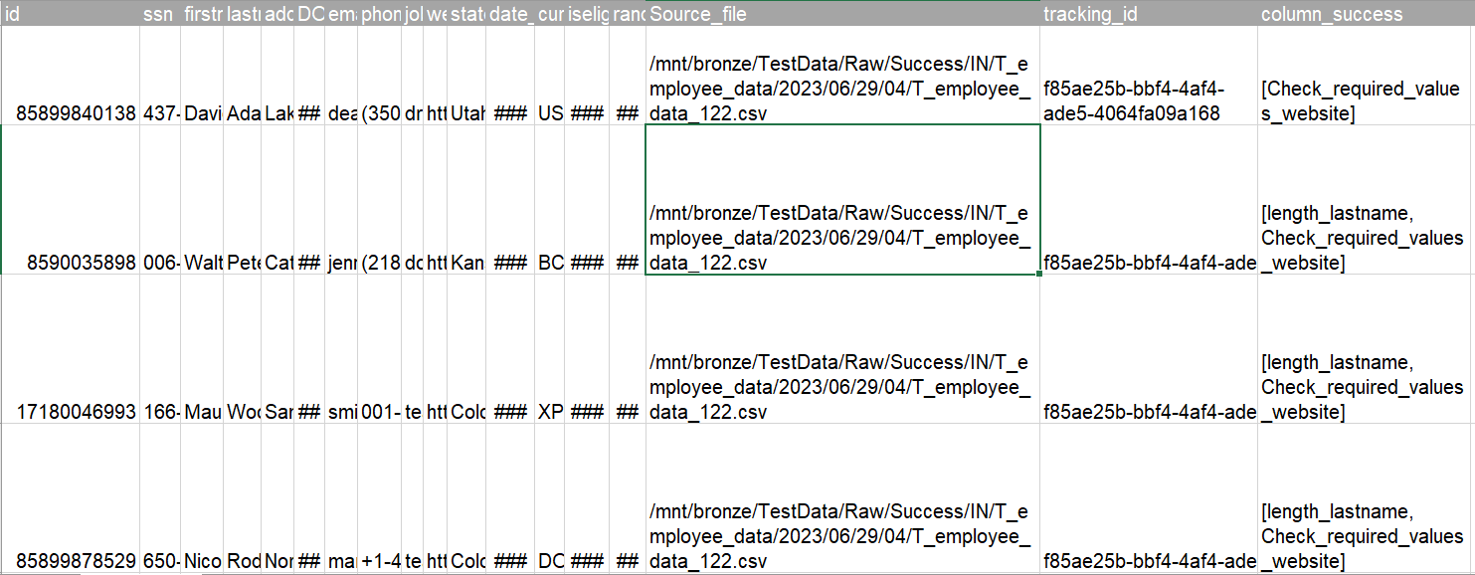
DataNexus Features
Data Quality Framework
7.1 DQF Pipeline Flow-Invalid records table
Actual Data
Error Information

Slide 26
DataNexus Features
Data Quality Framework
7.2 Segregation of valid and invalid data
Once the validations are done against each row, the data is segregated into valid rows and invalid rows in different delta tables
Valid rows are rows that are successfully validated against each data quality check , Invalid rows are rows that failed at least one data quality check.
Logging layer contains the information about the valid rows count and invalid rows count along with details of the validations that failed for each row
One or more Data quality checks can be configured for each column and there can be columns without any data quality checks.
7.3 Data Quality Framework Validations
# | Check | Description | Text | Numeric | Timestamp | Examples
1 | Data Type | Validates schema of data if it is matching predefined schema. |  |  |  | Pre defined schema : ID int, name string Examples of Schema of data Valid : ID int, name string Invalid : ID string, name string
2 | NULL | Validates data to check if non-nullable columns has null values. |  |  |  | Expected column value – 1 (any number) or ‘nav’ (any string) or 12-12-2023 (any date format) Valid : 2 or ‘ABC’ or 11-11-2022 Invalid : NULL
3 | Date Format | Validates on date fields to check if format of the date matches the predefined date format. | × | × |  | Expected Date format – dd-mm-yyyy Valid : 01-01-1999 Invalid : 9999-01-01
4 | Range | Validates data to check if column values are between the predefined range. | × |  | × | Predefined range - 70 to 100 Valid : 70<=value<=100 Invalid : 70>value>100
Notes:
Configurable

Slide 27
DataNexus Features
Data Quality Framework
7.3 Data Quality Framework Validations-contd.
# | Check | Description | Text | Numeric | Timestamp | Examples
5 | Email | Validates data to check if email columns matches the predefined regular expression. |  | × | × | Expected Email format – naveen@bosch.com Valid : naveen@bosch.com Invalid : naveen@com
6 | Length | Validates data to check if length of column value is between the predefined maximum and minimum length. |  |  |  | Predefined min length -9 and max length -33 Valid : 9<=length(value)<=33 Invalid : 9>length(values)>33
7 | Multi-Column sum Check | Validates integer fields and add the values of multiple fields and checks if total matches the predefined sum. |  |  |  | Expected sum =25 Valid : col1=12 and col2= 13 then col1+col2=25 Invalid : col1=10 and col2=9 then col1+col2!=25
8 | Multi-Column unique Check | Validates in checking duplicate rows based on composite keys |  |  |  | R1={c1=12,c2=xyz,c3=abcd,c4=34} R2={c1=12,c2=xyz,c3=axyf,c4=34} Valid : If multi column check is enabled for c1,c2,c3,c4 then validation Invalid : If multi column check is enabled for c2,c4
9 | String Column Pre-Post fix check | Validates data if column values has predefined prefix and post fix |  |  |  | Expected string value prefix –’A-’ postfix – ’01’ Valid : ‘A-nav01’ Invalid : ‘B-nav02’
Notes:
Configurable

Slide 28
DataNexus Features
Data Quality Framework
7.4 Data Quality Monitoring dashboard
s.no | Report | Details | Batch | stream
1 | Invalid Data quality Validation Summary | Provides DQF column level logging details. This dashboard provides below all details Invalid records percentage Day wise statistics of bad records by validation type Invalid records by column name and validation type Invalid data details |  | ×

Slide 29
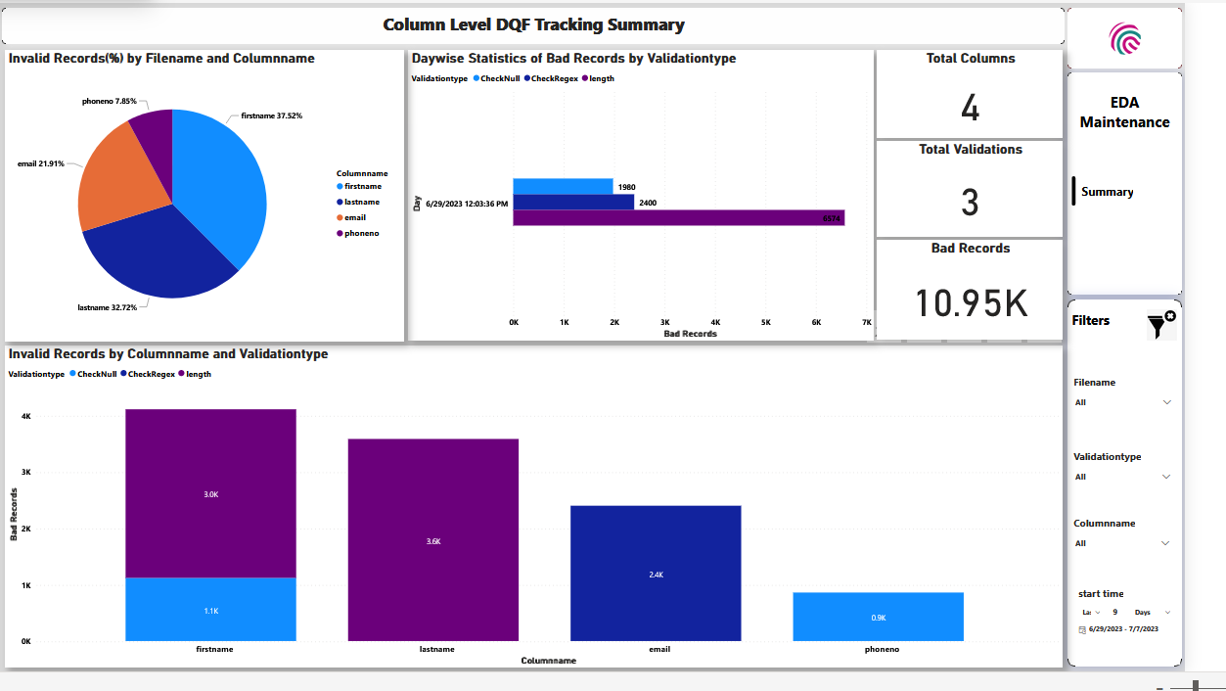
DataNexus Features
Data Quality Framework
7.4.1 Sample Data Quality Monitoring dashboard

Slide 30
DataNexus Process Flow
DataOps
MLOps*
Databases and APIs
Data Masking
Data unmasking
Data Masking
Data unmasking
Landing Layer
Bronze Layer
Silver Layer
Business logic/ ML model
Gold Layer
File validation
DQF validation
Real-time streams
Logging Layer
Metadata Layer
Governance Layer
Real time
* WIP

Slide 31

DataNexus Features
Silver Layer
Silver Layer contains delta tables for holding the data from valid Bronze Layer files in structured delta lake tables.
In this layer tables are organized under corresponding source system databases.
User access to these tables are controlled using RBAC in this layer. This is a manual activity to be done based on user access matrix.
Data is partitioned in this layer based on preconfigured partition columns.
Data is masked as per the encryption method configured in Metadata Layer.
Silver Layer will have persisted data in delta tables.

Slide 32
DataNexus Features
8.1 Silver Layer’s structure
Ex:
If there are any partition column present, then files are loaded into the different folders of specific column value
A | B | C | D
a1 | b1 | c1 | d1
a2 | b2 | c2 | d2
... | ... | ... | ...
an | bn | cn | Dn
Silver Layer
Source System1
Success
Error
If Partitioned
File Template1
File Template
In the above table Column, A and B are considered as a partition column1 and2
Then folder’s will be partitioned as shown in the image and files from bronze will be loaded into folders.
Table
Year
File Template
Month
Date
a1
a2
An
Partition column-1
b1
b2
b1
b3
bn
Partition column-2
Hour
Tables

Slide 33
DataNexus Process Flow
DataOps
MLOps*
Databases and APIs
Data Masking
Data unmasking
Data Masking
Data unmasking
Landing Layer
Bronze Layer
Silver Layer
Business logic/ ML model
Gold Layer
File validation
DQF validation
Real-time streams
Logging Layer
Metadata Layer
Governance Layer
Real time
* WIP

Slide 34
DataNexus Features
Silver Layer
8.2 Partitioning
# | Features | Description | Batch | Stream
1 | Partitioning | Dynamic partitioning of delta tables in Silver Layers for better read performance. Partitioning columns to be configured in metadata layer |  | ×

Slide 35
DataNexus Process Flow
DataOps
DataOps
MLOps*
Databases
Databases and APIs
Databases
Data Masking
Data unmasking
Data Masking
Data Masking
Bronze Layer
Gold Layer
Bronze Layer
Landing Layer
Bronze Layer
Landing Layer
Landing Layer
Silver Layer
Business logic/ ML model
File validation
File validation
File validation
DQF validation
DQF validation
DQF validation
Real-time streams
Real-time streams
Logging Layer
Metadata Layer
Governance Layer
Real time
* WIP

Slide 36
DataNexus Features
Business Logic Pipelines
DQF pipelines perform the business logic transformations to process the data from silver layer into meaningful insights such as KPIs ,metrics etc.
Batch inferences from ML models are done.
These pipelines are specific to the use case and works independently of DataNexus.
The data processed by these pipelines are stored in the form of tables in Gold Layer.
9.1 Silver to Gold Pipeline Flow
Silver
Gold
Source System1
Success
Encrypted and Tokenized data can be unmasked, other masking types cannot be reversed.
Master tables
File Template
Table with unmasked data
Tables
Data Unmasking
Business Logics/ML Inference
Tables with KPIs, metrics, inferences
cc | N | 1 | Xx | ab
ab | jj | 2 | xx | aa

Slide 37
DataNexus Process Flow
DataOps
DataOps
DataOps
MLOps*
Databases
Databases
Databases and APIs
Databases
Data unmasking
Data Masking
Data unmasking
Data Masking
Data Masking
Bronze Layer
Gold Layer
Bronze Layer
Landing Layer
Bronze Layer
Landing Layer
Landing Layer
Silver Layer
Silver Layer
Business logic/ ML model
File validation
File validation
File validation
DQF validation
DQF validation
DQF validation
Real-time streams
Logging Layer
Metadata Layer
Governance Layer
Real time
* WIP

Slide 38
DataNexus Features
Gold Layer
10.1 Gold Layer Structure
Gold Layer contains the data in tabular format and it acts as a serving layer for other downstream applications such as ML apps, Visualization tools etc.
In Gold Layer data is organized under use case specific databases.
User access to tables is controlled using RBAC. This is done manually based on the user access matrix
Master tables are used in this layer.
Gold Layer
FoF
HeaL
Use case1
Use case1
Table with KPIs , metrics
Table with KPIs , metrics
Use case2
Use case2
Table with KPIs , metrics
Table with KPIs , metrics
Master tables
Master tables

Slide 39
DataNexus Process Flow
DataOps
DataOps
MLOps*
Databases and APIs
Databases
Databases
Databases
Data Masking
Data unmasking
Data Masking
Data Masking
Bronze Layer
Gold Layer
Bronze Layer
Landing Layer
Bronze Layer
Landing Layer
Landing Layer
Landing Layer
Silver Layer
Business logic/ ML model
File validation
File validation
File validation
DQF validation
DQF validation
DQF validation
Real-time streams
Real-time streams
Logging Layer
Metadata Layer
Governance Layer
Real time
* WIP

Slide 40
DataNexus Features
Metadata Layer
Metadata Layer contains configuration details to support the functioning of DataNexus. These metadata are stored in Multiple tables in SQL database. Maintenance of configuration is done manually.
*Automated scripts will be used to load prefilled configuration template files.
Sl. no | Metadata Configurations
1 | Source system and files details
2 | Column level details
3 | File and DQF Validations details
4 | Validation mapping details
5 | Data masking details
6 | Alert configuration details
7 | Pipeline scheduler details
Notes:
Configurable

Slide 41
DataNexus Process Flow
DataOps
MLOps*
Databases
Databases and APIs
Databases
Data Masking
Data unmasking
Data Masking
Bronze Layer
Gold Layer
Bronze Layer
Landing Layer
Bronze Layer
Landing Layer
Landing Layer
Silver Layer
Business logic/ ML model
File validation
File validation
File validation
DQF validation
DQF validation
Real-time streams
Real-time streams
Logging Layer
Metadata Layer
Governance Layer
Real time
* WIP

Slide 42
DataNexus Features
Logging Layer
Logging Layer contains logs and statistics from all the pipelines. The logs are stored in different SQL tables and contains all the details regarding the pipeline executions (refer below table).
Detailed results of column level data quality validations are stored in delta tables in Silver Layer.
Sl. no | Log Details
1 | File landing time in Landing Layer​
2 | File validation and DQF Validation Status​
3 | Total Columns​
4 | Total Rows​
5 | Invalid Record Count​
6 | Valid Record Count​
7 | Error Record Count​

Slide 43
DataNexus Process Flow
DataOps
MLOps*
Databases
Databases and APIs
Databases
Data Masking
Data unmasking
Data Masking
Bronze Layer
Gold Layer
Bronze Layer
Landing Layer
Bronze Layer
Landing Layer
Landing Layer
Silver Layer
Business logic/ ML model
File validation
File validation
File validation
DQF validation
DQF validation
Real-time streams
Real-time streams
Logging Layer
Metadata Layer
Governance Layer
Real time
* WIP

Slide 44
DataNexus Features
Governance Layer
13.1 Data Governance and Data Lineage
Centralize access control using Unity Catalog
Unity Catalog UI to capture runtime data lineage. Lineage is captured down to the column level, and includes notebooks, workflows, and dashboards related to the query.
With RLS and CLS, row filters and column masks to table are applied to prevent access to sensitive data by certain users. These filters and masks are implemented as SQL user-defined functions (UDFs)
13.1 Access Control Mechanism
Sl. no | Table Name | Configuration Details
1 | [dbo].[T_uc_usergroup_creation] | Group_name : Name of the group to be created Username : provide usernames that need to be add in that newly created group Is_enabled : enable/disable flag for adding/removing usernames
2 | [dbo].[T_uc_access_usergroups] | group : The name of the user group to which the access is needed object_name : The name of the table,schema for which the access is needed object_type : the type of the object(table,schema) for which access is needed access_level : read table : The name of the table for which object is needed(if the target object is schema,then leave this as None) schema : The name of the Schema,schema of the table for which object is needed catalog : the name of the catalog under which the relevant schema is present action : add- if you are trying to provide access,remove-if you are trying to remove access

Slide 45
DataNexus Features
Governance Layer
13.1 Column and Row Level Security
Sl. no | Table Name | Configuration Details
1 | [dbo].[T_uc_rls_cls_configs] | Full_table_name : tablename in which CLS column is present.Enter the table name in this format catalog.schema.table Column_name : column name on which CLS need to be applied Group_name : group_name for which CLS need to be applied List_of_values : row value for which RLS need to be appiled Is_enabled : flag to enable/disable RLS or CLS Security_type : Type of security (RLS /CLS)

Slide 46
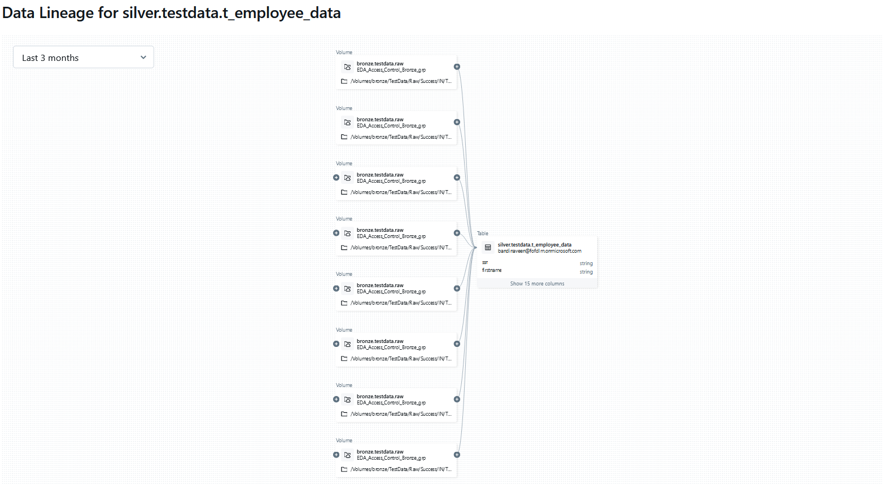
DataNexus Features
Governance Layer
13.1 Data Lineage in Databricks UI

Slide 47
DataNexus Process Flow
DataOps
MLOps*
Databases and APIs
Databases
Databases
Databases
Data Masking
Data unmasking
Data Masking
Bronze Layer
Gold Layer
Landing Layer
Bronze Layer
Landing Layer
Landing Layer
Landing Layer
Silver Layer
Business logic/ ML model
File validation
File validation
File validation
DQF validation
DQF validation
Real-time streams
Real-time streams
Logging Layer
Metadata Layer
Governance Layer
Real time
* WIP

Slide 48
DataNexus Features
DataOps
14.1 Monitoring Dashboard
14.1 Streaming data monitoring dashboards (1 of 3)
This dashboard utilizes the streaming data logs from Logging layer and Silver Layer and visualizes them as KPIs.
Metrics such as Micro batches processed ,Valid row count, invalid row count are visualized.
It is updated in real-time
One dashboard per stream.
Sl.no | Reports
1 | Total streams that are running
2 | Total batches that are processed
3 | Percentage of valid data and invalid data
4 | Records processing rate by batchid
5 | Records processing statistics by batchid

Slide 49
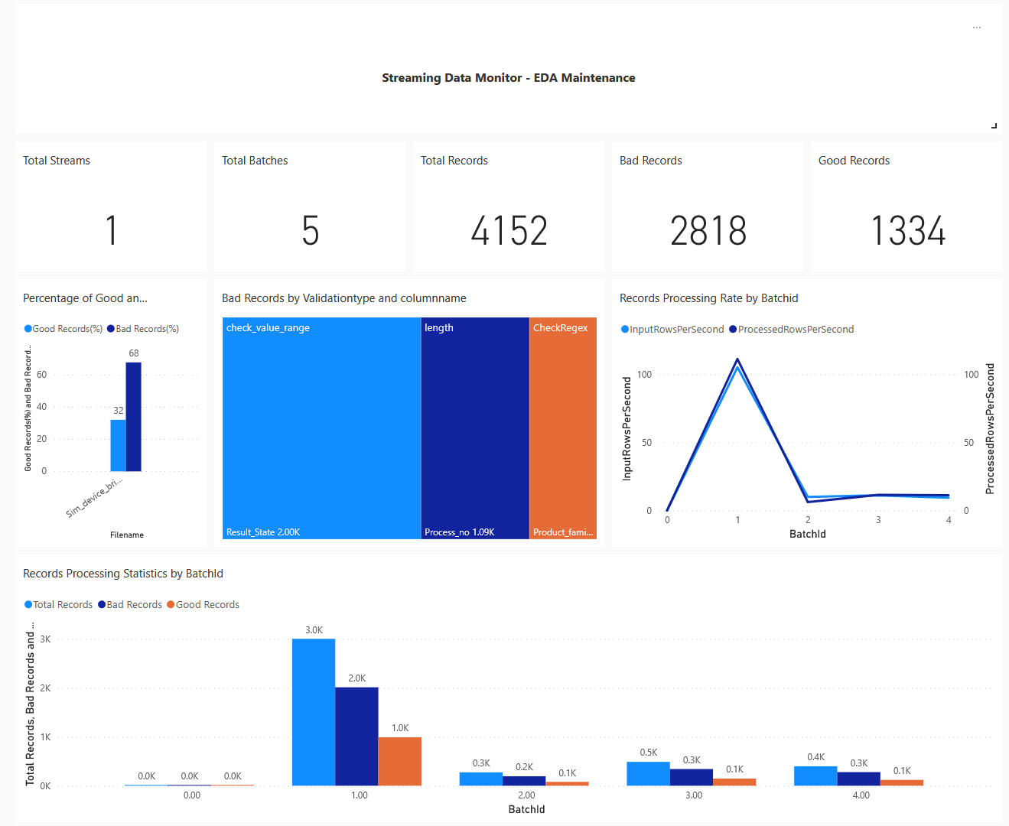
DataNexus Features
14.1 Streaming data monitoring dashboard (1 of 3)

Slide 50
DataNexus Features
DataOps
14.1 Batch data monitoring dashboards (2 of 3)
This dashboard utilizes the data from Logging layer and Silver Layer and visualize them as KPIs.
Pipeline run, files processed, Valid row count, invalid row count, batch processed are visualized across different dimensions such as Time, Source systems.
It can be refreshed on a configurable interval.
Sl. no | Details
1 | Number of files loaded statistics
2 | Number of records loaded statistics
3 | Day wise record count statistics
4 | Records count by use case
5 | Jobwise details : job runid, job name, job start time ,job end time details
6 | Batchwise details : fileid, filename template, total rows, good data, bad data details
7 | Invalid data details : column name, row index, validation type details

Slide 51
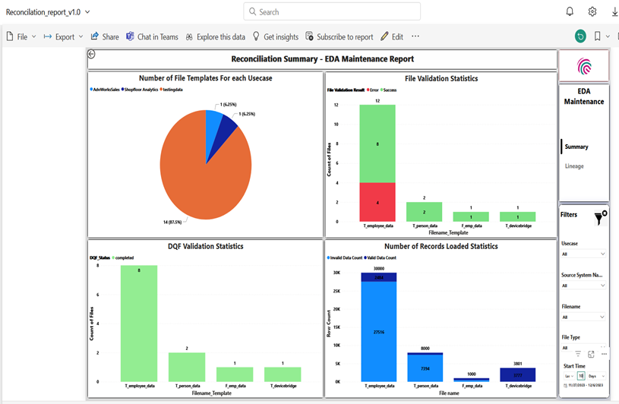
DataNexus Features
14.1 Batch data monitoring dashboards (2 of 3)

Slide 52
DataNexus Features
14.1 Cost Management Dashboard(3 of 3)
This dashboard provides insights on cost and usage of DataNexus infra. This Dashboard provides below all details.
Sl. no | Details
1 | Usage cost by service name
2 | Usage cost by service tier
3 | Cost over time
4 | Service name with service tier cost

Slide 53
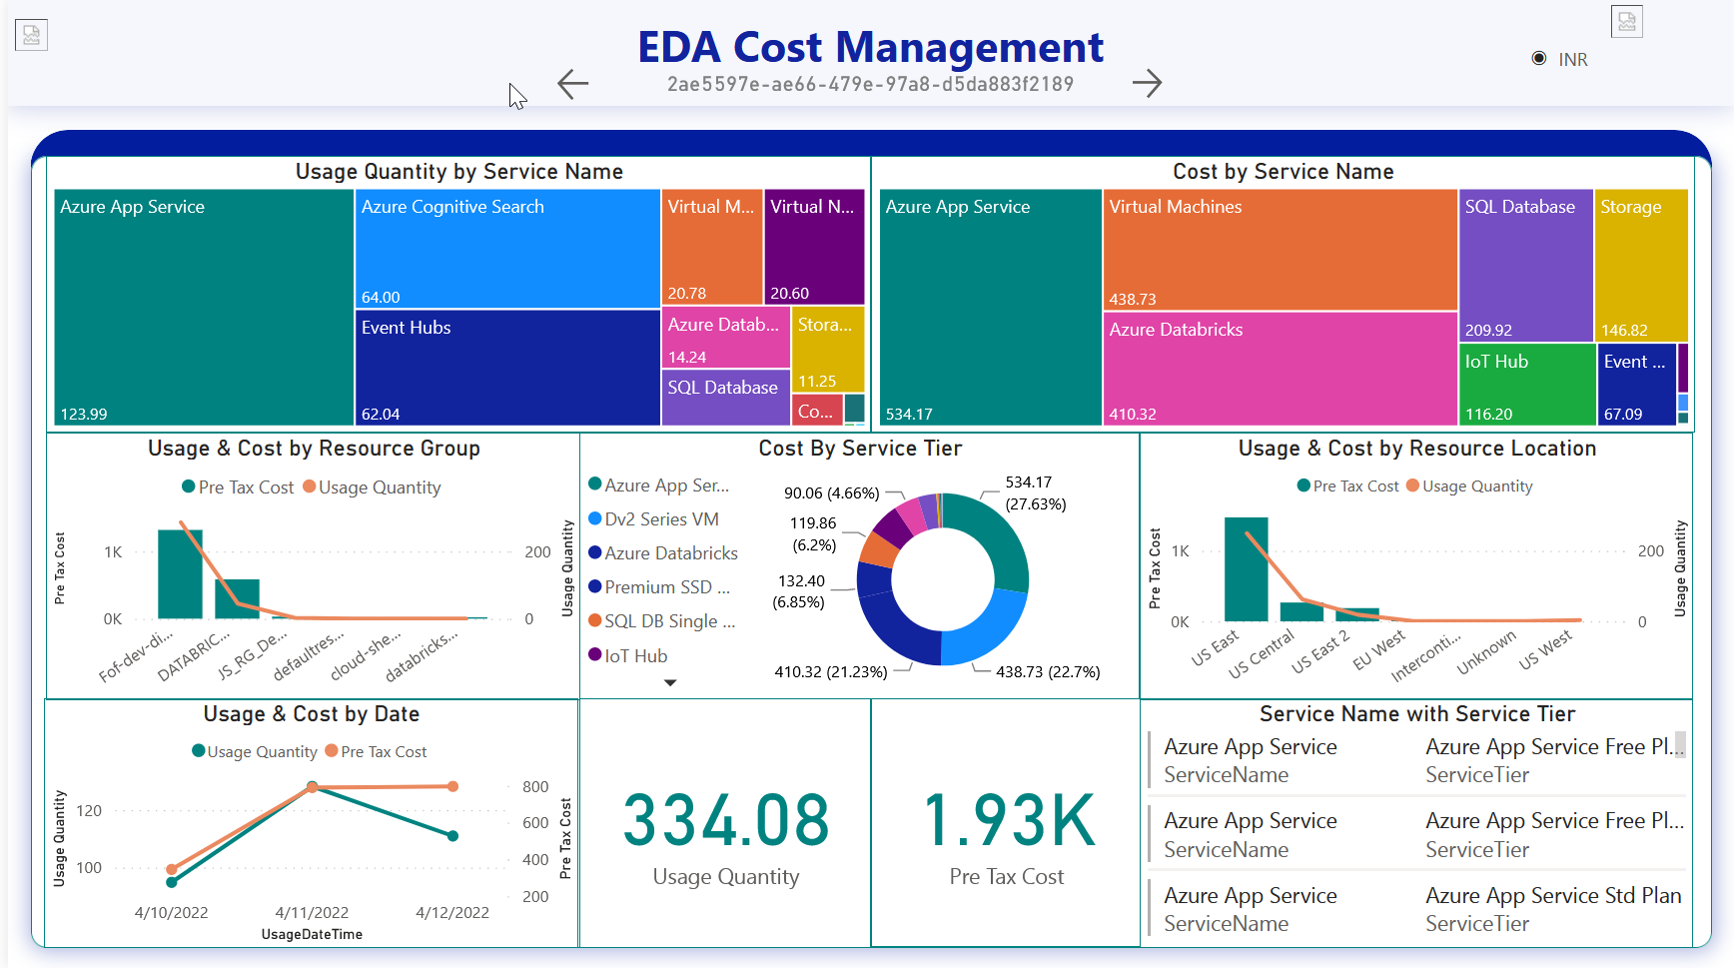
DataNexus Features
14.1 Sample Screenshot of Cost Management Dashboard(3 of 3)

Slide 54
DataNexus Features
DataOps
14.2 CICD
CICD to promote code to UAT and prod from dev Azure environments.
 | Azure SQL Database | ADF | ADB | PowerBI
CICD Deployment |  |  | × | 
14.3 IAC: One Click Deployment
All the DataNexus deployment steps are deployed by a CICD Pipeline ,with a release gate, leveraging terraform (IaC tool) and Azure DevOps Pipelines(orchestrator).
# | Deployment Steps
1 | Configuration of Azure Subscription and ADO
2 | Infrastructure Pipeline Deployment
3 | Configuration of Azure Key vault
4 | Configuration of Azure SQL Server
5 | ADF Global Params configurations
6 | Decommissioning of Environment

Slide 55
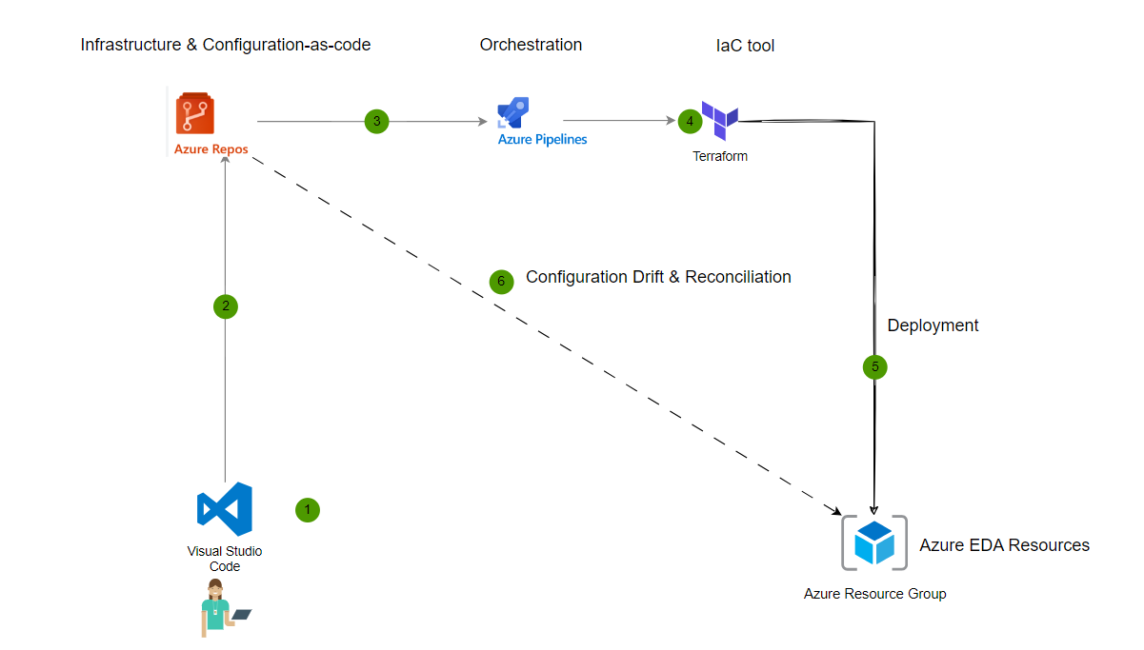
DataNexus Features
DataOps
14.3 IAC: One Click Deployment

Slide 56
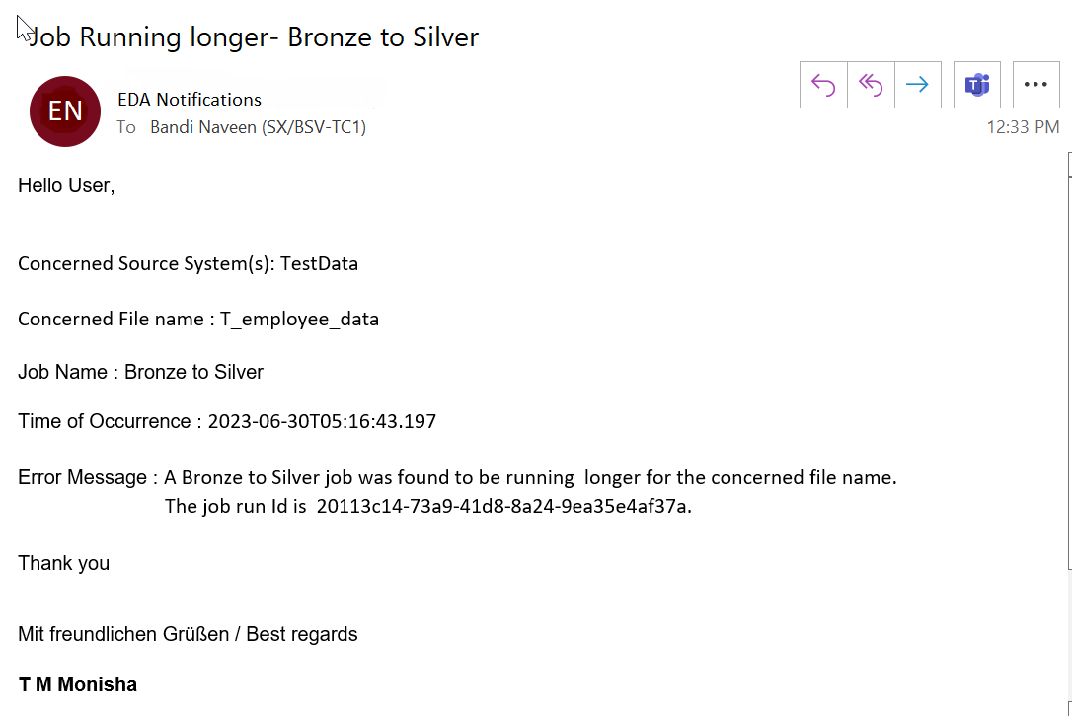
DataNexus Features
14.4 Alerts
Email alerts can be sent in case of below events.
# | Reason | Alerts are sent when
1 | Long running jobs | If a data pipeline runs longer that configured limit, alert will be sent to configured source system owner. The source system owner can be configured in the Metadata Layer.
2 | Technical Errors | If a data pipeline fails due to any error, alert will be sent to configured source system owner. The source system owner can be configured in the Metadata Layer.
14.4.1 Sample Alert mail for long running job

Slide 57
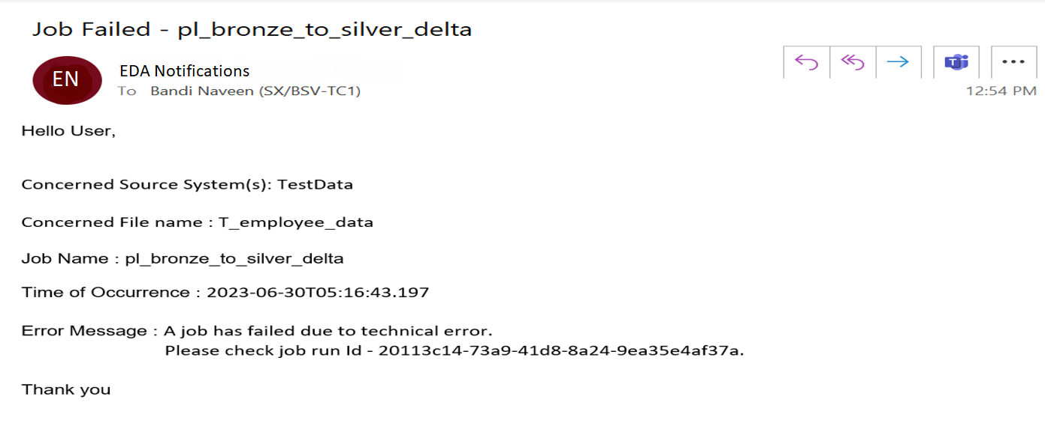
DataNexus Features
14.4 Alerts
14.4.1 Sample Alert mail for job failure due to technical error

Slide 58
DataNexus Features
DataOps
14.5 Housekeeping Jobs
House keeping jobs are Schedule to perform routine maintenance activities on the data lake.
# | Job | Description | Landing | Bronze | Silver | Gold
1 | Purge older versions of Delta Lake | This job that removes cache and temp files older than a retention threshold. | × | × |  | 
2 | Optimize Delta Lake read performance | Optimize delta tables by user provided columns which has high cardinality | × | × |  | 
3 | Storage life cycle management for Data storage in Data Lake | Automated transition of files to a cheaper storage tier for cost optimization | × | × |  | 
Code Standardization
SonarQube has been utilized to standardize code for high priority issues.
Security
Azure Active Directory is used for Authorization & Authentication for all user access requests.
Roles & Permissions-Define the roles and Grant permission accordingly. (Creation of Custom Roles as required).
Key Vault is used to Store all the passwords.
Pentest is done for complete framework, basis which the network configurations are done.

Slide 59
DataNexus Features
Security
Sl. no | List of Secrets
1 | Service principle - tenant ID, client ID, Secret.
2 | Azure data bricks – Token.
3 | SQL Server Password.
4 | SQL Server and SQL DB Name.
 | TARA | Pen Test | OSS Scan
Security Assessments |  |  | 
Performance
17.1 Performance testing metrics
Results of the performance testing for the framework are listed in below table.
File Type | File Size | Total Records | Good Records | Bad Records | Duration
CSV | 397.85MB | 25,00,000 | 5,29,341 | 19,70,659 | 3m 8s
CSV | 716.11MB | 45,00,000 | 9,54,085 | 35,45,915 | 5m 0s
CSV | 1.01GB | 65,00,000 | 13,73,217 | 51,26,783 | 6m 52s
CSV | 1.48GB | 95,00,000 | 20,12,221 | 74,87,779 | 7m 14s

Slide 60
DataNexus Features
16.1 Performance testing metrics
File Type | File Size | Total Records | Good Records | Bad Records | Duration
CSV | 6GB | 4,00,00,000 | 90,76,544 | 3,09,23,456 | 8m 2s
JSON | 541.44MB | 20,00,000 | 15,76,773 | 4,23,227 | 4m 14s
JSON | 1.59GB | 60,00,000 | 12,71,157 | 47,28,843 | 4m 2s
JSON | 2.9GB | 1,05,00,000 | 24,38,456 | 79,61,544 | 6m 7s
17. Data size and velocity handling capability​
18. UI for metadata config maintenance
A web application to provide convenient UI for users to insert, update, view or delete the DataNexus metadata/ configurations stored in the SQL database.
The application supports single entry from the UI as well as bulk uploading of metadata/ configurations from the excel file.

Slide 61
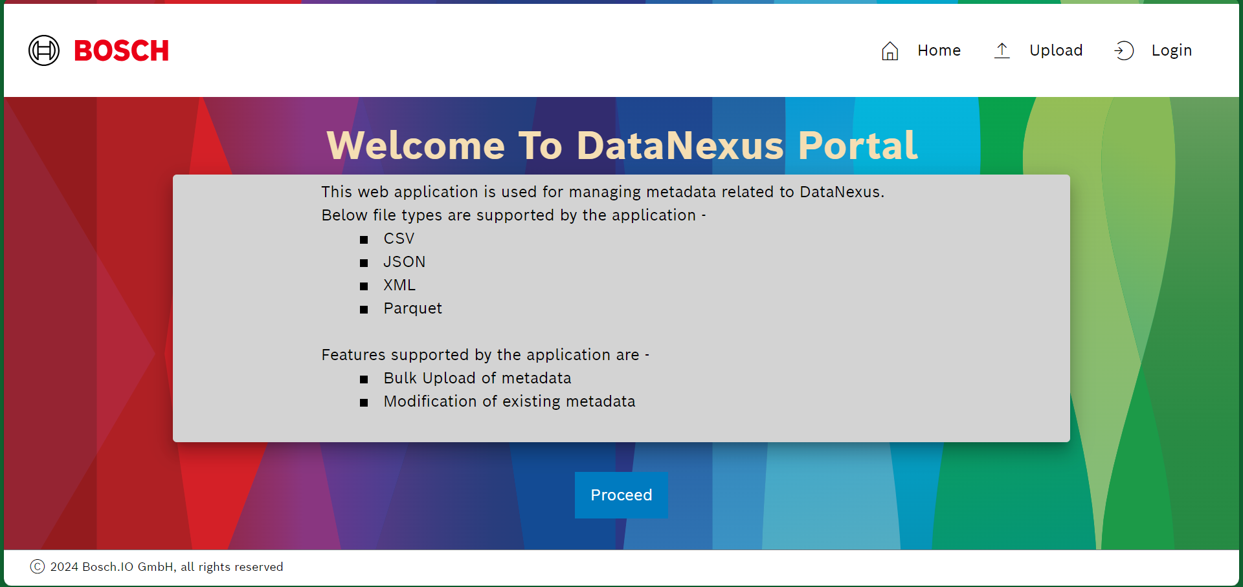
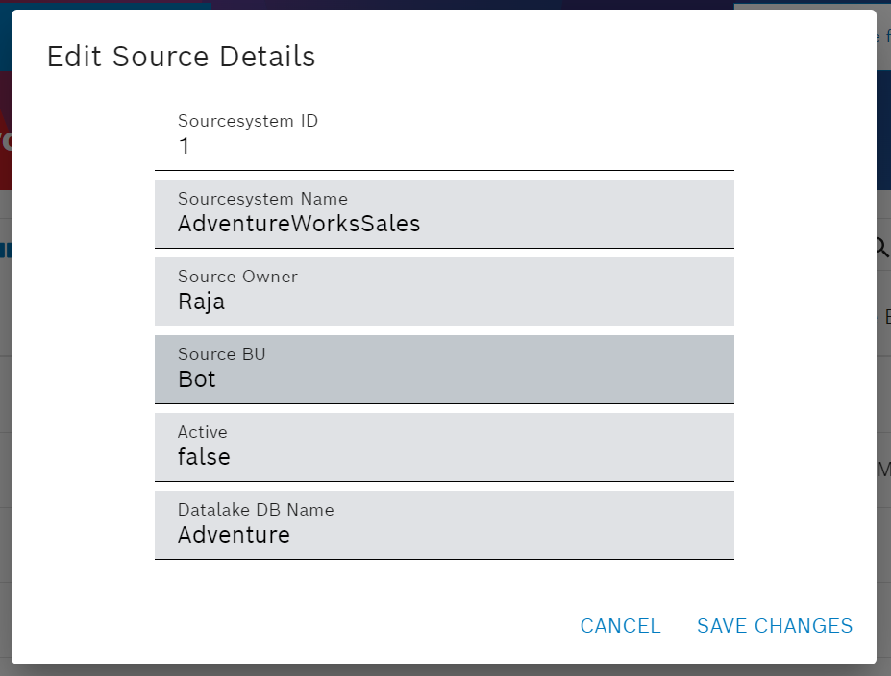
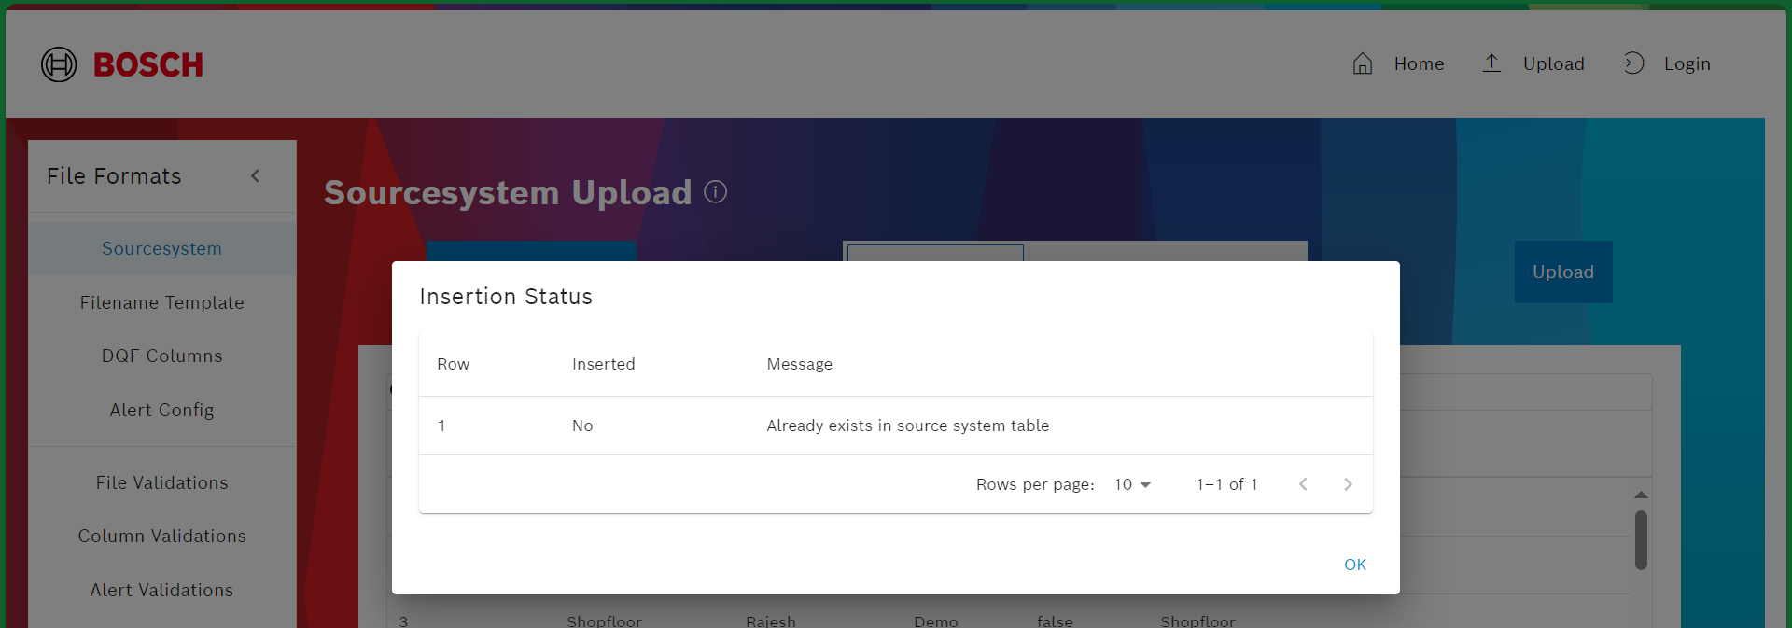
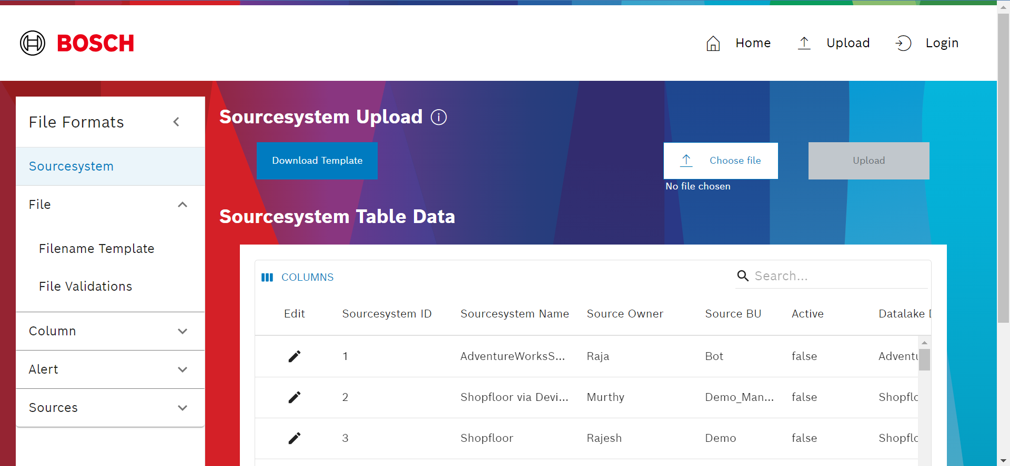
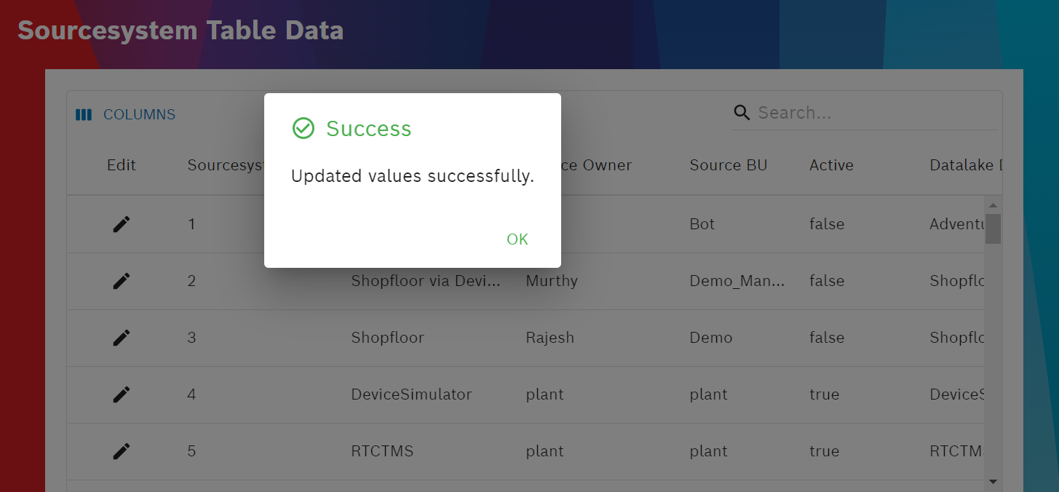
DataNexus Features
18. UI for metadata config maintenance

Slide 62
DataNexus Features
19. Others
Chatbot
PBI-NLP
Features | Description | csv | json | txt | avro | xml
Infer Schema using Schema Definition Files | Schema definition for files are stored in files which are used to process the incoming files. | × |  | × | × | 
Flush Scripts | Script to delete old folders and files from storage account. |  |  |  |  | 

Slide 63
DataNexus Features
20. Anonymization & Pseudonymization
As part of Anonymization and Pseudonymization, different Data Masking techniques can be applicable at different layers.
Bronze Layer : Hashing and Tokenization are the data masking techniques that can be applicable at bronze layer.
Silver Layer : Encryption, Tokenization, Shuffling , Replacing are the different data masking techniques that can be applicable.
Note: If Anonymization or Pseudonymization needs to be applied at bronze layer, the storage format of the file will be parquet.

Slide 64
OPL
Master data to be highlighted in documentation
Streaming
Data archiving/purging to be brought in DataNexus.
Configurable house keeping job schedules in DataNexus-pending

