Slide 1


HTML Test Preparation
http://telerikacademy.com
Asya Georgieva
QA Trainer
Telerik Software Academy
academy.telerik.com

Slide 2

Web Technologies Basics

Slide 3
Question
We have the following User-Agent string: Mozilla/5.0 (Windows NT 6.1; WOW64) AppleWebKit/537.1 (KHTML, like Gecko) Chrome/21.0.1180.89 Safari/537.1 What is the operating system?
Microsoft Windows 7 – 32-bit
Ubuntu Linux – 64 bit
Microsoft Windows 7 – 64-bit
Apple iOS
Apple OSX
Microsoft Windows 8 – 32-bit
Microsoft Windows XP – 32 or 64 bit

Slide 4

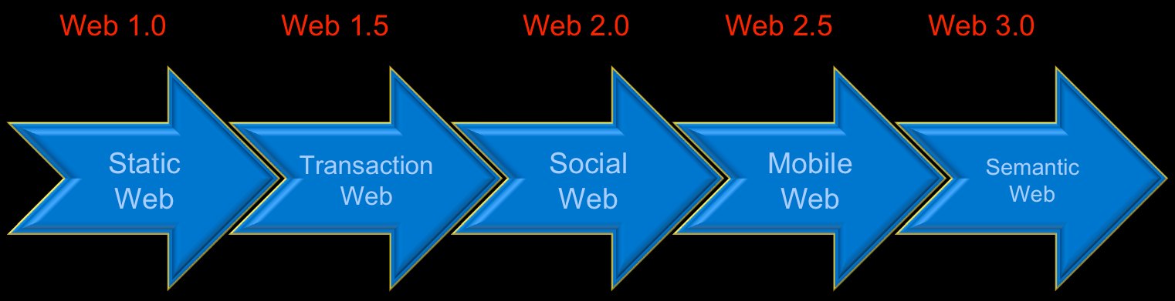
Question
Who is the main content creator in Web 3.0?
A team of highly trained monkeys
Computers (Artificial Intelligence)
Users
Developers
Professional authors
The government

Slide 5
Question
A web page consists of:
A set of HTML5 documents
A HTML file + corresponding CSS file
A HTML file + optional additional resources (images, styles, scripts, etc.)
A text document written in HTML language + images and other assets (optionally)
A single HTML file
A web server hosting HTML files, CSS styles and images
A HTML file hosted somewhere in the cloud

Slide 6

HTML Fundamentals

Slide 7

Question
What does HTML stand for?
Hyperlinks and Text Markup Language
Hyper Text Markup Language
Home Tool Markup Language
Hyperlinks Tool Markup Language

Slide 8

Question
What are attributes?
Properties of the HTML Elements
The smallest piece of HTML
Combination of opening and closing tags

Slide 9

Question
The value of the attributes is surrounded by:
;
“ ” or ‘ ’
" " or ``
“ ’ or ‘ ”
“ ‘
" " or ' '
" ” or ' '

Slide 10

Question
Which of the following tags is used for the largest heading:
<h6>
<head>
<heading>
<header>
<h1>

Slide 11

Question
Which of the following tags is used for inserting a line break?
<br />
<break />
<lb />
<nl>
<\n>

Slide 12
Question
What is the correct way for creating a hyperlink?
<a url=" http://telerikacademy.com "> Telerik Academy </a>
<a href="http://telerikacademy.com"> Telerik Academy</a>
<a> http://telerikacademy.com </a>
<a name=" http://telerikacademy.com "> Telerik Academy </a>

Slide 13
Question
What is the correct way for creating an e-mail link?
<email href="academy@telerik.com">
<email>academy@telerik.com</email>
<a href="mailto:academy@telerik.com ">
<a href="academy@telerik.com">
<mailto href="academy@telerik.com">

Slide 14

Question
What is the correct way for making a checkbox?
<input type="check" />
<check>
<checkbox>
<input type="checkbox" />

Slide 15

Question
Which is of the following is the tag for making a text area?
<input type="textbox" />
<input type="textarea" />
<textarea>
<input type="multiline" />

Slide 16

Question
Which of the code line is a valid html and will display a textbox field?
<textfield>
<textinput type="text" />
<text></text>
<input />

Slide 17
Question
What is the correct way for inserting an image?
<image src="image.gif" alt="TelerikAcademy" />
<img alt=" TelerikAcademy">image.gif</img>
<img href="image.gif" alt=" TelerikAcademy" />
<img src="image.gif" alt="TelerikAcademy" />

Slide 18
Question
What we gain, when we write valid HTML code?
The code becomes more understandable to other developers
The browser will not understand invalid HTML
The browser renders valid HTML faster than invalid
CSS styles works only on valid HTML
It is cooler to be valid!

Slide 19

Answer
The <!DOCTYPE> tag is an instruction to the web browser about what version of HTML the page is written in
The browser handles the page accordingly to its Doctype declaration
HTML 5 Doctype:
<!DOCTYPE html>

Slide 20
Question
Image tags should have either their width or their height set. Why is that?
When lower than the actual height/width is given, the browser downloads a smaller image file
The browser should know the space for the image, to load the other content below/near it
When width/height is not set, the images is with default width and height 0, and it does not show

Slide 21

Answer
If height and width are set, the space required for the image is reserved when the page is loaded
Without these attributes, the browser does not know the size of the image, and cannot reserve the appropriate space

Slide 22

Question
How do you comment out HTML markup?
<-Telerik Academy->
<-- Telerik Academy -->
<!-- Telerik Academy -->
< Telerik Academy />
//Telerik Academy
/* Telerik Academy */
# Telerik Academy #

Slide 23

Question
Which of the following is the correct use of the <title> tag?
<title="Telerik Academy"></title>
<title="Telerik Academy" />
<title text="Telerik Academy" />
<title content="Telerik Academy" />
<title>Telerik Academy</title>

Slide 24

Question
Which of the following tags mean most to search engines?
Heading 1
Header
Paragraph
All of above

Slide 25

Question
The <title> tag:
Displays a title for the page in search-engine results
The <h1> tag – primary heading of a document
Used by search engines
Include only one per page in XHTML 1.1
Many h1 in HTML5

Slide 26

Question
What are <div> tags used for?
To replace paragraphs. i.e. <p>
To logically divide the paragraphs
To logically divide the document
To provide space between tables

Slide 27
Answer
The HTML div tag is used for defining a section of your document.
With the div tag, you can group large sections of HTML elements together and format them with CSS
<div style="text-align:center">
<p>Navigation section</p>
</div>
<div style="border:1px solid black">
<p>Content section</p>
</div>

Slide 28

Question
HTML Elements are combination of:
Tags and ids
Attributes and classes
Tag and classes
Tags and attributes
Classes and names

Slide 29
Question
The HTML element <html> is:
Used to mark the beginning and middle of a HTML document
Used to mark the beginning and ending of a HTML document
Used to mark the beginning of a HTML document
Used to mark the ending of a HTML document
Used to mark the middle of a HTML document

Slide 30
Answer
<!DOCTYPE html>
<html>
<head>
<title>
. . .
</title>
</head>
<body>
. . .
</body>
</html>
An HTML element starts with a start tag / opening tag
An HTML element ends with an end tag / closing tag
The element content is everything between the start and the end tag
Some HTML elements have empty content

Slide 31

Question
HTML <body> element should contains:
All the visible to the user markup
All the invisible to the user markup
Resources
Attributes
Scripts and data

Slide 32
Answer
<!DOCTYPE html>
<html>
<head>
<title>
. . .
</title>
</head>
<body>
<!--Content-->
</body>
</html>
The <body> tag defines the document's body.
The <body> element contains all the contents of an HTML document, such as text, hyperlinks, images, tables, lists, etc.

Slide 33
Question
Which of the following are block elements?
<div>, <p>
<span>, <p>
<a>, <div>
<em>, <h1>
<h1>, <ul>
1,2,3
2,3,4
3,4,5
1,5
3,4
4,5

Slide 34
Answer
Block level elements normally start (and end) with a new line when displayed in a browser
Examples: <h1>, <p>, <ul>, <table>, <div>
Inline elements are normally displayed without starting a new line
Examples: <b>, <td>, <a>, <img>, <span>

Slide 35

Question
Which of the following tags you can use to make a list that shows the items with numbers?
<ul></ul>
<ol></ol>
<dl></dl>
<list></list>

Slide 36

Question
What tag is used to create a Definition list?
<dt></dt>
<dd></dd>
<dl></dl>
<di></di>
<dl><di>

Slide 37

Tables

Slide 38
Question
Which of these tags are related to the <table> tags?
<ttable>
<head>
<body>
<tfoot>
<tr>
<th>
<tt>
<tf>
1,2,4
2,3,4
4,5,6
5,6,7
5,6,8
1,5,6
2,4,6

Slide 39
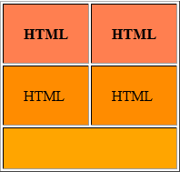
Question
Which of the following code blocks will visualize the table:
To be continued…

Slide 40
Question
<table cellpadding="22" border="1">
<tr><th>HTML</th><th>HTML</th></tr>
<tr><td>HTML</td><td>HTML</td></tr>
<tr><td colspan="2"></td></tr>
</table>
<table cellpadding="22" border="1">
<tr><td>HTML</td><td>HTML</td></tr>
<tr><td>HTML</td><td>HTML</td></tr>
<tr><td colspan="2"></td></tr>
</table>
<table cellpadding="22" border="1">
<tr><th>HTML</th><th>HTML</th></tr>
<tr><th>HTML</th><th>HTML</th></tr>
<tr><td colspan="2"></td></tr>
</table>
<table cellpadding="22" border="1">
<tr><th>HTML</th><td>HTML</td></tr>
<tr><td>HTML</td><td>HTML</td></tr>
<tr><td colspan="2"></td></tr>
</table>

Slide 41
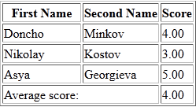
Question
Which of the following tags is the best to be placed in the missing position:
tfood
tablefoot
footer
tfooter
tfoot
None of the above
To be continued…

Slide 42
Question
<table border="1">
<colgroup><col style="width:100px" /><col/></colgroup>
<thead>
<tr>
<th>First Name</th>
<th>Second Name</th>
<th>Score</th>
</tr>
</thead>
<…>
<tr><td colspan="2">Average score:</td><td>4.00</td></tr>
</…>
<tbody>
<tr><td>Doncho</td><td>Minkov</td><td>4.00</td></tr>
<tr><td>Nikolay</td><td>Kostov</td><td>3.00</td></tr>
<tr><td>Asya</td><td>Georgieva</td><td>5.00</td></tr>
</tbody>
</table>

Slide 43
Question Cont.
Which of the following tags is the best to be placed in the missing position:
tfood
tablefoot
footer
tfooter
tfoot
None of the above

Slide 44

Question
What table attribute is used in the picture:
cellspacing = 15 and cellpadding = 0
cellpadding = 15 and cellspacing = 15
cellspacing = 0 and cellpadding = 15
cellmargin
cellpadding
margin
padding
None of the above

Slide 45
Question
Is this code valid?
<!DOCTYPE html>
<html>
<head><title>Telerik Academy</title></head>
<body>
<h1>Telerik Academy</h1>
<li>Home</li>
<li>Software Academy</li>
<li>Courses</li>
<li>BG coder</li>
<li>About</li>
</body>
</html>
To be continued…

Slide 46




Question
Is this code valid?
Yes, it is
No, it isn’t

Slide 47
Answer
<!DOCTYPE html>
<html>
<head><title>Telerik Academy</title></head>
<body>
<h1>Telerik Academy</h1>
<ul>
<li>Home</li>
<li>Software Academy</li>
<li>Courses</li>
<li>BG coder</li>
<li>About</li>
</ul>
</body>
</html>
The <ul> tag together with the <li> tag creates unordered lists

Slide 48
Question
What is wrong with the following code?
<!DOCTYPE html4>
<html>
<head>
<title>Example</title>
</head>
<body>
<div id="my-div">
<div id="sub-div">
<h1>Section 1</h1>
<p>Content paragraph</p>
<p>Here's another content article</p>
</div>
To be continued…

Slide 49
Question
<div>
<h1>Section 2</h1>
<p>Content paragraph</p>
<p>Here's another content article</p>
</div>
<table cellpadding="22">
<tr>
<th>Telerik</th>
<th>Academy</th>
</tr>
<tr>
<td colspan="2"></td>
</tr>
</table>
</div>
</body>
</html>
To be continued…

Slide 50

Question
What is wrong with the following code?
The Doctype should have more attributes
The Doctype should be <!DOCTYPE html5>
The Doctype should be <!DOCTYPE html>
The Ids must be the same
No errors

Slide 51
Question
What is wrong with the following code?
<table cellpadding="15" border="1">
<tr>
<td valign="top">1</td>
<td>
<table class="main-table" cellpadding="15" border="1">
<tr><td>2</td>
<td>
<table class="main-table" cellpadding="15" border="1">
<tr><td>4<td><td>5</td></tr>
</table>
</td>
</tr>
</table>
</td>
</tr>
</table>
To be continued…

Slide 52

Question
There are duplicated classes
There is a tag, which is not closed
There is a tag, which is not opened
There is no such attribute like “valign”
There is no such attribute like “valign” with value “top” (valign="top")

Slide 53
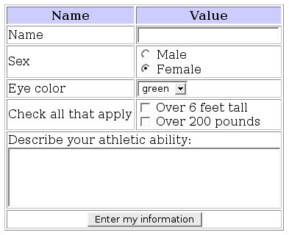
Forms

Slide 54

Question
What does the "action" attribute tells in the form tag?
How the form data should be sent
Where the form data should be sent
Whose form data should be sent
Which of the form data should be sent

Slide 55
Question
What does the "method" attribute tells in the form tag?
Where the form data should be sent
Whose the form data should be sent
How the form data should be sent
What the form data should be sent

Slide 56
Question
What is wrong with the following code?
<h1>Telerik Academy</h1>
<div>
<img src="image.png" />
<h2>HTML course</h2>
<h3>C# course</h3>
<span>Students</span>
<br>
<span>Age</span>
</br>
</div>
The </br> tag
The <img> tag
The <h1> tag
The src attribute

Slide 57

Question
What is the best way to insert an input element that is not shown on the page?
<input type="…" name="Account" value="This is your Account" />
hidden
invisible
secret
private
cover

Slide 58
Question
Which of the following tags is the most appropriate for the missing position:
<!DOCTYPE html>
<html>
<head><title></title></head>
<body>
<form method="post" action="form.aspx">
<…>
<legend>Personal Information</legend>
<input type="text" id="Name" />
<input type="text" id="Email" />
</…>
</form>
</body>
</html>
fieldset
textarea
inputset
formset
legendset

Slide 59
Question
Which is the most appropriate tag for the missing position ?
<label for="classes">Countries</label>
<… multiple="multiple" id="classes">
<option value="geo">Bulgaria</option>
<option value="math">Italy</option>
<option value="eng">Spain</option>
</…>
To be continued…

Slide 60

Question
Which is the most appropriate tag for the missing position ?
form
fieldset
legend
selected
select
textarea
<label for="classes">Countries</label>
<… multiple="multiple" id="classes">
<option value="geo">Bulgaria</option>
<option value="math">Italy</option>
<option value="eng">Spain</option>
</…>

Slide 61
Question
Is this code valid?
<!DOCTYPE html>
<html>
<head><title>Example</title></head>
<body>
<h1>Parts</h1>
<ul>
<li>Part 1</li>
<li>Part 2</li>
<li>Part 3
<ul>
<li>Part 3.1</li>
</li>
</ul>
<li>Part 4
<ul><li>4.1</li></ul>
</li>
</ul>
</body>
</html>
To be continued…

Slide 62
Question
Is this code valid?
Yes, it is
No, it isn’t

Slide 63
Answer
<!DOCTYPE html>
<html>
<head><title>Example</title></head>
<body>
<h4>Parts</h4>
<ul>
<li>Part 1</li>
<li>Part 2</li>
<li>Part 3
<ul>
<li>Part 3.1</li>
</ul>
</li>
<li>Part 4
<ul><li>4.1</li></ul>
</li>
</ul>
</body>
</html>

Slide 64

Semantic HTML

Slide 65

Question
What is CSS used for (3 answers):
Define the layout of the elements
Define the presentation
Define the content of a web page
Handles the request to the web server
Define style rules

Slide 66

Question
What does the semantic HTML give us:
Improves server performance
More difficult to render by the browsers
A way to show the SEO engines the correct meaning of the HTML page
Easier to read by the machines

Slide 67
Question
Which of the following are HTML5 semantic tags for layout?
<nav>, <a>
<section>, <footer>
<span>, <section>
<em>, <header>
<footer>, <p>
<nav>, <header>
<article>, <nav>
1,2,3
4,5,6
1,3,4
5,6
2,6, 7
1,2
4,6

Slide 68
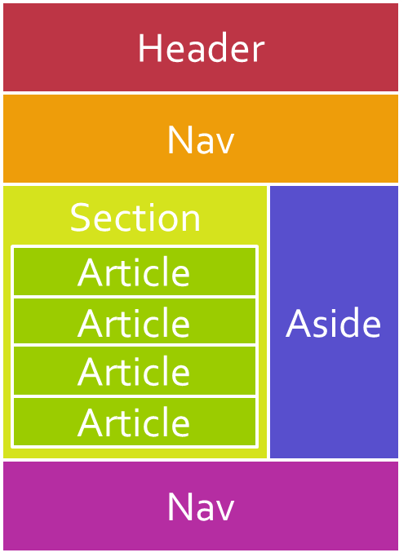
Answer
Some of the new semantic elements in HTML5 are:
<article>, <time>, <figure>, <footer>, <header>, <aside> <section> and <nav>

Slide 69
Question
Which of the following tags is semantically the most appropriate?
<body>
<header>
<h1>Telerik Academy</h1>
<…>
<ul>
<li><a href="#">Home</a></li>
<li><a href="#">Software Academy</a></li>
<li><a href="#">Courses</a></li>
<li><a href="#">Resources</a></li>
</ul>
</…>
</header>
</body>
To be continued…

Slide 70
Question
Which of the following tags is semantically the most appropriate?
<div>
<p>
<headerItem>
<nav>
<section>
<details>
<content>

Slide 71
Answer
Which of the following tags is semantically the most appropriate?
<body>
<header>
<h1>Telerik Academy</h1>
<nav>
<ul>
<li><a href="#">Home</a></li>
<li><a href="#">Software Academy</a></li>
<li><a href="#">Courses</a></li>
<li><a href="#">Resources</a></li>
</ul>
</nav>
</header>
</body>
The <nav> tag defines a section of navigation links

Slide 72
Answer
Combine the text and the tags so that the result is semantically correct markup?
<…>
<…>
<…>C# програмиране - част I</…>
</…>
<p> В безплатния курс "HTML oснови" се изучават основите на уеб програмирането. Разглеждат се начални понятия за уеб, като браузъри, уеб сървъри, системата клиент- сървър, инструменти за разработка, езика HTML и др..
</p> </…>
To be continued…

Slide 73
Question
Combine the text and the tags so that the result is semantically correct markup?
<article>, <header>, <h1>, </h1>, </header>, </article>
<article>, <div>, <span>, </span>, </div>, </article>
<div>, <header>, <span>, </span>, </header>, </div>
<div>, <p>, <h1>, </h1>, </p>, </div>
<div>, <div>, <span>, </span>, </div>, </div>

Slide 74
Answer
Combine the text and the tags so that the result is semantically correct markup?
<article>
<header>
<h1>C# програмиране - част I</h1>
</header>
<p> В безплатния курс "HTML oснови" се изучават основите на уеб програмирането. Разглеждат се начални понятия за уеб, като браузъри, уеб сървъри, системата клиент- сървър, инструменти за разработка, езика HTML и др..
</p> </article>

Slide 75
Question
Combine the text and the tags so that the result is semantically correct markup?
<dd><dt></dt><dl></dl></dd>
<dl><td></td><tr></tr></dl>
<dt><dl></dl><dd></dd></dt>
<dl><dt></dt><dd></dd></dl>
<…>
<…>CSS</…>
<…>Cascading Style Sheets</…>
<…>PHP</…>
<…>PHP:Hypertext Preprocessor</…>
<…>HTML</…>
<…>HyperText Markup Language</…>
</…>

Slide 76
Answer
Combine the text and the tags so that the result is semantically correct markup?
<dl>
<dt>CSS</dt>
<dd>Cascading Style Sheets</dd>
<dt>PHP</dt>
<dd>PHP:Hypertext Preprocessor</dd>
<dt>HTML</dt>
<dd>HyperText Markup Language</dd>
</dl>
A definition list is a list of items, with a description of each item

