Slide 1
CDAC Mumbai
CallMyMedic
Assessment
SOFTWARE REQUIREMENT SPECIFICATION
FOR
CALL MY MEDIC
[21-11-2020]
CDAC, MUMBAI
Revision History:
Version. | DATE | Authored By | Reviewed By | REASONFORCHANGE
00 | 21/11/2020 | Team-38 |  | 1st release
i

Slide 2
CDAC Mumbai
CallMyMedic
Assessment
Table of Contents
1. Introduction .....................................................................................................................................1
1.1 Purpose .................................................................................................................................... 1
1.2 Document Conventions ............................................................................................................ 1
1.3 Intended Audience and Reading Suggestions .......................................................................... 1
1.4 Product Scope ........................................................................................................................... 2
1.5 References ................................................................................................................................ 3
2. Overall Description .........................................................................................................................3
2.1 Product Perspective .................................................................................................................. 3
2.2 Product Functions ..................................................................................................................... 3
2.3 User Classes and Characteristics .............................................................................................. 3
2.4 Operating Environment ............................................................................................................ 3
2.5 Design and Implementation Constraints .................................................................................. 3
2.6 User Documentation ................................................................................................................. 4
2.7 Assumptions and Dependencies ............................................................................................... 4
3. External Interface Requirements ..................................................................................................4
3.1 User Interfaces .......................................................................................................................... 4
3.2 Hardware Interfaces ................................................................................................................. 5
3.3 Software Interfaces ................................................................................................................... 5
3.4 Communications Interfaces ...................................................................................................... 5
4. System Features ..............................................................................................................................5
4.1 System Feature 1 ...................................................................................................................... 5
4.2 System Feature 2 (and so on) ................................................................................................... 5
5. Other Non-functional Requirements.............................................................................................6
5.1 Performance Requirements ...................................................................................................... 6
5.2 Safety Requirements................................................................................................................. 7
5.3 Security Requirements ............................................................................................................. 7
5.4 Software Quality Attributes....................................................................................................... 7
5.5 Business Rules .......................................................................................................................... 7
6. Other Requirements .......................................................................................................................8
ii

Slide 3
CDAC Mumbai
CallMyMedic
Assessment
1. Introduction
1.1 Purpose
Due to Covid-19 Situation, it is risky to go Out and if we had any kind of Medical Emergency then this became more risky. In India, There is around 135CR population, While Doctor per Patient is in ratio of 1:1000, Some get Medical Facility some may not. If they get Medical facility ,Cost for Normal Consultancy has been raised to great Extend. So we are making CALL MY MEDIC , Which will compare all best doctors who are near by you and give there rating , fees and connect them with you at low cost. You can booked appointment, incase of Emergency.
1.2 Document Convention
Headings: -
Text: -Bold
Font-Size: - 14
Highlighting: - Times New Roman
Sub Headings: -
Text: -Bold
Font-Size: - 12
Highlighting: - Times New Roman
Header: -
Text: - Simple
Font-Size: -10
Highlighting: - Times New Roman
Footer: -
Text: - Simple
Font-Size: -10
Highlighting: - Times New Roman
Intended Audience and Reading Suggestions
Developers : in order to be sure they are developing the right project that fulfills requirements provided in this document.
Testers : in order to have an exact list of the features and functions that has to respond according to requirements and provided diagrams.
1

Slide 4
CDAC Mumbai
CallMyMedic
Assessment
Users : in order to get familiar with the idea of the project and suggest other features that would make
it even more functional.
Documentation writers : to know what features and in what way they have to explain. What security
technologies are required, how the system will response in each user’s action etc.
Admin, Receptionist, Doctors and patients: in order to know exactly what they have to expect from
the system, right inputs and outputs and response in error situations.
1.2 Product Scope
Patient From any point form this world can connect with there Doctor.
Customer can also order Medicine, Without Stepping Out oh his House.
Security will maintain by Payment gateway, Risk is avoided.
Medical Emergency can be handle.
24*7 free Customer Support for Register User.
1.3 References
https://stackoverflow.com/
http://tomcat.apache.org/
https://spring.io/projects/spring-boot
https://spring.io/
https://www.java.com/en/
2. Overall Description
2.1 Product Perspective
This web application is totally independent system that manages activities of the
CallMyMedic as taking appointments, generating patient reports, personnel management and
administrative issues. In this project all the records are stored in single database.
Different users have different permission to access this web application. Each user has
unique id. If any data is lost user is having option to recovery. User’s don’t have right to alter records
after particular time period and also it is not having option to alter other patient records.
2.2 Product Functions
Authentication for different users.
Real-time validation of all fields and database to prevent errors.
Printing of prescription, certificate.
2

Slide 5
CDAC Mumbai
CallMyMedic
Assessment
History of patients recorded in database.
Maintaining the billing section of the Hospital.
Built in backup and restore facilities.
Compatible with any platform.
2.3 User Classes and Characteristics
The admin, doctors, and patients will be the main users. The system is also designed
to be user-friendly.
Admin :
Admin should have prior knowledge of the system. Admin is able to control the whole system.
He/she can add, delete, update and modify the system.
Doctor :
Doctor should fairly know about the usage of the system. Doctors are able to see the respective
appointments taken. And also can view patient’s details and records.
.
Patient :
Anyone can view the information of the Doctor. Patients can view their own records and doctors
details and timings. And also can take appointment online.
2.4 Operating Environment
➢ Hardware platform:
o Processor – Above Pentium 4, with clock speed of 2.0 GHz
o RAM – 1 GB or above
o Hard Disk – Free disk space of above 20 GB
➢ Software platform:
o Front-end: JavaScript , HTML, CSS, Bootstrap
o Back-end: MySQL , Spring-boot
➢ Supported tools:
o Eclipse, Visual Code Studio, MySQL Workbench
2.5 Design and Implementation Constraints
Constraints:
o User interface is only in English. No other language option is available
o User can log-in only with his assigned user-name and password
o Limited to HTTP/HTTPS
3

Slide 6
CDAC Mumbai
CallMyMedic
Assessment
2.6 User Documentation
User documentation mainly comprises of Help menu of application. It will give all the
minute details about the project, if any user has any query about any module or functionality,
one can refer it and see how to operate the application. This report is the complete
documentation of our project. It gives complete details about the project, its functionality, users,
software used, hardware requirement,environment and so on.
2.7Assumptions and Dependencies
➢ There is an active internet connection with the system
➢ The system has internet browser installed
Users know the English language, as the user interface will be provided in English.
The code should be free with compilation errors/syntax errors.
The product must have an interface which is simple enough to understand.
3. External Interface Requirements
3.1 User Interfaces
The main element is web-pages using HTML, Javascript, Springboot, Bootstrap. Multiple
interfaces are there like log-in pages, home pages of Admin, Doctor, and Patient. The developer will have to study the designing of the product. The use of the controls and the component from the Add items feature of the HTML. The user of the product will get very user friendly web page which will be very easy to work with.
4

Slide 7
CDAC Mumbai
CallMyMedic
Assessment
3.2 Hardware Interfaces
This system doesn’t require any hardware interface. The one used here is monitor,
keyboard and mouse.
In the hardware interface, the system interacts with hardware given the processor is above
P4 with clock speed of 2.0 GHz with 1 GB RAM and the Hard Disk with 20 GB free space in the
memory.
3.3 Software Interfaces
In software interfaces, Bootstrap is the back-end technology used along with MySQL Database.
The front-end technologies include JavaScript , HTML, CSS, Bootstrap. Data will be communicated between these interfaces accordingly.
3.4 Communications Interfaces
The main communication interface for interacting with the System will be the web Browser.
4. System Features
4.1 Login Account
4.1.1 Description :
To open the user account the users have to enter login information.
4.1.2 Stimulus / Response
User must enter valid user id and password to open user page. If it is valid then it links
to user account page. If the user is new to the CallMyMedic he/she has to register.
4.1.3 Basic Data Flow
Here First the user enters login id and password.
After entering the login information system checks whether entered login id and
password is valid or not.
If it is valid then it is linked to the user account.
If the user doesn’t have user account then user needs to register.
4.1.4 Functional Requirements
Here administrator, doctors and patients are using the different login pages.
5

Slide 8
CDAC Mumbai
CallMyMedic
Assessment
4.2 Admin
4.2.1 Description :
Admin is a super-user. He/she is able to control the whole system. Admin can add, delete, update and modify the system.
4.2.2 Stimulus / Response
Admin logs into the admin account and do the relevant changes daily. Admin keeps the system up-to-date.
4.2.3 Basic Data Flow
Admin logs into the system.
Can add/delete/update/modify records.
He/she controls the entire system.
4.2.4 Functional Requirements
Admin has got the rights to add/delete the doctor, employees, old records and can view the entire system.
4.3 Online Appointment
4.3.1 Description :
Patients can take appointments through online by entering Date and Time. Doctor approves. Patient has to register or login to take appointment through online.
4.3.2 Stimulus / Response
Patients should enter valid information to take appointment online. After entering appointment details doctor verifies the information and gives date and timings.
4.3.3 Basic Data Flow
Patient first logs into the website.
After logging in, the patient enters the appointment information.
The receptionist verifies the sent details from the patient and updates date and time.
Patient receives the approval message with date and time.
6

Slide 9
CDAC Mumbai
CallMyMedic
Assessment
4.3.4 Functional Requirements
Patients can take appointment online or through phone call.
patient can view the old appointment details and their records.
4.4 Doctor
4.4.1 Description :
Doctors can check appointments taken by patients. Doctors can view Patients Test reports and he can enter and view suggested prescription details. And also can check billing.
4.4.2 Stimulus / Response
Here doctor enters the patient report and enters prescription details.
4.4.3 Basic Data Flow
Doctor logins to the website.
Doctor checks old record and appointment details.
Doctor enters prescription and test reports.
He can view billing details.
4.4.4 Functional Requirements
Doctor can view patient appointment, old records, prescription, payment details.
4.4 Billing and Maintenance
4.4.1 Description :
In this doctors enters consultancy fee, laboratory charges, etc.
4.4.2 Stimulus / Response
Here doctor enters the patient report and enters prescription details.
4.4.3 Basic Data Flow
Doctor enters the consultancy fee and laboratory fee
4.4.4 Functional Requirements
Consultation Fee
7

Slide 10
CDAC Mumbai
CallMyMedic
Assessment
5. Performance Requirements
Call My Medic manages facilities required by the casual users quickly and easily. It offers to
take appointments faster through online. It takes appointment details from the patients and send the
appointment date and timings to the particular patient.
5.1 Safety Requirements
In case the user forgets or loses Password, the repair functionality helps by choosing
“forgot password” option in the main login window.
To avoid this kind of situations, backups can be done regularly.
While typing the password, if the caps lock is on it must be notified.
5.2Security Requirements
This system is provided with authentication without which no user can pass. So only the
legitimate users are allowed to use the application. If the legitimate user’s share the authentication
information then the system is open to outsiders.
5.3 Software Quality Attributes
5.3.1 Reliability
Good validations of user inputs will be done to avoid incorrect storage of records.
5.3.2 Maintainability
During the maintenance stage, SRS document can be referred for any validations.
5.3.3 Portability
This system can be installed in any personal computers supporting windows
operating system platform.
5.3.4 Flexibility
The system keeps on updating the data according to the transactions that takes place.
5.3.4 Timeless
The system carries out all the operations with consumption of very less time.
Security: Security of the system is maintained by giving access to only authenticated user id and password.
8

Slide 11
CDAC Mumbai
6.Other Requirements
➢ Appendix A: Glossary
CallMyMedic
Assessment
o
o
o
o
o
O
SRS: Software Requirement Specification
GUI: Graphical User Interface
P4: Pentium 4
SQL: Structured Query Language
HTML: Hyper Text Markup Language
CSS: Cascading Style Sheet
9

Slide 12
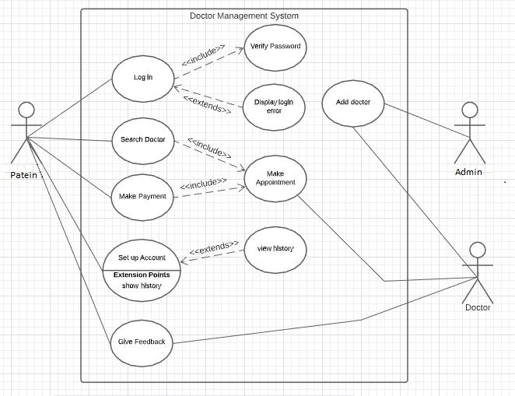
CDAC Mumbai
CallMyMedic
Assessment
Appendix B: Analysis Models
a) Use Case Diagram
10

Slide 13
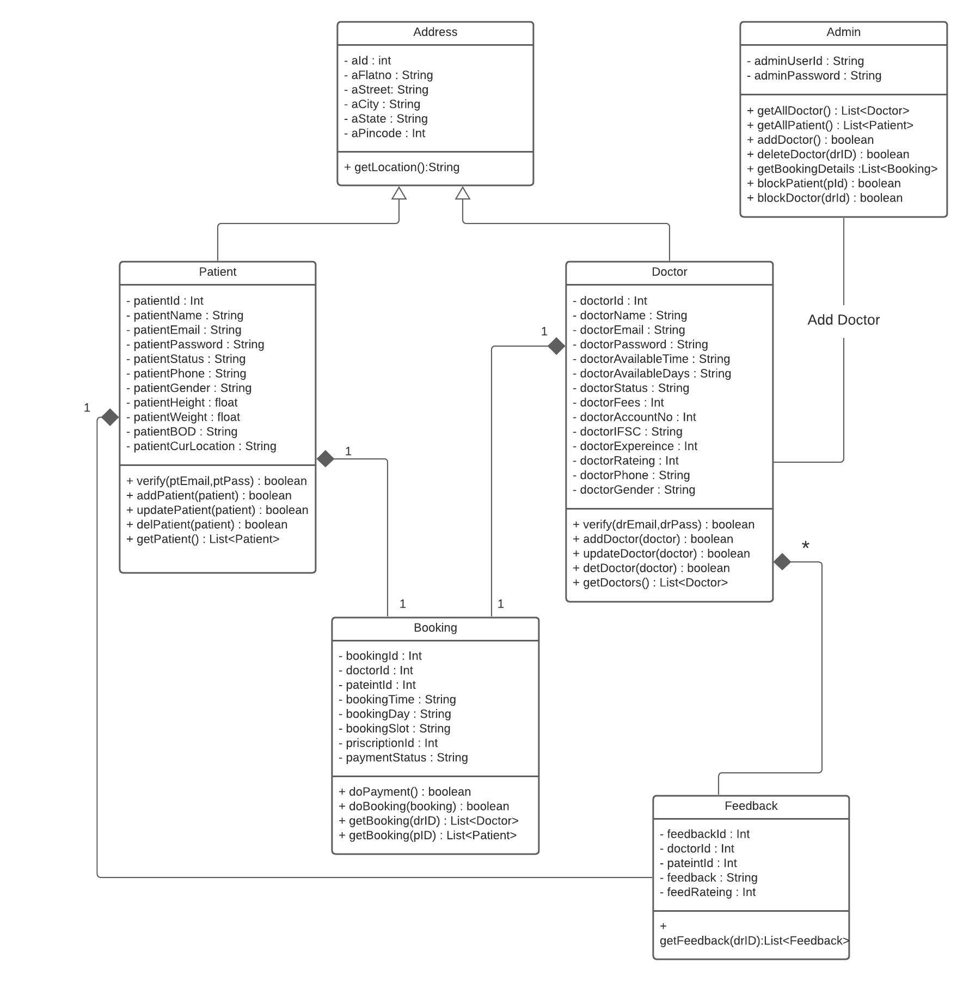
CDAC Mumbai
b) Class Diagram
CallMyMedic
Assessment
11

Slide 14
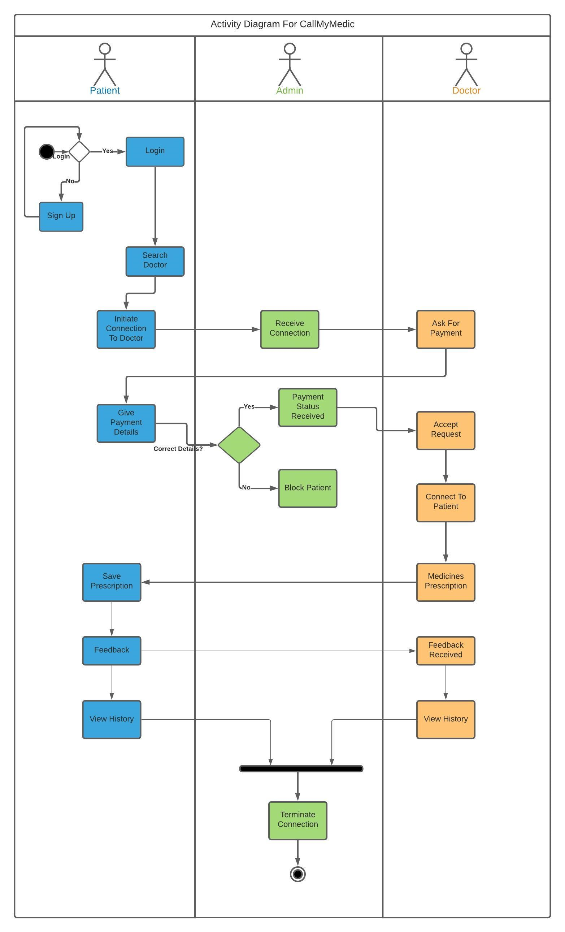
CDAC Mumbai
c) Activity Diagram 1.1:
DAC Forum & Mentor
Assessment
11

Slide 15
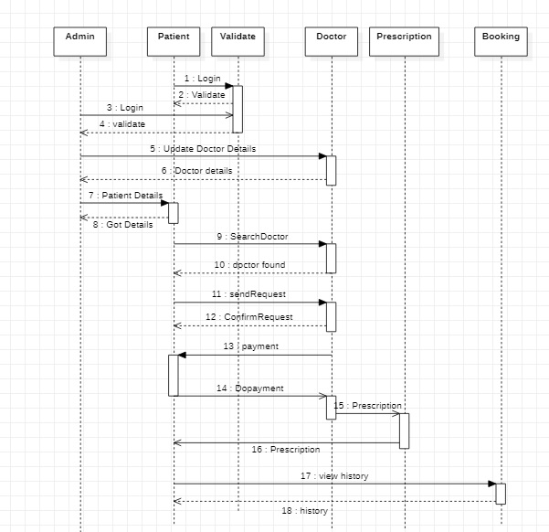
CDAC Mumbai
d) Sequence Diagram 1.1:
CallMyMedic
Assessment
13

Slide 16
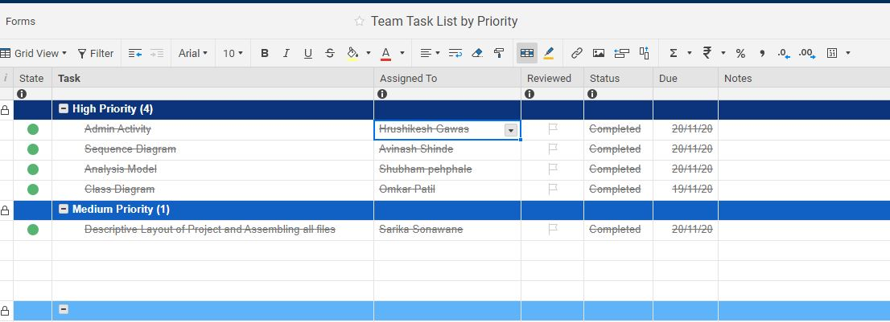
CDAC Mumbai
Task Report:
CallMyMedic
Assessment
Task | Assigned To
Activity Diagram | Hrushikesh Gawas
Sequence Diagram | Avinash Shinde
Analysis Model | Shubham Phepale
Class Diagram | Omkar Patil
Description and detailing | Sarika Sonawane
14

