Slide 1
XML .NET
Concepts and Implementation
Badar Gillani

Slide 2
Agenda
Section – I
  XML Technology
  Why XML
  XML Skeleton
  Uses of XML
  General Schema Example
Section – II
  XML in .NET Framework
  XML.NET Architecture
  Namespaces and Classes Hierarchy
  XmlReader Class
  XmlWriter Class
  XmlDocument Class
  System.Xml.Xsl
  Sytem.Xml.Xpath
  XML and ADO.NET
  XML and .NET Services

Slide 3
XML Technology
Derived from SGML (Standard Generalized Markup Language)
Text-based format
Describes document structures using markup tags
Useful for describing document formats for Web
It is also useful for describing both structured as well as semi-structured data.
Notes:
Text-based format means that one can read and edit an xml document using standard text editing tools

Slide 4
Why XML?
Platform-independent
    Can be run over any operating System
    Can be processed using any programming language
Extensible:
    No fixed vocabulary
    Flexible, change the structure by adding new tags
Supports Global implementation being fully Unicode
No emphasis on display and rendering the XML document

Slide 5
XML Skeleton
Syntax similar to HTML
  Start tag <start>
  end tag </start>
  Case sensitive
  White spaces are preserved
  Elements must be properly nested
XML Infoset
  Information items which are abstract representation of components of an xml document
  Up to 11 information items including Document, element, attribute, processing instructions etc.

Slide 6
Skeleton
Schema Languages
  Used to describe the structure and content of xml document
  During document interchange describes the contract between the producer and consumer application
  DTDs, XDR, XSD
XML APIs
  Tree-model API – (full tree in memory)
    XmlDocument Class in .NET, DOM, SAX
  Cursor-based API – lens on one node at a time
    XPathNavigator Class in .NET (only required fields in mem.)
    XmlCursor class from BEA's XMLBeans toolkit
  Streaming API
    SAX, XMLPULL,
  Object to XML Mapping API
    include JAXB, the .NET Framework's XmlSerializer and Castor.

Slide 7
Skeleton
XML Query
  In some cases data extraction from XML documents through available APIs is difficult or all of the data can not be extracted.
  XPath, XQuery
XML Transformation
  XSLT is the primary transformation tool
  There are various vendor tools available for transforming XML to HTML, PDF, WORD, RTF etc.

Slide 8
Uses of XML
Traditional data processing
  XML encodes the data for a program to process
Document-driven programming
  XML documents are containers that build interfaces and applications from existing components
Archiving
  Foundation for document-driven programming, where the customized version of a component is saved (archived) so it can be used later
Binding
  DTD or schema that defines an XML data structure is used to automatically generate a significant portion of the application that will eventually process that data

Slide 9
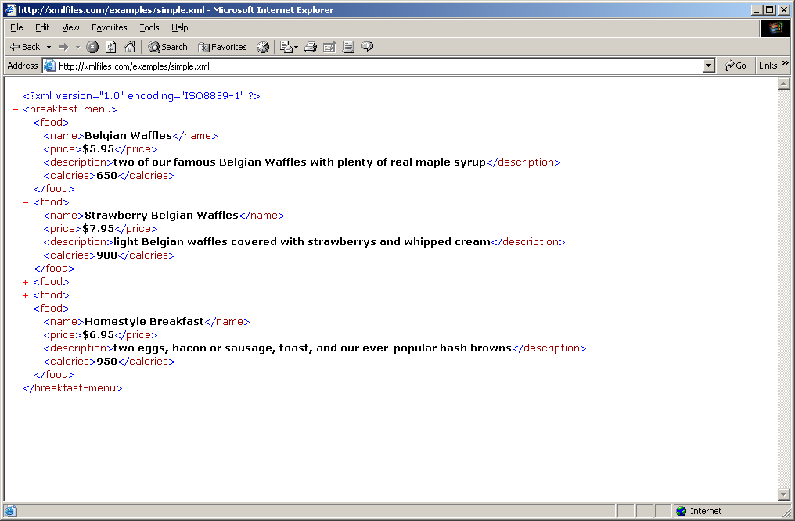
Schema
Anatomy of XML document

Slide 10
<?xml version="1.0" encoding="ISO-8859-1"?>
<?xml-stylesheet href="test_xml.xsl" type="text/xsl"?>
<?cocoon-process type="xslt"?>
<%
String url ="jdbc:oracle:thin:@goedel.newcs.uwindsor.ca:1521:CS01";
Connection connect= null;
ResultSet result = null;
int user=1;
String query="select * from personal";
try{
Class.forName("oracle.jdbc.driver.OracleDriver");
connect = DriverManager.getConnection(url,user,pw);
java.sql.Statement stmt = connect.createStatement();
result=stmt.executeQuery(query);
}
catch (Exception ex) {
ex.printStackTrace();
}
%>
out.println("<breakfast-menu>");
  while(result.next()){
    out.println("<food>");
    out.println("<name>"+result.getString(“name”)+"</name>");
    out.println("<price>"+result.getString(“prices")+"</price>");
    out.println("<description>"+result.getString(“detail")+"</description>");
    out.println("<calories>"+result.getString(“cal")+"</calories>");
    out.println("</food>");
  }
out.println("</breakfast-menu>”);

Slide 11
Section-II Coverage
XML in .NET Framework
XML.NET Architecture
Namespaces and Classes Hierarchy
XmlReader Class
XmlWriter Class
XmlDocument Class
System.Xml.Xsl
Sytem.Xml.XPath

Slide 12
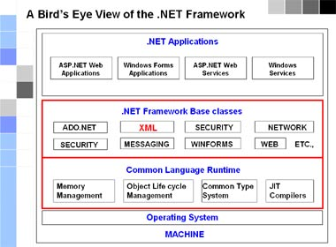
XML in .NET Framework

Slide 13
XML.NET Architecture
XML is extensible in the .NET Framework (extending the existing classes)
In the .NET Framework XML has a pluggabble architecture.
Pluggable ~ abstrract classes can be easily substituted
Pluggable ~ Data can be streamed between components and new components can be inserted that can alter the processing of the document

Slide 14
Pluggable Architecture
Developer can create new classes by extending the existing ones
Can introduce new features and thus changes the behavior of existing ones
e.g. create MyXmlTextReader extending the XmlTextReader class which converts an attribute-centric document to an element-centric document

Slide 15
XML.NET Classes & Namespaces
The Framework has several XML classes that allow working with XML documents and data
These classes are the core elements of .NET Framework
Most of the XML classes are contained in the System.Xml namespace.
The term namespace refers to a logical grouping of the classes designed to implement a specific functionality.

Slide 16
Hierarchy
System.Xml Namespace
XmlReader
XmlDocument
XMlWriter
XmlElement
XmlNavigator
XmlAttribute
System.Xml.XPath
System.Xml .Xsl
System.Xml.Serialization
System.Xml Schema

Slide 17
XML Parsing
General Parsing Models
  Pull Model : forward only
  Push Model: forward only
  Document Object Model (DOM)
Parsing in .NET
  Pull Model
  DOM

Slide 18
XmlReader Class
XmlReader
XmlTextReader
MoveTo()
Read()
XmlNodeReader
XmlValidatingReader
XmlRedare – Abstract Class
XmlTextReader – Reads text based stream, non-cached, read-only
XmlNodeReader – Reads in memory DOM tree
XmlValidatingReader – validates with DTD, XDR XSD schemas

Slide 19
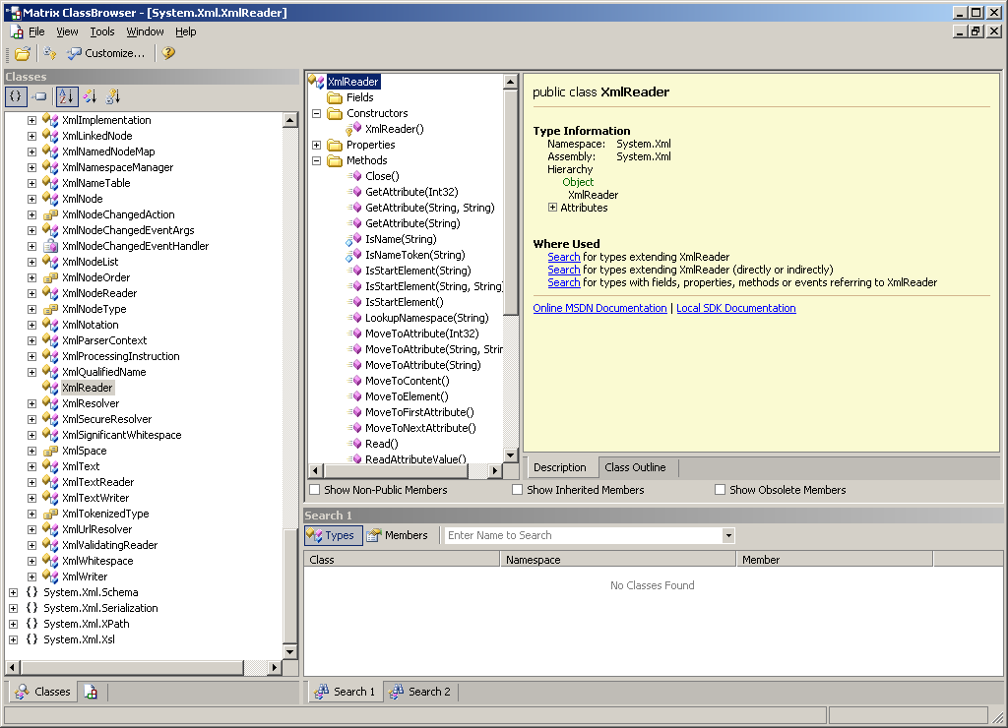

Slide 20
XmlReader Example
XmlReader reader;
Reader = new XmlTextReader(“test.xml”);
While(reader.Read()){
/*
Your processing code here
*/
}

Slide 21
Use of XmlReader using C#
<%@ Import Namespace="System.Data" %>
<%@ Import Namespace="System.Data.SqlClient" %>
<%@ Import Namespace="System.Xml" %>
<script language="C#" runat="server">
void Page_Load(Object s, EventArgs e) {
SqlConnection con = new sqlConnection(ConfigurationSettings.AppSettings["con"]);
SqlCommand cmd = new SqlCommand("SELECT * FROM Employees FOR XML AUTO, ELEMENTS, XMLDATA",con);
con.Open();
XmlReader xr = cmd.ExecuteXmlReader();
while(xr.Read()) {
Response.Write(Server.HtmlEncode(xr.ReadOuterXml()).ToString() + “<br>");
}
con.Close();
}
</script>

Slide 22
VB Script for XmlReader
Imports System
Imports System.Xml
Public Class Form1
Inherits System.Windows.Forms.Form
Private Const filename As String = "c:\books.xml"
public Shared Sub Main(]
Dim reader As XmlTextReader = Nothing
Dim strOut As String
Try
'Point the reader to the data file and ignore all whitespaces
reader = New XmlTextReader(filename)
reader.WhitespaceHandling = WhitespaceHandling.None
'Parse the file and display each of the nodes.
Do While (reader.Read())
Select Case reader.NodeType
Case XmlNodeType.Element
strout = strOut + "<" +reader.Name
If reader.HasAttributes Then
While reader.MoveToNextAttribute()
strOut = strout + "" + reader.Name +" '"+
End While
End If
strOut = strOut + ">"
Case XmlNodeType.Text
strOut= strOut + readerValue
Case XmlNodeType.EndElement
strOut = strOut + "</" + reader.Name
strOut = strPut + ">" +vbCrLf
End Select
Loop

Slide 23
XmlWriter Class
XmlWriter
XmlTextWriter
MoveTo()
Read()
XmlNodeWriter
XmlWriter writer = new XmlTextWriter();
writer.WriteStartDocument();
Writer.WriteStartElement(“name”, “Badar”);

Slide 24
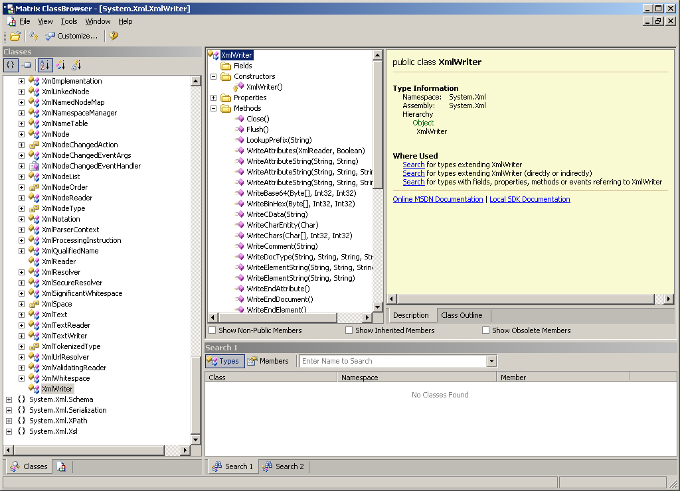
XmlWriter Class Overview

Slide 25
Imports System
Imports System.IO
Imports System.Xml
Public Class From1
Inherits System.Windows.Forms.Form
Private Sub Button1.Click(ByVal sender As System.Object, ByVal e As System.)
DisplayXML()
End Sub
Private Sub DisplayXML()
Dim filename As String = "c:\newbook.xml"
Dim wrt As XmlTextwriter = New XmlTextWriter(filename Nothing)
wrt.Formatting = Formatting.Indented
wrt.WriteStartDocument(True)
wrt.WriteStartComment("Catalog fragment")
wrt.WriteStartElement("books")
wrt.WriteStartElement("book")
wrt.WriteAttributeString(“gener", "", “technology)
wrt.WriteAttributeString("publicationdate", "", 1995)
wrt.WriteAttributeString("ISBN", "", "0-670-77289-5)
wrt.WriteElementString("title", "", "The Road Ahead")
wrt.WriteStartElement("author", "")
wrt.WriteElementString("first-name", "Bill")
wrt.WriteElementString("last-name", "Gates")
wrt.WriteEndElement()
wrt.WriteElementString("price", "29.95")
wrt.WriteEndElement()
wrt.WriteEndElement()
wrt.WriteEndDocument()
wrt.Flush()
wrt.Close()
Dim doc As New XmlDocument()
doc.PreserveWhotesapces = True
doc.Load(filename)
TextBox1.Text = doc.InnerXml
End Sub
End Class
VB code for XmlWriter

Slide 26
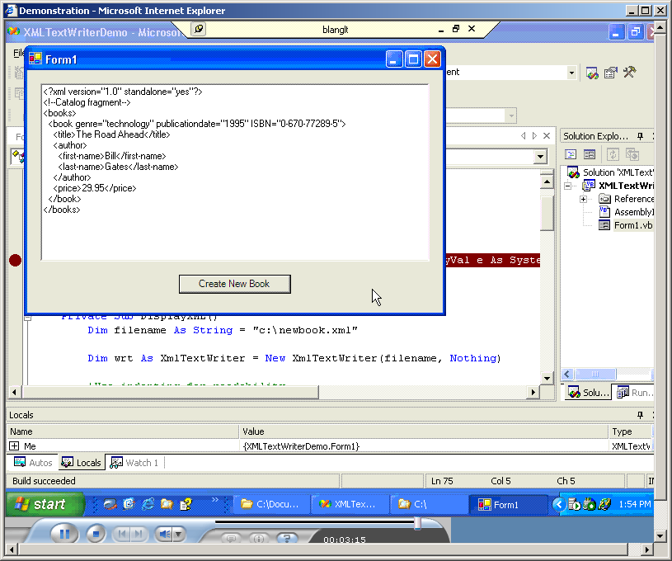
Output in the textbox

Slide 27
C# code for XmlWriter
namespace WriteXML
{ using System;
using System.Xml;
public class BankAccount
{
private const string m_strFileName = "c:\\account.xml";
public static void Main()
//Make sure M is in uppercase in Main() above
{
XmlTextWriter bankWriter = null;
bankWriter = new XmlTextWriter (m_strFileName, null);
try
{
bankWriter.WriteStartDocument();
bankWriter.WriteStartElement("", "BankAccount", "");
bankWriter.WriteStartElement("", "Number", "");
bankWriter.WriteString("1234");
bankWriter.WriteEndElement();
bankWriter.WriteStartElement("", "Type", "");
bankWriter.WriteString("Checking");
bankWriter.WriteEndElement();
bankWriter.WriteStartElement("", "Balance", "");
bankWriter.WriteString("25382.20");
bankWriter.WriteEndElement();
bankWriter.WriteEndElement();
bankWriter.Flush();
}
catch(Exception e)
{
Console.WriteLine("Exception: {0}", e.ToString());
}
finally
{
if (bankWriter != null)
{ bankWriter.Close(); }
}
}
}
}

Slide 28
XmlDocument (DOM)
XmlDocument
XmlNodeList
XmlNamedNodeMap
XmlNodeList – Collection of Different Xml Nodes
XmlNamedNodeMap – collection pf Attributes
Methods
  Laod
  LoadXml
  Save

Slide 29
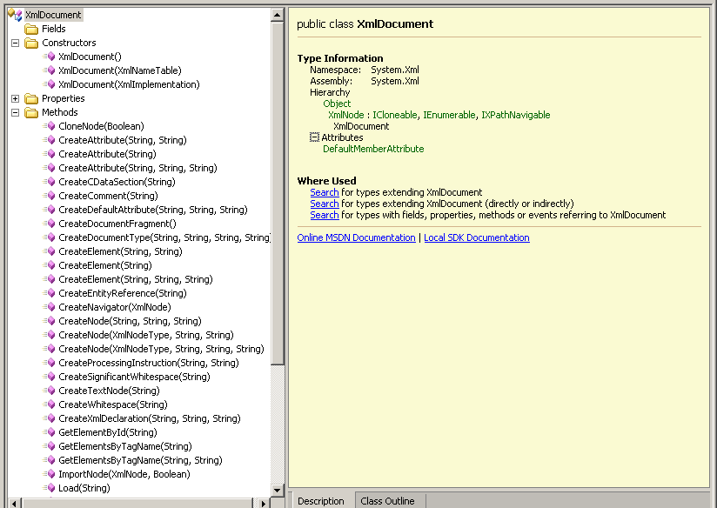

Slide 30
VB code for XmlDocument
Imports System.Xml
Public Class Form1
Inherits System.Window.Forms.Form
Private Sub Button1 Click(ByVal sender As System.Object, ByVal e As System. Object)
'Create a new XMlDocument Class and use the Load method to Load file
Dim myXmlDocument As XmlDocument = New XmlDocument()
myXmlDocument.Load("c:\books.xml")
'Use the XmlNode Object returned by the DocumentElement property
'of the XmlDocument to manipulate an XML node
Dim node As XmlNode
node = myXmlDocument.DocumentElement
'Now we find all the price nodes and then double the value for each book
For Each node In myXmlDocumnet.SelectNode("//price")
Dim price As Decimal
price = System.Decimal.Parse(node.InnerText)
'Doubling the price
Dim newprice As String
newprice = CType(price * 2, Decimal).ToString("#.00")
'Writing change to the document
node.InnerText = newprice
Next
'here we save the altered XML to new file called books2.xml
muXmlDocument.Save("c:\books2.xml")

Slide 31
C# code for XmlDocument
using System;
using System.Xml;
namespace PavelTsekov {
  class MainClass {
    XmlDocument xmldoc;
    XmlNode xmlnode;
    XmlElement xmlelem;
    XmlElement xmlelem2;
    XmlText xmltext;
    static void Main(string[] args) {
      MainClass app=new MainClass();
}
    public MainClass() //constructor {
      xmldoc=new XmlDocument(); //let's add the XML declaration section xmlnode=xmldoc.CreateNode(XmlNodeType.XmlDeclaration,"","");
      xmldoc.AppendChild(xmlnode); //let's add the root element
      xmlelem=xmldoc.CreateElement("","ROOT","");
      xmltext=xmldoc.CreateTextNode("This is the text of the root element");
      xmlelem.AppendChild(xmltext);
      xmldoc.AppendChild(xmlelem); //let's add another element (child of the root) xmlelem2=xmldoc.CreateElement("","SampleElement","");
      xmltext=xmldoc.CreateTextNode("The text of the sample element");
      xmlelem2.AppendChild(xmltext);
      xmldoc.ChildNodes.Item(1).AppendChild(xmlelem2);
      //let's try to save the XML document in a file: C:\pavel.xml
        try { xmldoc.Save("c:\pavel.xml");
        //I've chosen the c:\ for the resulting file pavel.xml }
        catch (Exception e) {
        Console.WriteLine(e.Message);
        }
    Console.ReadLine();
    }
  }
}

Slide 32
XML Transformation
System.Xml.Xsl
  XslTransform – Transforms XML data using XSLT stylesheets
  XsltArgumentList – Allows parameters and extension objects to be invoked from within the stylesheet
  Xsltexception – Returns information about the last exception thrown while processing an XSL transform

Slide 33
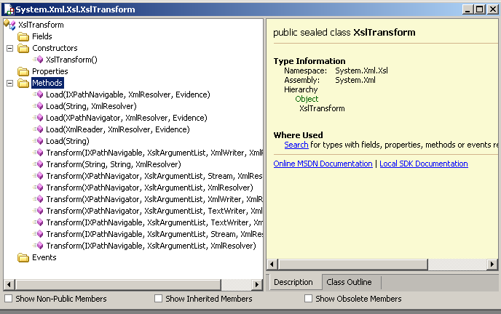
XslTransform Class

Slide 34
XslTranform
book.xsl
==============================================================================================================
<xsl:stylesheet xmlns:xsl=http://www.w3.org/1999/XSL/Transform version=“1.0”>
<xsl:template match="bookstore"/>
<xsl:template match=“/">
<HTML>
<BODY>
<TBALE BORDER="2">
    <TR>
    <TD>ISBN</TD>
    <TD>Title</TD>
    <TD>Price</TD>
    </TR>
    <xsl:apply-template select="book">
    <xsl:sort select="@ISBN"/>
    </xsl:apply-tempalet>
    <xsl:for-each select=“book”>
    <TR>
    <TD><xsl:value-of select="@ISBN"/></TD>
    <TD><xsl:value-of select="title"/></TD>
    <TD><xsl:value-of select="price"/></TD>
    </TR>
    </xsl:for-each>
    </TABLE>
    </BODY>
  </HTML>
</xsl:template>
</xsl:stylesheet>
==============================================================================================================

Slide 35
VB code for XslTransform
Imports System
Imports System.IO
Imports System.Xml
Imports System.Xml.XPath
Imports System.Xml.Xsl
Imports System.Net
Public Class Form1
Inherits System.Windows.Forms.Form
Dim filename As String = "c:\books.xml"
Dim stylesheet As String = "c:\book.xsl"
Private Sub Button1_click(ByVal sender As System.Object, ByVal e As System.EventArgs) Handle Button1.Click
Dim xslt As XslTransform = New XslTransform()
xslt.Load(stylesheet)
Dim doc As XPathDocument = New XPtahDocument(filename)
Dim writer As XmlTextWriter = New XmlTextWriter("c:\sortedbooks.html", Nothing)
xslt.Transform(doc, Nothing, writer)
writer.Close()
End Sub
End Class

Slide 36
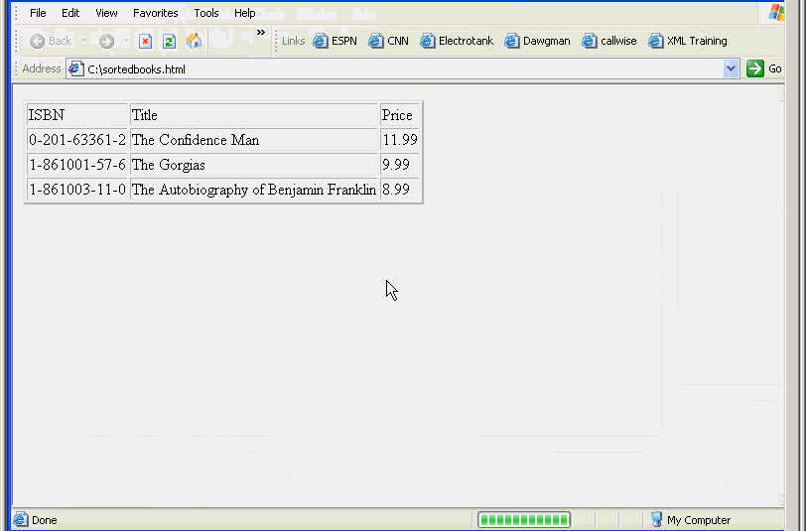
Output in HTML

Slide 37
Xpath Query in .NET
Used to specify query expressions to locate nodes in XML document
Used in XSLT stylesheets to locate and apply transformation to specific nodes in an XML document
Used in DOM code to locate and process specific nodes in an XML document

Slide 38
System.Xml.XPath
Key Classes
  XPathDocument
  XpathNavigator
  XPathNodeIterator
  XPathExpression

Slide 39
Code of the XPath Query
Private Sub Button1_click(ByVal sender As System.Object, ByVal e As System.EventArgs) Handles Button1.Click
Dim PlatoBookList As XmlNodeList
Dim PlatoBook As XmlNode
Dim strOut As String
PlatoBookList =xmldoc.SelectNOdes("//last-name[.='Plato']/ancestor::node()/title")
strOut = strOut +"Books written by Plato:"+vbCrLf
strOut = strOut +"***********************"+vbCrLf
For Each PlatoBook In PaltoBookList
strOut = strOut +PlatoBook.InnerText.vbCrLf
Next
MsgBox(strOut)
End Sub

Slide 40
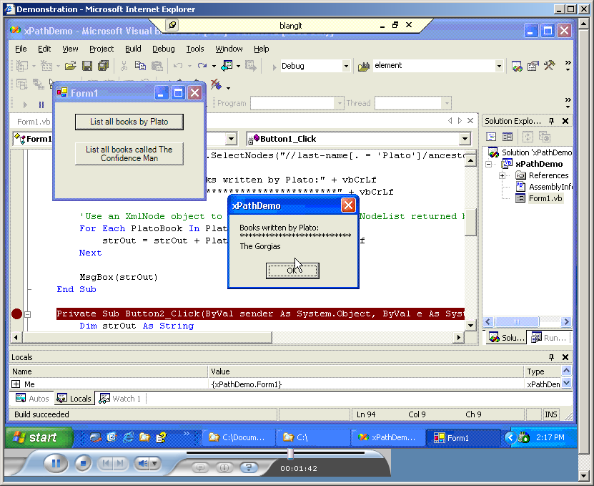
Query Output

Slide 41
XML and ADO.NET
In .NET Framework tight integration has been introduced between XML classes and ADO.NET
The DataSet components are able to read and write XML using XmlRead and XmlWrite Classes
There is a synchronization between XmlDocument and DataSet, which enables automatic update
XmlDataDocument (extension of XmlDocument) provides a bridge between relational and hierarchical data

Slide 42
References
Book
Employing XML in .NET Framework http://msdn.microsoft.com/library/default.asp?url=/nhp/default.asp?contentid=28000438
XML – Module 1: Introduction to the Core .Net Framework XML Namesapces and Classes
by Bill Lange (Online Seminars) http://msdn.microsoft.com/library/default.asp?url=/seminar/mmcfeed/mmcdisplayfeed.asp?lang=en&product=103337&audience=100402
by Roger Wolter Microsoft Corporation
http://msdn.microsoft.com/library/default.asp?url=/library/en-us/dnwebsrv/html/webservbasics.asp

