Slide 1
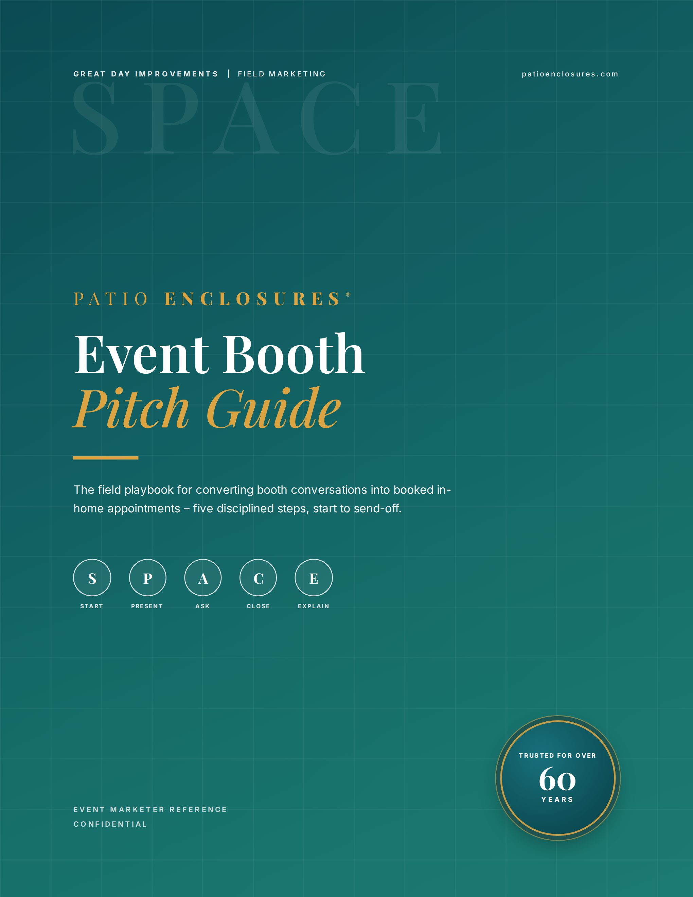
Notes:
⏱ TIMING: 1 minute | Slide 1 of 20 — Cover
Welcome everyone. Today's session is built around one goal: giving you a repeatable system to turn every booth conversation into a booked in-home appointment. The tool is called the SPACE method — five disciplined steps from the moment someone stops at your booth to the moment they walk away with an appointment confirmed. This isn't a motivation talk. It's a playbook. By the end of this hour you'll have the script, the objection responses, the setup standards, and the product knowledge to execute it at any event.
📋 QUICK RECAP: SPACE = Start → Present → Ask → Close → Explain. Each step earns the next.
❓ ENGAGEMENT QUESTION (to open): "Before we dive in — on a scale of 1 to 5, how confident do you feel right now walking up to a stranger at a booth and starting a conversation? Drop your number in the chat. We'll come back to that number at the end." [Let answers come in — acknowledge the range, then move on.]

Slide 2
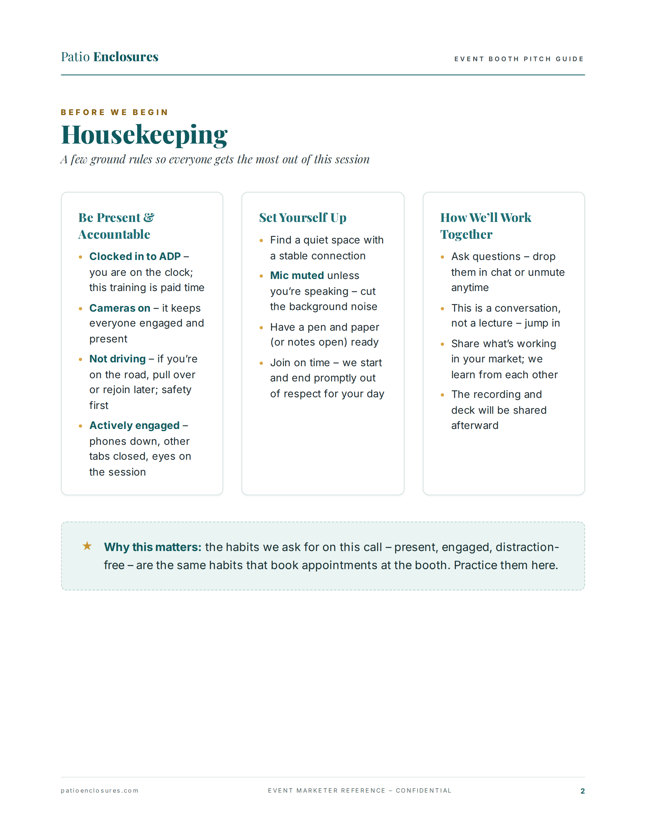
Notes:
⏱ TIMING: 2 minutes | Slide 2 of 20 — Housekeeping
A few ground rules before we start. Clock in using the ADP app — this is paid training time. Cameras on — it keeps everyone engaged and models the presence we're going to talk about at the booth. If you're driving, pull over or rejoin later. Have a pen handy or notes open because this moves fast. Mics muted unless you're speaking. And this is a conversation — not a lecture. Jump in, push back, share what's working in your market.
Here's the connection I want to make right now: the habits on this slide — present, engaged, distraction-free — are the exact habits that book appointments at the booth. You're practicing them right now whether you realize it or not. The recording and deck will be shared after the session.
❓ ENGAGEMENT QUESTION: "Where is everyone joining from today? Drop your city or market in the chat — I want to know what kind of events you're working." [Read a few aloud. Creates community and market context early.]

Slide 3
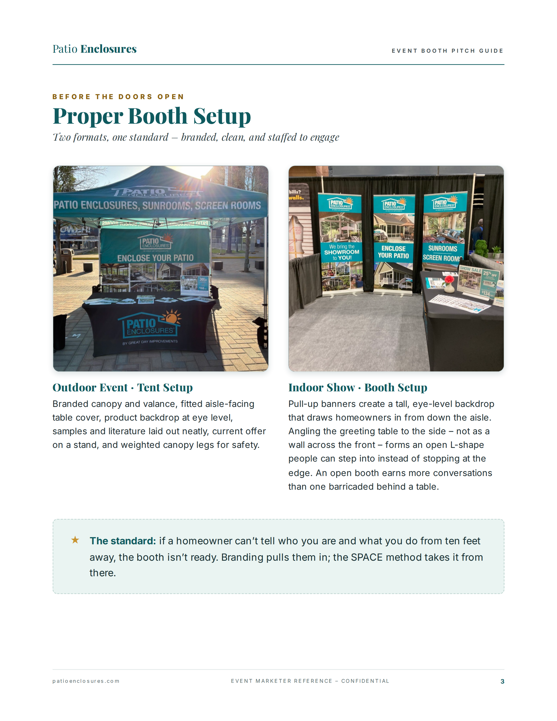
Notes:
⏱ TIMING: 2 minutes | Slide 3 of 20 — Proper Booth Setup
Before the SPACE method can do any work, the booth has to do its job first. A homeowner decides in about three seconds whether to stop — before you say a single word. So branding is your first pitch. These are the two formats you'll run: outdoor tent events and indoor home shows. Both follow the same standard — branded, clean, and open. For outdoor: branded canopy and valance, fitted table cover, product backdrop at eye level, literature neat and accessible, weighted legs for safety. For indoor: pull-up banner walls at eye level creating a tall backdrop, table angled to the side to form an L-shape people can step into rather than a wall they stop at the edge of. The L-shape is key — it creates a space people enter, not a counter they stand at.
The standard is non-negotiable: if a homeowner can't tell who you are and what you do from ten feet away, the booth is not ready. Branding pulls them in. SPACE takes it from there.
❓ ENGAGEMENT QUESTION: "Has anyone had a booth setup issue that you think cost you a conversation — maybe a canopy that wasn't weighted, a messy table, banners that fell? What happened?" [Collect 1–2 stories. Reinforces the standard with real consequences.]

Slide 4
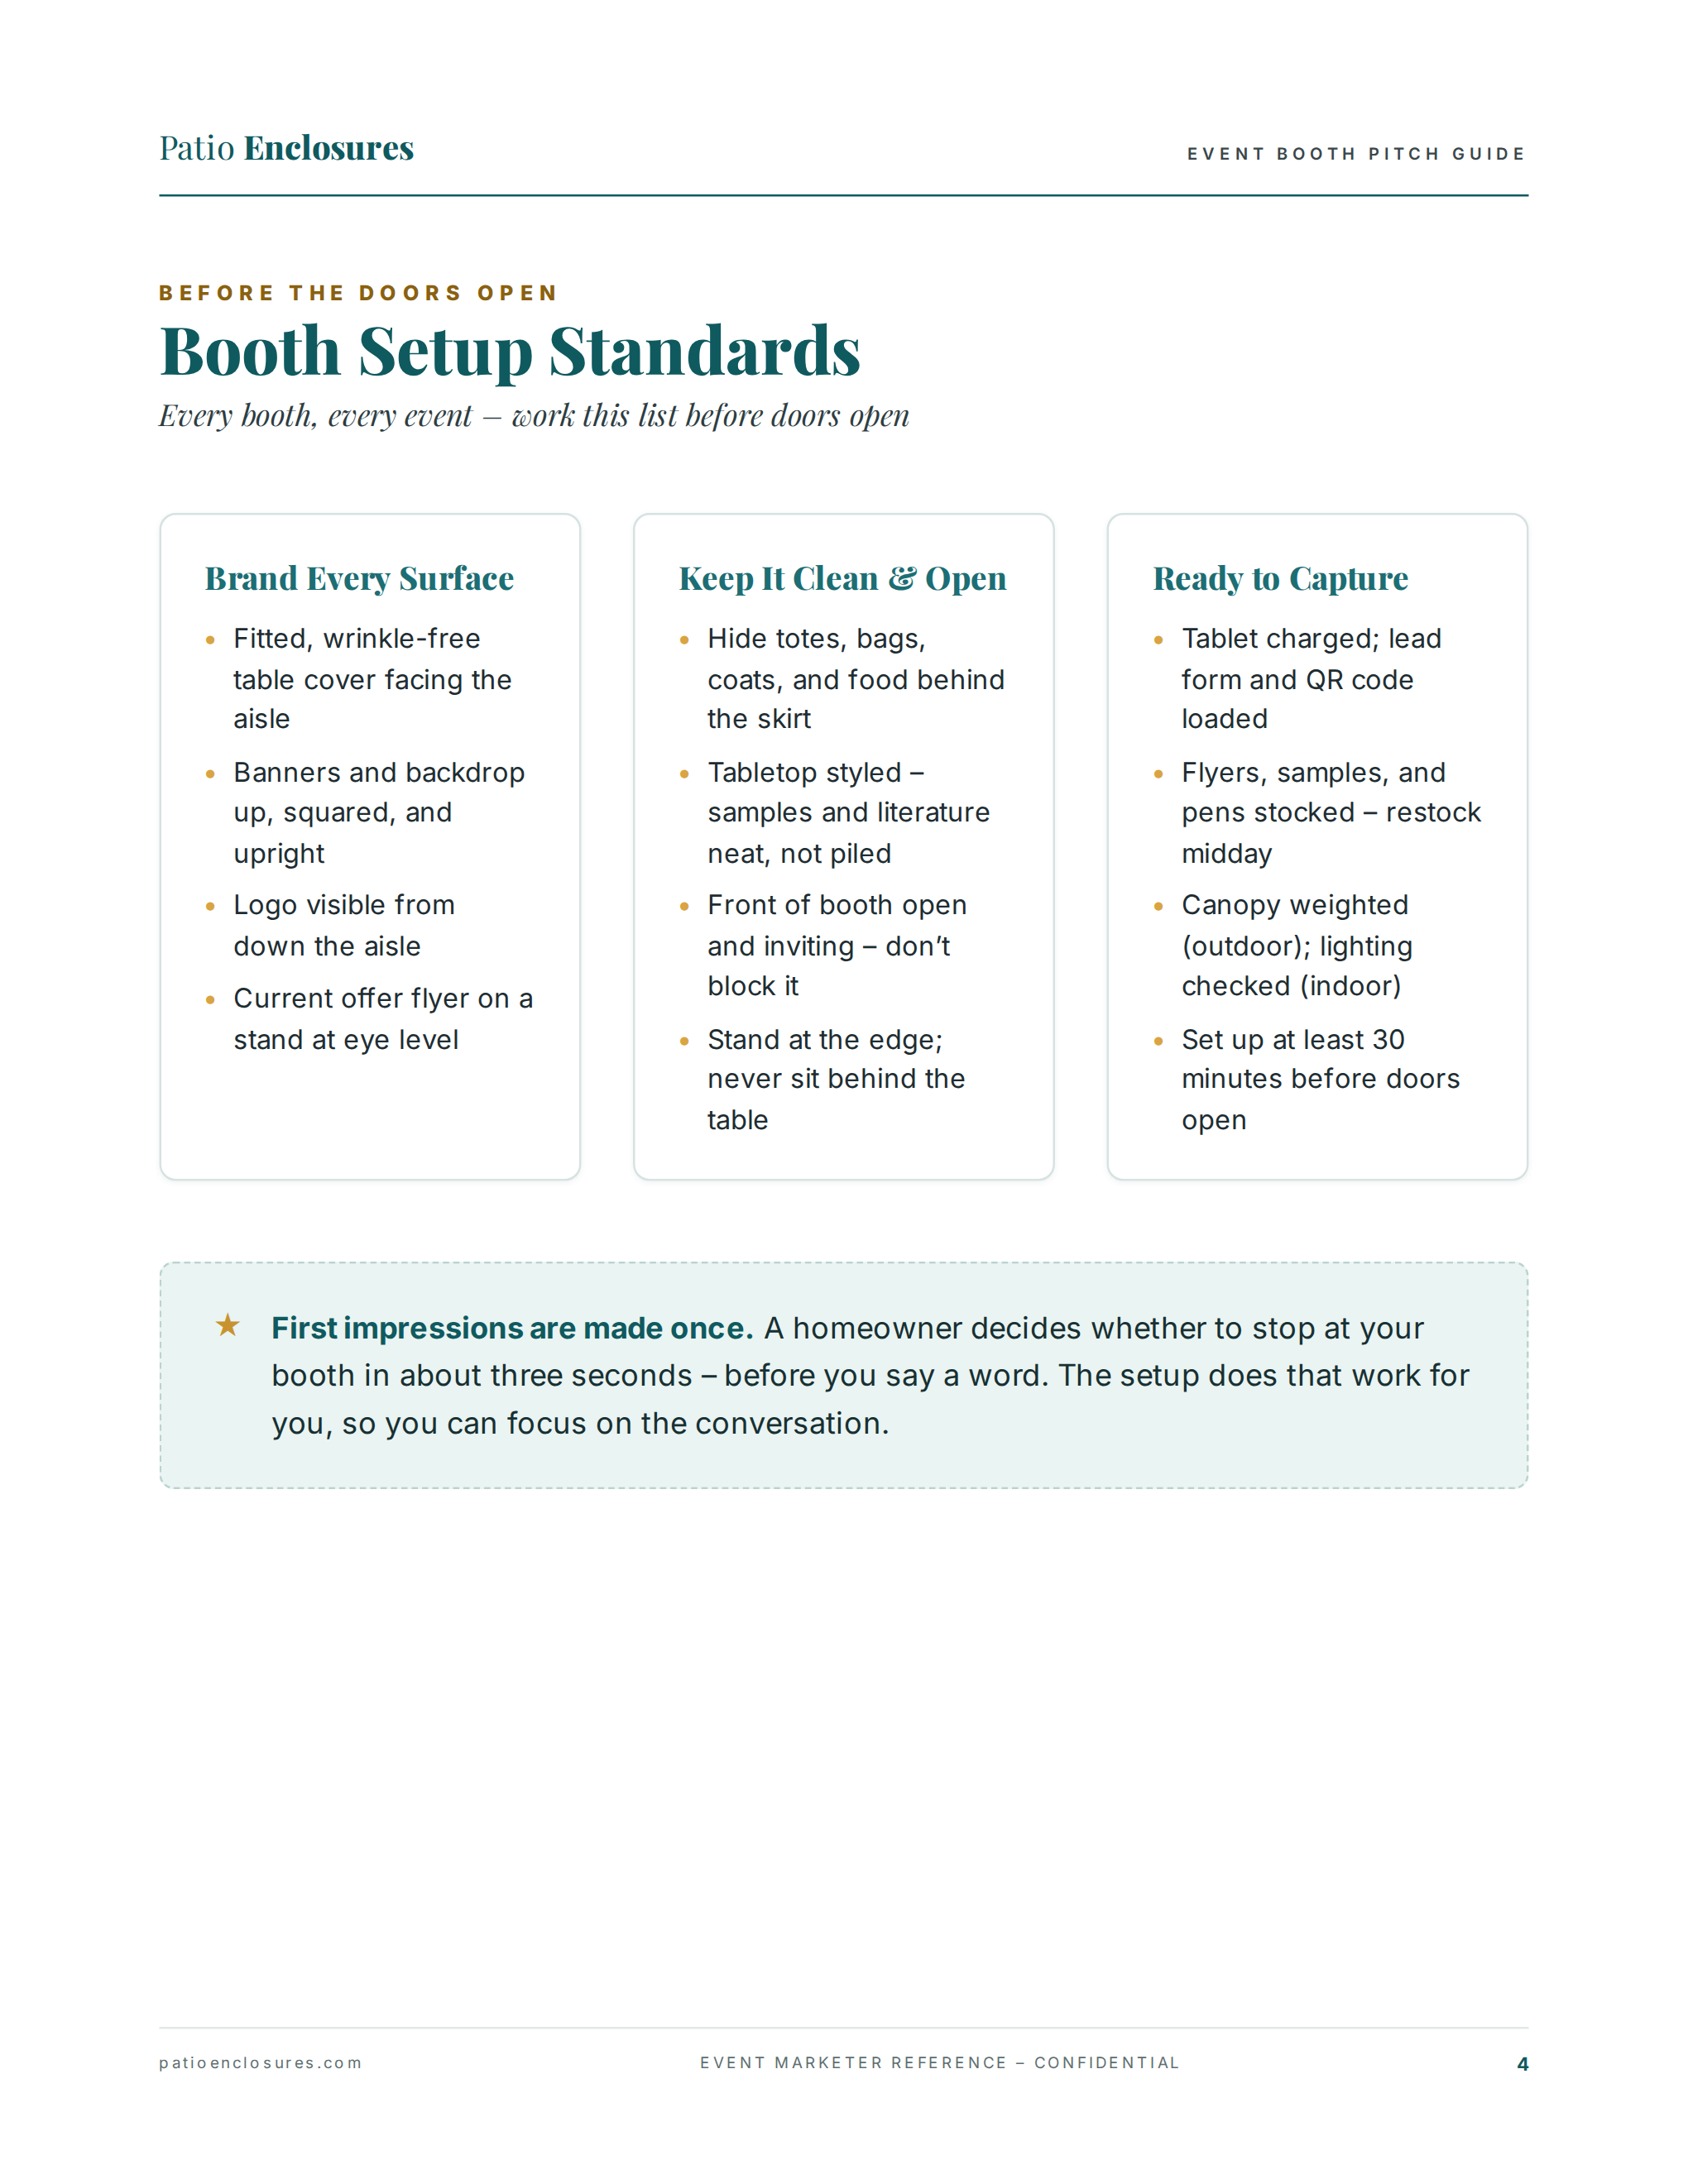
Notes:
⏱ TIMING: 2 minutes | Slide 4 of 20 — Booth Setup Standards
Every booth, every event — work this checklist before doors open. Three categories: Brand Every Surface, Keep It Clean and Open, and Ready to Capture. Under Branding: fitted wrinkle-free table cover facing the aisle, banners up and squared, logo visible from down the aisle, current offer flyer at eye level. Under Clean and Open: personal items hidden — totes, bags, food all behind the skirt — tabletop neat not piled, front of booth open and inviting, and critically: stand at the edge of the booth, never sit behind the table. Under Ready to Capture: tablet charged, lead form and QR code loaded and tested, flyers and samples stocked — restock midday, canopy weighted outdoors, lighting checked indoors, and setup complete at least 30 minutes before doors open.
First impressions are made once. That three-second window is happening constantly at an event — dozens of times an hour. The setup does that work for you so you can focus on the conversation.
❓ ENGAGEMENT QUESTION: "Quick check — which of these three areas do you think is most often the weak spot at events in your market: branding, keeping it clean and open, or being ready to capture? Drop it in the chat." [Acknowledge the pattern — usually "clean and open" or "ready to capture." Reinforces awareness without blame.]

Slide 5
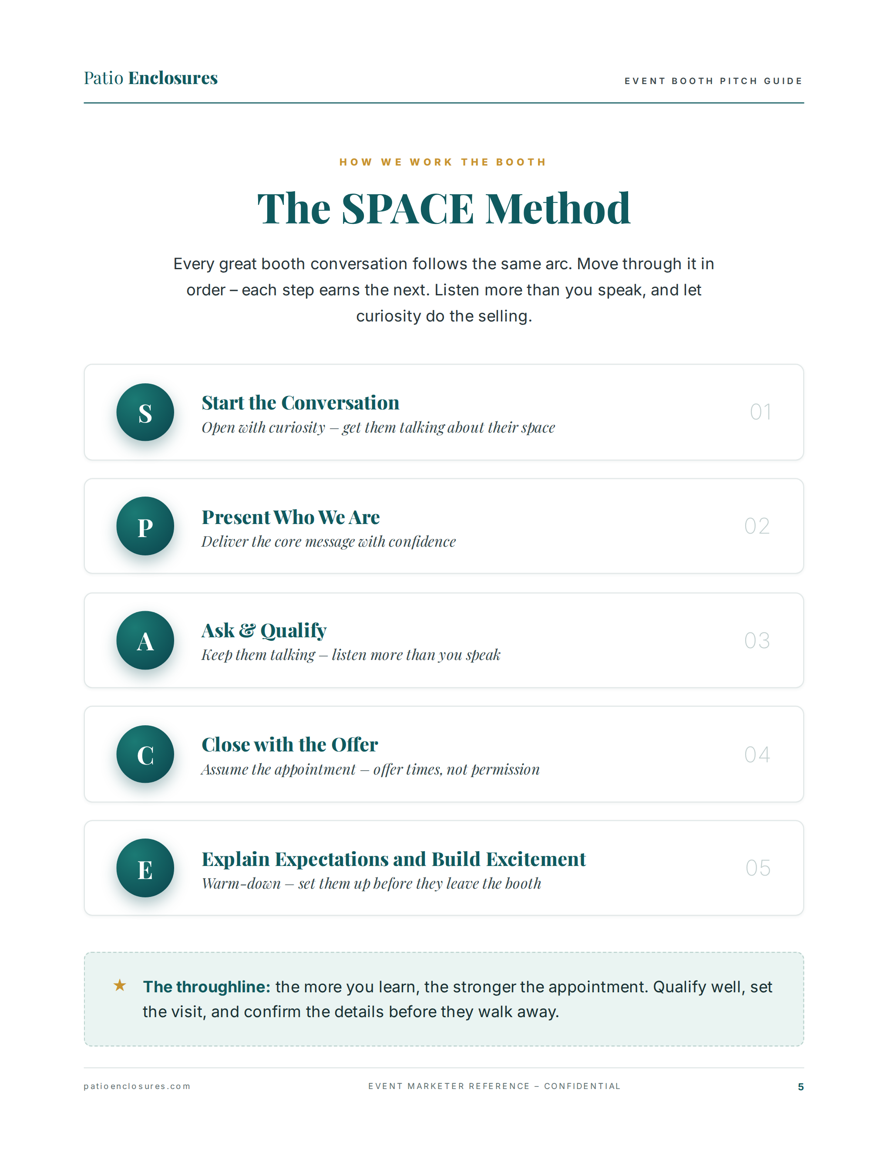
Notes:
⏱ TIMING: 2 minutes | Slide 5 of 20 — The SPACE Method Overview
Everything we're going to cover for the next 35 minutes lives inside these five steps. S — Start the Conversation: open with curiosity, get them talking about their space. P — Present Who We Are: deliver the core message with confidence. A — Ask and Qualify: keep them talking, listen more than you speak. C — Close with the Offer: assume the appointment, offer times not permission. E — Explain Expectations and Build Excitement: set them up before they leave the booth. Move through these in order — each step earns the next. Don't skip steps. Don't rush to C before you've done A. The throughline is this: the more you learn, the stronger the appointment. Qualify well, set the visit, and confirm the details before they walk away.
❓ ENGAGEMENT QUESTION: "Which of these five steps do you think is hardest in real life at a booth — and why? Drop your letter in the chat: S, P, A, C, or E." [Collect answers — likely C or S. Use their answers to preview what's coming: "Good — we're going to spend the most time on the ones you flagged."]

Slide 6
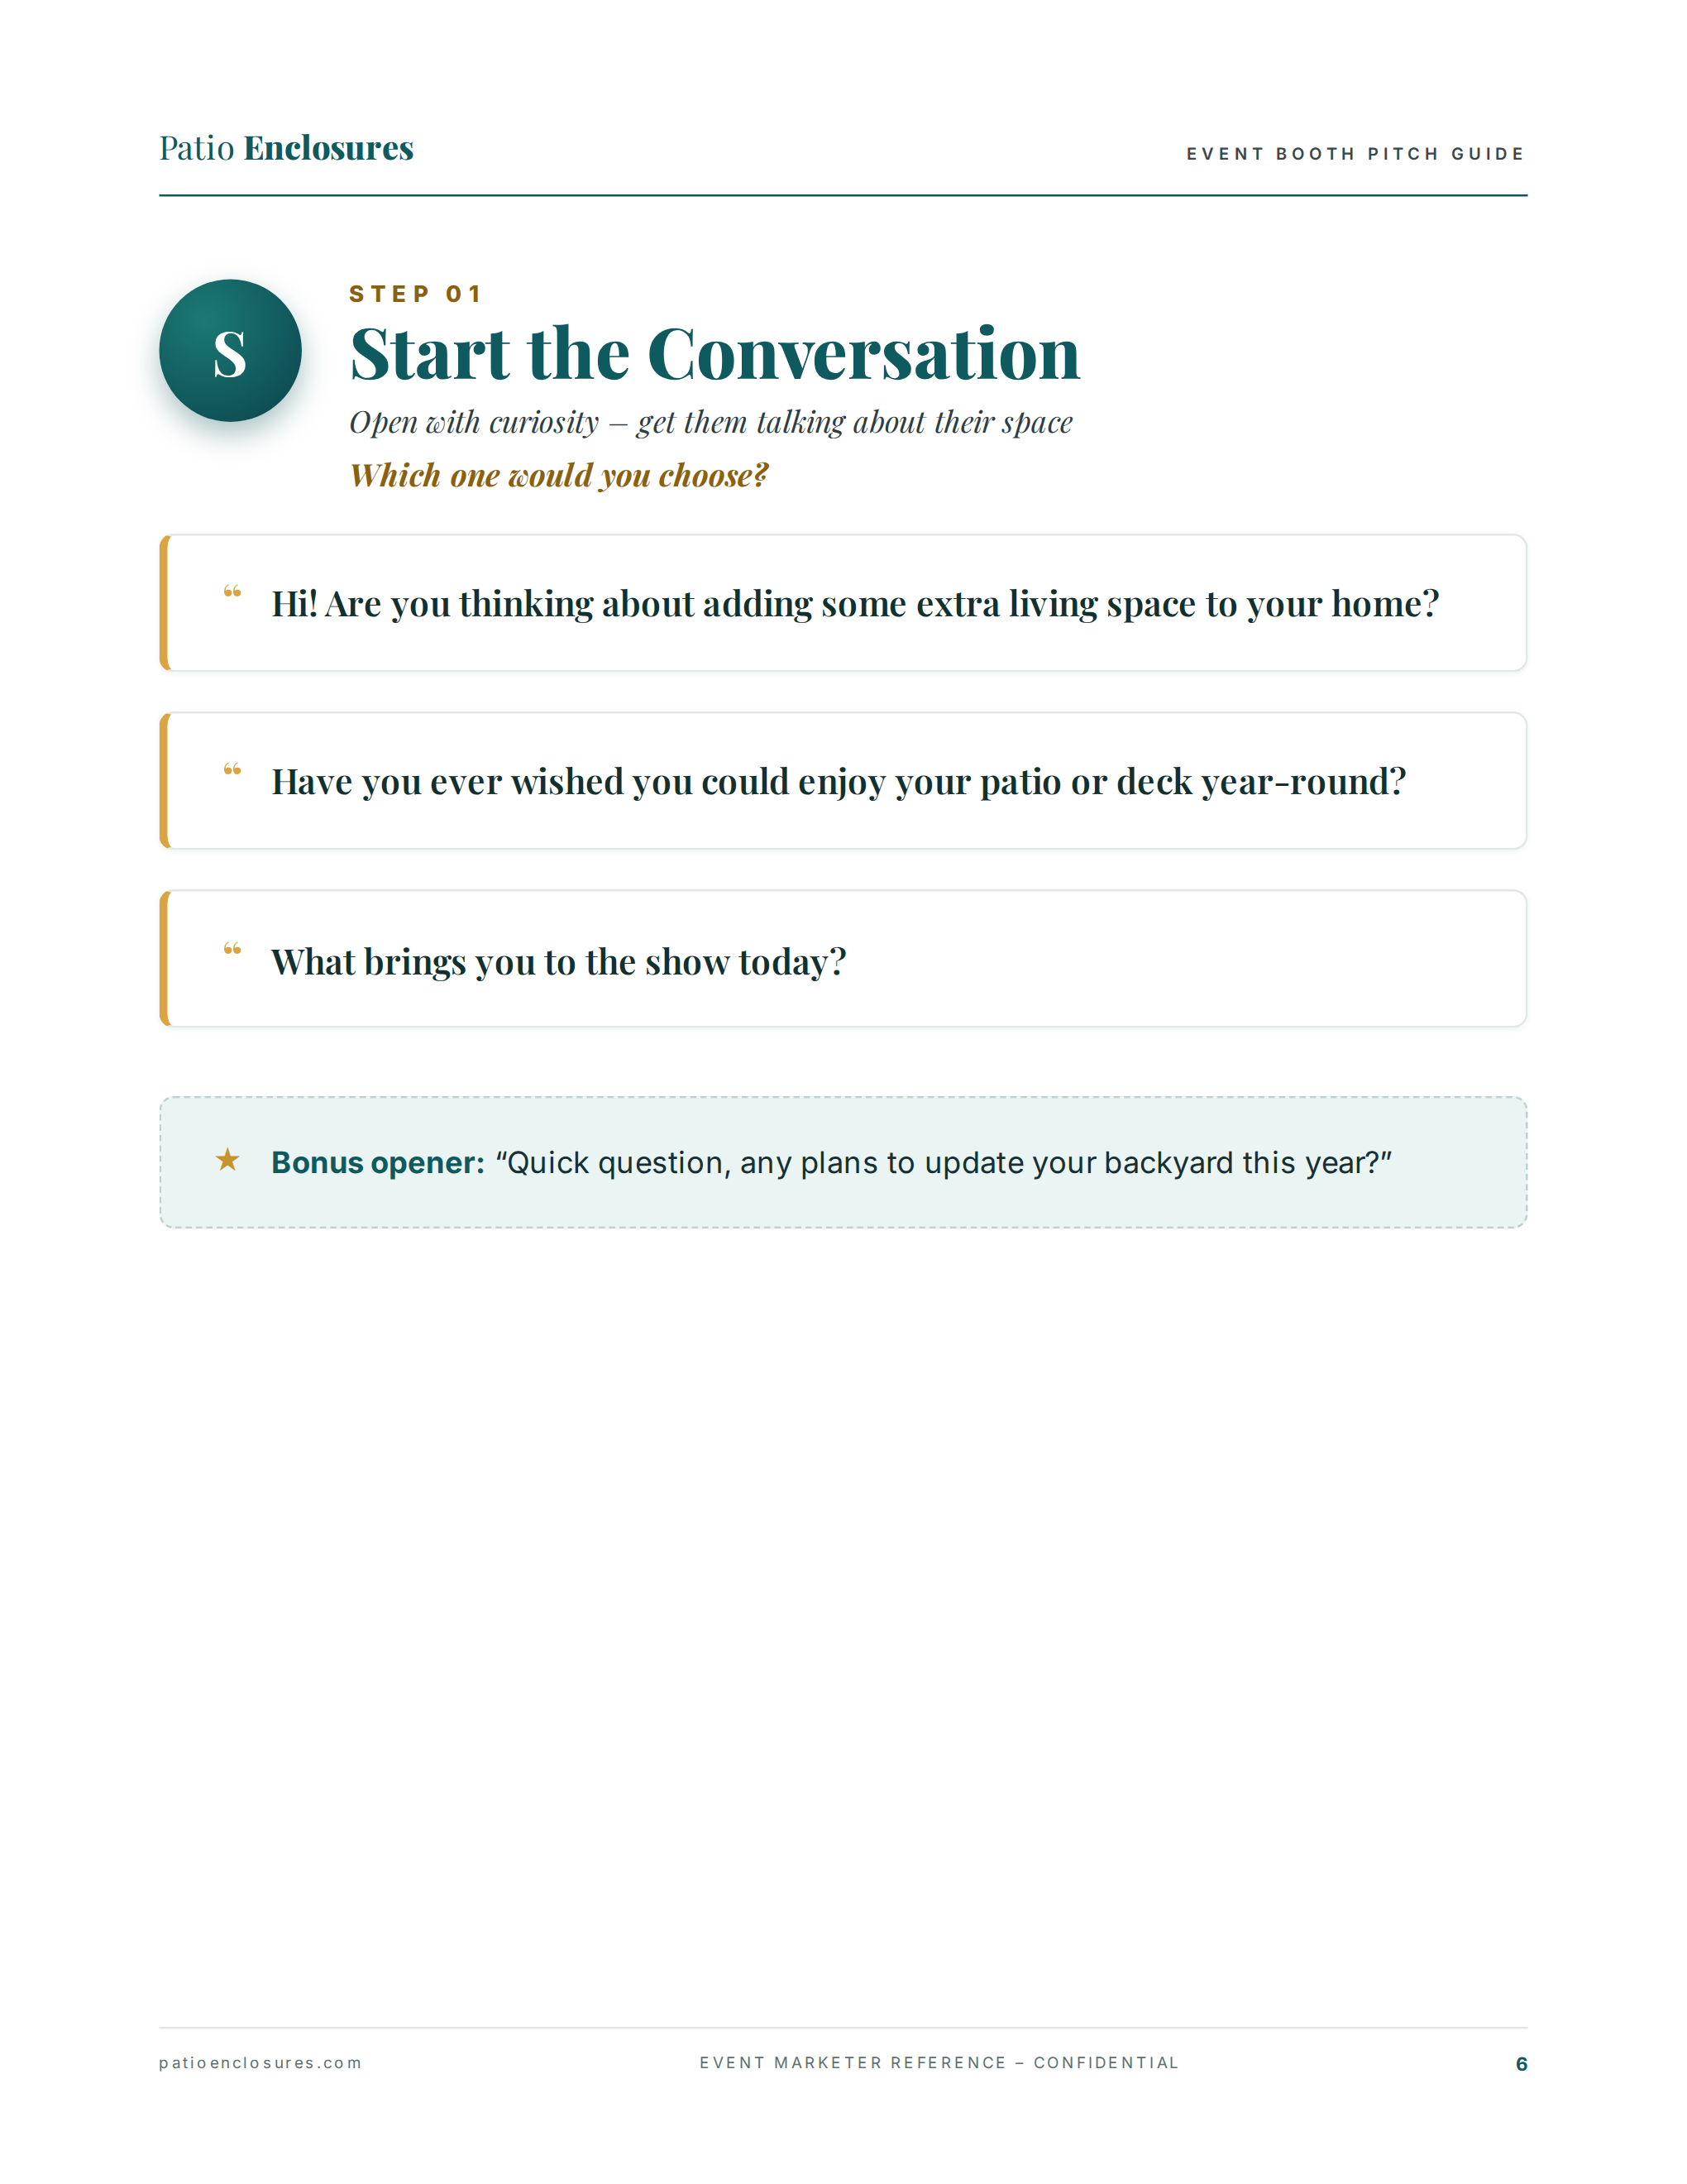
Notes:
⏱ TIMING: 4 minutes | Slide 6 of 20 — S: Start the Conversation
Step one is the hardest for most people — breaking the ice with a stranger in a busy event environment. The slide shows three proven openers. Option one: "Hi! Are you thinking about adding some extra living space to your home?" — this leads with the dream, not the product. Option two: "Have you ever wished you could enjoy your patio or deck year-round?" — this leads with a felt need. Option three: "What brings you to the show today?" — this is a universal catch-all that works anywhere. And the bonus opener at the bottom is deliberately low-stakes: "Quick question — any plans to update your backyard this year?" Anyone can answer that. It sounds like a neighbor chatting, not a sales pitch.
The key to all of these is that they are questions, not pitches. You are not leading with who you are, what you sell, or what's on special. You're leading with curiosity about them. That's what earns the next 30 seconds.
❓ ENGAGEMENT QUESTION: "I want each of you to pick your favorite opener from this slide — or tell me the one you actually use at events. Drop it in the chat." [Read 2–3 aloud. If someone shares a different opener that works, validate it. Then ask:] "Now — say it out loud to yourself right now. Just say it. If you're comfortable, unmute and say it to the group." [Aim for at least one person to model it aloud. Normalizes practicing out loud.]

Slide 7
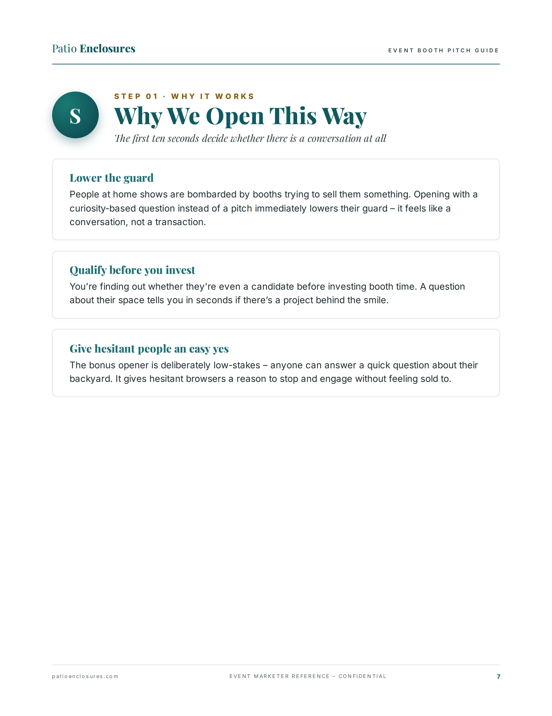
Notes:
⏱ TIMING: 3 minutes | Slide 7 of 20 — Why We Open This Way
The first ten seconds of a booth conversation determine whether there is a conversation at all. Here's why this approach works. First — it lowers the guard. People at home shows are constantly being pitched. Opening with a question about their space signals conversation, not transaction. They exhale. Second — it qualifies before you invest. A question about their backyard tells you in seconds whether there's a project behind the smile, or whether this person is just enjoying the show. You stop spending your whole day talking to people who aren't candidates. Third — it gives hesitant people an easy yes. The bonus opener is deliberately the lowest-stakes question imaginable. Anyone can say yes or no to "any plans to update your backyard?" That answer tells you whether to keep going or let them move on gracefully.
❓ ENGAGEMENT QUESTION: "Think about the last event you worked. What percentage of the people who stopped at your booth do you think were actually candidates — meaning homeowners with a real project in mind? Ballpark it." [Collect answers. The range is usually 20–40%. Use it to reinforce the value of qualifying fast.]

Slide 8
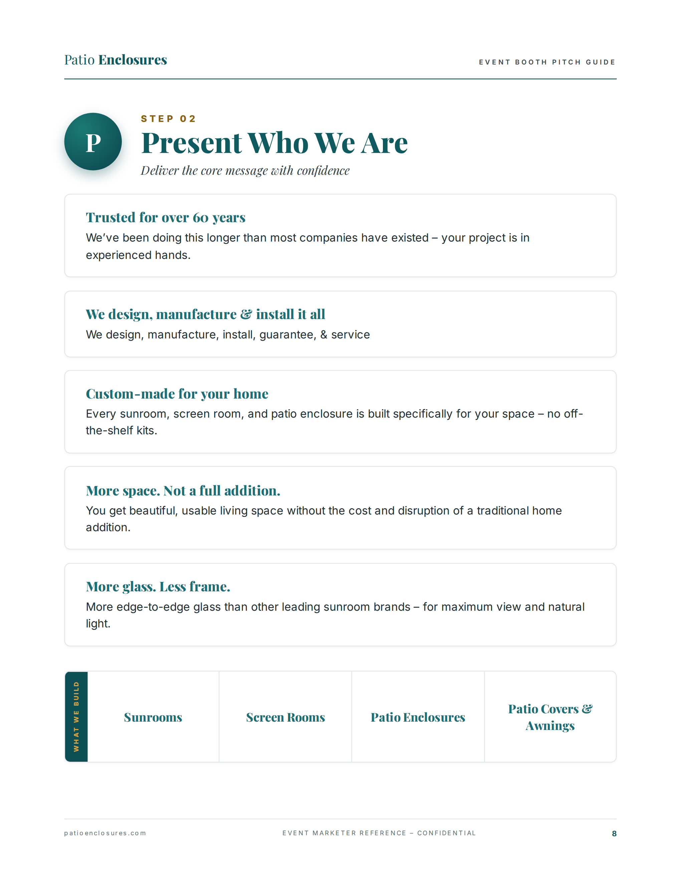
Notes:
⏱ TIMING: 4 minutes | Slide 8 of 20 — P: Present Who We Are
Once someone is engaged, you have a window to deliver our core message. These are the five points — and they have to land with confidence, not be read off a screen. Walk through each one: We've been doing this for over 60 years — your project is in experienced hands. We design, manufacture, install, guarantee, and service everything ourselves — no middlemen. Every sunroom, screen room, and patio enclosure is built specifically for your home — no off-the-shelf kits. We give you beautiful, usable living space without the cost and disruption of a traditional home addition. And we have more glass and less frame than other leading sunroom brands, for maximum view and natural light. At the bottom, the four things we build: Sunrooms, Screen Rooms, Patio Enclosures, and Patio Covers and Awnings.
These five points should flow in under 45 seconds. You're not reading them — you're saying them. Practice them until they're automatic.
❓ ENGAGEMENT QUESTION: "Without looking at the slide — can someone tell me one of the five core messages from memory? Unmute or drop it in chat." [See who can recall one. Praise accuracy. If someone stumbles, prompt them gently and reinforce: "That's exactly why we practice. These need to be automatic at the booth."]

Slide 9
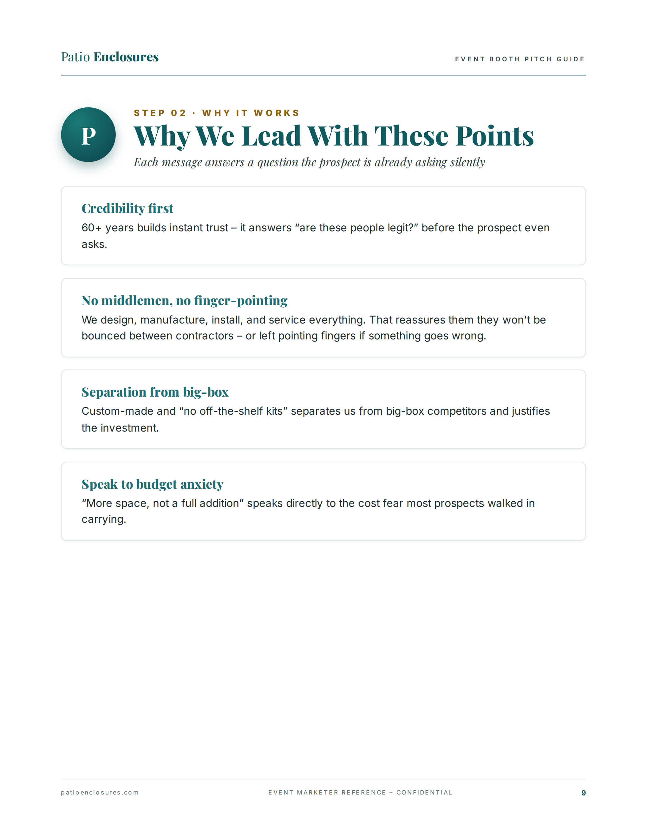
Notes:
⏱ TIMING: 3 minutes | Slide 9 of 20 — Why We Lead With These Points
Each of those five messages answers a question the prospect is already asking silently — they just haven't said it out loud yet. Credibility first: 60-plus years instantly answers "are these people legit?" before the prospect even thinks to ask. No middlemen, no finger-pointing: designing, manufacturing, installing, and servicing everything ourselves tells them they won't be bounced between contractors if something goes wrong. Separation from big-box: custom-made and no off-the-shelf kits is the sharpest line between us and a big-box store — and it justifies the investment. Speak to budget anxiety: "more space, not a full addition" directly addresses the cost fear most prospects walked in carrying. They thought they couldn't afford what they want. That line reframes the conversation before they can say "we can't afford it."
❓ ENGAGEMENT QUESTION: "Which of those four silent questions do you hear most often as an actual spoken objection at the booth? Cost concerns? Credibility? Contractor worries?" [Let 1–2 people respond. Bridge to the objection handling slide later: "We'll come back to handling those in detail — hang on to that."]

Slide 10
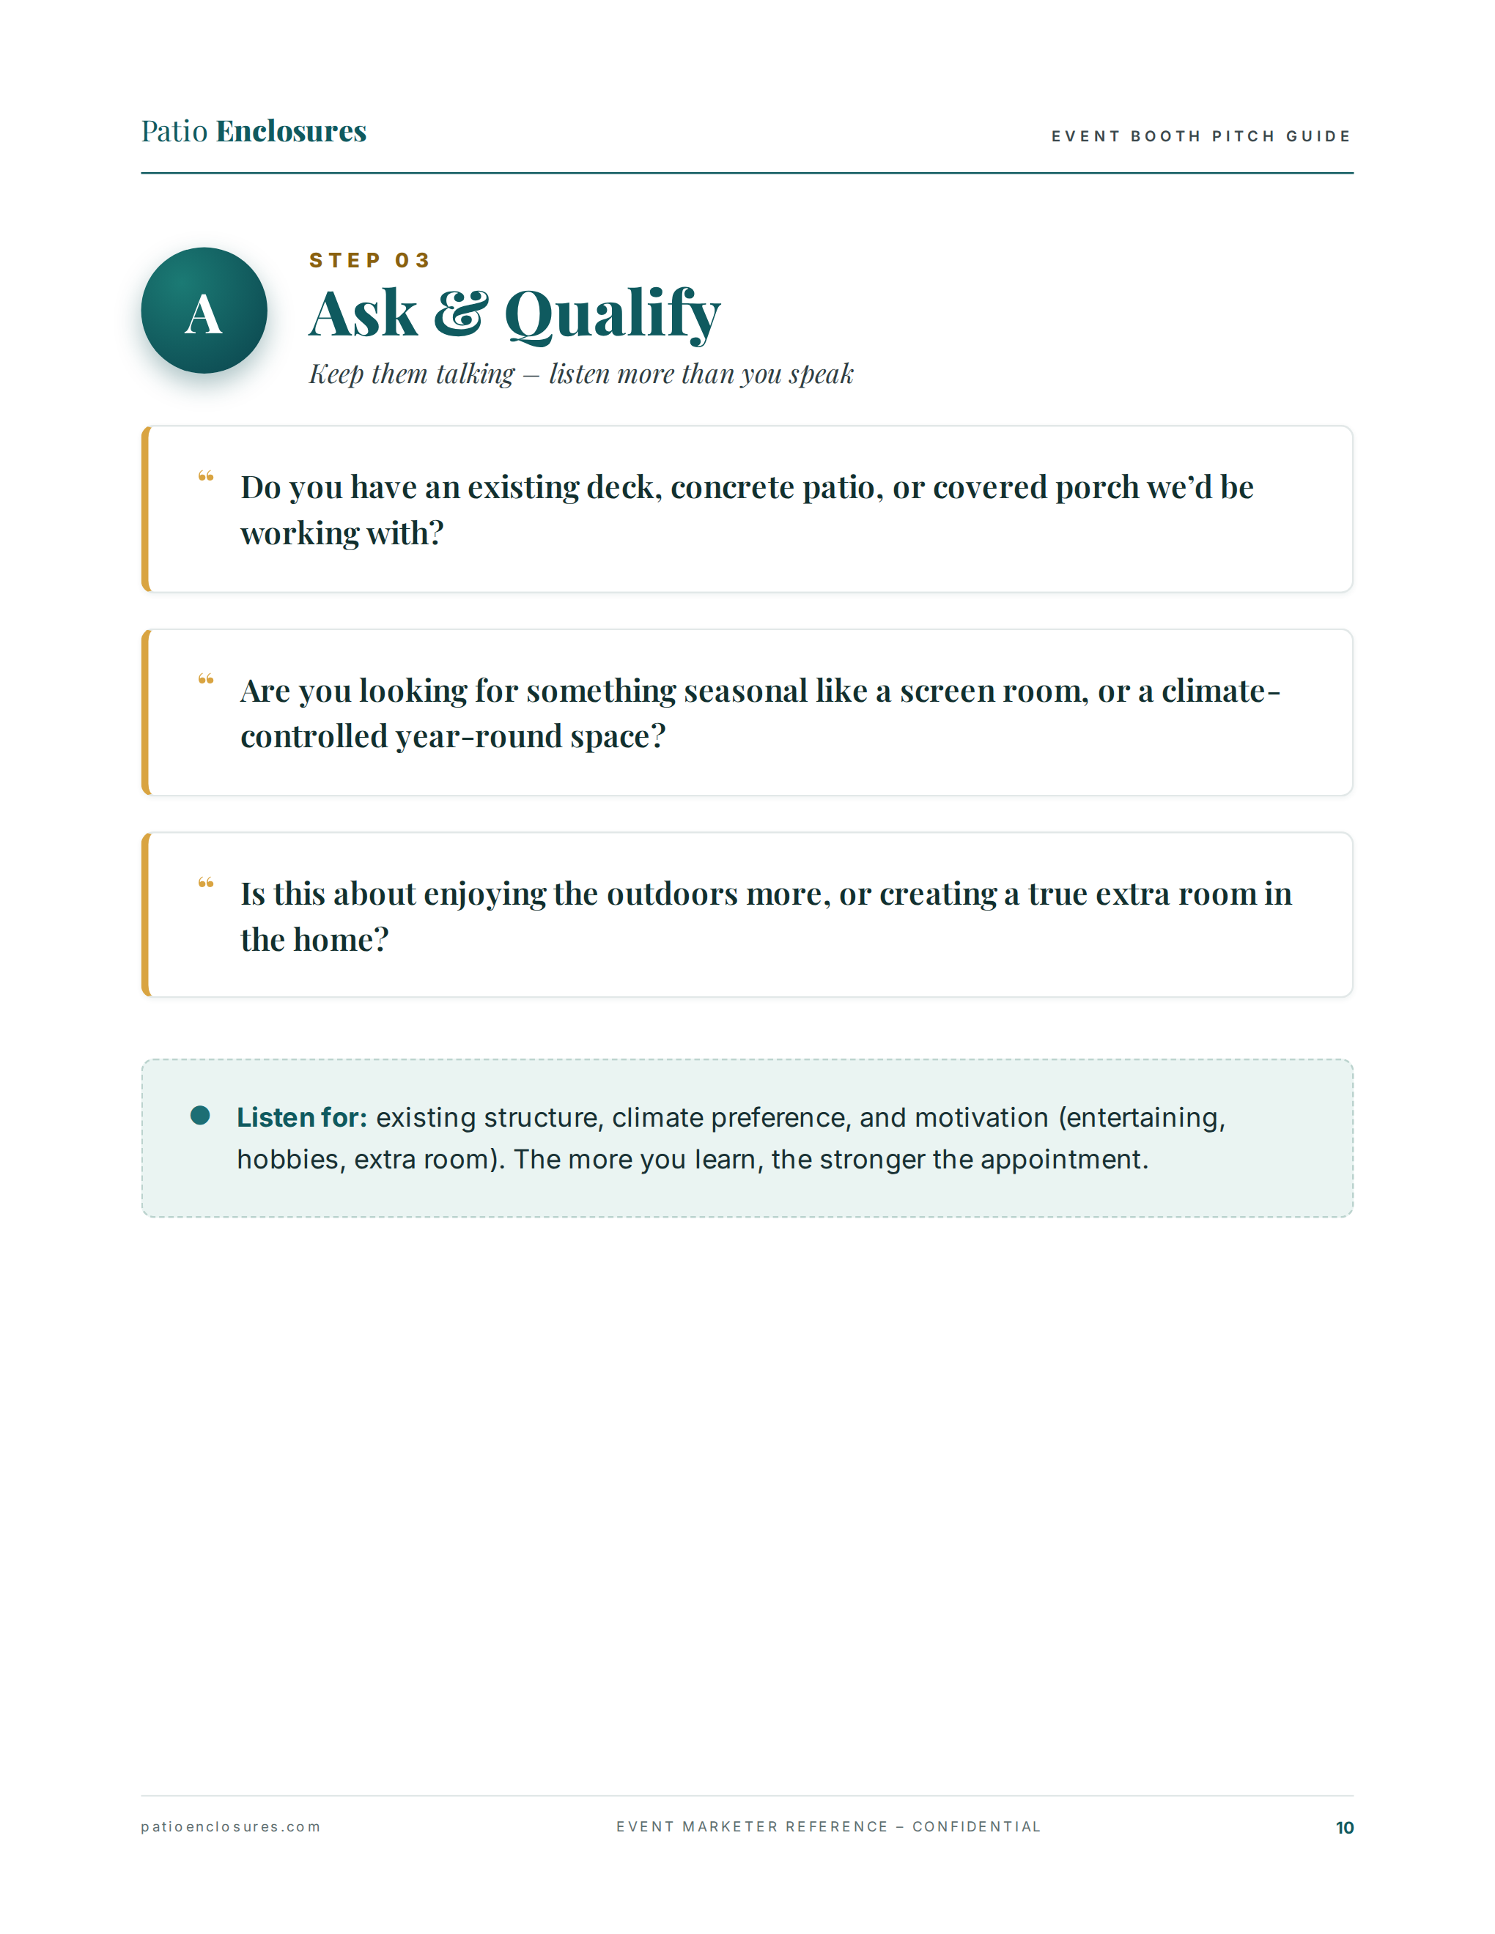
Notes:
⏱ TIMING: 4 minutes | Slide 10 of 20 — A: Ask and Qualify
Step three is where most appointments are won or lost — and most people rush through it. These three questions are your toolkit. First: "Do you have an existing deck, concrete patio, or covered porch we'd be working with?" — this tells you what structure you're starting from. Second: "Are you looking for something seasonal like a screen room, or a climate-controlled year-round space?" — this reveals product fit. Third: "Is this about enjoying the outdoors more, or creating a true extra room in the home?" — this reveals the emotional motivation, which is what you use to close. Listen for three things: existing structure, climate preference, and motivation — entertaining, hobbies, or true extra room. Write it down or remember it. The more you learn here, the stronger the close will be.
❓ ENGAGEMENT QUESTION (role-play): "I'm going to play a homeowner. Somebody unmute and ask me one of these three qualifying questions — then I'll give you an answer and you tell me what you learned from it." [Pick a volunteer, play a homeowner, give an answer with clues. Then debrief: "What did that tell you about product fit? About how to close?"]

Slide 11
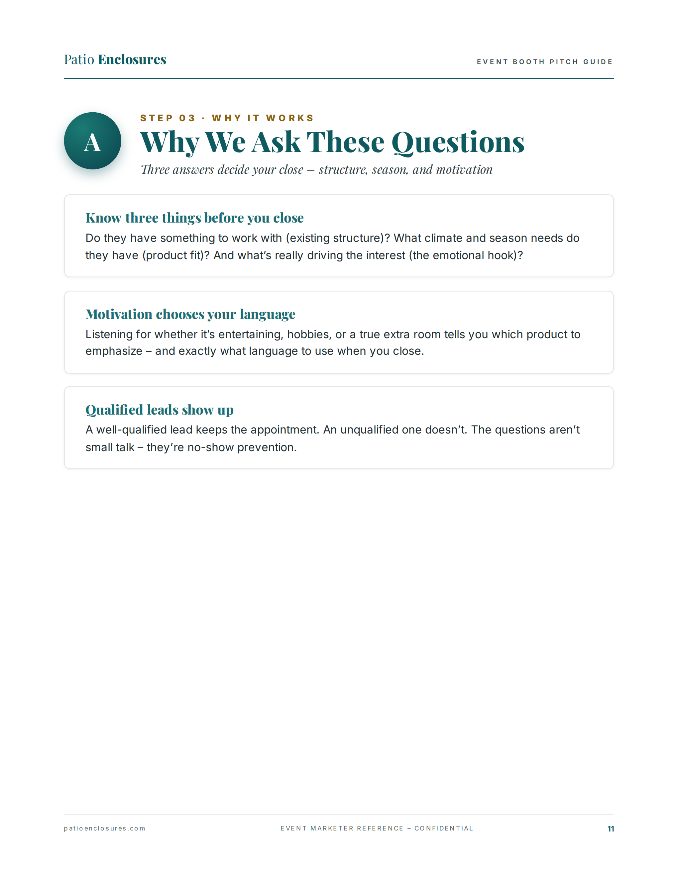
Notes:
⏱ TIMING: 3 minutes | Slide 11 of 20 — Why We Ask These Questions
Three answers decide your close — structure, season, and motivation. Do they have something to work with? What climate and season needs do they have? What's really driving the interest — their emotional hook? Motivation also tells you which product to emphasize and exactly what language to use when you close. If someone says "I want to use it year-round for a home office," your close language sounds very different than if someone says "I just want somewhere to sit outside without bugs in the summer." Motivation chooses your language. And here's the piece that most people miss: a well-qualified lead keeps the appointment. An unqualified lead doesn't show up. The questions aren't small talk — they are no-show prevention. Every question you skip is a ghost appointment waiting to happen.
❓ ENGAGEMENT QUESTION: "Has anyone had an experience where someone seemed really excited at the booth but didn't show for the appointment? What do you think was missing from that conversation?" [Collect 1–2 stories. Connect the missing piece back to qualification. The answer is almost always: they didn't know enough about the person's real situation or motivation.]

Slide 12
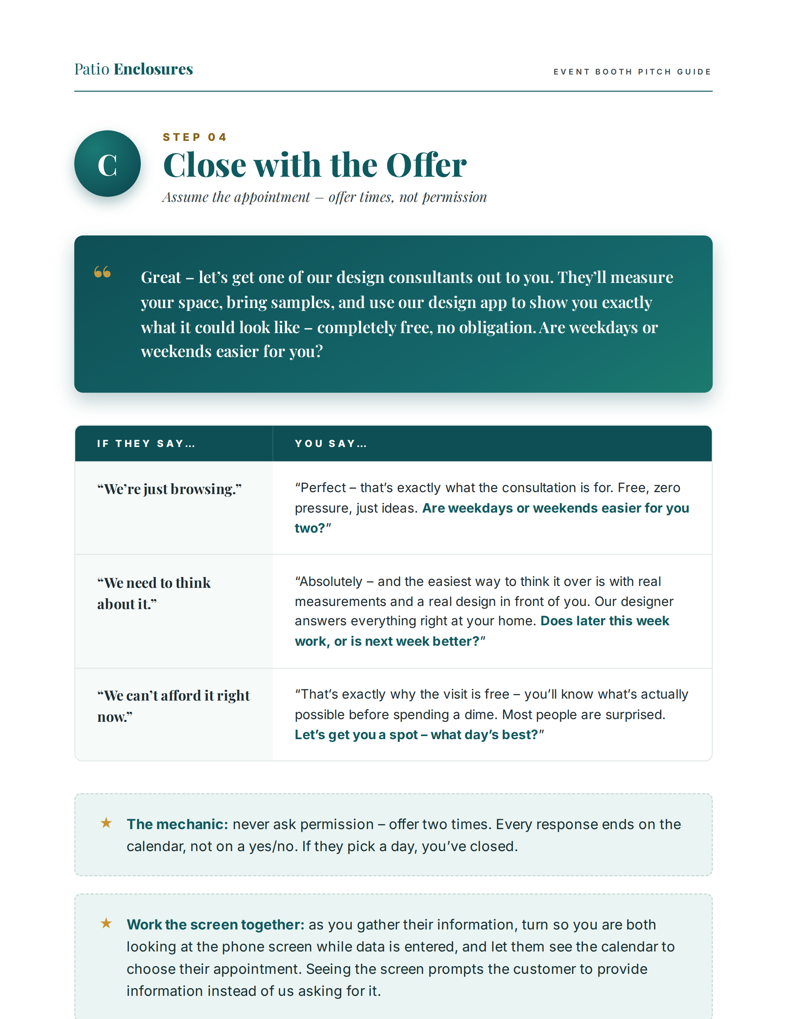
Notes:
⏱ TIMING: 5 minutes | Slide 12 of 20 — C: Close with the Offer
This is the step most people get wrong — because they ask instead of assume. The close script is in the highlighted box at the top: "Great — let's get one of our design consultants out to you. They'll measure your space, bring samples, and use our design app to show you exactly what it could look like — completely free, no obligation. Are weekdays or weekends easier for you?" Notice: we never asked IF they want an appointment. We offered two calendar options. The table below gives you word-for-word responses to the three objections you'll hear most. "We're just browsing" — perfect, the consultation is exactly what browsing looks like; weekdays or weekends? "We need to think about it" — of course; the easiest way to think it over is with real measurements and a real design in front of you; does later this week work or is next week better? "We can't afford it right now" — that's exactly why the visit is free; most people are surprised; let's get you a spot — what day is best? Every response ends on the calendar. Every single one.
Work the screen together: as you enter their info, turn the tablet so you're both looking at it. Let them see the calendar. Seeing the screen prompts them to engage and provide information instead of you asking for it.
❓ ENGAGEMENT QUESTION: "Which of those three objections trips you up the most — browsing, need to think, can't afford? Drop it in the chat." [Read the results. Then say:] "Let's say it together. Somebody unmute and give me the response to [most common one] right now." [Walk one person through the response word for word. Normalize the script.]

Slide 13
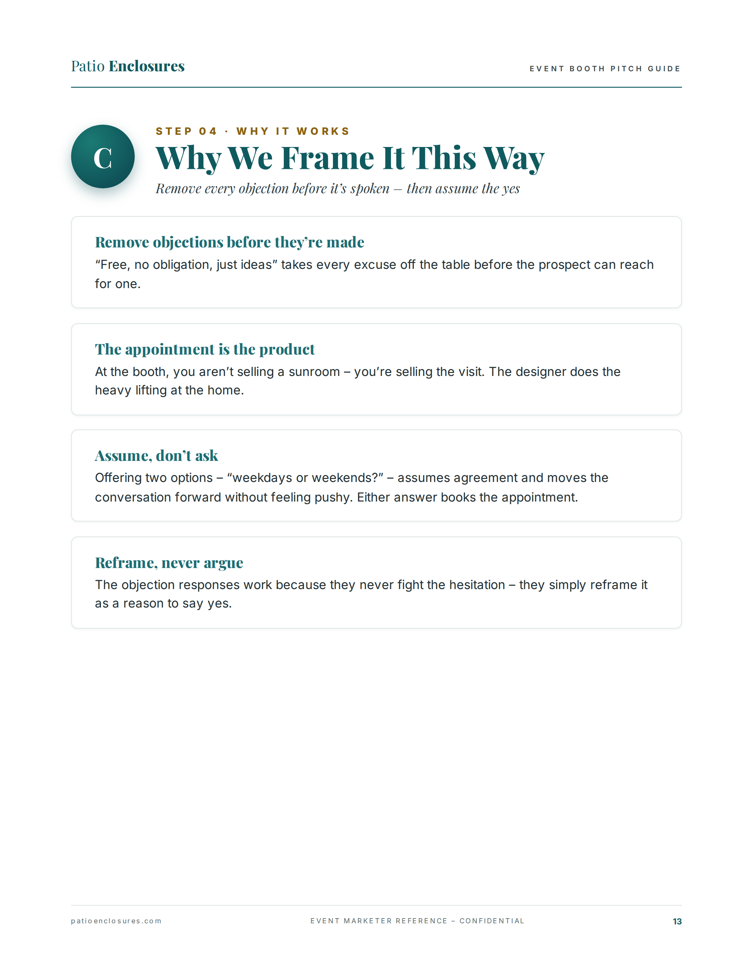
Notes:
⏱ TIMING: 3 minutes | Slide 13 of 20 — Why We Frame It This Way
Four principles make the close work. Remove objections before they're made: "free, no obligation, just ideas" takes every excuse off the table before the prospect can reach for one. The appointment is the product: at the booth you are not selling a sunroom — you are selling the visit. The designer does the heavy lifting at the home. Say that to yourself: your job is the appointment, not the sunroom. Assume, don't ask: offering two options — weekdays or weekends — assumes agreement and moves the conversation forward without feeling pushy. Either answer advances the close. Reframe, never argue: the objection responses never fight the hesitation — they simply reframe it as a reason to say yes. "We need to think about it" becomes "the easiest way to think it over is with real measurements in front of you." The prospect's resistance becomes the case for the visit.
❓ ENGAGEMENT QUESTION: "In your own words — what is the one thing you're selling at the booth? Not the product. What is it?" [Collect answers in chat. Look for: "the appointment," "the visit," "the consultation." If someone says "the sunroom" or "the product," gently redirect: "Close — you're selling the reason to let us come to the home. The designer sells the sunroom."]

Slide 14
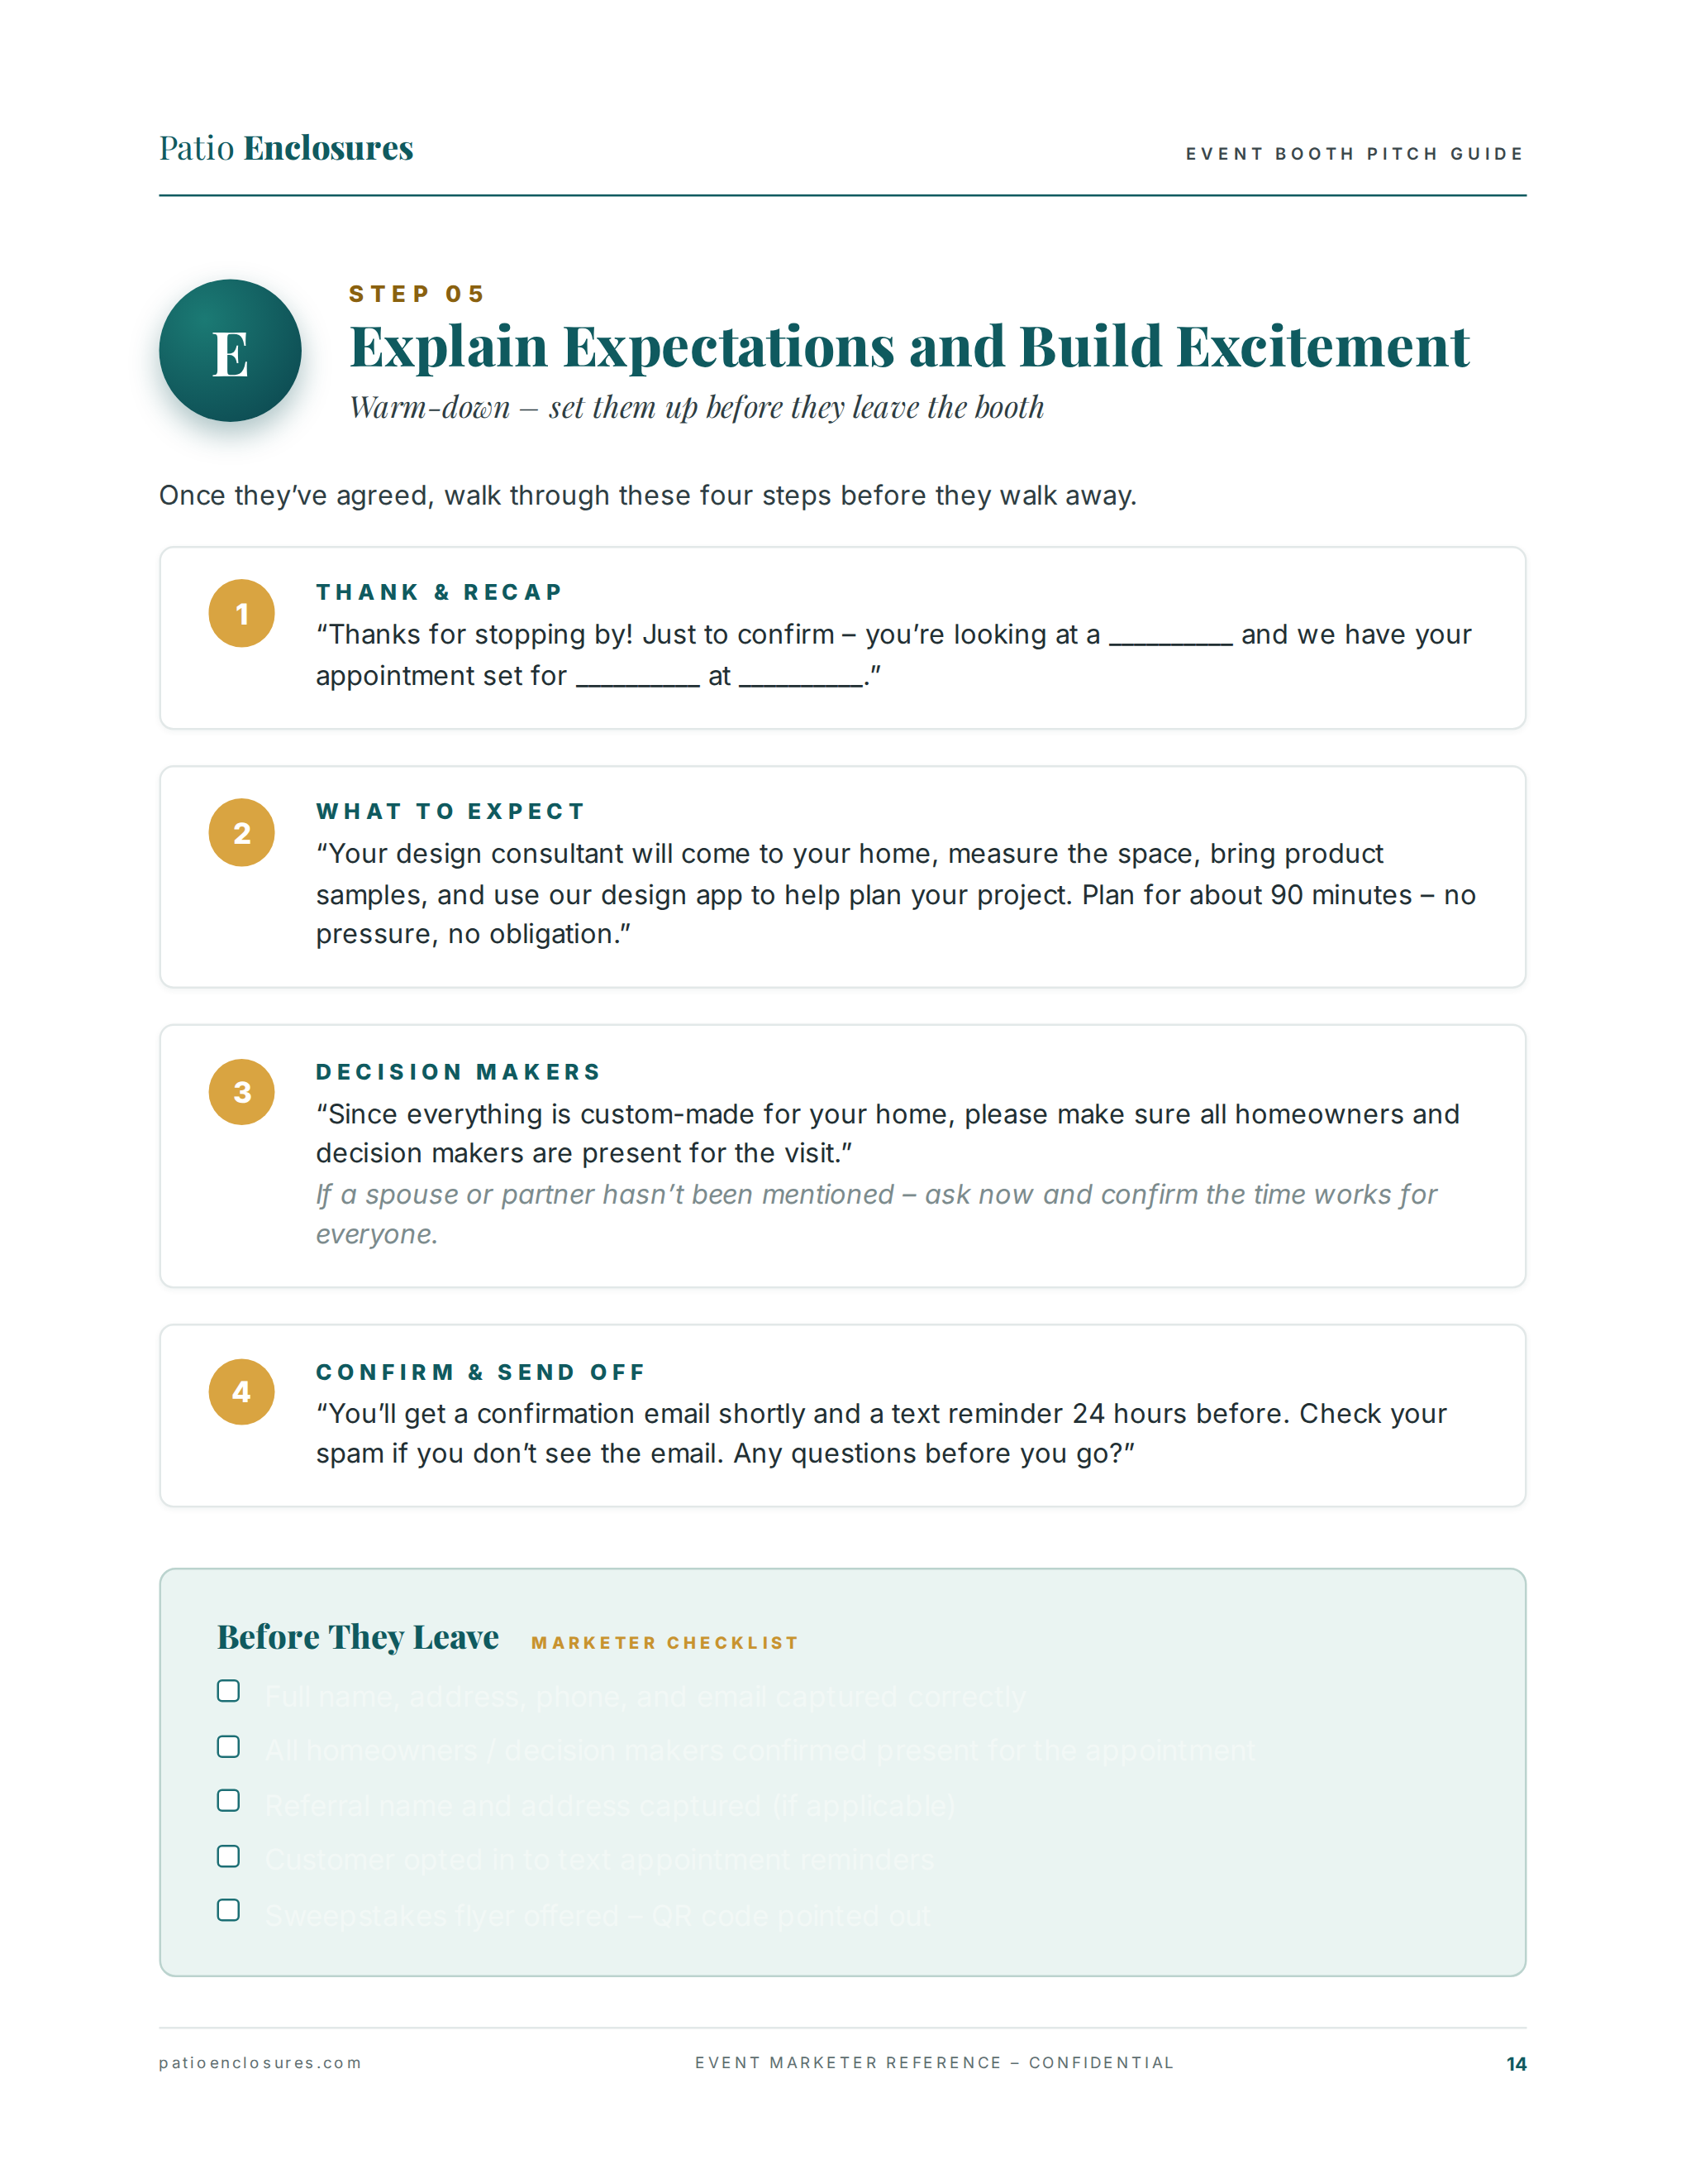
Notes:
⏱ TIMING: 4 minutes | Slide 14 of 20 — E: Explain Expectations and Build Excitement
You have the appointment. Do not let them walk away until you've done all four of these steps. Step one — Thank and Recap: "Thanks for stopping by! Just to confirm — you're looking at a [product] and we have your appointment set for [day] at [time]." Fill in those blanks out loud, with them standing there. This makes the commitment real in their own ears. Step two — What to Expect: "Your design consultant will come to your home, measure the space, bring product samples, and use our design app to help plan your project. Plan for about 90 minutes — no pressure, no obligation." This removes the unknowns that cause cold feet. Step three — Decision Makers: "Since everything is custom-made for your home, please make sure all homeowners and decision makers are present for the visit." If a spouse or partner hasn't been mentioned yet, ask now. Confirm the time works for everyone. Step four — Confirm and Send Off: "You'll get a confirmation email shortly and a text reminder 24 hours before. Check your spam if you don't see the email. Any questions before you go?" Then use the Before They Leave checklist to make sure you haven't missed anything.
❓ ENGAGEMENT QUESTION: "Which of these four steps do you think people most often skip or rush through at the booth?" [Collect answers — usually step 3, Decision Makers, or step 1, the recap. Then say:] "And what's the cost of skipping that step?" [Bridge: a skipped recap means weaker commitment; a skipped decision-maker step means a spouse shows up the day of and kills the sale.]

Slide 15
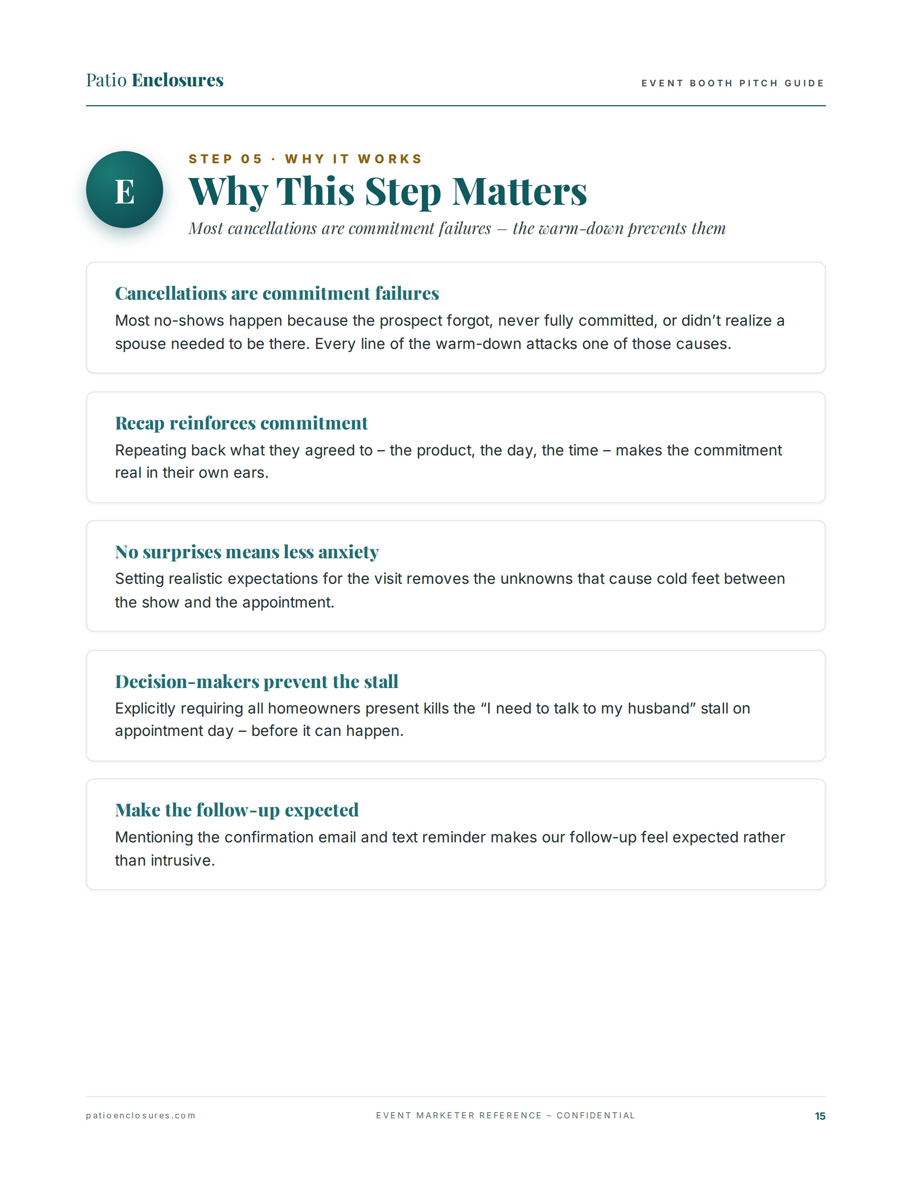
Notes:
⏱ TIMING: 3 minutes | Slide 15 of 20 — Why This Step Matters
Most cancellations are commitment failures — not interest failures. The prospect was interested at the booth. What broke down was the commitment. Every line of the warm-down attacks one of the three causes of cancellations: they forgot, they never fully committed, or they didn't realize a spouse needed to be there. The recap makes the commitment real in their own words. Setting expectations removes the unknowns that cause cold feet between the show and the appointment — they know what's coming, how long it takes, and what it's for. Requiring all homeowners present kills the "I need to talk to my husband" stall on appointment day before it can happen. And mentioning the confirmation email and text reminder makes our follow-up feel expected rather than intrusive — they're not surprised when we reach out, because you told them it was coming.
❓ ENGAGEMENT QUESTION: "What's your current show-rate on booth appointments — meaning what percentage of people who book at the booth actually keep the appointment? Ballpark is fine." [Collect numbers — typically 40–70%. Use the range to make the point:] "Every percentage point of improvement in show rate is direct revenue. This warm-down is the cheapest way to move that number."]

Slide 16
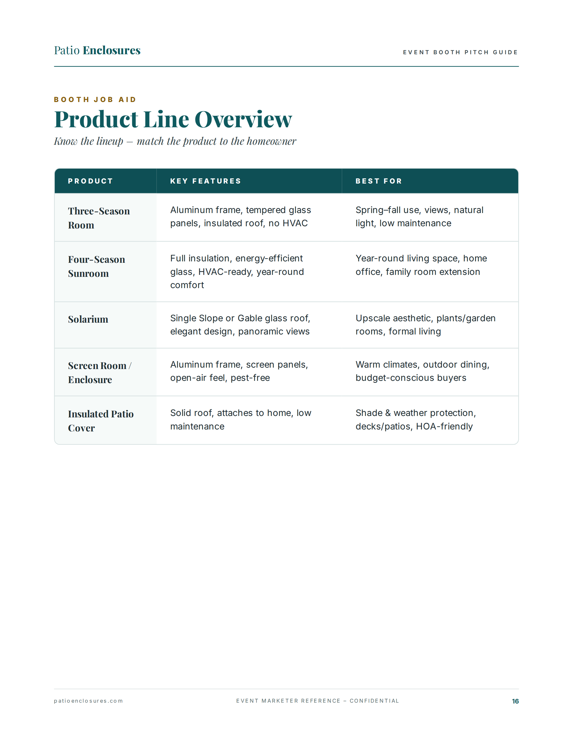
Notes:
⏱ TIMING: 2 minutes | Slide 16 of 20 — Product Line Overview
This slide is your field reference — know the lineup cold so you can match the product to the conversation without hesitating. Three-Season Room: aluminum frame, tempered glass panels, insulated roof, no HVAC — best for spring through fall use, views, natural light, and low maintenance. Four-Season Sunroom: full insulation, energy-efficient glass, HVAC-ready, year-round comfort — best for year-round living space, home office, family room extension. Solarium: single slope or gable glass roof, elegant design, panoramic views — best for upscale aesthetic, plants, garden rooms, formal living. Screen Room or Enclosure: aluminum frame, screen panels, open-air feel, pest-free — best for warm climates, outdoor dining, budget-conscious buyers. Insulated Patio Cover: solid roof, attaches to home, low maintenance — best for shade and weather protection, decks and patios, HOA-friendly.
❓ ENGAGEMENT QUESTION: "Quick product match — I'll describe a homeowner and you tell me which product fits. Ready? A homeowner in Florida who wants to eat outside without bugs but doesn't want the cost of a full enclosure — what do you recommend?" [Collect answers — Screen Room / Enclosure. Then try one more:] "Now: a homeowner in Ohio who works from home and wants a year-round dedicated office space — what's their product?" [Four-Season Sunroom. Reinforce the matching logic.]

Slide 17
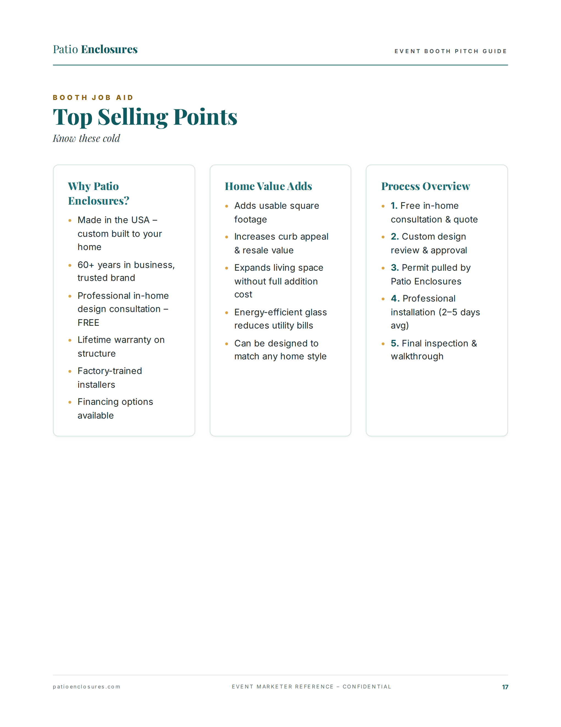
Notes:
⏱ TIMING: 2 minutes | Slide 17 of 20 — Top Selling Points
These are the points you need to know by heart — no looking them up at the booth. Why Patio Enclosures: made in the USA, custom-built to your home, 60-plus years in business, professional in-home design consultation free, lifetime warranty on structure, factory-trained installers, and financing options available. Home Value Adds: adds usable square footage, increases curb appeal and resale value, expands living space without full addition cost, energy-efficient glass reduces utility bills, and can be designed to match any home style. Process Overview in five steps: free in-home consultation and quote, custom design review and approval, permit pulled by Patio Enclosures, professional installation averaging 2–5 days, and final inspection and walkthrough. These are your proof points when a prospect pushes back on any of the big objections — quality, value, process, or trust.
❓ ENGAGEMENT QUESTION: "Without looking — what's the warranty on the structure?" [Listen for: lifetime structural warranty. Then:] "And how long is a typical installation?" [2–5 days. These are the two facts that surprise prospects most and that people most often get wrong at the booth.]

Slide 18
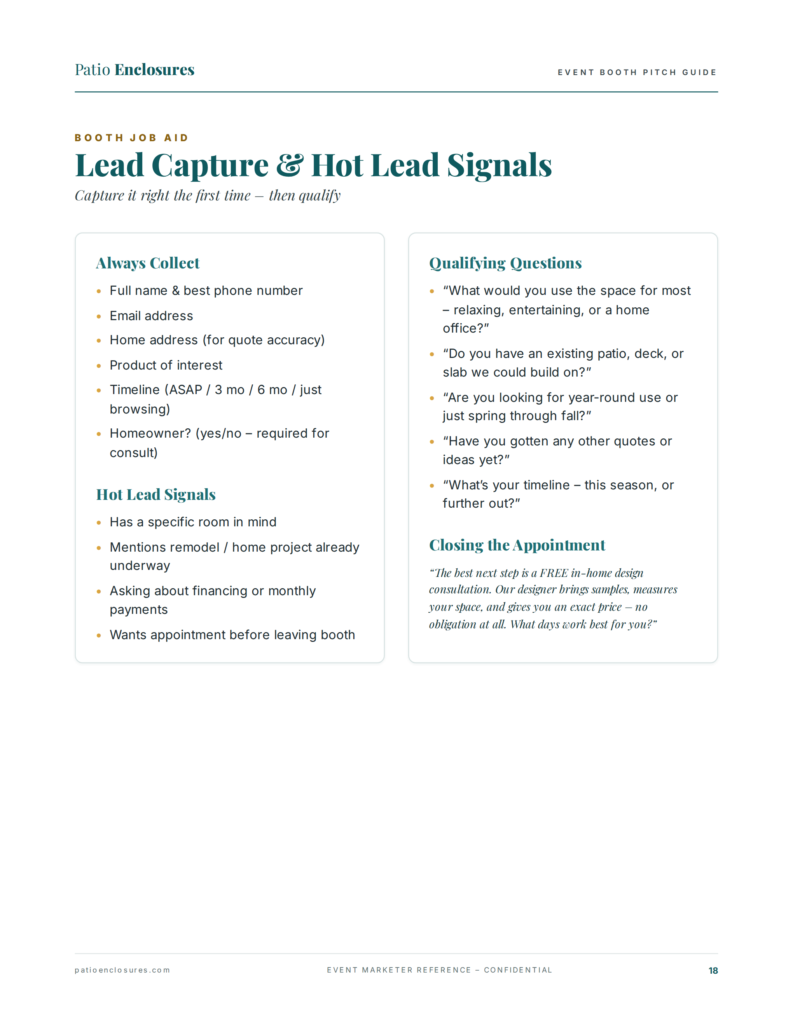
Notes:
⏱ TIMING: 2 minutes | Slide 18 of 20 — Lead Capture and Hot Lead Signals
Capture it right the first time — then qualify. Six things you always collect: full name and best phone number, email address, home address for quote accuracy, product of interest, timeline — ASAP, 3 months, 6 months, or just browsing — and homeowner status, yes or no, because it's required for the consultation. Hot lead signals tell you to move fast: they have a specific room in mind, they mention a remodel or home project already underway, they're asking about financing or monthly payments, or they want the appointment before leaving the booth. The qualifying questions on the right are your conversation deepeners. And the closing script at the bottom is the one you use when you're ready to move to the appointment: "The best next step is a FREE in-home design consultation. Our designer brings samples, measures your space, and gives you an exact price — no obligation at all. What days work best for you?"
❓ ENGAGEMENT QUESTION: "What's your most reliable hot lead signal — the one that tells you this person is serious before they've even said they're interested? What do you look for?" [Collect 2–3 answers. Common ones: asking about price, bringing up a specific room, mentioning they've already gotten one quote. Validate all of them and add any that weren't mentioned.]

Slide 19
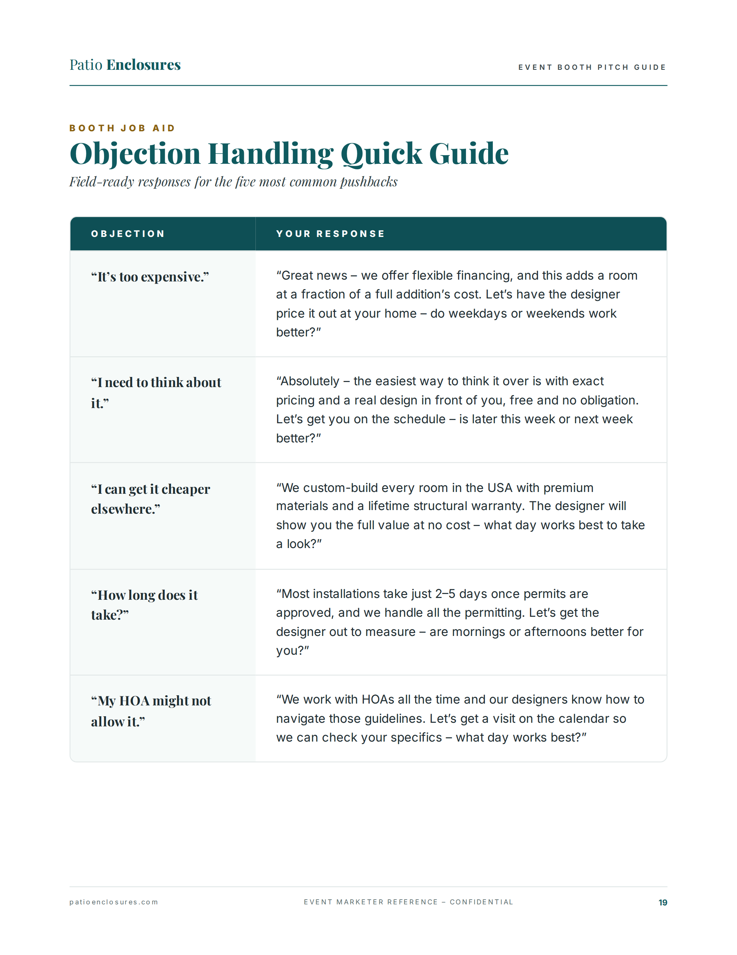
Notes:
⏱ TIMING: 3 minutes | Slide 19 of 20 — Objection Handling Quick Guide
Five objections, five field-ready responses — and notice every single response still ends with a calendar question. "It's too expensive" — great news, flexible financing; this adds a room at a fraction of a full addition's cost; let's have the designer price it out at your home — weekdays or weekends? "I need to think about it" — absolutely; the easiest way to think it over is with exact pricing and a real design in front of you, free and no obligation; is later this week or next week better? "I can get it cheaper elsewhere" — we custom-build in the USA, lifetime structural warranty; the designer will show you the full value at no cost — what day works best? "How long does it take?" — 2–5 days once permits are approved, and we handle all the permitting; let's get the designer out to measure — mornings or afternoons better? "My HOA might not allow it" — we work with HOAs all the time, our designers know how to navigate those guidelines; let's get a visit on the calendar so we can check your specifics — what day works best? The pattern: validate, reframe, back to the calendar.
❓ ENGAGEMENT QUESTION (hot seat drill): "I'm going to pick someone and give them an objection. You give me the response — word for word. Ready? [Name], here's yours: 'We really can't afford it right now.'" [After they respond, give brief feedback. Then do one more with a different person if time allows. This is the highest-value engagement activity in the deck.]

Slide 20
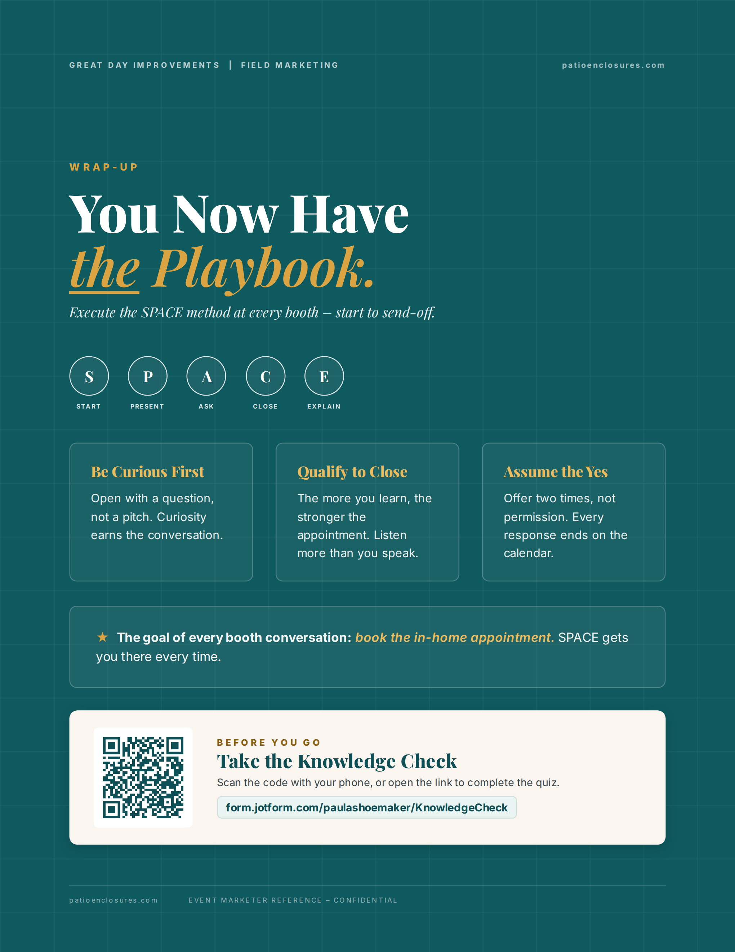
Notes:
⏱ TIMING: 4 minutes | Slide 20 of 20 — You Now Have the Playbook
This is the wrap. You now have everything you need to execute at every booth: the SPACE method start to send-off. Three things to carry with you every time. Be Curious First: open with a question, not a pitch — curiosity earns the conversation. Qualify to Close: the more you learn, the stronger the appointment — listen more than you speak. Assume the Yes: offer two times, not permission — every response ends on the calendar. The goal of every single booth conversation is the same thing: book the in-home appointment. Not a brochure handoff. Not a nice chat. The appointment. SPACE gets you there every time if you execute the steps in order. Before you go — complete the knowledge check. Scan the QR code or open form.jotform.com/paulashoemaker/KnowledgeCheck. It takes about 15 minutes and locks in what you just learned.
❓ FINAL ENGAGEMENT QUESTION: "We started by asking your confidence level on a scale of 1 to 5 for walking up to a stranger at a booth. Where are you now? Drop your number in the chat." [Read the results. Celebrate any increase. Then close with:] "Your number goes up every time you practice. Say the opener out loud before your next event. Say the close script in your car on the way there. The reps you put in off the floor are what show up on the floor." [Direct them to the knowledge check and close out.]

