Slide 1
Superstore Sales & Profitability Analysis
Power BI | Power Query | DAX | Data Analysis
From commercial data to business insights
Interactive Power BI portfolio project
2.33M$ Sales | 292.30K$ Profit | 5,111 Orders | 12.56% Profit Margin

Slide 2
Business Problem & Objectives
Business Problem
How can sales and profitability drivers be identified, underperforming products and regions detected, and data-driven recommendations formulated?
Objectives
• Evaluate overall sales and profit performance
• Identify profitable and loss-making products
• Compare regions, categories and customer segments
• Assess discounts and their association with profitability
• Translate findings into actionable recommendations
Tools: Power BI • Power Query • DAX

Slide 3
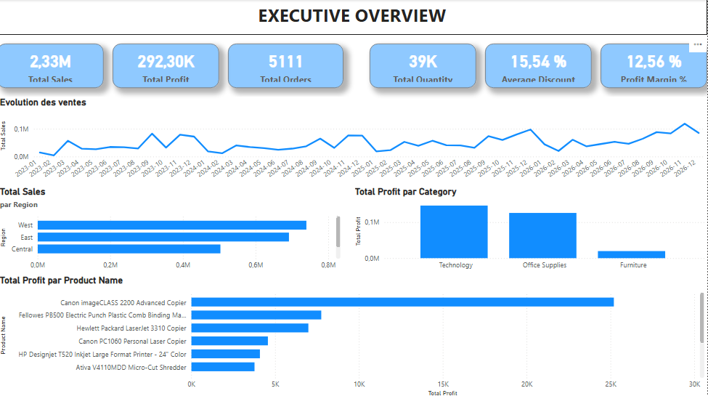
01 — Executive Overview
Overall commercial performance

Slide 4
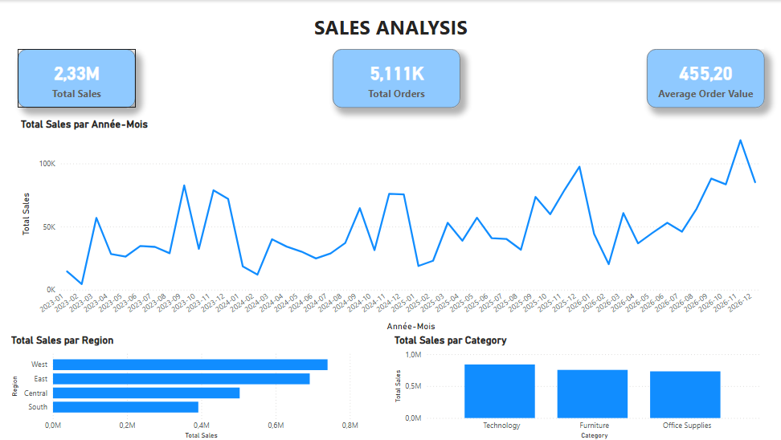
02 — Sales Analysis
Sales trends, regions and categories

Slide 5
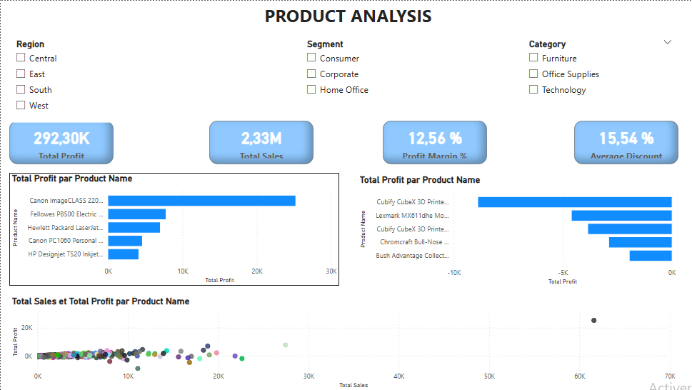
03 — Product Analysis
Product profitability, risks and sales/profit relationship

Slide 6
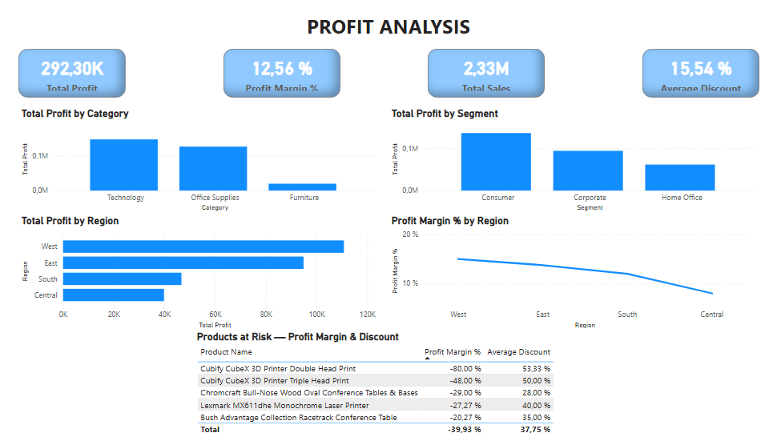
04 — Profit Analysis
Profitability by category, segment and region

Slide 7
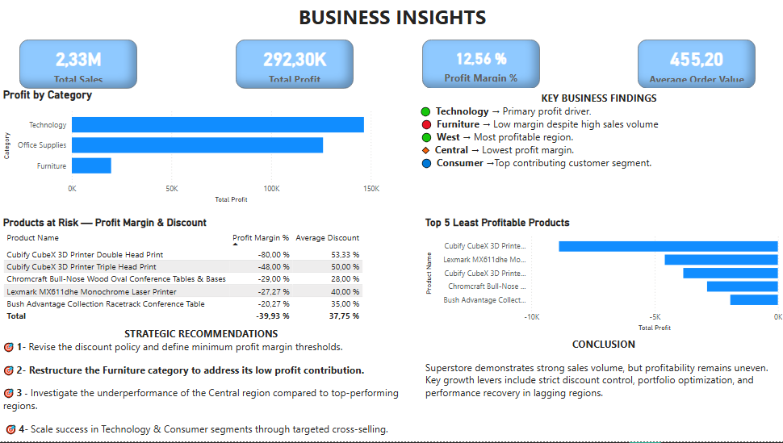
05 — Business Insights
Key findings, strategic recommendations and conclusion

Slide 8
Key Takeaways & Professional Value
Key Takeaways
• Technology is a major profitability driver.
• High discounts are associated with several strongly negative margins.
• Furniture requires attention despite meaningful sales volume.
• West is among the strongest-performing regions; Central requires investigation.
• Consumer is the leading profit-contributing segment.
Strategic focus
• Review discount thresholds and minimum margin levels.
• Audit loss-making products and investigate regional performance gaps.
• Scale successful Technology and Consumer activities through targeted cross-selling.
Data Analyst | Excel & Power BI

