Slide 1
Superstore Sales & Profitability Analysis
Power BI | Power Query | DAX | Data Analysis
From commercial data to business insights
Interactive Power BI portfolio project
2.33M$ Sales | 292.30K$ Profit | 5,111 Orders | 12.56% Profit Margin

Slide 2
Business Problem & Objectives
Business Problem
How can sales and profitability drivers be identified, underperforming products and regions detected, and data-driven recommendations formulated?
Objectives
• Evaluate overall sales and profit performance
• Identify profitable and loss-making products
• Compare regions, categories and customer segments
• Assess discounts and their association with profitability
• Translate findings into actionable recommendations
Tools: Power BI • Power Query • DAX

Slide 3
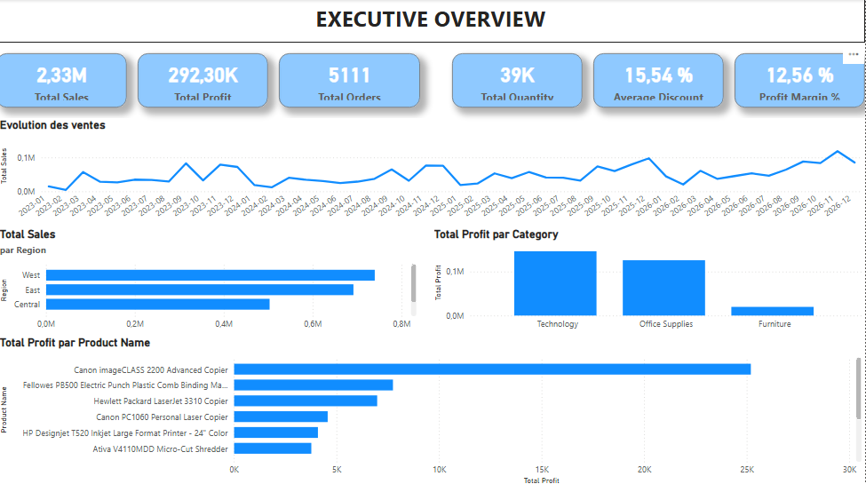
01 — Executive Overview
Overall commercial performance

Slide 4
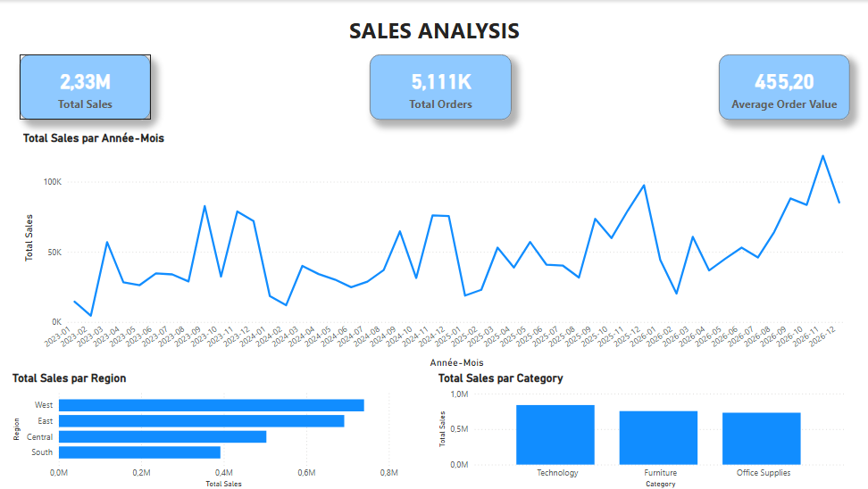
02 — Sales Analysis
Sales trends, regions and categories

Slide 5
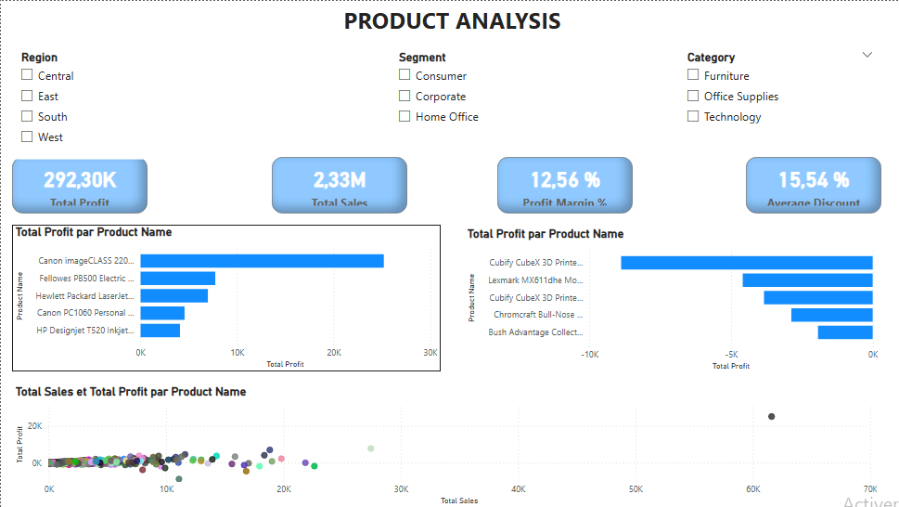
03 — Product Analysis
Product profitability, risks and sales/profit relationship

Slide 6
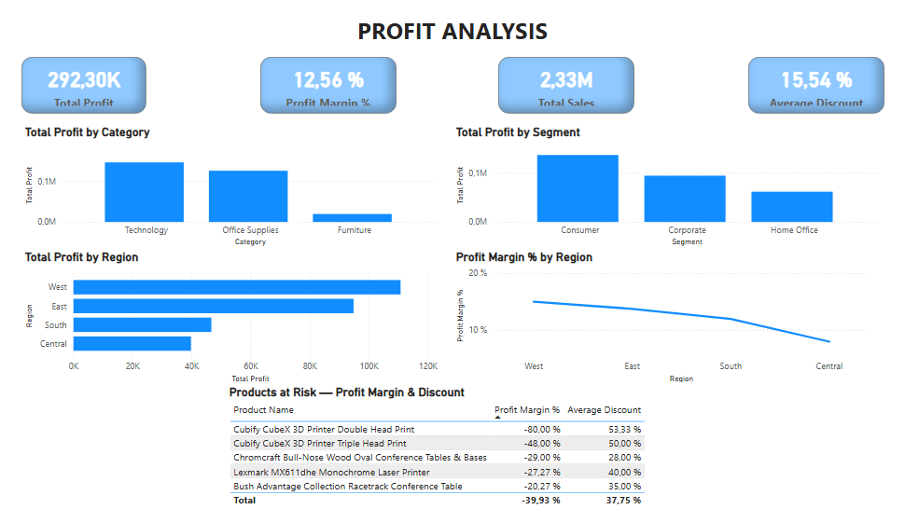
04 — Profit Analysis
Profitability by category, segment and region

Slide 7
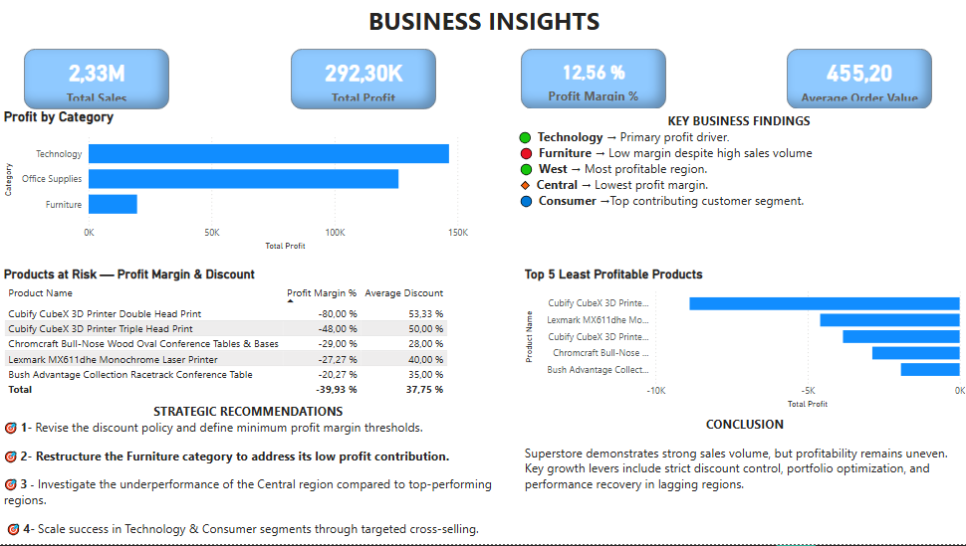
05 — Business Insights
Key findings, strategic recommendations and conclusion

Slide 8
Key Takeaways & Professional Value
Key Takeaways
• Technology is a major profitability driver.
• High discounts are associated with several strongly negative margins.
• Furniture requires attention despite meaningful sales volume.
• West is among the strongest-performing regions; Central requires investigation.
• Consumer is the leading profit-contributing segment.
Strategic focus
• Review discount thresholds and minimum margin levels.
• Audit loss-making products and investigate regional performance gaps.
• Scale successful Technology and Consumer activities through targeted cross-selling.
Data Analyst | Excel & Power BI

Slide 9
06 — AI Data Annotation & Quality
Practical independent project • French-language data quality • Evidence-based QA
From raw audio and AI outputs → structured annotations → quality-controlled evidence
Audio evaluation
Transcription & diarization
QA & issue classification
7 French audio samples reviewed across naturalness, fluency, pronunciation, articulation, tone and audio quality.
7 timestamped speaker segments documented, including speaker identification, interruption and overlap handling.
12 observable issues classified by type and severity, with objective QA comments and traceable timestamps where applicable.
Portfolio status: practice-based independent project — not presented as paid professional employment.

Slide 10
AI Data Annotation — Workflow & Quality Controls
A structured annotation process designed for consistency, accuracy and guideline compliance
01
02
03
04
05
Review source
Understand the audio/text, prompt and project instructions.
Annotate
Transcribe, timestamp, identify speakers and apply the required labels.
Inspect
Check fluency, intelligibility, overlaps, interruptions and audio issues.
Classify
Record observable issues, severity and supporting evidence.
Validate
Apply the rubric consistently and flag ambiguity rather than guessing.
Annotation principles
QA mindset
Preserve hesitations and repetitions when faithful transcription is required; distinguish overlap/interruption from pronunciation errors; record the exact overlap interval when available.
Describe observable issues objectively, apply the same criteria across samples, document evidence, and avoid unsupported assumptions.

Slide 11
AI Output Evaluation — Quality Rubric
Extending annotation skills into structured evaluation of AI-generated responses
Instruction Following
Did the output follow the prompt and constraints?
Accuracy
Are the factual or task-specific claims correct?
Relevance
Does the answer directly address the requested task?
French Quality
Is the French clear, natural and appropriate?
Hallucination
Does the output introduce unsupported information?
Professional positioning: AI Data Annotation • Data Quality • QA • French Language Evaluation • Information Verification

