Slide 1
Project 5: Zipf’s Law distribution of Finnish Wikipedia Corpus.
Tobias Westphal, Mathis Patigny, and Clément Richard

Slide 2
Share of Work
Tobias Westphal: Tasks 1-4, report
Clément Richard: Tasks 5-9, report
Mathis Patigny: Tasks 10-11, report

Slide 3
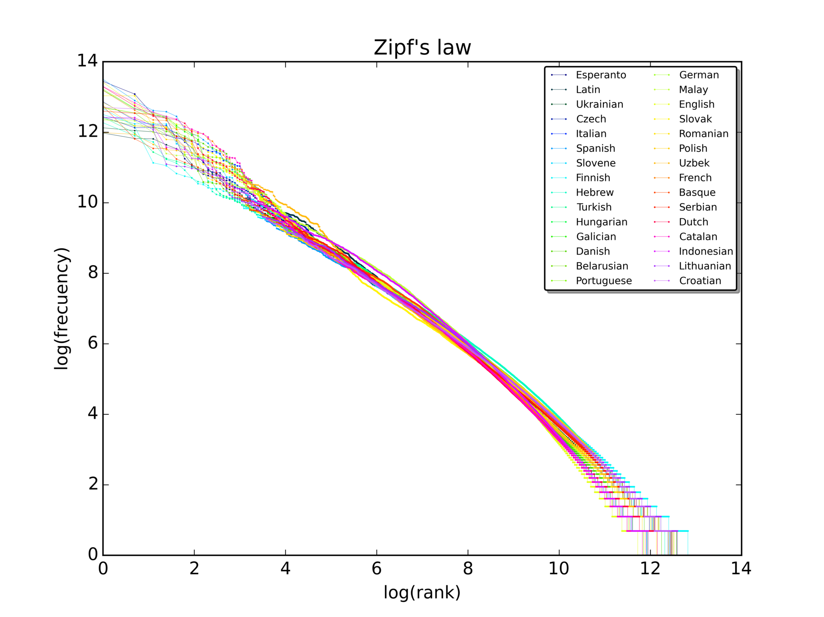
Zipf‘s Law
For set of measurements sorted in decreasing order
value of the n-th entry is approximately inversely proportional to n
Rank and frequency appear as straight line on log-log scale

Slide 4
Finnish Wikipedia Corpus
This projects basis for testing of Zipf‘s law
Provided as 66 .VRT files
Contains 425,506 pages and ~83,300,000 tokens
Each page tokenized
Tokens annotated via CoNLL-U format
ID, FORM, LEMMA, UPOS, XPOS, FEATS, HEAD, DEPREL, DEPS, MISC

Slide 5
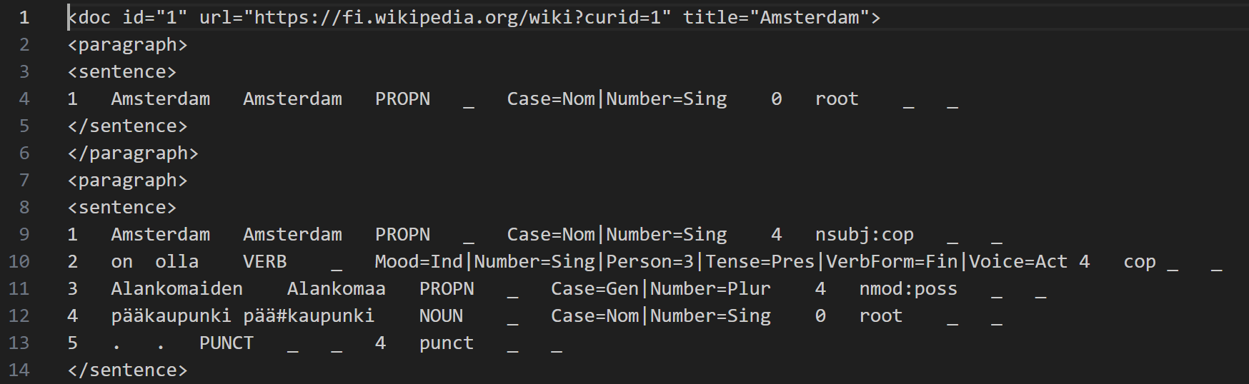
Corpus access
.VRT files parsed to create dataframe from CoNLL-U table content
Parsing done per file
Resulting dataframes merged to one
Corpus dataframe saved as .parquet file
Faster access

Slide 6
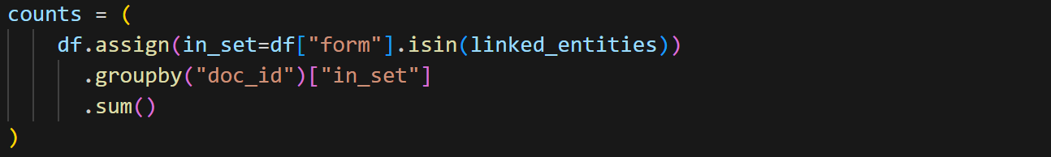
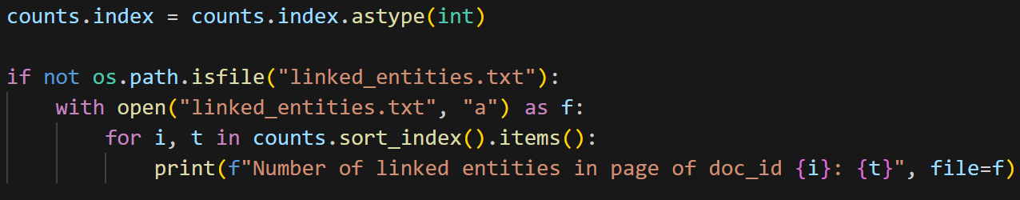
Linked Entity Counts

Slide 7
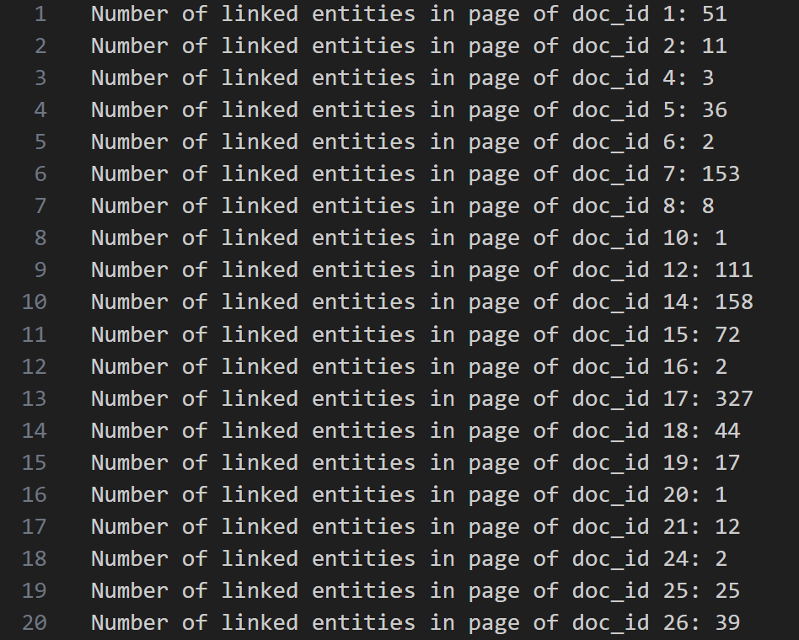
Linked Entity Counts

Slide 8
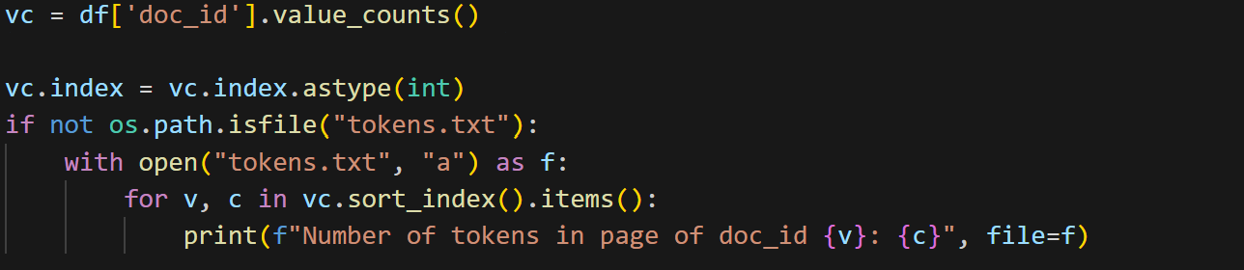
Token Counts

Slide 9
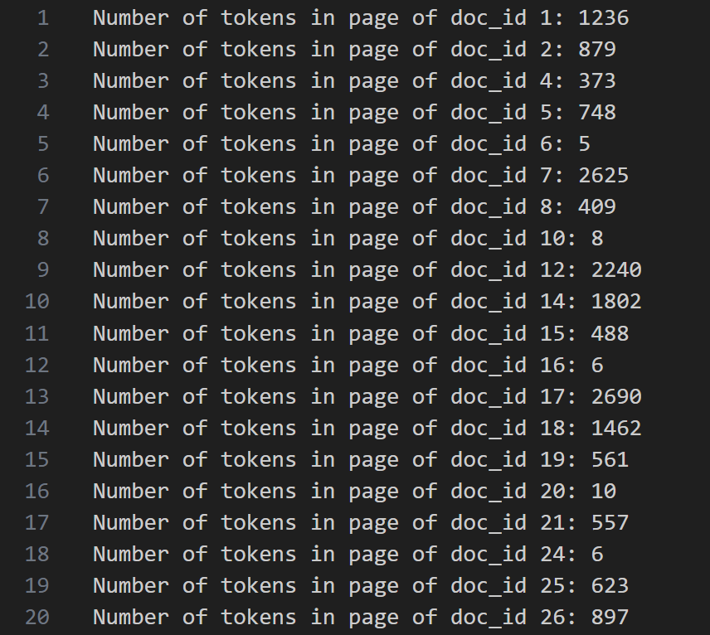
Token Counts
Minimum Nr. of Tokens observed on a Page: 1
Maximum Nr. of Tokens observed on a Page: 32864

Slide 10
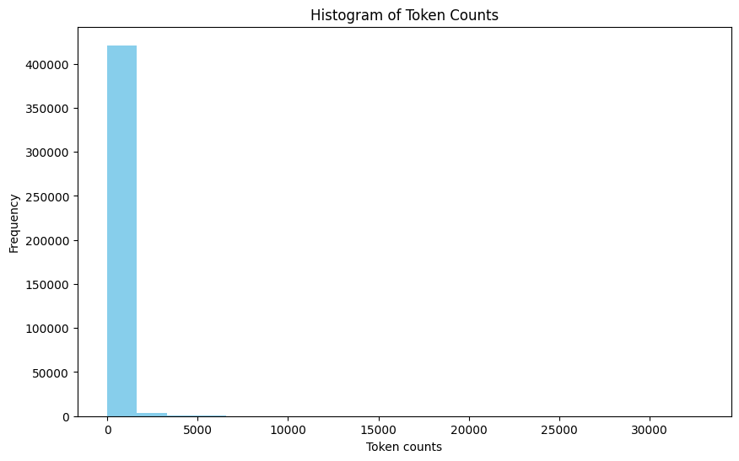
Token Counts

Slide 11
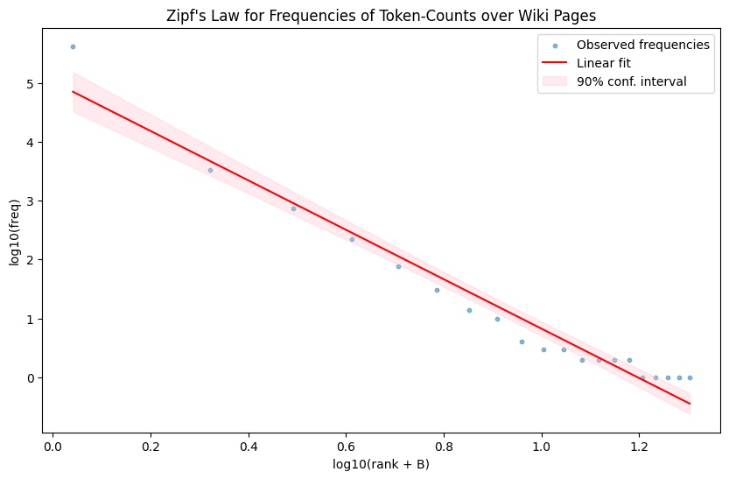
Frequencies of Token Counts
Observations outside 90% confidence bounds: 65.0%
R² ≈ 0.960
Adjusted R² ≈ 0.958

Slide 12
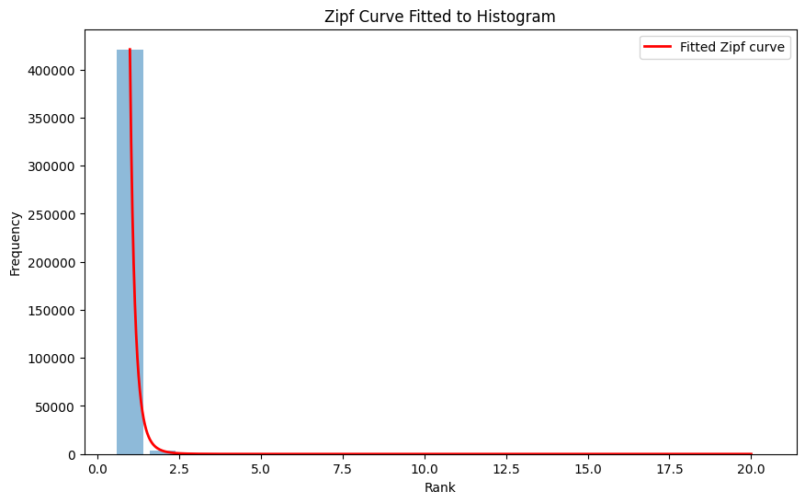
Curve to Histogram Fitting

Slide 13
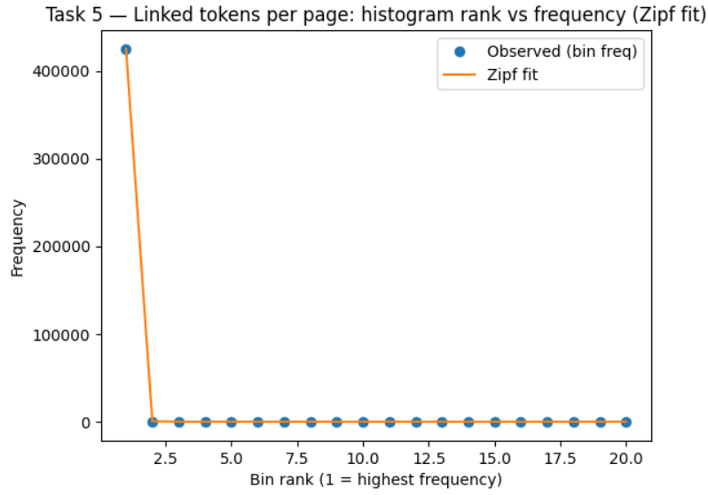
20-bin histogram

Slide 14
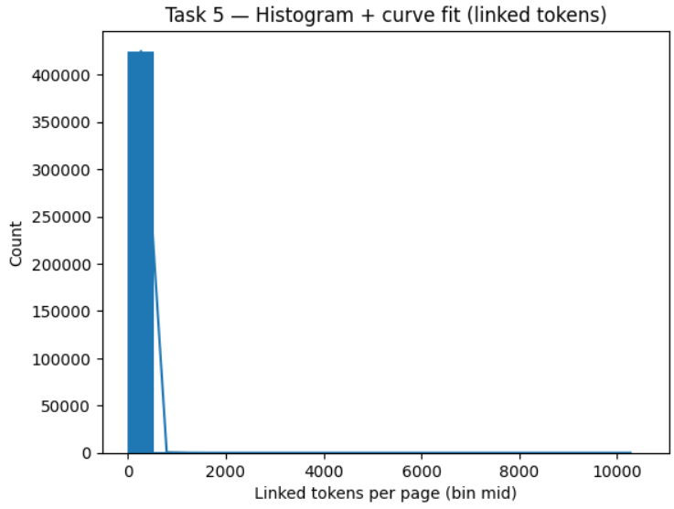
Zipf fit curve
Compared total and linked tokens per page.
Both follow Zipf’s law with strong power-law behavior
(R² ≈ 0.98).

Slide 15
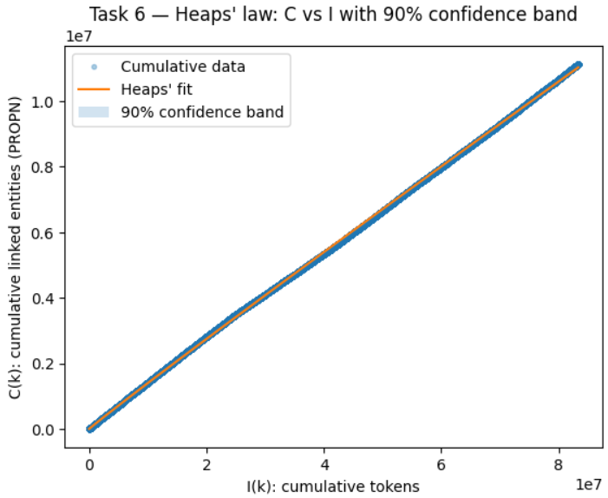
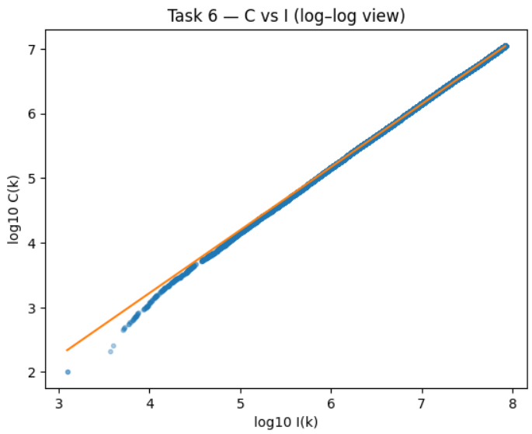
Heaps’ Law: Cumulative Linked Entities
Cumulative linked entities follow Heaps’ law. Nearly linear scaling between entities and tokens
(β ≈ 0.97,R² ≈ 0.9998).

Slide 16
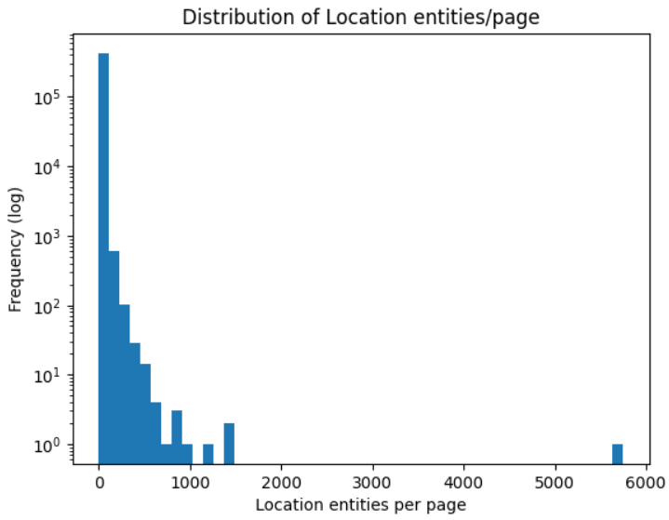
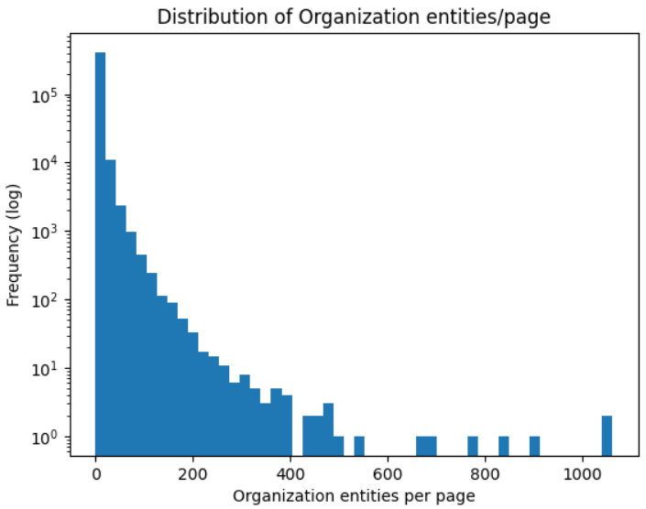
Histogram of LOC and ORG counts per page

Slide 17
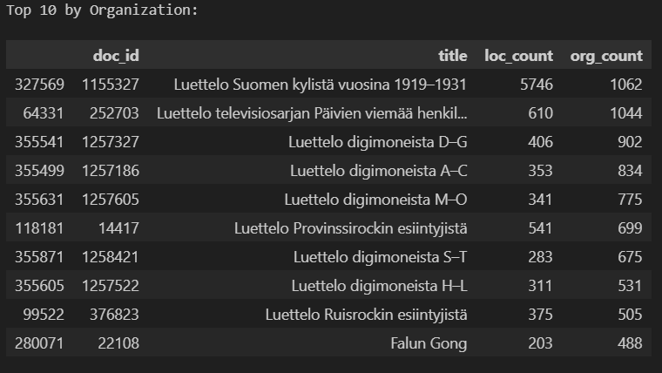
Example of the top pages by organizations
Detected Location (L) and Organization (P) entities using spaCy’s Finnish NER model.
Found heavy-tailed distribution — list pages dominate the upper tail.

Slide 18
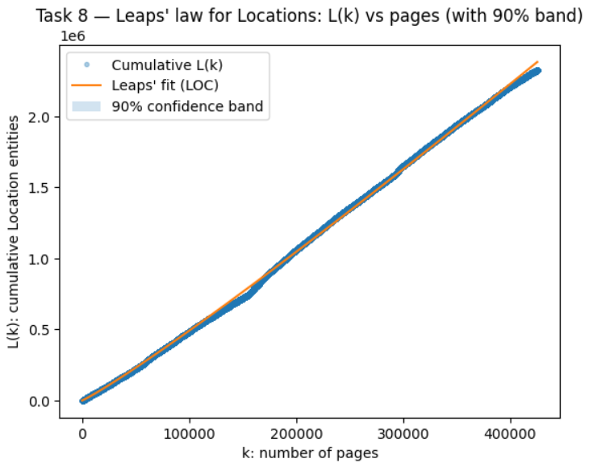
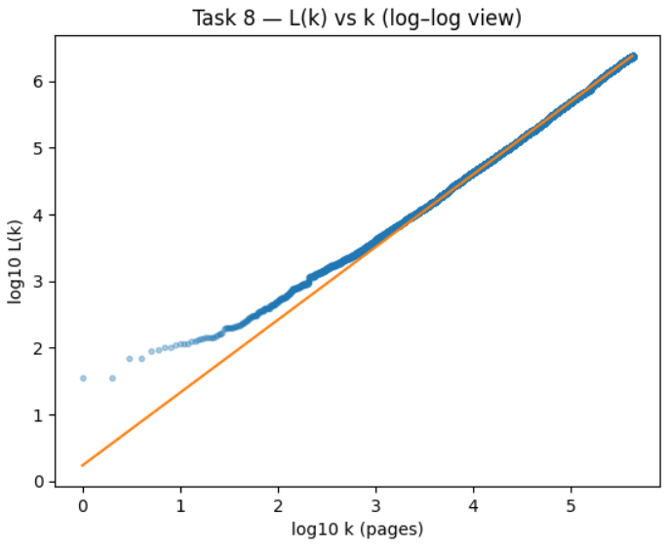
Leaps’ law for Locations
Leaps’ law fit for Locations:
β ≈ 1.09, R² ≈ 0.999
Cumulative Location entities scale almost linearly with number of pages.

Slide 19
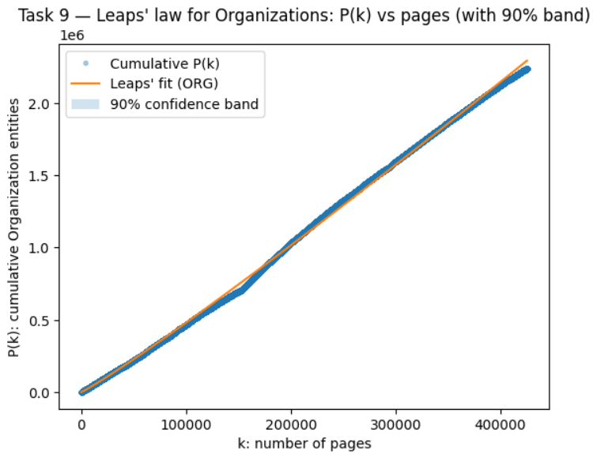
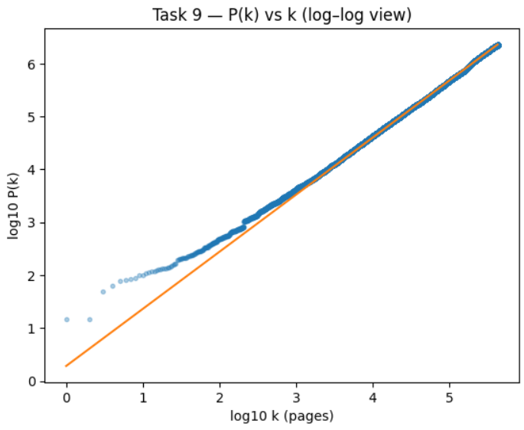
Leaps’ law for Organizations
Leaps’ law fit for Organizations:
β ≈ 1.08, R² ≈ 0.999
Shows same growth pattern as Locations.

Slide 20
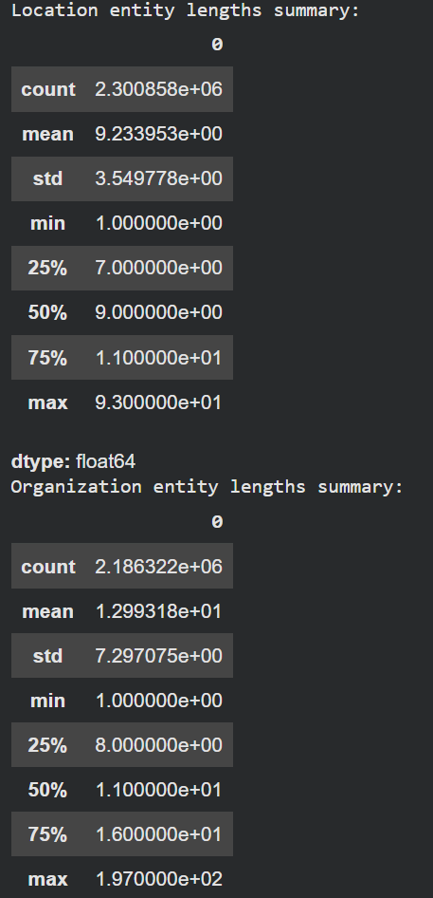
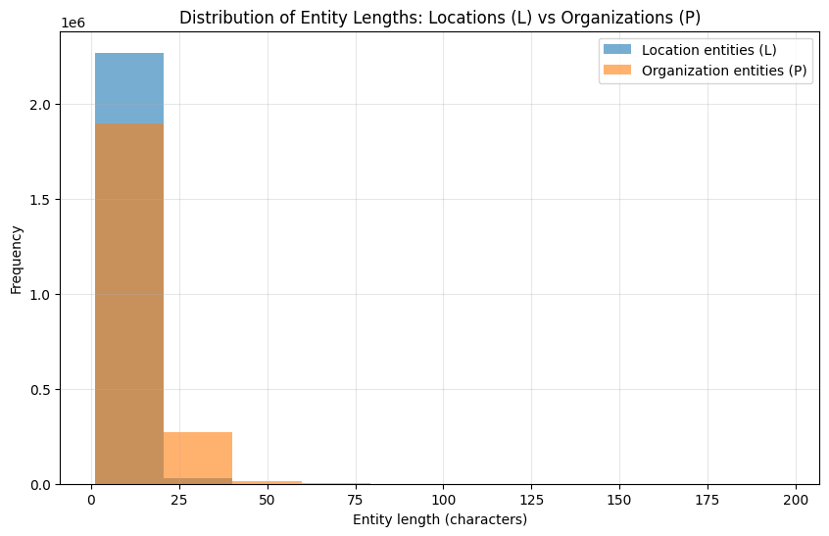
Character lengths of Organizations vs Locations

Slide 21
Limitations and Issues
No real-time shared document or git.
Data are very large which made some scripts very very long to run (~3 hours for the longest one)
Often ended up « re-pre-process » the data for later Tasks as we didn’t get some specific characteristics previously.

Slide 22
What’s next?
Mainly finishing the report.
Maybe try to cleanup the code and make the data pre-processing more optimized
Confronting our results to other research papers

