Slide 1
Checkers 2³²:
Literally Just Another Checkers Game
By: Justin Seara, Michael Kilmer, Joe Chew, Roger White

Slide 2

Development Begins! Eventually
Decided on Unity early
Development done in C#
Smoother Dev Cycle Thanks To:
Built-in Bug Reporting
Unity Test Tools
Easy Co-operation with Github

Slide 3


Our Tools
Gendarme - Code Analysis Tool
Unity Test Tools - 1st party suite of tools, includes code coverage & unit testing tools
Github - Better than Perforce

Slide 4
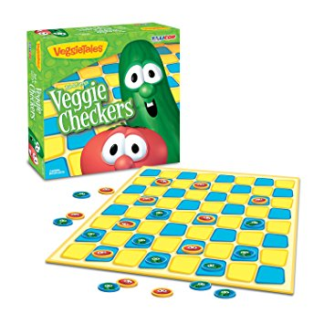
Our Product
It’s just checkers. That’s it.
We will forever regret not making it VeggieTales themed.

Slide 5
Demo Time!

