Slide 1
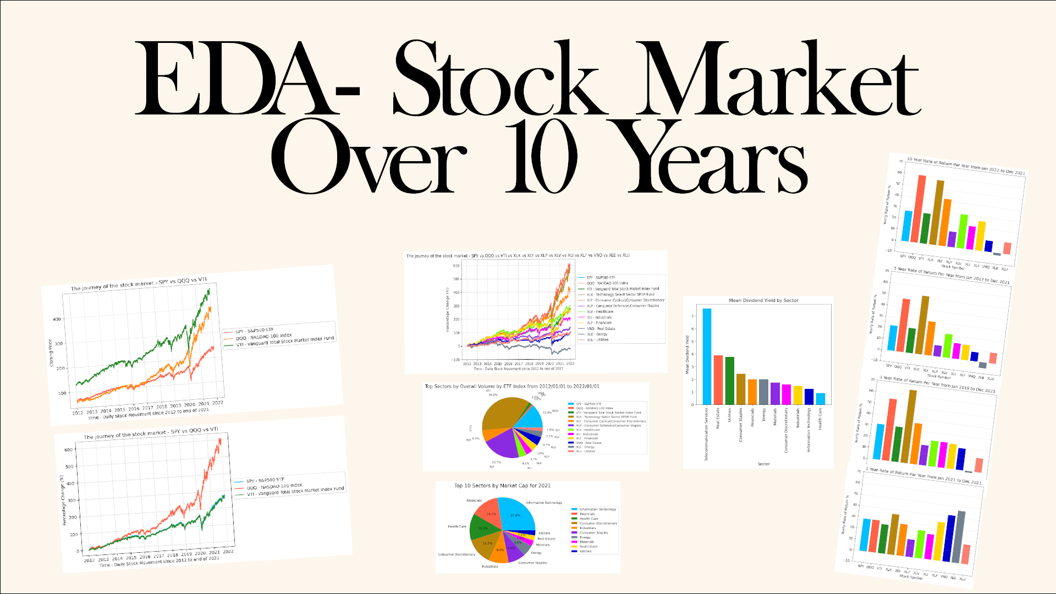
Exploring which sectors did best!

Slide 2
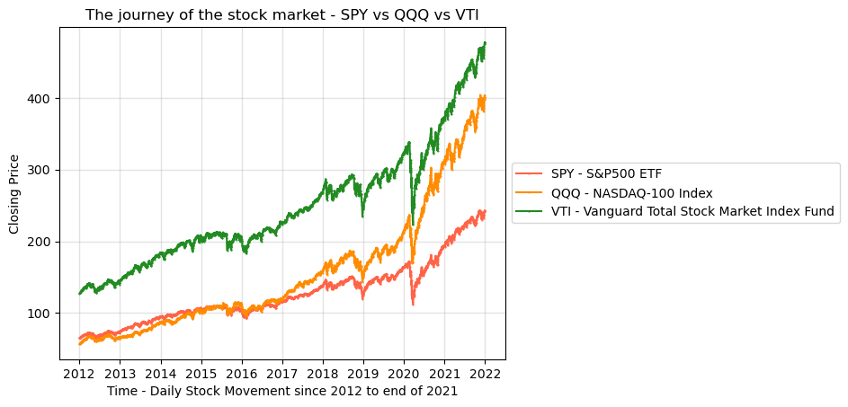
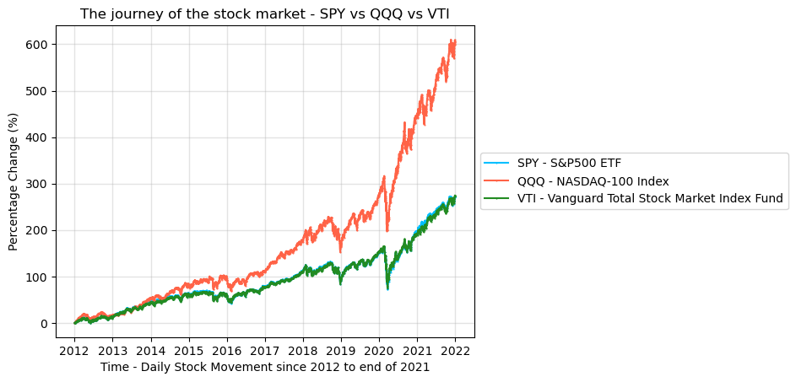
Stock Market performance over a 10 year period: SPY vs QQQ vs VTI.
3 Most Popular ETFs representing the US Stock Market:
After Standardization:

Slide 3
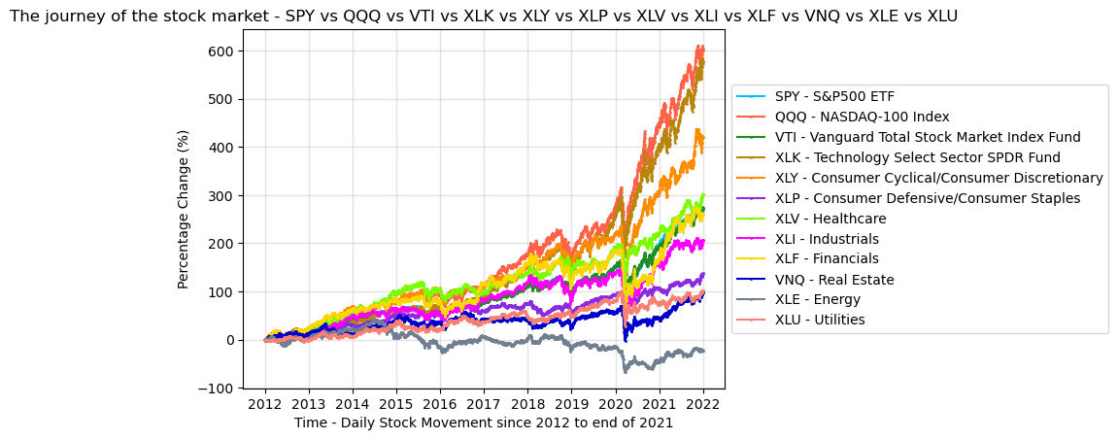
Then we added in the other Indexes represented by ETFs and their performance over the last 10 years:

Slide 4
We then created a Dataframe to show the Rate of Return for all of our Stock Indexes over 10, 5, 3, 1 Years:
 | 10 Year Yearly Rate of Return | 5 Year Yearly Rate of Return | 3 Year Yearly Rate of Return | 1 Year Yearly Rate of Return
SPY | 27.251764 | 22.496309 | 31.496114 | 28.788736
QQQ | 59.920913 | 47.159013 | 55.183996 | 28.625007
VTI | 27.024997 | 21.873049 | 31.169354 | 25.835205
XLK | 57.365362 | 51.906531 | 65.081789 | 35.942137
XLY | 41.954259 | 30.230958 | 36.489073 | 28.239873
XLP | 13.755392 | 9.824019 | 17.878729 | 15.572541
XLV | 30.093911 | 20.873221 | 22.930393 | 24.736612
XLI | 20.678455 | 14.01157 | 22.855927 | 22.451097
XLF | 26.034896 | 13.591397 | 22.103918 | 34.28473
VNQ | 9.834159 | 8.113414 | 19.307561 | 41.182919
XLE | -2.1886 | -5.262878 | -1.381693 | 46.206537

Slide 5
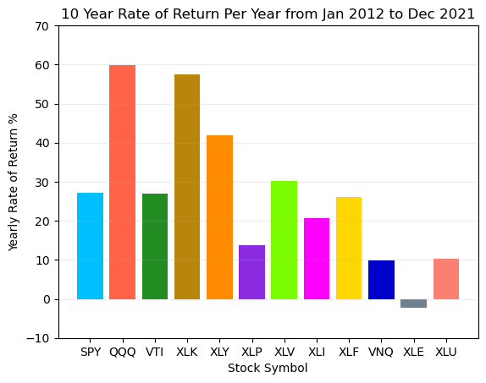
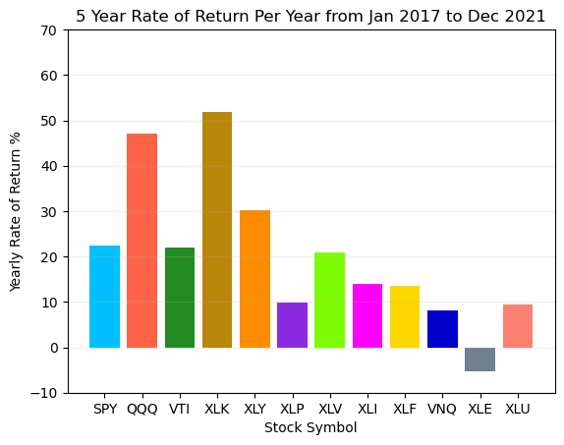
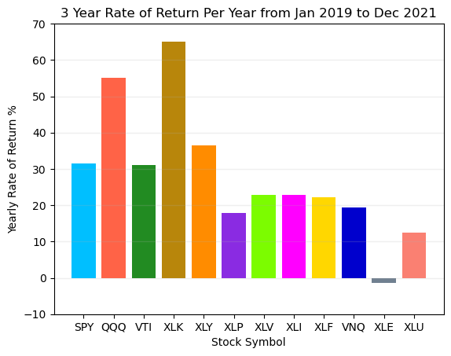
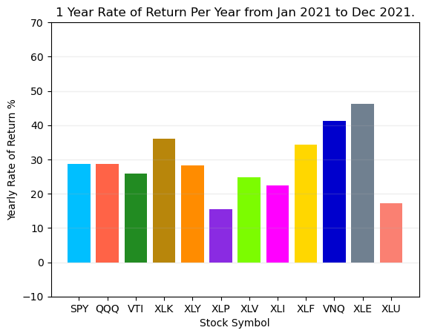
We then graphed those results for 10, 5, 3 and 1 year Rate of Return for all of our Stock Indexes using a Bar Chart:

Slide 6
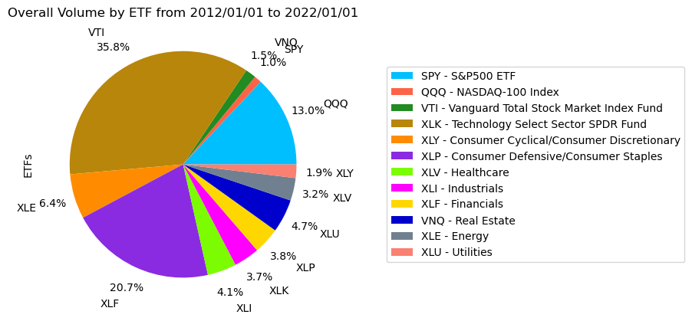
Top 10 Industries by Volume:

Slide 7
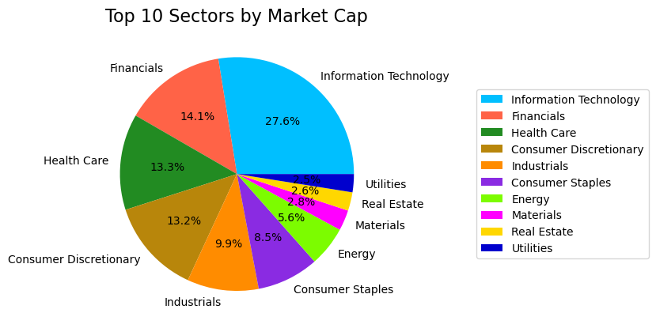
Top 10 Sectors by Market Cap:

Slide 8
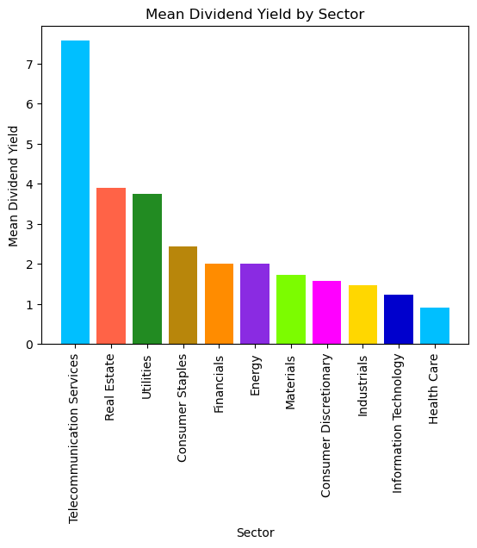
Mean Dividend Yield by Sector:

Slide 9
Project Learnings and Questions?

