Slide 1
LEARN | BUILD | COMPARE | DETECT
NEAR-DUPLICATE
DOCUMENT DETECTION FRAMEWORK
Shingling, SimHash, MinHash, Jaccard and Cosine Similarity
SHINGLE
HASH
COMPARE
PROJECT DETAILS
A web application that finds documents that are almost, but not exactly, identical by comparing their shingles, hash fingerprints and word vectors.
Department: Computer Science and Engineering
Subject: Data Structures and Algorithms
Stack: FastAPI, React, scikit-learn
Academic Project | Review Presentation

Slide 2
PROJECT RECAP
Project Overview
FROM DOCUMENTS TO FINGERPRINTS TO SCORES
01
02
03
04
05
Document Input
Text Preprocessing
Shingling
SimHash / MinHash
Similarity & Report
Upload two or more TXT, PDF or DOCX files.
Lowercase, remove noise, tokenize and drop stop words.
Turn each document into a set of overlapping k-word shingles.
Build compact fingerprints and signatures.
Score each pair, label it and save it to history.
Core idea: do not rely on one metric. Exact scores (Jaccard, cosine) and estimates (MinHash, SimHash) are shown separately.
02

Slide 3
CURRENT STATUS
Implementation Progress
WHAT IS BUILT AND WHAT IS STILL PLANNED
Upload & validation
100%
Preprocessing & shingling
100%
SimHash & MinHash
100%
Jaccard & cosine
100%
History & CSV export
100%
Learning pages & PDF report
0%
Current focus: add the algorithm learning pages, the PDF report and side-by-side text panels.
03

Slide 4
SYSTEM ARCHITECTURE
System Architecture
REACT FRONTEND, FASTAPI BACKEND, LOCAL HISTORY
PREPROCESS
USER
REACT UI
Vite + Tailwind
FASTAPI
REST API
RESULTS & CSV
SHINGLING
SIMHASH / MINHASH
HISTORY DB
SQLite
SIMILARITY
Files are parsed in memory and never stored. History keeps file names and scores only.
04

Slide 5
INPUT & PREPROCESSING
Input & Preprocessing
CLEAN TEXT, CONSISTENT TOKENS, READY FOR COMPARISON
INPUT
Lowercase
Clean
Tokenize
Filter
Normalize
TXT / PDF / DOCX text
Two or more documents
Shingle size k
Number of MinHash functions
Detection threshold
Standardize letter case
Remove punctuation and symbols
Split into words
Remove stop words
Collapse extra whitespace
Why preprocessing matters
The same sentence can differ in case, spacing or punctuation. Normalizing removes false differences before shingles are built.
05

Slide 6
DSA ALGORITHMS
DSA Algorithms
COMPACT SIGNATURES FOR FAST NEAR-DUPLICATE COMPARISON
Shingling
SimHash
MinHash
Set of overlapping k-word sequences
64-bit fingerprint, weighted word votes
Signature that estimates Jaccard
Jaccard
TF-IDF Cosine
Hamming Distance
|A ∩ B| / |A ∪ B|, exact
Angle between word vectors
Differing bits between fingerprints
SimHash and MinHash are different algorithms: SimHash compares word content, MinHash estimates shingle-set overlap.
06

Slide 7
DETECTION FLOW
Near-Duplicate Detection Flow
FROM TEXT TO SHINGLES TO FINAL LABEL
Doc A + B
Preprocess
Shingle
Hash
Score
Label
Highly Similar
Moderately Similar
Low Similarity
Jaccard at or above threshold
Between half and full threshold
Below half the threshold
Decision rule: the label follows Jaccard against the threshold you set. A score is evidence, not proof of copying.
07

Slide 8
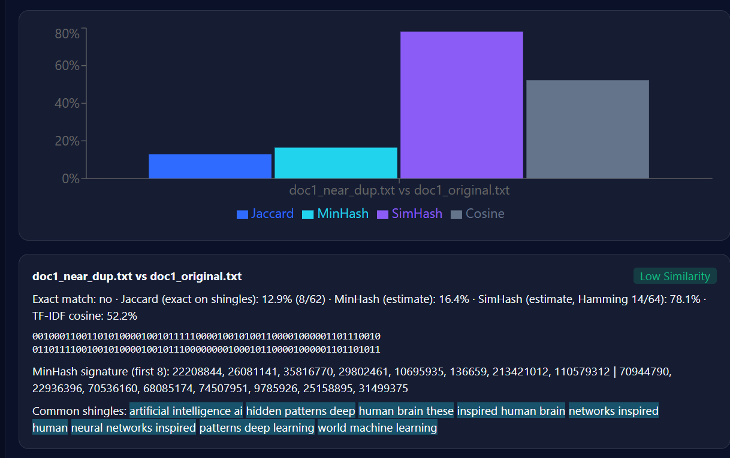
DOCUMENT ANALYSIS
Document Analysis
REAL OUTPUT FOR doc1_near_dup vs doc1_original
12.9%
16.4%
Jaccard
MinHash
78.1%
52.2%
SimHash
Cosine
8 of 62 shingles are shared; Hamming distance is 14 of 64 bits.
08

Slide 9
SIMILARITY SCORES
Similarity Scores
FOUR MEASURES FROM ONE REAL COMPARISON
Jaccard (exact)
12.9%
MinHash (estimate)
16.4%
SimHash (estimate)
78.1%
TF-IDF cosine (exact)
52.2%
Why they differ
MinHash vs Jaccard
Jaccard needs identical word sequences; cosine and SimHash compare word content.
MinHash approximates Jaccard, so 16.4% vs 12.9% is estimation error.
09

Slide 10
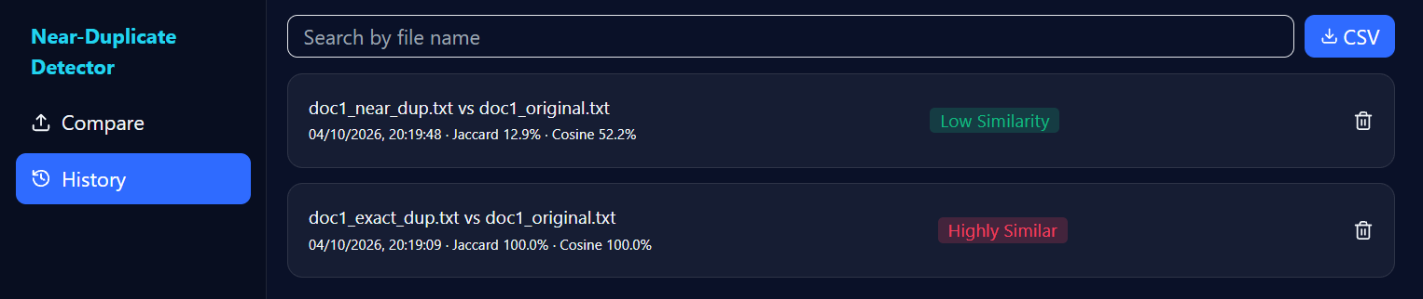
IMPLEMENTATION & UI
Implementation & User Interface
FROM ANALYSIS ENGINE TO A SIMPLE REVIEW EXPERIENCE
TECHNOLOGY STACK
Frontend React, Vite, Tailwind, Recharts
Backend Python, FastAPI
Algorithms NumPy, scikit-learn
Files PyMuPDF, python-docx
Storage SQLite history
History page: each comparison is saved with time, scores and label; entries can be searched, deleted or exported.
10

Slide 11
ALGORITHM RESULT EXAMPLE
Algorithm Result Example
ACTUAL OUTPUT FROM THE APPLICATION
Shingling
8 of 62 shingles shared
FINAL LABEL (JACCARD)
SimHash
Hamming 14/64 = 78.1%
12.9%
MinHash
16.4% estimated Jaccard
LOW SIMILARITY
TF-IDF cosine
52.2% vector similarity
Exact duplicate pair: Jaccard 100%, cosine 100%, Highly Similar.
Exact match
No
Lower the threshold in the app to classify this near-duplicate pair as similar.
11

Slide 12
REMAINING WORK
Remaining Work
FROM A WORKING CORE TO A COMPLETE SYSTEM
Learning pages
Text panels
Interactive pages for shingling, SimHash, MinHash and Hamming distance.
Show original and preprocessed text side by side with matching passages.
PDF report
PostgreSQL
Add a downloadable PDF alongside the CSV export.
Store users and reports when persistence is needed.
Threshold tuning
Large corpora
Test low, medium and high similarity cases.
Add LSH banding to compare many documents quickly.
FINAL REVIEW: validated accuracy, clear evidence and a polished interface.
12

Slide 13
CONCLUSION
Conclusion
A SMARTER WAY TO FIND NEAR-DUPLICATE DOCUMENTS
Efficient
Multi-Signal
Transparent
Configurable
Compact fingerprints replace full-text comparison.
Exact and estimated scores complement each other.
Every score is computed from the real files.
Shingle size, hash count and threshold are adjustable.
PROJECT OUTCOME: raw documents become measurable, reviewable similarity evidence.
THANK YOU
13

