Slide 1

April 2026
Modeling Fire Using a Convolution Algorithm within ArcGIS Pro
Implementation of a Directional Cellular Automata within ArcGIS Pro using Python
Patrick Maher
Undergraduate Student, The University of Texas at Austin

Slide 2
Wildfire Risk
Steadily increasing everywhere
Rapidly increasing in the American Southwest, including Texas
Becomes increasingly important as rangelands are turned into subdivisions at the edge of the human-wildland interface

Slide 3
Fire Modeling
Assists in wildfire mitigation by predicting fire spread in undisturbed conditions
Model outputs are useful for projecting fire risk for insurance purposes
Major wildfire modeling is not integrated with industry GIS technology
Even simple models within GIS are useful and increase access to model-driven decisionmaking

Slide 4
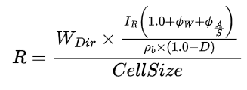
Core Methodology
A simplified version of the Rothermel fire spread equation is implemented
Fire spread rate is calculated at every neighbor of every burning cell using the below equation.
R = Fire Spread Potential
Wdir = Wind direction influence
IR = Fire Intensity
ɸw = Directionless wind speed multiplier
ɸA/S = Aspect influence divided by slope influence
⍴b = Fuel sink flammability (fuel density)
(1-D) = Fuel Drying Length

Slide 5
Internal Data Processing Steps
Terrain Analysis Functions
Slope
Aspect
Reclassification of Anderson 13 Fuel Model
Burn-Intensity
Required Ignition Energy

Slide 6
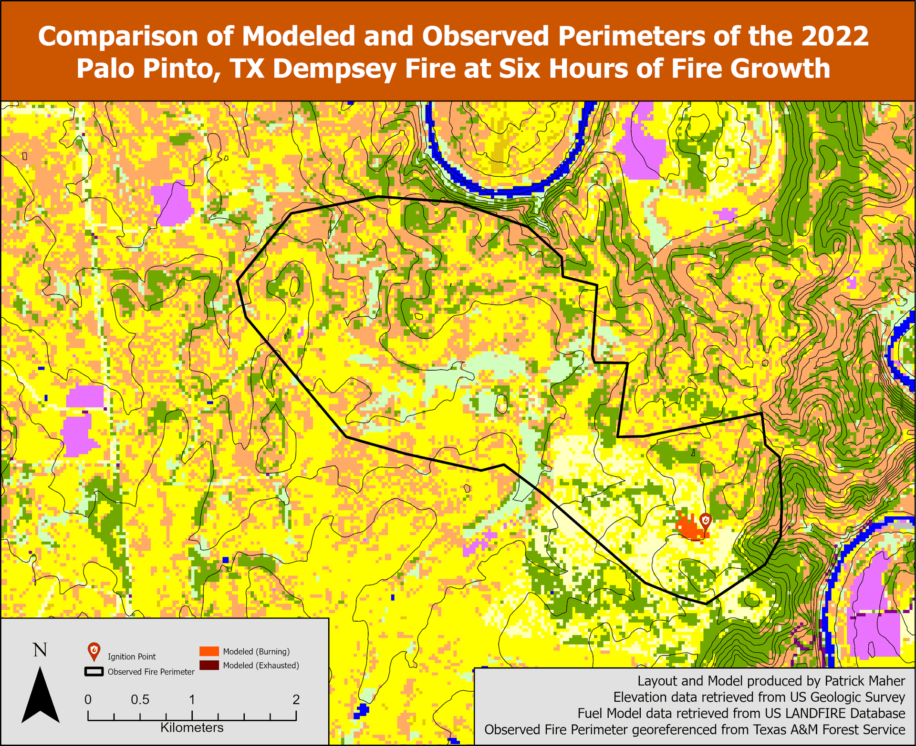

Slide 7
Results
The model is somewhat accurate at predicting early spread of a historic fire, but overestimates fire spread, especially in longer assessments
Accuracy Assessment Indicates:
Kappa Score of 0.653
Type 1 Fire Classification Accuracy of 68%
Type 2 Fire Classification Accuracy of 92%

Slide 8
Limitations
Grid-based spread models handle diagonal spread poorly.
Potential for over-calibration of model to study area
Poor data for observed fire spread limits the ability to test model accuracy
Simplification of heat fluxes into spread probabilities is unrealistic
Computationally expensive
Wind is a global parameter and doesn’t interact with terrain

Slide 9
Conclusions
The cellular model as produced is a useful baseline tool for predicting wildfire spread and is reasonably accurate.
Additional work needs to be done calibrating parameter values and transition rules to increase model accuracy.
Supplemental functions, including the ability to resume a model and automatically create output maps should be added to increase the model’s usefulness.

Slide 10
References
1. Alexander, M., & Cruz, M. (2019). A rule of thumb for estimating a wildfires’s forward spread rate.
2. Anderson, H. E. (1982). Aids to determining fuel models for estimating fire behavior (INT-GTR-122; p. INT-GTR-122). U.S. Department of Agriculture, Forest Service, Intermountain Forest and Range Experiment Station. https://doi.org/10.2737/INT-GTR-122
3. Andrews, P. L. (2018). The Rothermel surface fire spread model and associated developments: A comprehensive explanation (RMRS-GTR-371; p. RMRS-GTR-371). U.S. Department of Agriculture, Forest Service, Rocky Mountain Research Station. https://doi.org/10.2737/RMRS-GTR-371
4. Baranovskiy, N. V., & Kirienko, V. A. (2022). Forest Fuel Drying, Pyrolysis and Ignition Processes during Forest Fire: A Review. Processes, 10(1). https://doi.org/10.3390/pr10010089
5. Brian L Tolk (CTR), Inga P La Puma, Daryn J Dockter (CTR), Charley M Martin, Paul F Bourget (CTR), Sean D Beverly, Eva L Soluk, Deborah Lissfelt (CTR), Sofronio C Propios (CTR), Lucas J Porter (CTR), Erica J Degaga, Tobin Smail (CTR), & Jacob G Casey (CTR). (n.d.). LANDFIRE 2022 (230) Update [Dataset]. U.S. Geological Survey. https://doi.org/10.5066/P974JF8W
6. Grishin, A. M., Zima, V. P., Kuznetsov, V. T., & Skorik, A. I. (2002). Ignition of Combustible Forest Materials by a Radiant Energy Flux. Combustion, Explosion and Shock Waves, 38(1), 24–29. https://doi.org/10.1023/A:1014097631884
7. McAllister, S., Grenfell, I., Hadlow, A., Jolly, W. M., Finney, M., & Cohen, J. (2012). Piloted ignition of live forest fuels. Fire Safety Journal. 51: 133-142., 133–142. https://doi.org/10.1016/j.firesaf.2012.04.001
8. Mindykowski, P., Fuentes, A., Consalvi, J. L., & Porterie, B. (2011). Piloted ignition of wildland fuels. Fire Safety Journal, Forest Fires, 46(1), 34–40. https://doi.org/10.1016/j.firesaf.2010.09.003
9. Xu, H., Zlatanova, S., Liang, R., & Canbulat, I. (2025). Generative AI as a Pillar for Predicting 2D and 3D Wildfire Spread: Beyond Physics-Based Models and Traditional Deep Learning. Fire, 8(8). https://doi.org/10.3390/fire8080293
10. Xu, Y., Li, D., Ma, H., Lin, R., & Zhang, F. (2022). Modeling Forest Fire Spread Using Machine Learning-Based Cellular Automata in a GIS Environment. Forests, 13(12). https://doi.org/10.3390/f13121974

Slide 11

Try it yourself! (Github Repository)

Slide 12
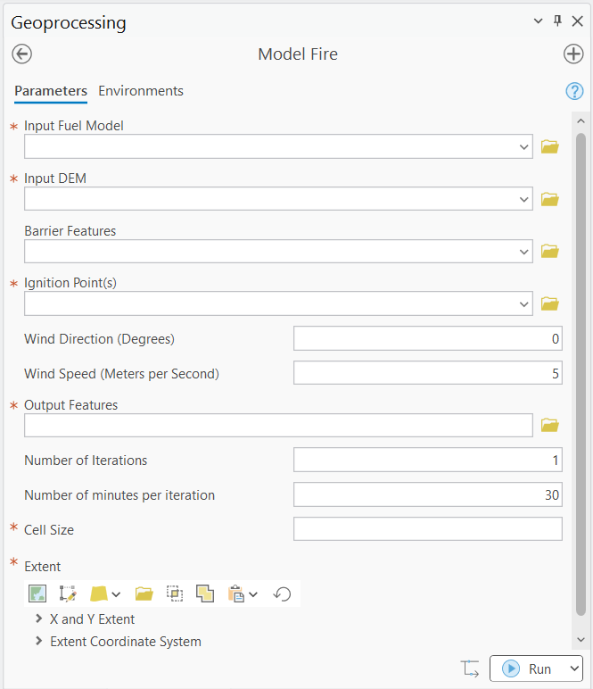
Toolbox User Interface
Required data:
DEM Elevation Dataset
LANDFIRE Anderson13 Surface Fuel Model
Ignition Points (User Input)
Nearly all data preprocessing is handled by the toolbox, it is essentially plug and play.
To install:
Download ArcAutoFire-v1.0.zip from releases and unzip folder
In ArcGIS’s Catalog pane, right click on the toolboxes folder and click “Add Toolbox”
Select ArcAutoFire.pyt
That’s it!

