Slide 1
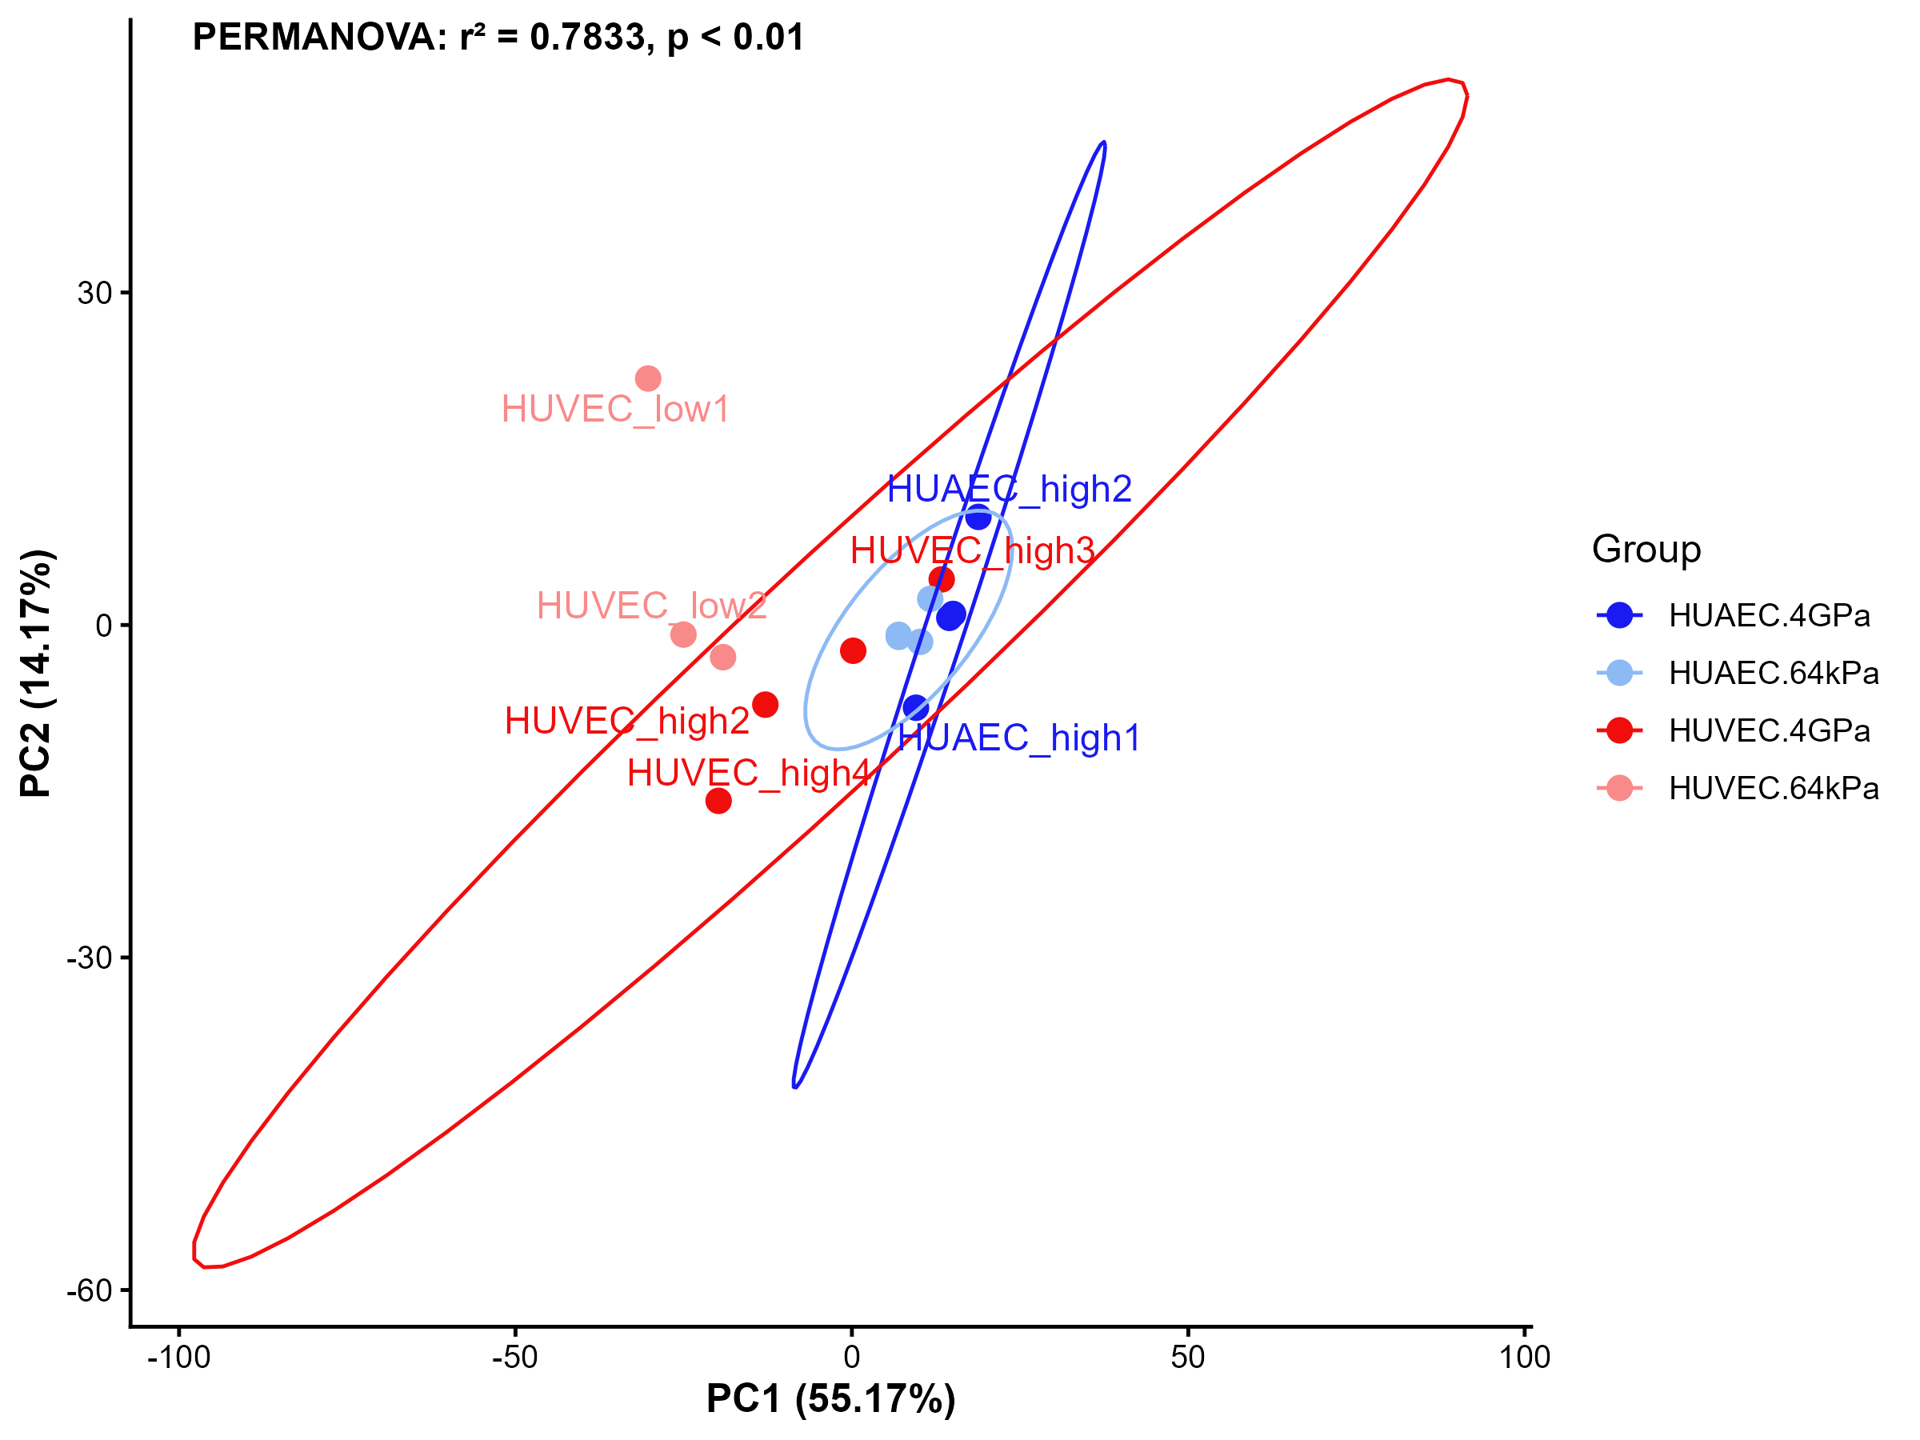
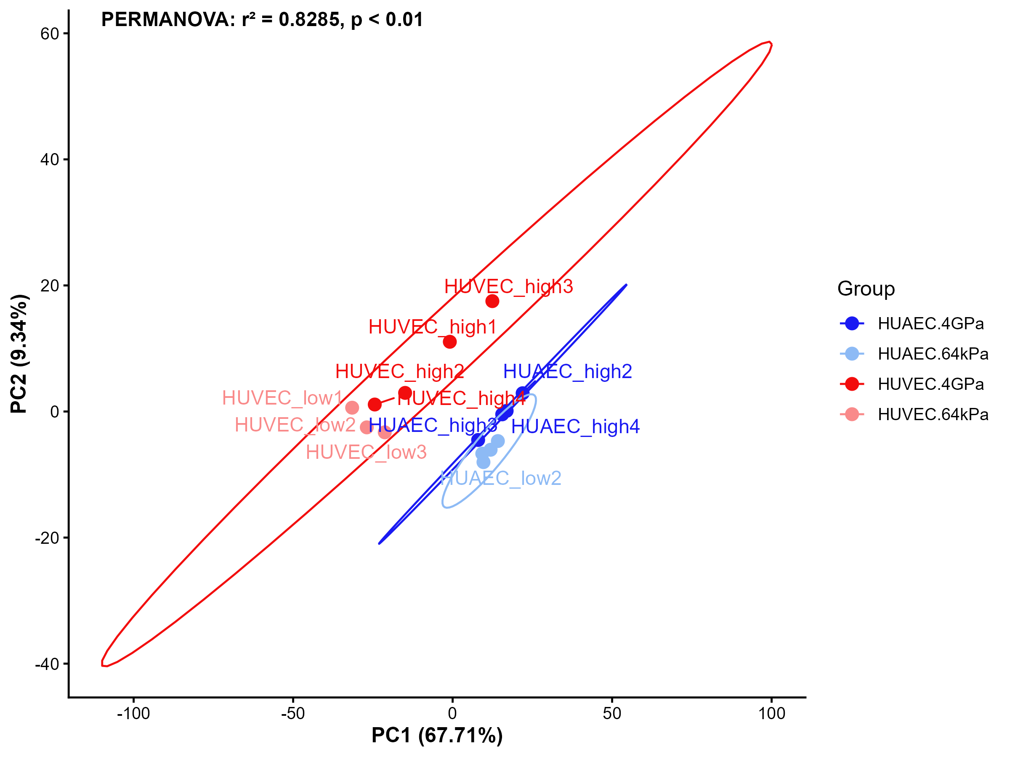
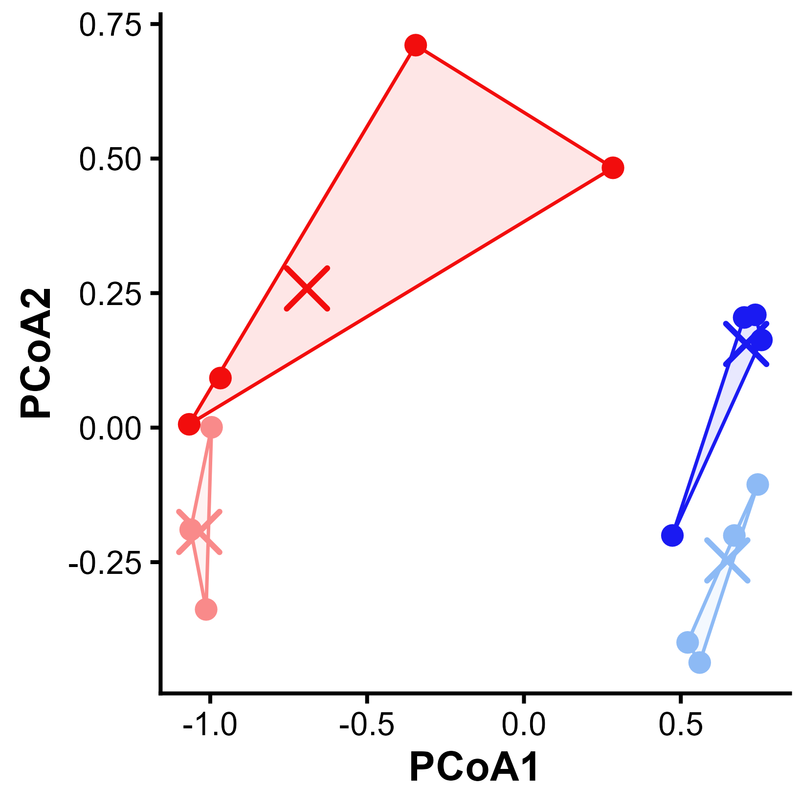
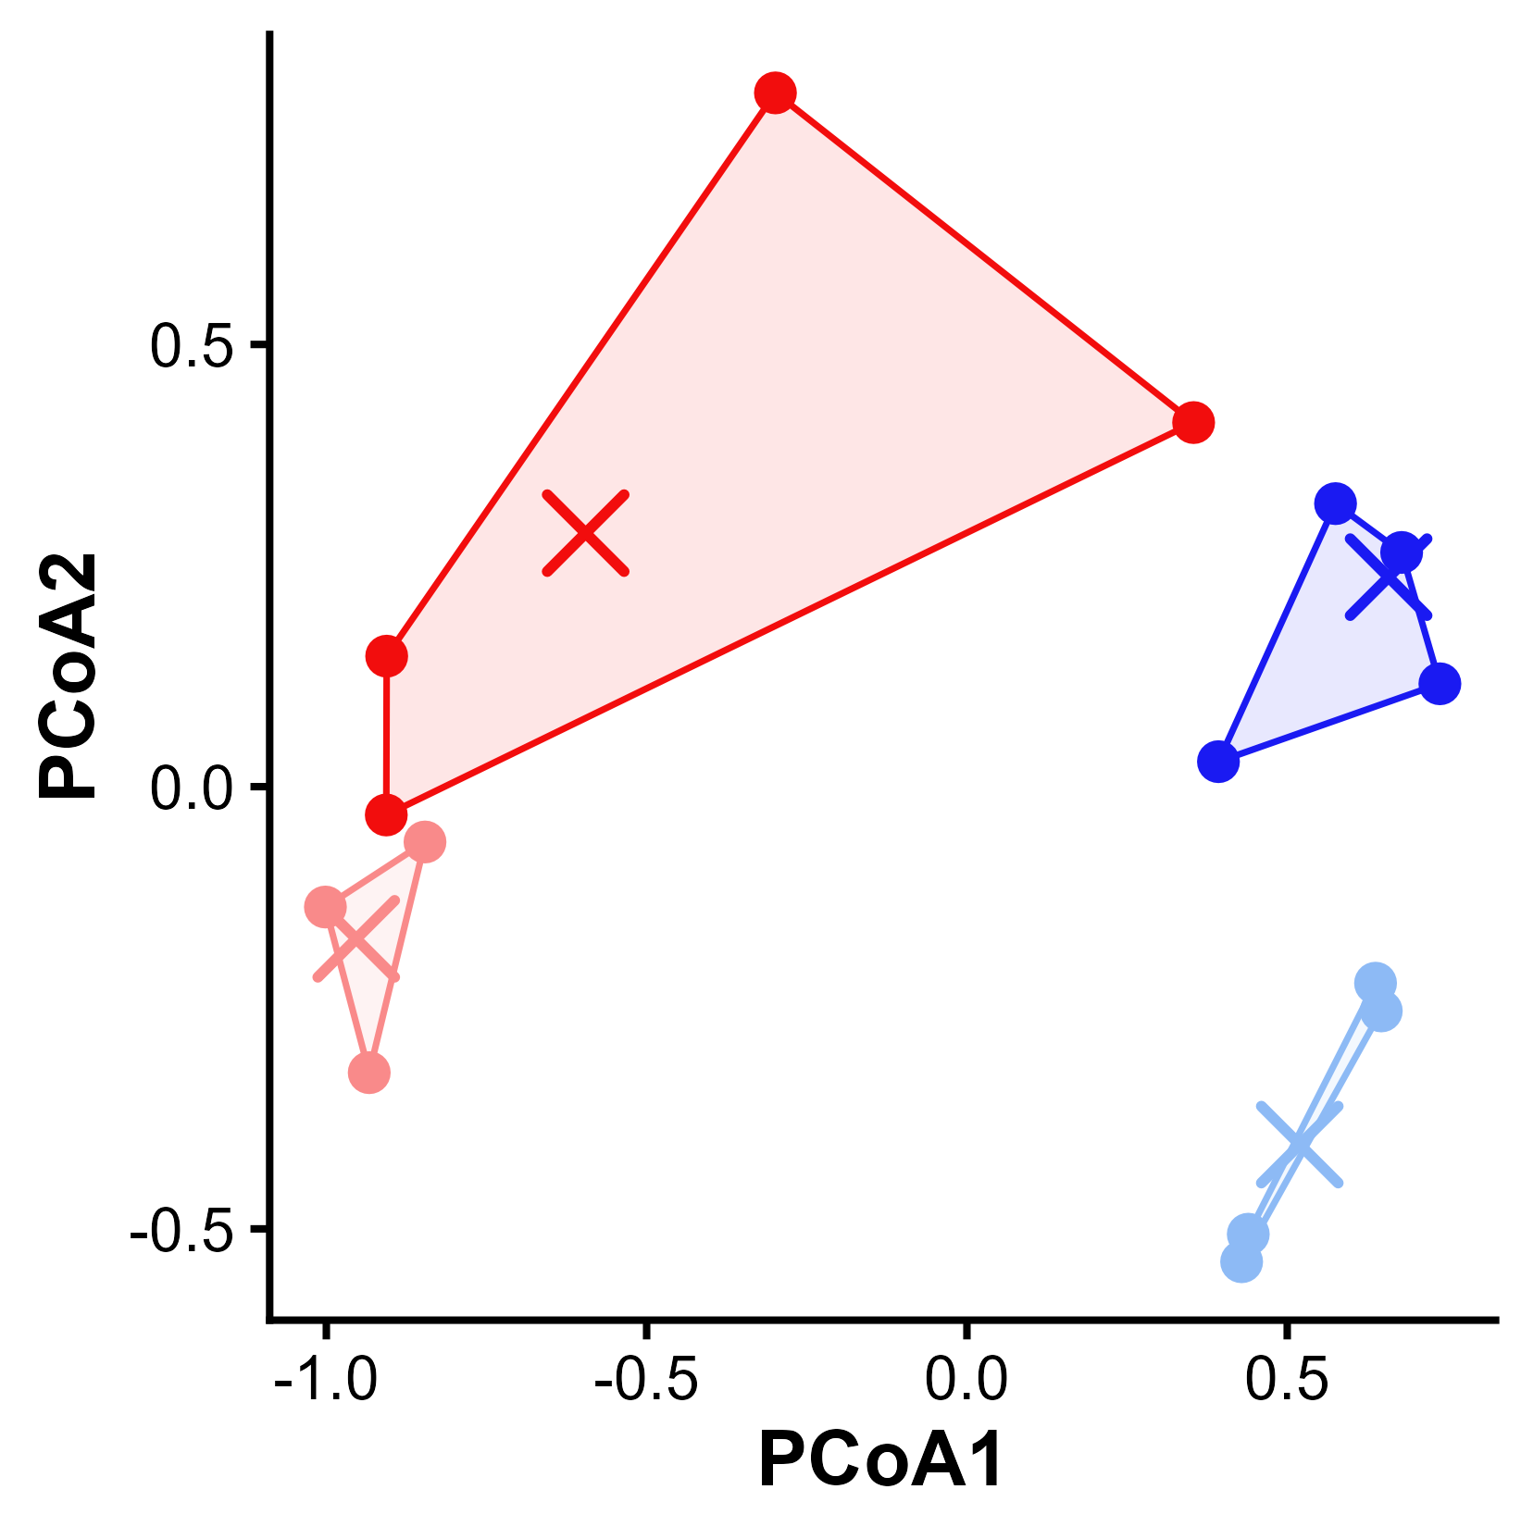
Nueva figura 2A
Nueva figura 3A

Slide 2
Nueva Figura 4

Slide 3
A
B
C
Genes regulated by transcriptional mechanisms
Genes regulated by both transcriptional and alternative splicing mechanisms
DGE
DTU
(genes)
610
1386
Genes regulated mainly by alternative splicing
153
D
E
UpSet plot
HUVEC 64kPa vs HUAEC 64kPa

Slide 4
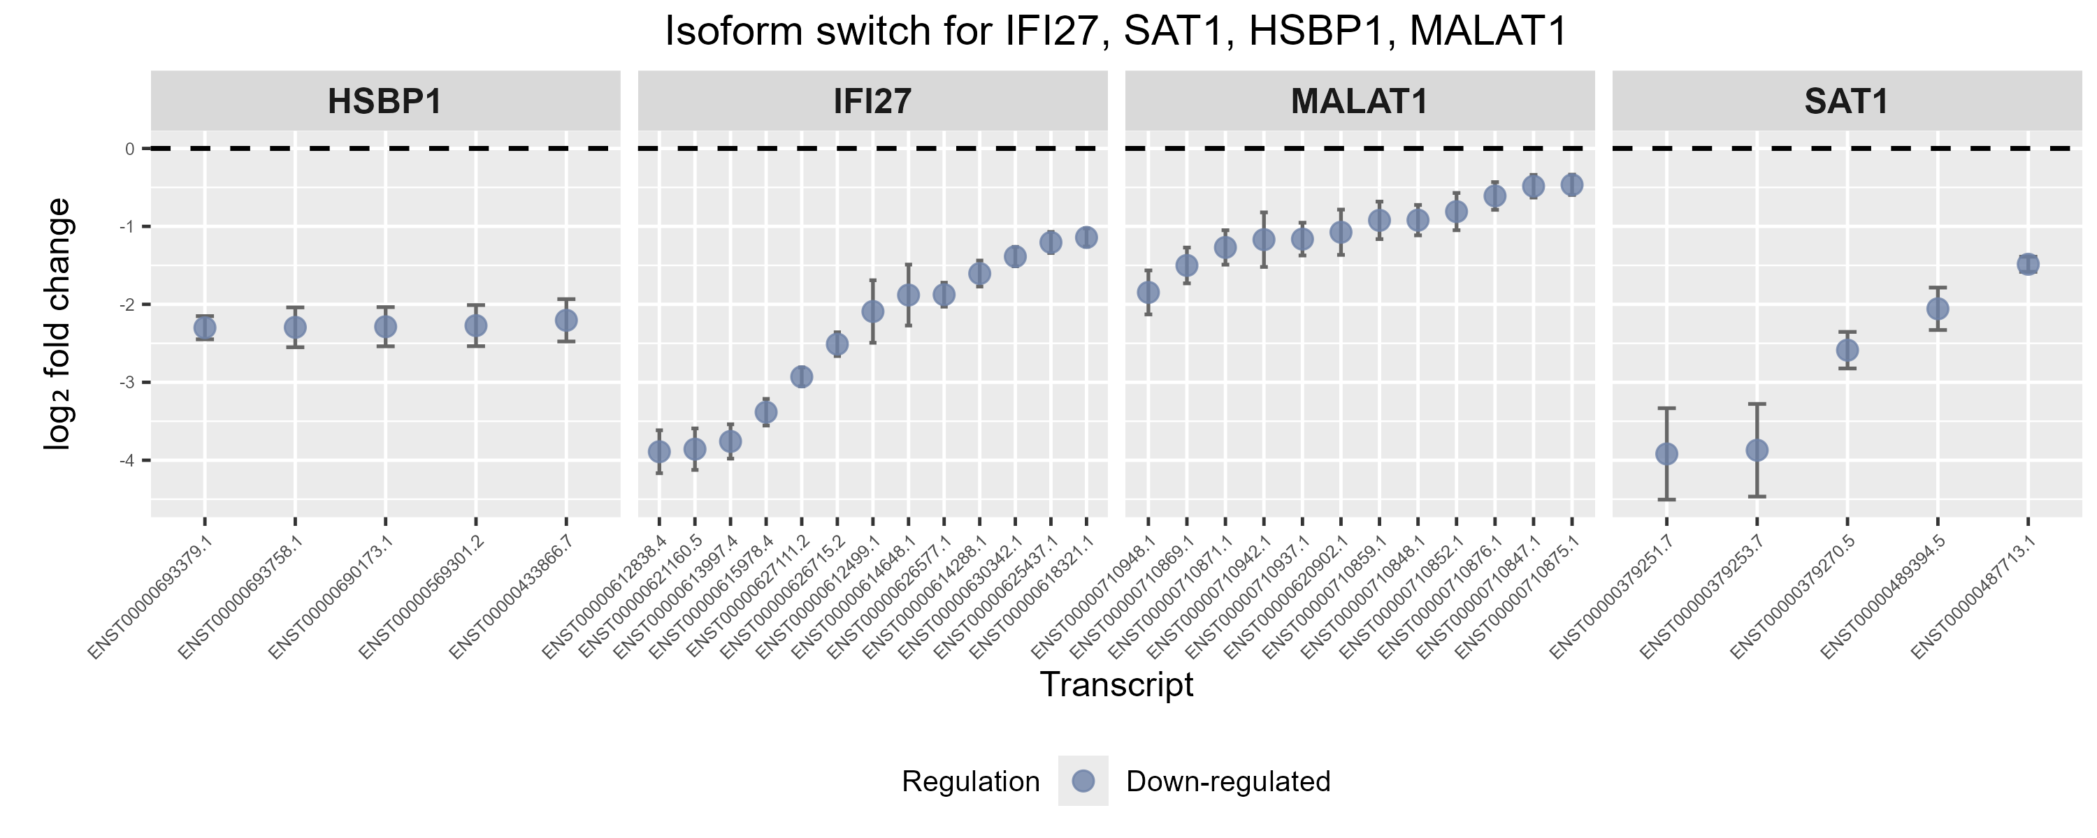
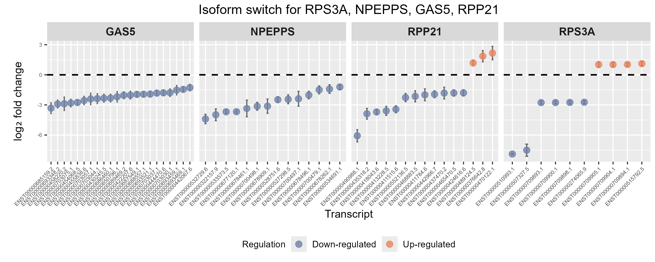
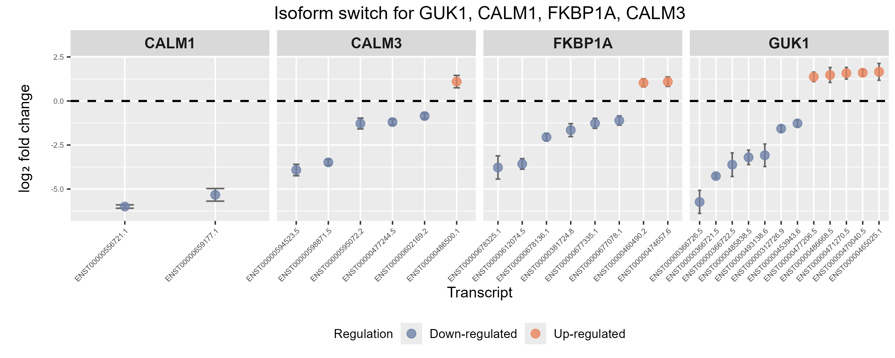
F
Arterio-venous DEG
Top DTU score with DEG
Top DTU score no DEG

Slide 5
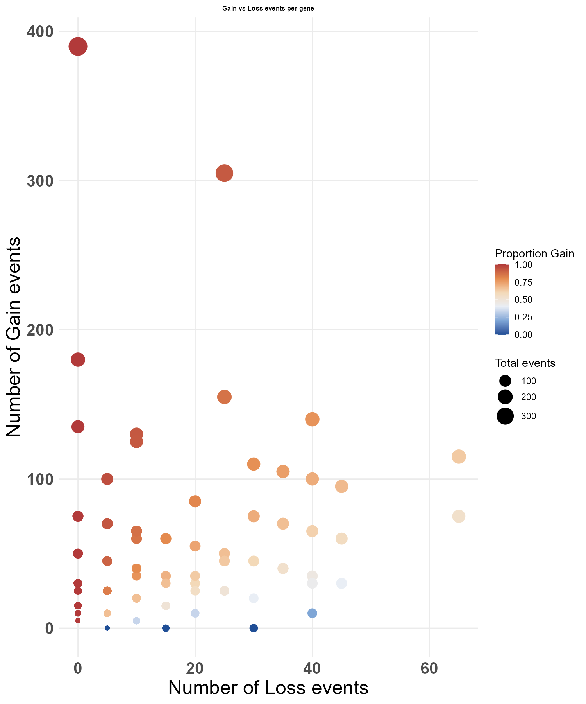
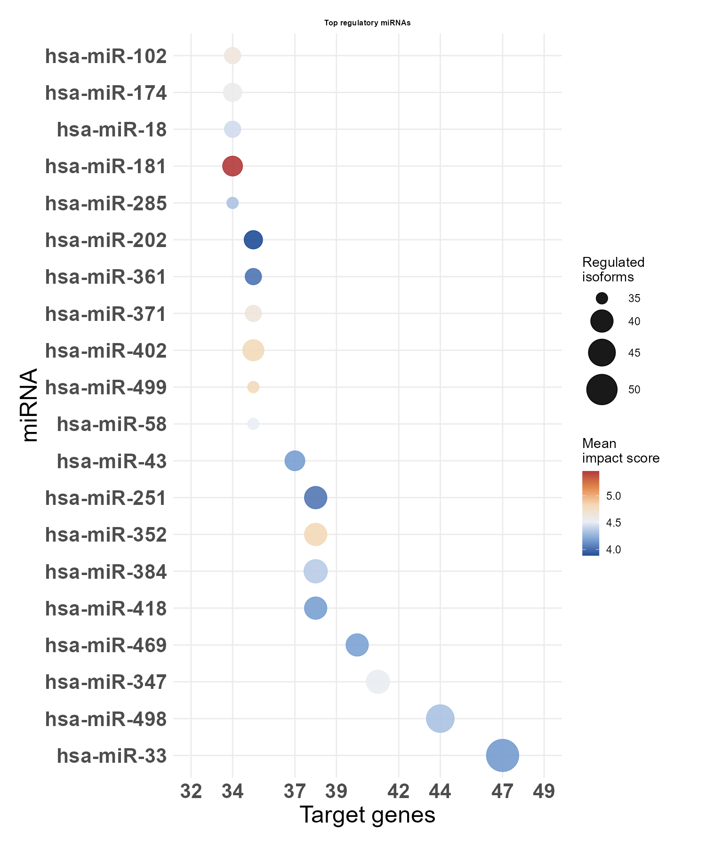
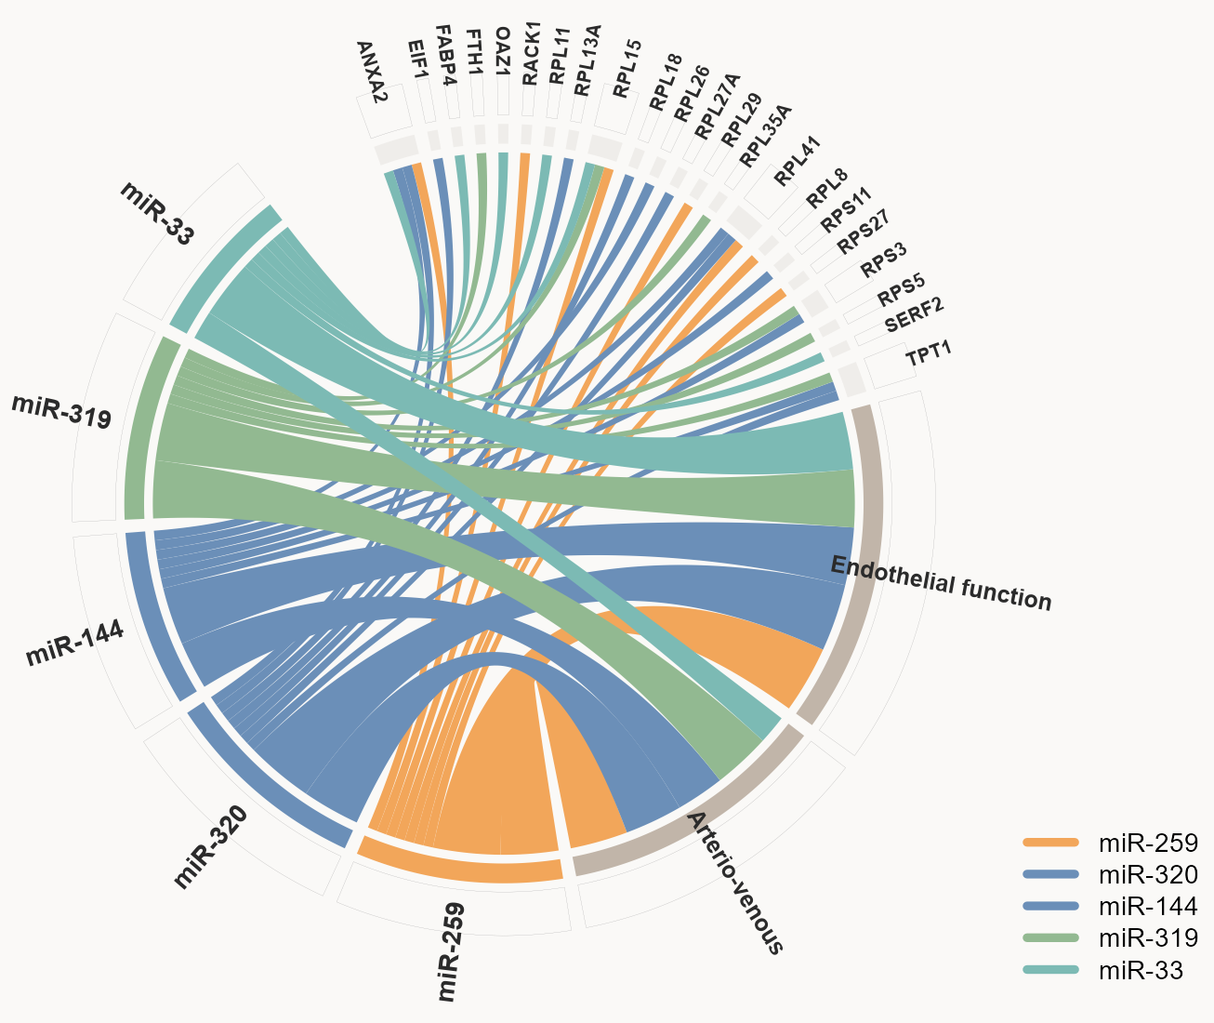
G
H
I

Slide 6

