Slide 1
☁
WHAT IS CLOUDDROP?
A cloud-native file management platform — upload, store, view, download and delete files securely at scale. Deployed on AWS CloudFront + EC2 + S3 + RDS.
CloudDrop
🌐 LIVE: d2q0tos3eezbrk.cloudfront.net
File Upload App on AWS
4
7
1
TechCrush Bootcamp // Group 1 // Capstone 2026
AWS Services
Tech Layers
Live App
Upload files to AWS S3
Presigned secure downloads
Search, filter & manage files
Delete from S3 + database
Notes:
Open with: 'CloudDrop is a production-style cloud file management app — not a tutorial project. It is live right now at d2q0tos3eezbrk.cloudfront.net, serving files from AWS S3, powered by a PostgreSQL database on RDS, and deployed automatically via GitHub Actions.'

Slide 2
The Problem We're Solving
Why organisations need cloud-based file management
⚠️
Limited Storage
🔒
Poor Accessibility
💥
Data Loss Risk
Local drives run out quickly with no easy way to expand capacity.
Files locked to one device — inaccessible remotely or by teammates.
No automatic backups. One hardware failure can wipe everything permanently.
📉
No Scalability
🗂️
Poor File Management
✅
CloudDrop Solves This
Traditional systems can't grow with demand — upgrades are slow and costly.
No structured way to search, track, or organise who uploaded what and when.
Scalable, accessible, secure cloud storage — AWS S3 + PostgreSQL + CloudFront.
Notes:
Walk through each problem. The last card is your pivot to CloudDrop. These are real problems faced by individuals and organisations every day.

Slide 3
Tech Stack — Every Layer Explained
What was used, what role it plays, and why it was chosen
Frontend
React + Vite
Dynamic UI — file list updates instantly. Vite provides fast production builds.
Backend
Node.js + Express
Handles all API logic. Sits between React and AWS — keeps credentials secure on server.
File Storage
Amazon S3
Stores actual files. Scalable, durable, 99.999999999% durability. 50MB upload limit.
Database
PostgreSQL on RDS
Stores file metadata — name, size, date, category. Enables search and filtering.
CDN + Security
CloudFront + AWS WAF
HTTPS globally via CDN. WAF protects against malicious traffic. Custom origin to EC2.
Hosting
EC2 + Nginx + PM2
EC2 runs Node.js. Nginx reverse proxy. PM2 keeps app alive after crashes or reboots.
CI/CD
GitHub Actions
Auto-deploys to EC2 on every push. Zero manual deployments. Completed in 51 seconds.
Notes:
Read the WHY column for each row — that's what impresses assessors. Highlight the CloudFront + WAF row — most bootcamp projects don't include a CDN or Web Application Firewall. That's enterprise-level thinking.

Slide 4
System Architecture
CloudFront CDN → EC2 → S3 + PostgreSQL RDS
User
Browser
CloudFront
+ WAF
EC2
+ Nginx
Amazon
S3
PostgreSQL
RDS
HTTPS
HTTP/80
Upload
Query
Any Device
HTTPS + Security
Node.js + Express
File Storage
Metadata DB
Upload Flow:
Browser → CloudFront (HTTPS) → Nginx (Port 80) → Node.js → Multer-S3 streams file → S3. Metadata → PostgreSQL
View Files:
React calls GET /api/files → Node.js queries PostgreSQL → Background S3 sync runs → File list returned to browser
Download Flow:
Node.js generates presigned S3 URL (1hr expiry) → Browser downloads directly from S3 — files never permanently public
Delete Flow:
Node.js deletes from PostgreSQL first → Then deletes from S3 → Both always in sync. No orphaned records remain
Notes:
Key points: CloudFront provides HTTPS and CDN — the app is served globally with low latency. WAF is configured to COUNT (not block) large file uploads over 8KB to allow multipart uploads. The delete flow removes from BOTH services — no orphaned data.

Slide 5
Architecture Highlights
Production-grade features built into CloudDrop
🔄
Graceful Fallback Mode
🔐
Security Architecture
Full Mode: S3 + PostgreSQL working together
helmet middleware — blocks XSS, clickjacking, MIME sniffing
S3-Only Mode: if DB is unreachable, app keeps serving files
AWS WAF — Web Application Firewall via CloudFront
App NEVER goes fully down — always functional
Presigned S3 URLs expire after 1 hour automatically
Every controller has explicit DB fallback logic
GitHub Secrets store all credentials — never in code
⚡
Background Database Sync
🌐
CloudFront Production Stack
On every list request S3 and PostgreSQL are compared
HTTPS served globally via CloudFront CDN
Files in S3 but missing from DB are automatically added
WAF SizeRestrictions_BODY set to Count — allows 50MB uploads
Files deleted from S3 are removed from DB automatically
Nginx serves React build + proxies /api/ to Express
Users always see accurate, consistent file lists
PM2 auto-restarts Node.js after crashes or reboots
Notes:
Lead with Graceful Fallback — most student projects crash when one service fails. CloudDrop keeps running. Then mention AWS WAF — that is enterprise security configuration most developers never touch in their first job.

Slide 6
REST API Design
// server/src/routes/files.js
Six clean endpoints — each with a single clear responsibility
GET
/api/health
Health check — confirms app status, DB mode (full vs S3-only), timestamp
GET
/api/files
List all files — supports ?category= and ?search= query filters
GET
/api/files/stats
Returns total file count and total storage size in bytes
POST
/api/files/upload
Upload file — streamed directly from browser to S3 via Multer-S3
GET
/api/files/:id/download
Generates presigned S3 URL with 1-hour expiry for secure download
DELETE
/api/files/:id
Deletes from both S3 and PostgreSQL atomically — no orphaned records
💡 Every endpoint has a database fallback — if PostgreSQL is unavailable the API continues serving files directly from S3
Notes:
Mention the health endpoint first — it tells you which mode the app is running in. The download endpoint is the most security-conscious one — presigned URLs mean files are NEVER directly exposed to the internet.

Slide 7
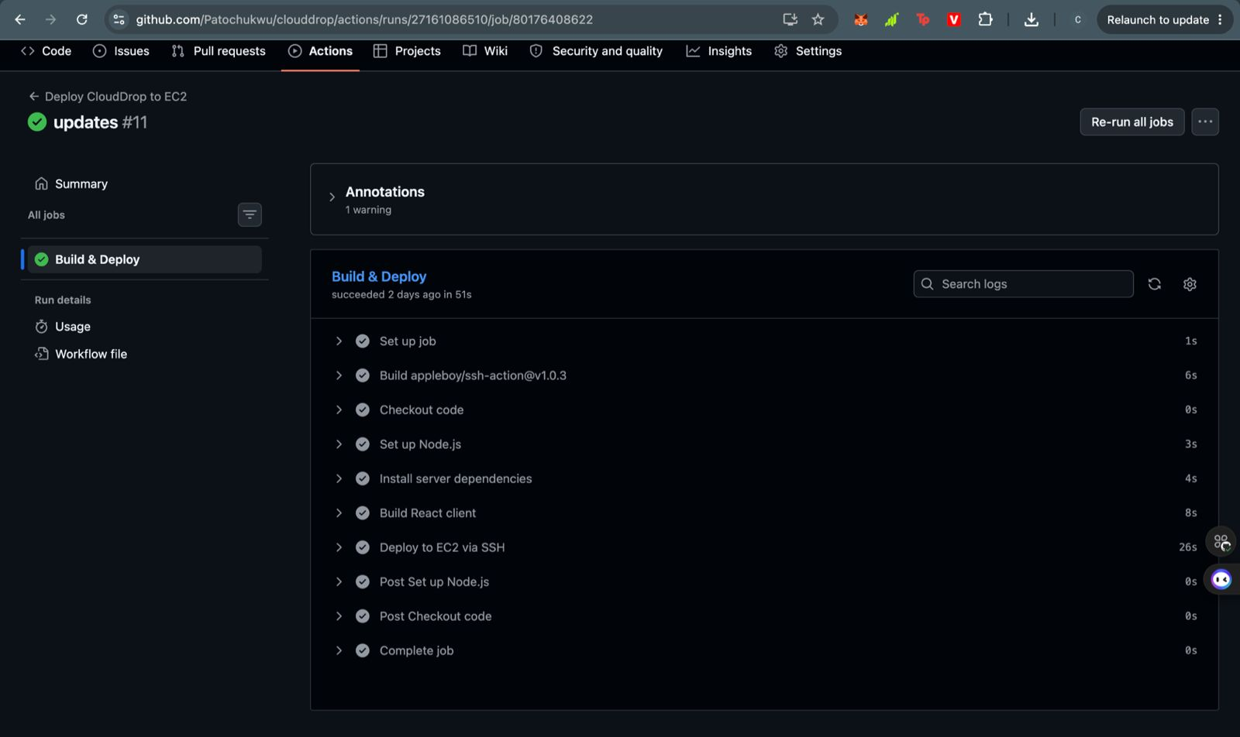
CI/CD Pipeline — Live Evidence
GitHub Actions deploying CloudDrop to EC2 — Build #11 succeeded in 51 seconds
💻
📦
✅ LIVE PIPELINE — BUILD #11
1
2
Push to clouddrop branch
Install dependencies
Commit triggers the workflow automatically
npm ci installs server packages from lock file
3
🏗️
4
🔑
Build React client
SSH into EC2
Vite compiles React. VITE_API_URL injected from Secrets
appleboy/ssh-action uses EC2_SSH_KEY secret
5
🔄
6
🚀
git reset --hard
PM2 restart
Pulls latest code — prevents merge conflicts on server
Node.js restarts with new code. App live in seconds
✅ All steps green // Build succeeded // Deployed in 51 seconds // Zero manual intervention
Notes:
Point to the screenshot and say: 'This is our actual pipeline — Build number 11. Every step shows a green tick. It completed in 51 seconds. From code push to live deployment with zero manual SSH into the server.'

Slide 8
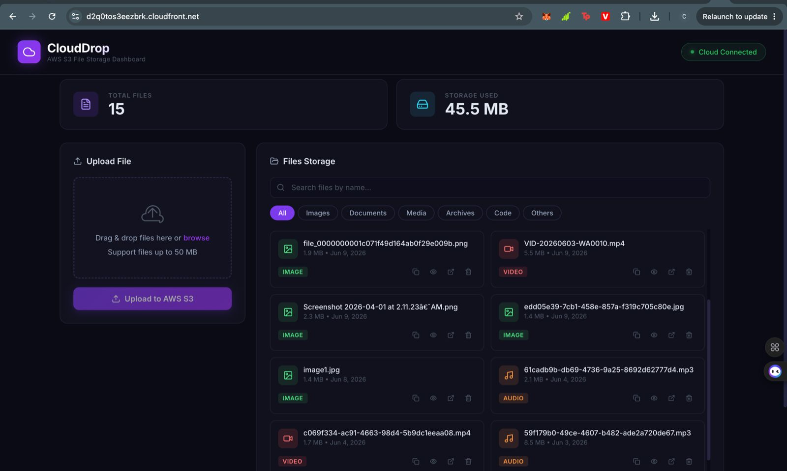
Live Application
TechCrush Group 1 — CloudDrop live at d2q0tos3eezbrk.cloudfront.net — 15 files, 45.5MB stored
☁️
Hosted On
📁
Total Files
💾
Storage Used
🔗
Status
🗂️
Categories
AWS CloudFront
15 Files
45.5 MB
Cloud Connected
Images, Video, Audio, Docs
Notes:
Let the screenshot speak. Say: 'This is the live application — accessible to anyone with the URL right now. You can see 15 files uploaded across different categories — images, video, audio. The Cloud Connected badge confirms S3 is live.'

Slide 9
Deployment Process
Nine steps from zero to live application on AWS
01
Launch EC2 Instance
02
Open Security Group Ports
03
Install Node.js + PM2
Ubuntu t2.micro. Key pair created. Security groups configured.
Port 22 (SSH), Port 80 (Nginx HTTP), Port 5000 (Node.js).
Node.js 24 via NodeSource. PM2 installed globally for process management.
04
Create S3 Bucket
05
Create PostgreSQL RDS
06
Setup CloudFront + WAF
Bucket policy configured. CORS set for CloudFront origin. 50MB limit.
RDS instance. Security group allows EC2 on Port 5432 only.
CloudFront distribution with EC2 as custom origin. WAF configured for file uploads.
07
Configure Environment Vars
08
Configure GitHub Actions
09
Deploy + Test
server/.env created — AWS keys, DATABASE_URL, S3_BUCKET_NAME, CLIENT_URL.
EC2_HOST, EC2_USER, EC2_SSH_KEY, VITE_API_URL added to GitHub Secrets.
npm install, Vite build, PM2 start. Upload, download, delete all tested.
Notes:
Step 6 — CloudFront + WAF — is what elevates this beyond a standard bootcamp project. Most teams deploy directly to EC2 HTTP. This team added HTTPS, CDN, and a Web Application Firewall. Mention that.

Slide 10
Challenges & Solutions
Four real technical problems encountered and resolved — documented in the README
S3 Signature Mismatch on Uploads
CORS Block on Remote Devices
Problem:
Files with special characters or Unicode in filenames failed with 'signature does not match' AWS error.
Problem:
App worked on localhost but blocked requests from EC2 public IP and other devices — CORS errors in browser.
Fix:
Added encodeURIComponent() to metadata in uploadMiddleware.js — ensures only safe ASCII in AWS Signature V4 headers.
Fix:
Compiled React with relative /api path. Updated Express CORS to dynamically match Host header — covers EC2, CloudFront, and custom domains.
Lesson:
AWS Signature V4 is sensitive to header encoding. Always URL-encode metadata values containing filenames.
Lesson:
Never hardcode localhost URLs. Use relative API paths and dynamic CORS validation for multi-environment deployments.
Express Wildcard Crash on Node 24
Mobile Layout Overflow
Problem:
Server crashed on startup with 'PathError: Missing parameter name' — bare wildcard (*) rejected by modern path-to-regexp.
Problem:
Dashboard panels were clipped and stretched on phone screens — unusable on mobile devices.
Fix:
Changed client fallback route to a regex /^(?!\/api).*$/ — cleanly serves React index page for all non-API routes.
Fix:
Added min-width: 0 to panel cards and minmax(0, 1fr) to CSS Grid layouts — forces items to fit inside mobile viewport.
Lesson:
Always test with the Node.js version specified in your deployment. path-to-regexp v8+ breaks bare wildcards.
Lesson:
CSS Grid items default to min-width: auto — they expand beyond their container. Always test on mobile viewports.
Notes:
These four challenges are documented in the README by the developer who solved them. This slide shows real engineering maturity. The S3 signature fix is particularly impressive — that is an advanced AWS issue that trips up experienced developers.

Slide 11
Results & Outcomes
Every feature delivered — live, tested, and working on AWS
☁️
Live on CloudFront
📁
File Upload Works
📋
List + Search + Filter
LIVE
✅ DONE
✅ DONE
App served globally over HTTPS. WAF protection active. Zero downtime.
Files stream to S3 via Multer-S3. Metadata in PostgreSQL. All file types supported.
15 files displayed with name, size, date, category. Search and filter working.
⬇️
Secure Downloads
🗑️
Delete — Fully Synced
🔄
CI/CD — 11 Deployments
✅ DONE
✅ DONE
✅ ACTIVE
Presigned S3 URLs with 1hr expiry. Files never permanently exposed to internet.
Removes from both S3 and PostgreSQL. Background sync keeps both consistent.
GitHub Actions pipeline ran 11 times successfully. Last build: 51 seconds.
Notes:
Every requirement is checked off. Mention Build #11 — the CI/CD pipeline has run 11 times which means the team iterated and improved the app 11 times. That shows active development, not a one-and-done project.

Slide 12
Future Improvements
Where CloudDrop goes next — building on production foundations already in place
Security
DevOps
Infrastructure
🔐
🐳
User Authentication
🔒
Dockerise the App
Custom Domain + SSL Cert
JWT login so each user sees only their files. Role-based access control.
Containerise frontend and backend for consistent cross-environment deploys.
Route53 domain with ACM certificate replacing the CloudFront default URL.
Feature
Scale
Analytics
🔍
☸️
Advanced Search
📊
Kubernetes on EKS
Usage Analytics
Full-text search across file names, types, tags, and upload dates.
Horizontal scaling for thousands of concurrent users using AWS EKS.
Storage charts, upload frequency, file type breakdown dashboard.
Notes:
The infrastructure is already enterprise-grade — CloudFront, WAF, RDS, GitHub Actions. Authentication is the logical next step since the database already stores file metadata per upload. Docker and Kubernetes are on the team's learning roadmap.

Slide 13
👥
Project Contributors
TechCrush Bootcamp // Group 1 // Capstone 2026
1
Oresanya Tumilara
2
Otulagun Paul Olaoluwa
3
Nwodi Chukwudi
4
Adeniyi Raji
5
Timothy Oluwatosin Olaleye
6
Mary Fred
7
Uchenna Monday Nwafor
8
Chukwuma Chisom Linda
9
Tosin Dada
Thank you to everyone who contributed to making CloudDrop a reality 🎉
Notes:
Take a moment here before the conclusion. Say: 'Before we close, we want to acknowledge everyone in Group 1 who contributed to CloudDrop.' Read through the names. Then move to the conclusion slide.

Slide 14
☁
CloudDrop
Built. Deployed. Delivered.
CloudDrop is a fully working, production-deployed cloud application. Four AWS services integrated. Four real technical problems solved. An automated CI/CD pipeline that deployed 11 times successfully.
🌐 LIVE APP: d2q0tos3eezbrk.cloudfront.net
AWS S3
CloudFront
WAF
EC2+Nginx
PostgreSQL RDS
React+Vite
Node.js
GitHub Actions
PM2
CI/CD
Thank you // Questions welcome
TechCrush Bootcamp // Group 1 // Capstone Project 2026
Notes:
Close with confidence. Point to the live URL on screen and say: 'This is not a local demo. You can visit this URL right now on your phone. It is a real application, live on AWS, available to anyone in the world.' Then invite questions.

