Slide 1

Pricing Elasticity with Multi-Agentic Workflow
This documentation describes the technical aspects of the Pricing Elasticity Project. The project focuses on calculating price elasticity based on historical order data and providing pricing insights using a multi-agent system built with LangGraph.
by Patrick Gomes

Slide 2
Elasticity Tables
computed_product_elasticities
computed_customer_elasticities
computed_c_p_elasticities
Elasticity for each combination of customer and product, capturing responsiveness to price changes.
Elasticity for each product, based on all orders related to that product.
Elasticity for each customer, aggregating their behavior over all purchases.

Slide 3

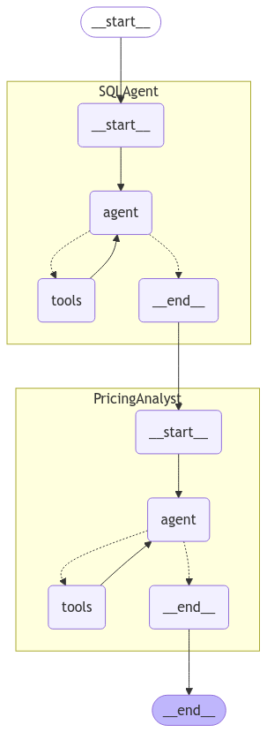

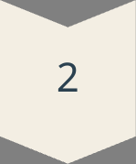
LangGraph Multi-Agent Flow
SQLAgent
Interacts with the SQLite database using a SQL toolkit.
PricingAnalystAgent
Acts as an expert in pricing analysis and strategy.

Slide 4
Summary
1
Log-log regression model
2
Multi-agent system
3
State graph
SQLAgent queries the database, PricingAnalystAgent synthesizes the output.
Coordinates agent interaction, ensuring a seamless flow from data extraction to expert analysis.
Calculates price elasticity using the log-log regression model.

