Slide 1

Pricing Elasticity with Multi-Agentic Workflow
The project focuses on calculating price elasticity based on historical order data and providing pricing insights using a multi-agent system built with LangGraph.
by Patrick Gomes

Slide 2
Elasticity Tables
computed_product_elasticities
computed_customer_elasticities
computed_c_p_elasticities
Elasticity for each combination of customer and product, capturing responsiveness to price changes.
Elasticity for each product, based on all orders related to that product.
Elasticity for each customer, aggregating their behavior over all purchases.

Slide 3
Elasticity Equation
Price elasticity is measured using a log-log linear regression model. The model is expressed mathematically as:
ln(Q) = ⍺ + βln(P) + ε
Where:
* Q is the quantity demanded.
* P is the price (which may be the regular price or sale price).
* ⍺ is the intercept term.
* β is the elasticity coefficient, representing the percentage change in quantity for a 1% change in price.
* ε is the error term.
The absolute value of β is used to report elasticity magnitude.

Slide 4

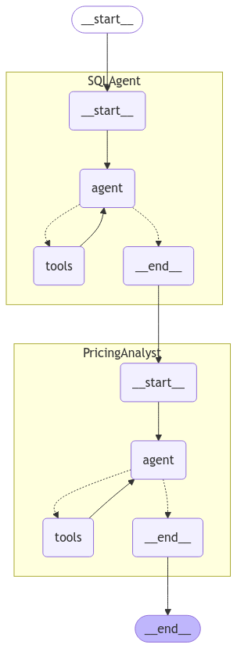


LangGraph Multi-Agentic Workflow
SQLAgent
Interacts with the SQLite database using a SQL toolkit.
PricingAnalystAgent
Acts as an expert in pricing analysis and strategy.

Slide 5
Summary
1
Log-log regression model
2
Multi-agent system
3
Workflow
SQLAgent queries the database, PricingAnalystAgent synthesizes the output.
Coordinates agent interaction, ensuring a seamless flow from data extraction to expert analysis.
Calculates price elasticity using the log-log regression model.

Slide 6
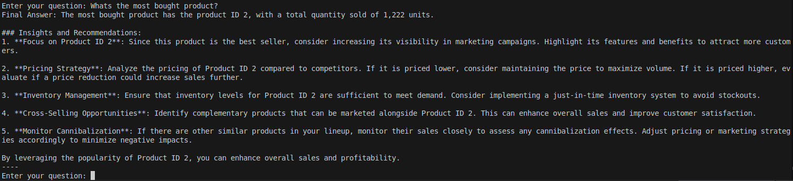
Examples with generated fake data
What’s the most bought product?

Slide 7
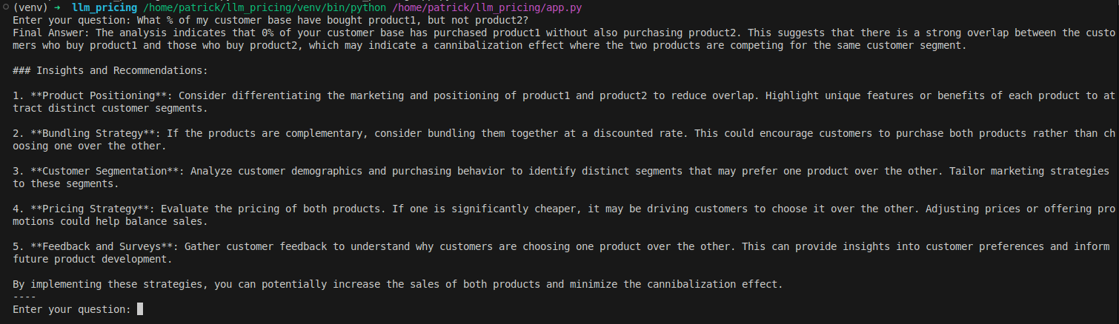
Examples with generated fake data
What % of my customer base have bought product1, but not product2?

Slide 8
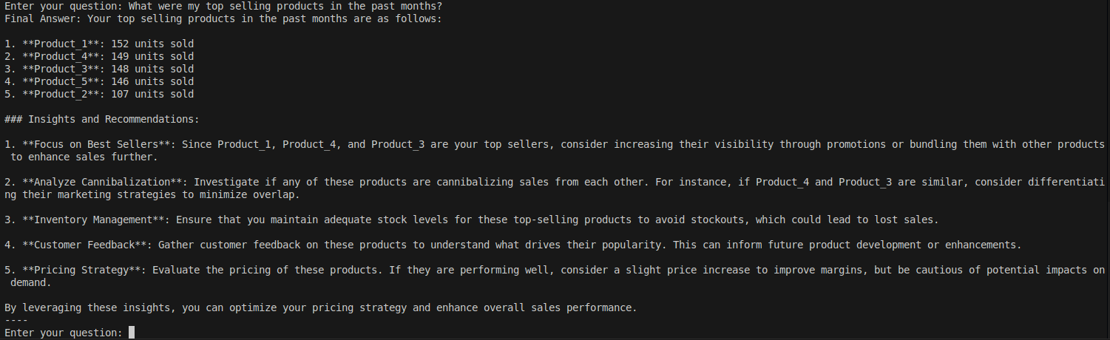
Examples with generated fake data
What were my top selling products in the past month?

Slide 9
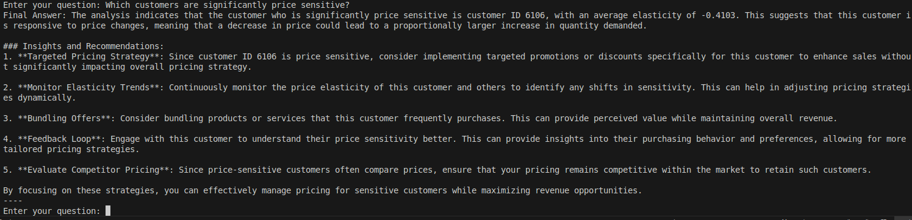
Examples with generated fake data
Which customers are significantly price sensitive?

Slide 10
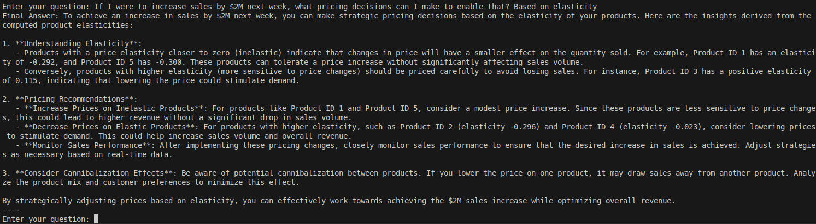
Examples with generated fake data
If I were increase sales by $2M next week, what pricing decisions can I make to enable that? Based on elasticity

