Slide 1
Putting Spark in your Application
Patrali De Bose
2/27/2018

Slide 2
Some generic concepts: What is Bigdata? Extremely large data sets that may be analyzed computationally to reveal patterns, trends, and associations, especially relating to human behavior and interactions. What is Spark? Apache Spark is an open-source framework for processing huge volumes of data (big data) with speed and simplicity. It is suitable for analytics applications based on big data. Spark can be used with a Hadoop environment, standalone or in the cloud. It was developed at the University of California and then later offered to the Apache Software Foundation. Why Spark? Spark offers about 100 times faster processing than Hadoop's MapReduce for the same amount of data. It also uses significantly fewer resources as compared to Hadoop, thereby making it cost-effective.

Slide 3
What is RDD? Resilient Distributed Datasets (RDD) is a fundamental data structure of Spark. - Immutable - Cacheable - Lazy evaluated - Type inferred - Fault tolerant

Slide 4
Recognize immutable
var collection ={1,2,3,4,5} for(int i = 0; i< collection.length; i++) { collection[i] += 1; } for(int i = 0; i< collection.length; i++) { collection[i] += 2; } | val collection ={1,2,3,4,5} val newCollection = collection.map (value => value +1 ) val NextNewCollection = collection.map (value => value +1 )

Slide 5
Multiple transformations in one pass: val c2 = collection.map( value => var result = value +1 result = result +2 ) Laziness: - Not computing transformations until needed. - Benefits? 1..2.. Do you see any challenge here?

Slide 6
Type inference: - Do not want to have semantic error when executing big data val c1 = collection.map ( value => value + 1) // returns array val c2 = c1.count() // returns int val c3 = c2. map() // will get error. Why?

Slide 7
Examples : Understand transformation and action
Transformation : map flatMap filter mapPartitions mapPartitionsWithIndex sample union intersection distinct groupByKey reduceByKey aggregateByKey sortByKey Join https://www.supergloo.com/fieldnotes/apache-spark-examples-of-transformations/ | Actions : reduce collect count first take takeSample countByKey saveAsTextFile https://www.supergloo.com/fieldnotes/apache-spark-examples-of-actions/

Slide 8
See Some examples :

Slide 9
Partition - Logical distribution of data - Derived from Hadoop Map/reduce - All input, intermediate and output data will be represented as partitioned - Basic unit of parallelism - RDD data is collection of partitions - Immutable - Fault tolerant - location awareness

Slide 10
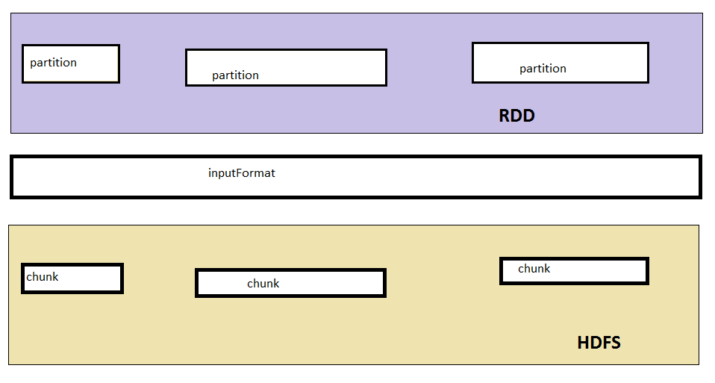

Slide 11
Partition Example Code…… So, we have seen that partitions are driven by? - Size of input data - # of cores available

Slide 12
Accessing Partitions - We can access a partition using using ‘mapPartitions’ of RDD - Do inter partition calculation MapPartitions Example…………………..

Slide 13
Partitions for transformed data - Partitioning will be different for key-value pair that are generated by shuffling - Partitioning is driven by partitioner specified - Default partition is hash partition - Partitioner can be customized HashPartitioning Example…………………..

Slide 14
Custom partitioning… - Partitioning the data according to your data structure - Gives control over number of partitions and distribution of data when grouping and reducing is done. - Default partition is hash partition - Partitioner can be customized CustomPartitioning Example…………………..

Slide 15
Look up … - Partitioning allows faster look up - Gives control over number of partitions and distribution of data when grouping and reducing is done. - use “lookup” api to look into the partition directly instead of go through the whole amount of data. Lookup Example…………………..

Slide 16
How is the laziness implemented? - By remembering lineage of transformation - By calling parent RDD - ‘Nil’ is the parent of the 1st RDD - This chain is persistent to disk when you do clustering, hence fault tolerant - Underneath data is immutable, hdfs is immutable But does it remember what operation to perform ( not only parent) ?

Slide 17
Subclassing : - Each spark operator creates an instance of specific subclass of RDD (example : map from MappedRDD, flatMap from FlatMappedRDD) - Subclass allows RDD to remember the operation that is performed in the transformation How?

Slide 18
How is the caching implemented? - Caching example How to extend spark api?

