Slide 1

HIRING A DATA SCIENTIST
ADDING VALUE TO YOUR COMPANY
Notes:
Cover page

Slide 2
DATA SCIENTIST ALTERNATIVE TITLES
Machine Learning Scientist
Big Data Engineer
Product Data Analyst
Data Analyst
Business Data Analyst
BI Data Analyst
Director of Data Science
Research Scientist
Data Engineering Manager
Machine Learning Engineer
Let’s focus solely on professionals with the title Data Scientist.
Notes:
Chart for different titles!

Slide 3
What is a Data Scientist?
They assist with business decision-making through advanced predictive analytics and machine learning
They provide greater insights of the business objectively
They interpret company data and recommend processes to improve outcomes
Data scientist salary in USD min 2859, Mean 108188, Max. 412000
These salaries depend on experience, part-time/full-time/contract, knowledge or specialized skills, and remote or onsite
We will focus on the title Data Scientist
Notes:
What is a Data Scientist

Slide 4
FULL-TIME MID LEVEL VS SENIOR LEVEL
MID LEVEL
SENIOR LEVEL
Mid level Data Scientist has 1 to 3 years experience
Mid level: Min : 2859, Mean : 81735, Max :200000
Senior level (5 years +): able to hire employees and manage a team as the company expands
Senior level(USD): Min- $20171, Mean- $152971, Max - $412000
Notes:
Chart for salary

Slide 5

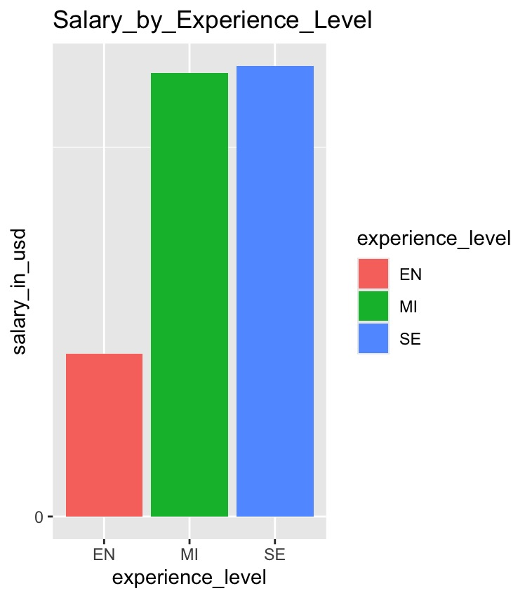



Salary by Experience Level

Slide 6
BENEFITS OF A REMOTE DATA SCIENTIST
Autonomy in workplace
Job satisfaction for the professional
Eliminates geographical limitations, collaborate with professionals all over the world
Offers better work life balance
Requires optimal discipline and time management skills
Remote average salary $83589

Slide 7
BENEFITS OF AN ONSITE DATA SCIENTIST
Onsite mean $74190
Increases real time professional collaboration in workplace while focusing on company objectives
Better integration of company culture for the Data Scientist and team
Faster decision-making for all parties
Notes:
Cont.

Slide 8
RECOMMENDATION
My recommendation is to start out with a full-time onsite mid level Data Scientist
The company will benefit from a lower salary, experienced (mid level), onsite Data Scientist
This Data Scientist will be equipped to pursue company objectives while obtaining the skills and experience to become a Senior level Data Scientist
When the company grows from a small business to a large business then it can consider if a team of Data Scientists will be appropriate for expanding business size
Notes:
Conclusion

Slide 9
References
https://www.linkedin.com/pulse/good-bad-reality-remote-data-science-xaltius-3dyve/
https://online.mason.wm.edu/blog/how-data-science-drives-business-decision-making
https://www.linkedin.com/pulse/pros-cons-building-internal-data-science-team-real-estate-abel-assefa/

