Slide 1


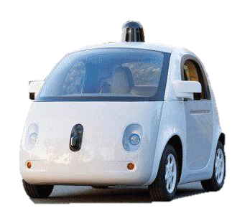
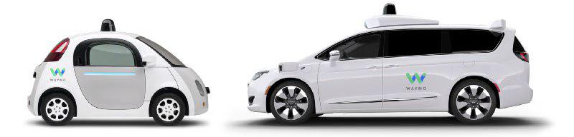
and
The first prototype of the autonomous car was called Firefly.
Waymo began with self-driving car of the Google in December of 2016. The goal of Waymo is of bring self-driving technology and Improve mobility.
As well as personal vehicles, Waymo has been exploring a variety of different areas of transportation, such as ride-hailing services and public transport options, incorporating a focus on communal mobility.
In 2017, Waymo has unveiled new sensors and chips that are less expensive to manufacture, cameras that improve visibility.
And has others companies working with the production of autonomous cars, Trucks and buses as: Volvo, Mercedes-Benz and Komatsu.
1.35 million deaths worldwide due to vehicle crashes in 2016;
2.4 million injuries in 2015 due to vehicle crashes.
Why is the Autonomous car important?

Slide 2



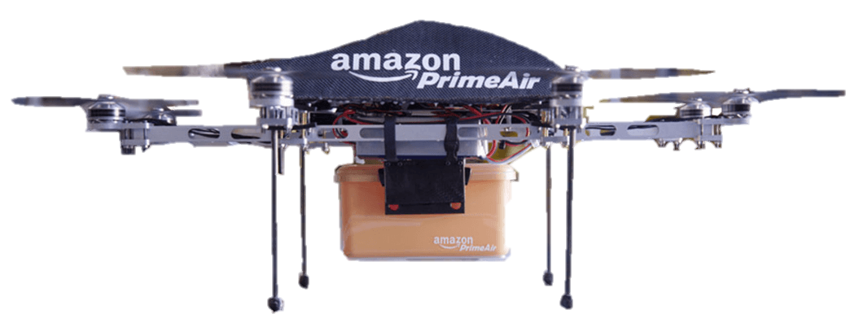

Amazon Prime Air is a service that will deliver packages up to five pounds in 30 minutes or less using small drones. They are testing the vehicles in multiple international locations.
And it’s the characteristics are safety and security are top priorities as they look to incorporate small drones into the airspace. They're working with regulators and industry to design an air traffic management system that will recognize who is flying what drone, where they are flying, and whether they are adhering to operating requirements.
It’s therefore a future delivery system from Amazon designed to safely get packages to customers in 30 minutes or less using unmanned aerial vehicles. Prime Air has great potential to enhance the services we already provide to millions of customers by providing rapid parcel delivery that will also increase the overall safety and efficiency of the transportation system.

Slide 3
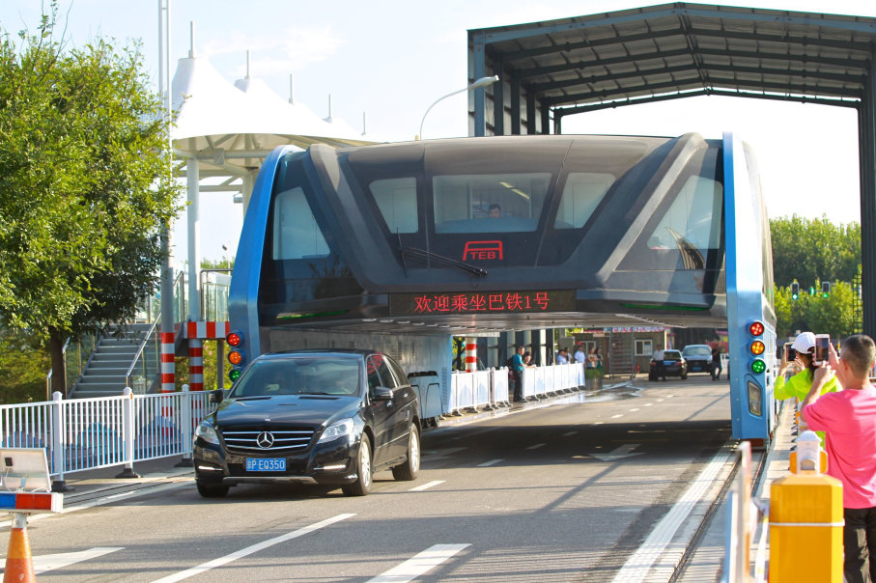
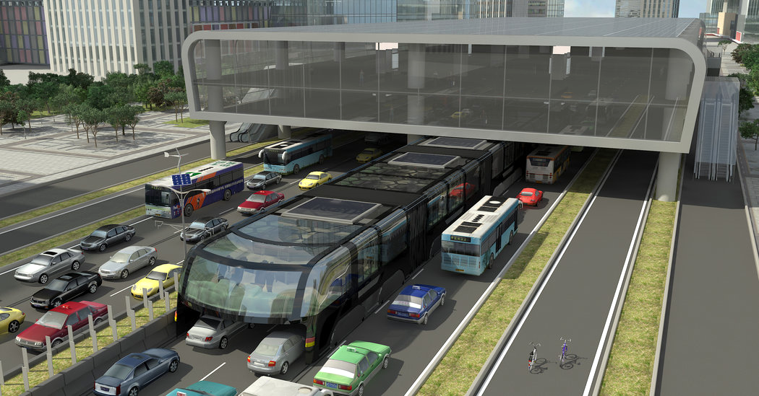
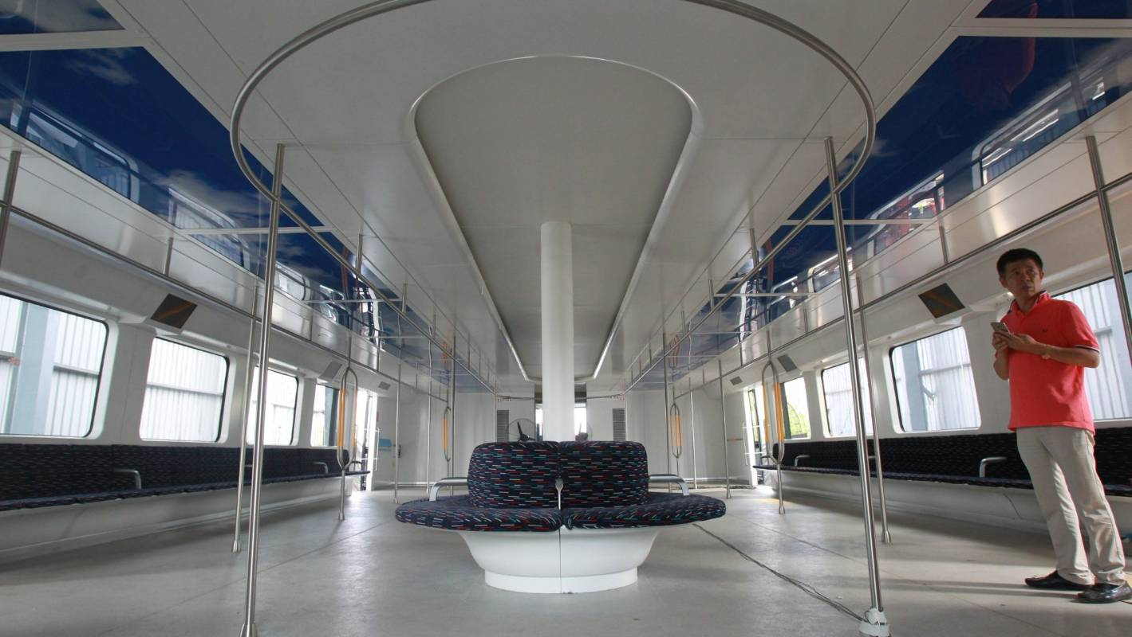
TRANSIT ELEVATED BUS
China is the most populous country in the world, has large cities and therefore has a traffic jams. To help improve this issue by giving more freedom to Chinese traffic, in 2013 China introduced the TEB (Transit Elevated Bus).
The Transit Elevated Bus, or TEB, is a vehicle that travels along rails above one-way traffic. It was tested in August 2016 in Qinghuangdao city. The first wagon has a capacity of 300 passengers that are 4.8 meters from the ground.
The composition is 22 meters long and 7.8 meters wide, and it scares anyone.
It's still important to take into consideration that trucks wouldn't be included in passing under this large bus, in addition to not having developed a safety system to avoid accidents due to the base of the bus being exposed.

