Slide 1
程序设计原理
函数
任课教师： 喻 梅
于瑞国
王建荣
李雪威
赵满坤

Slide 2
Introduction
Why Do We Need Functions?
Avoid code duplication
Make programs modular
Improve readability and maintenance
Break complex problems into smaller tasks

Slide 3
Introduction
Suppose that you need to find the sum of integers from 1 to 10, 10 to 20, from 20 to 37 ,and from 35 to 49.
int sum(int i1,int i2)
{
int sum = 0;
for(int i=i1;i<=i2;i++)
sum += i;
return sum;
}
int main()
{
cout<<"The sum is:"<<sum(1,10)<<endl;
cout<<"The sum is:"<<sum(20,37)<<endl;
cout<<"The sum is:"<<sum(35,49)<<endl;
return 0;
}
for(int i=1;i<=10;i++)
sum +=i;
cout << "The sum is:"<<sum<<endl;
for(int i=20;i<=37;i++)
sum +=i;
cout << "The sum is:"<<sum<<endl;
for(int i=35;i<=49;i++)
sum +=i;
cout << "The sum is:"<<sum<<endl;

Slide 4
Defining a Functions
What Is a Function?
A function is a block of code that performs a specific task.
A function has four parts:
  Return value type
  Function name
  Parameters
  Function body

Slide 5
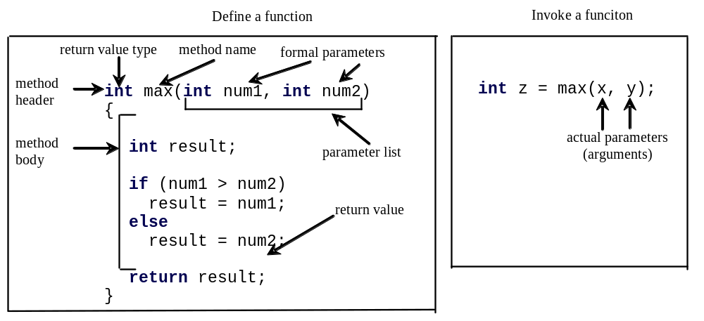
Defining a Functions
returnValueType functionName(list of parameters)
{
//function body;
}

Slide 6
Introducing Functions, cont.
Function signature is the combination of the function name and the parameter list.
The variables defined in the function header are known as formal parameters.
When a function is invoked, you pass a value to the parameter. This value is referred to as actual parameter or argument.

Slide 7
Introducing Functions, cont.
A Function may return a value. The returnValueType is the data type of the value the function returns. If the function does not return a value, the returnValueType is the keyword void. For example, the returnValueType in the main function is void.

Slide 8
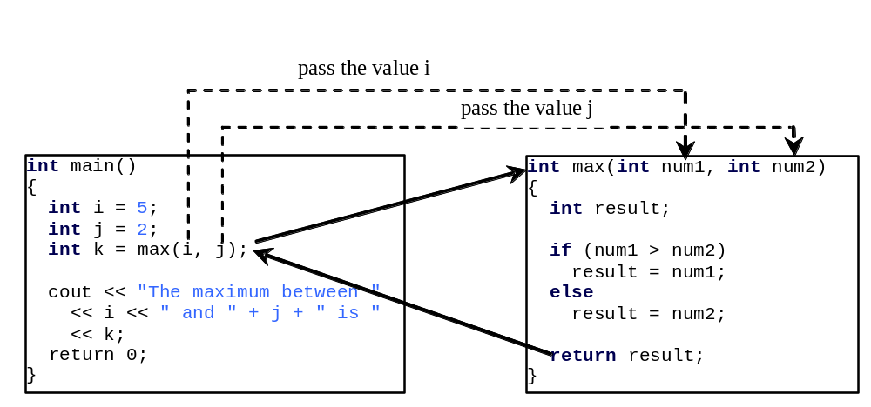
Calling Functions, cont.

Slide 9
Memory
Memory Space
Memory space
  A “continuous” space
  Three regions
…
0xF5B089A0
…
0xF5C08A75
…
0xF5D18995
0xF5E20000
…
Code Region
Static Region
(Static variables, global variables, ...)
Dynamic Region
(local variables, parameters, ...)
Heap
( used by programmer)
Stack
(used by system)

Slide 10
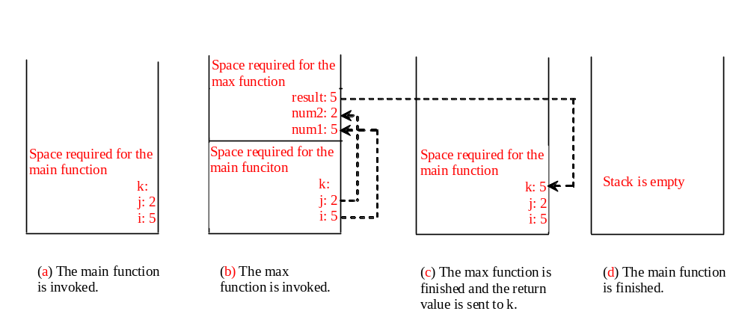
Call Stacks

Slide 11
Passing Arguments by Value
When you invoke a function with a parameter, the value of the argument is passed to the parameter. This is referred to as pass-by-value. If the argument is a variable rather than a literal value, the value of the variable is passed to the parameter. The variable is not affected, regardless of the changes made to the parameter inside the function. We will examine an interesting scenario in the following example, in which the parameters are changed in the function but the arguments are not affected.

Slide 12
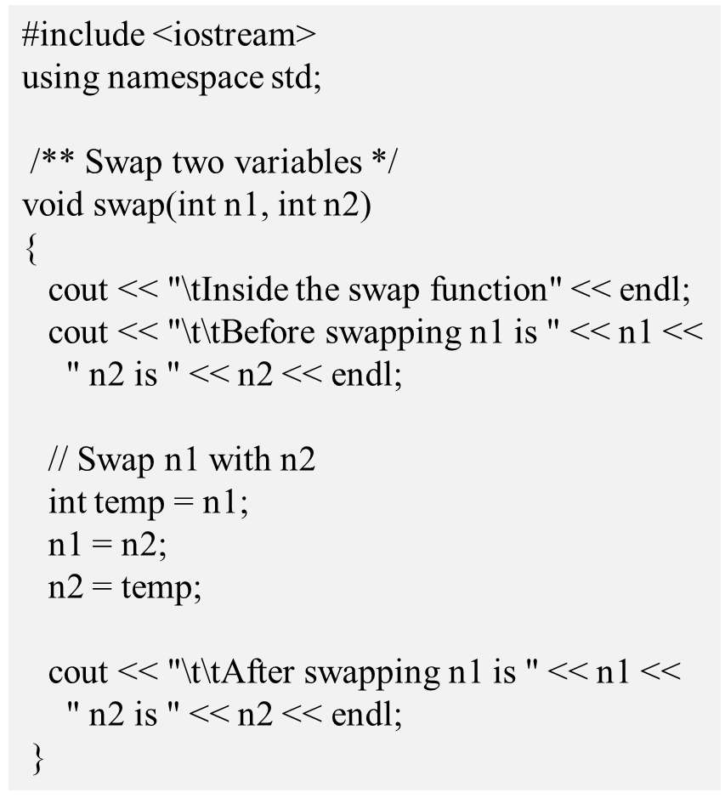
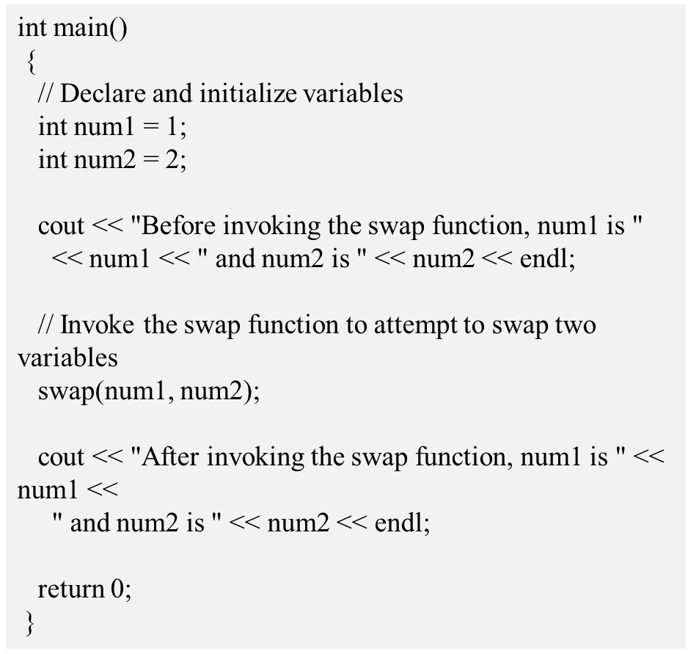
Passing Arguments by Value

Slide 13
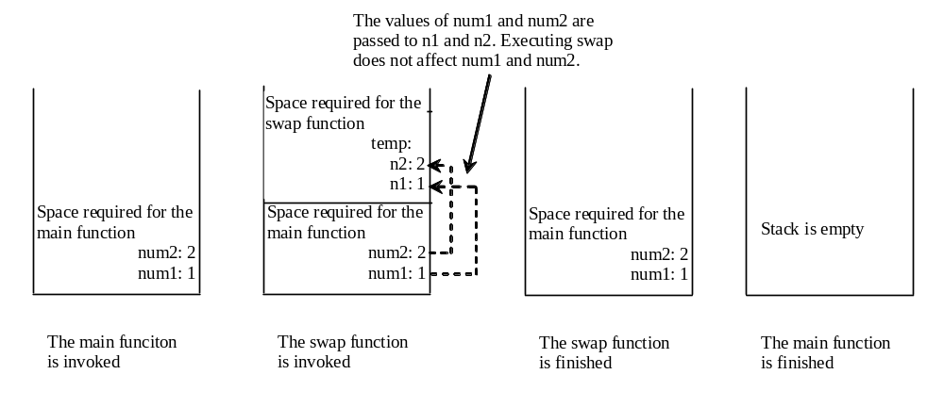
Passing Argument by Value, cont.

Slide 14
Exercise
样例输入
15 5
20 3
65 13
0 0
样例输出
5
1
13
提示
1<=n,m<=10¹⁵
题目描述
给你两个数，求最大公约数。要求用函数实现。
输入
输入数据包含多个测试实例，每组数据占一行，每行有两个正整数n和m。n和m同时为0标示输入数据的结束，本行不做处理。
输出
对于每组输入样例，输出一个数，是他们的最大公约数

Slide 15
Exercise
题目描述
编写一个求x的n次方的函数。题目中会给出两个数x和n，输出x的n次方即可。
输入
输入数据包含多个测试实例，每组数据占一行，每行有两个正整数x和n。x和n同时为-1标示输入数据的结束，本行不做处理。保证 0<=x，n<=15
输出
对于每组输入样例，输出一个数，是x的n次方的计算结果。
样例输入 Copy
2 3
3 5
5 7
5 0
-1 -1
样例输出 Copy
8
243
78125
1
提示
0<=x,n<=15

Slide 16
Exercise
题目描述
寻找并输出11~999(闭区间)之间的数m，它满足m、m的平方和m的立方均为回文数。
– 回文：各位数字左右对称的整数。
例如：11满足上述条件
11*11=121，11*11*11=1331.
用函数实现
输入
无
输出
输出所有的11~999之间的数m，m的含义参照题目描述，每个数占一行，按照从大到小的顺序输出。

