Slide 1
程序设计原理
函数2
任课教师： 喻 梅
于瑞国
王建荣
李雪威
赵满坤

Slide 2
Overloading Functions
/** Return the max between two int values */
int max(int num1, int num2)
{
if (num1 > num2)
return num1;
else
return num2;
}

Slide 3
Overloading Functions
The max function that was used earlier works only with the int data type. But what if you need to find which of two floating-point numbers has the maximum value? The solution is to create another function with the same name but different parameters, as shown in the following code.
Overloading functions enable you to define the function with the same name as long as their signatures are different.

Slide 4
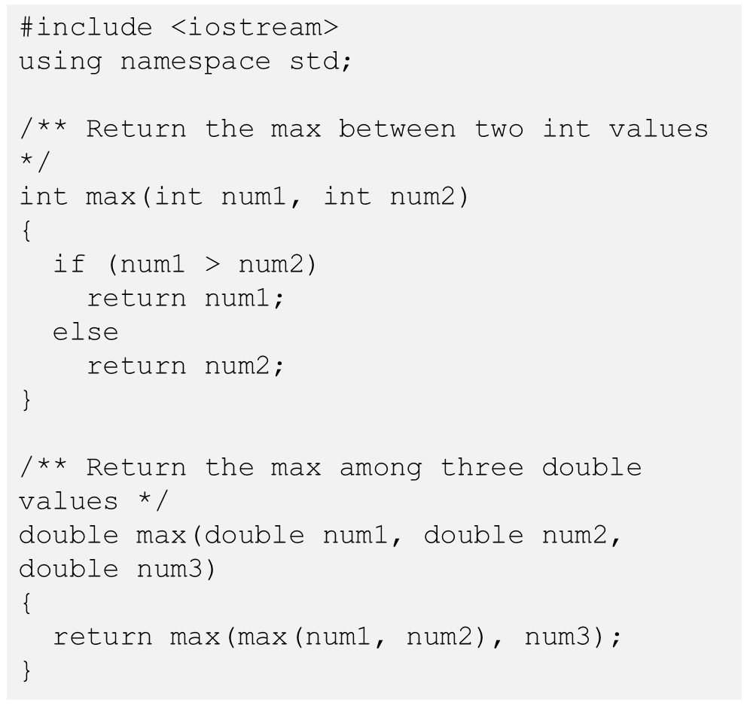
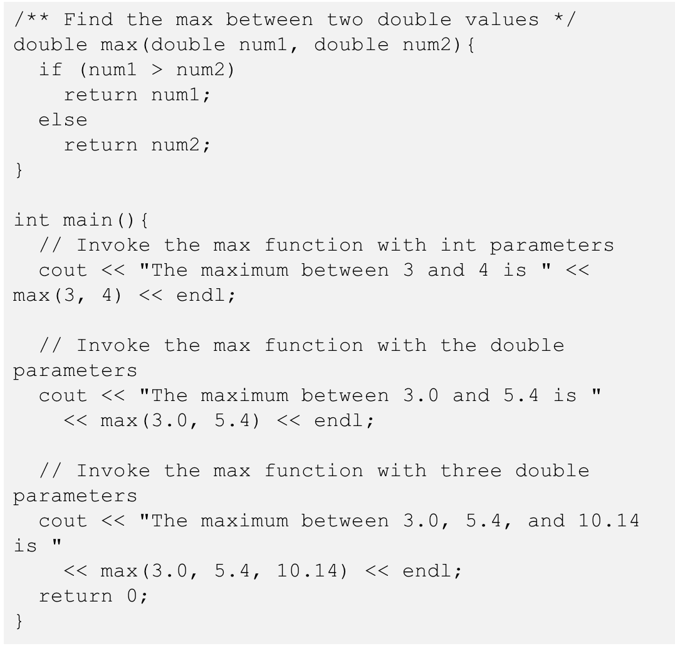
Overloading Functions

Slide 5
Ambiguous Invocation
#include <iostream>
using namespace std;
int maxNumber(int num1, double num2)
{
if (num1 > num2)
return num1;
else
return num2;
}
double maxNumber(double num1, int num2)
{
if (num1 > num2)
return num1;
else
return num2;
}
int main()
{
cout << maxNumber(1, 2) << endl;
return 0;
}
Sometimes there may be two or more possible matches for an invocation of a function, but the compiler cannot determine the most specific match. This is referred to as ambiguous invocation. Ambiguous invocation is a compilation error.

Slide 6
Function Prototypes
Before a function is called, it must be declared first. One way to ensure it is to place the declaration before all function calls. Another way to approach it is to declare a function prototype before the function is called. A function prototype is a function declaration without implementation. The implementation can be given later in the program.

Slide 7
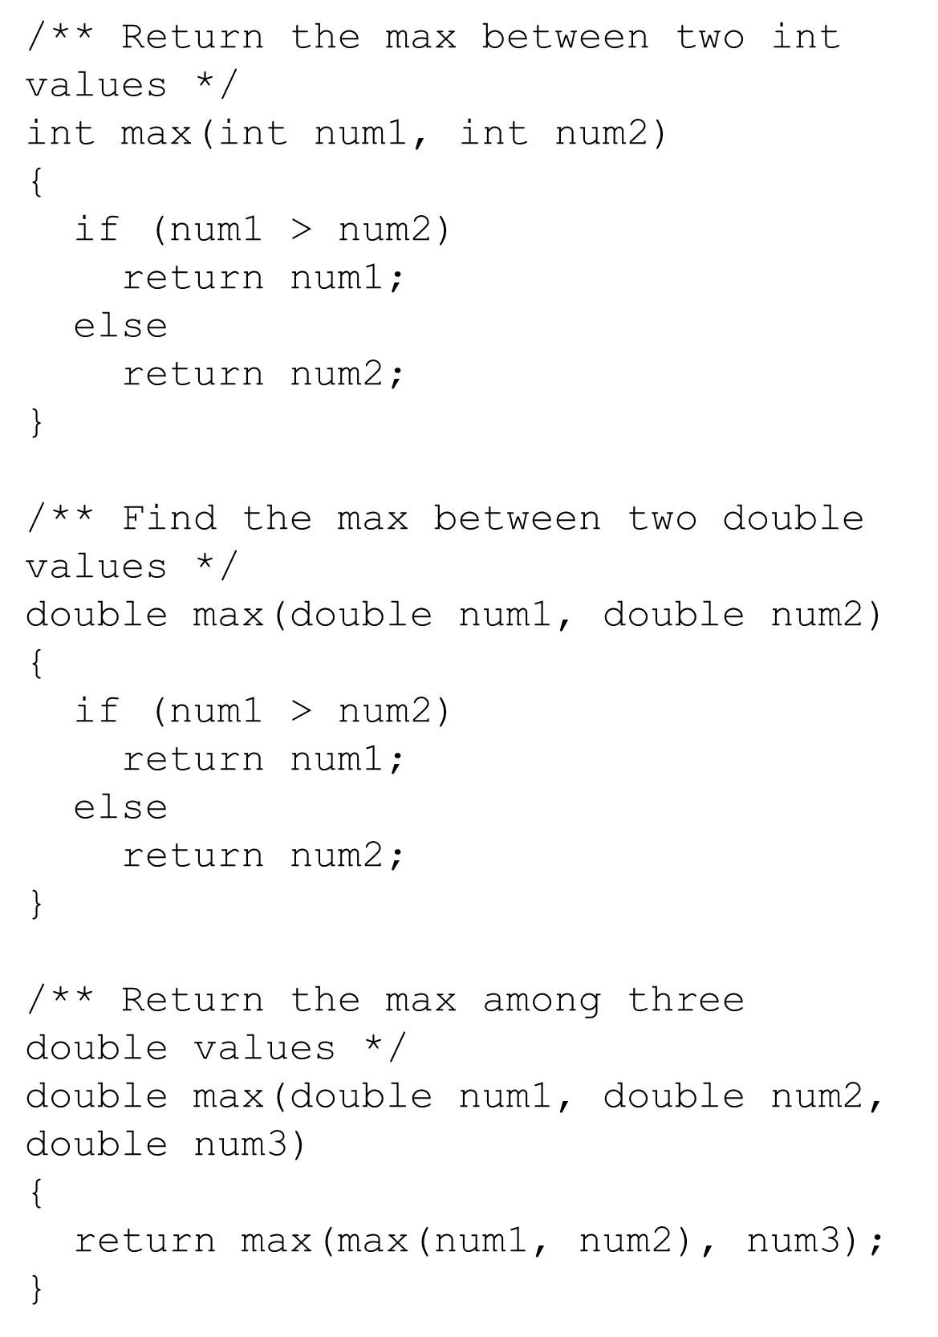
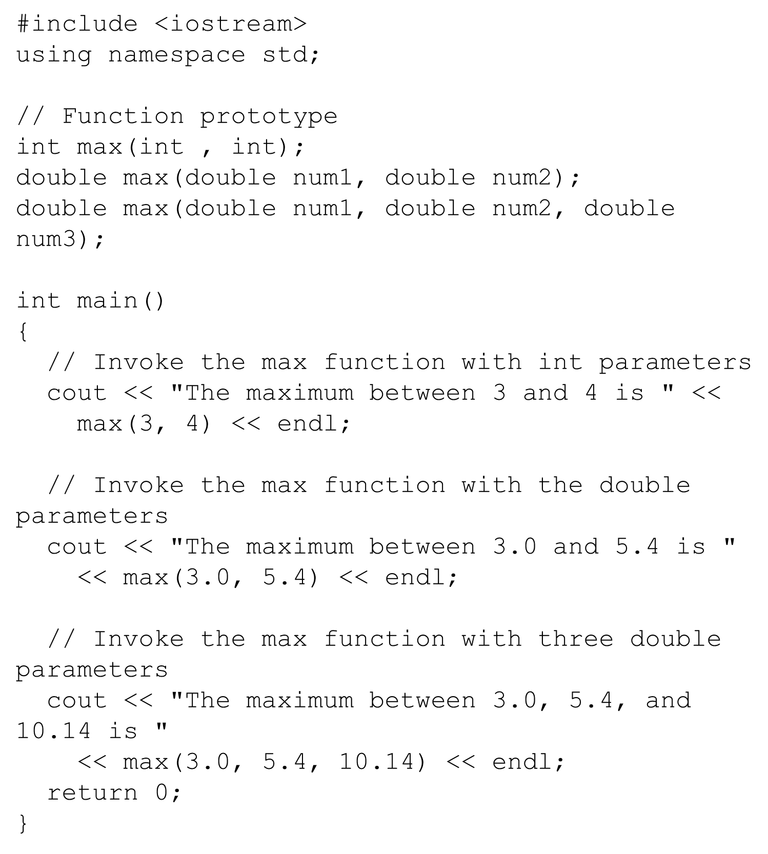
Function Prototypes

Slide 8
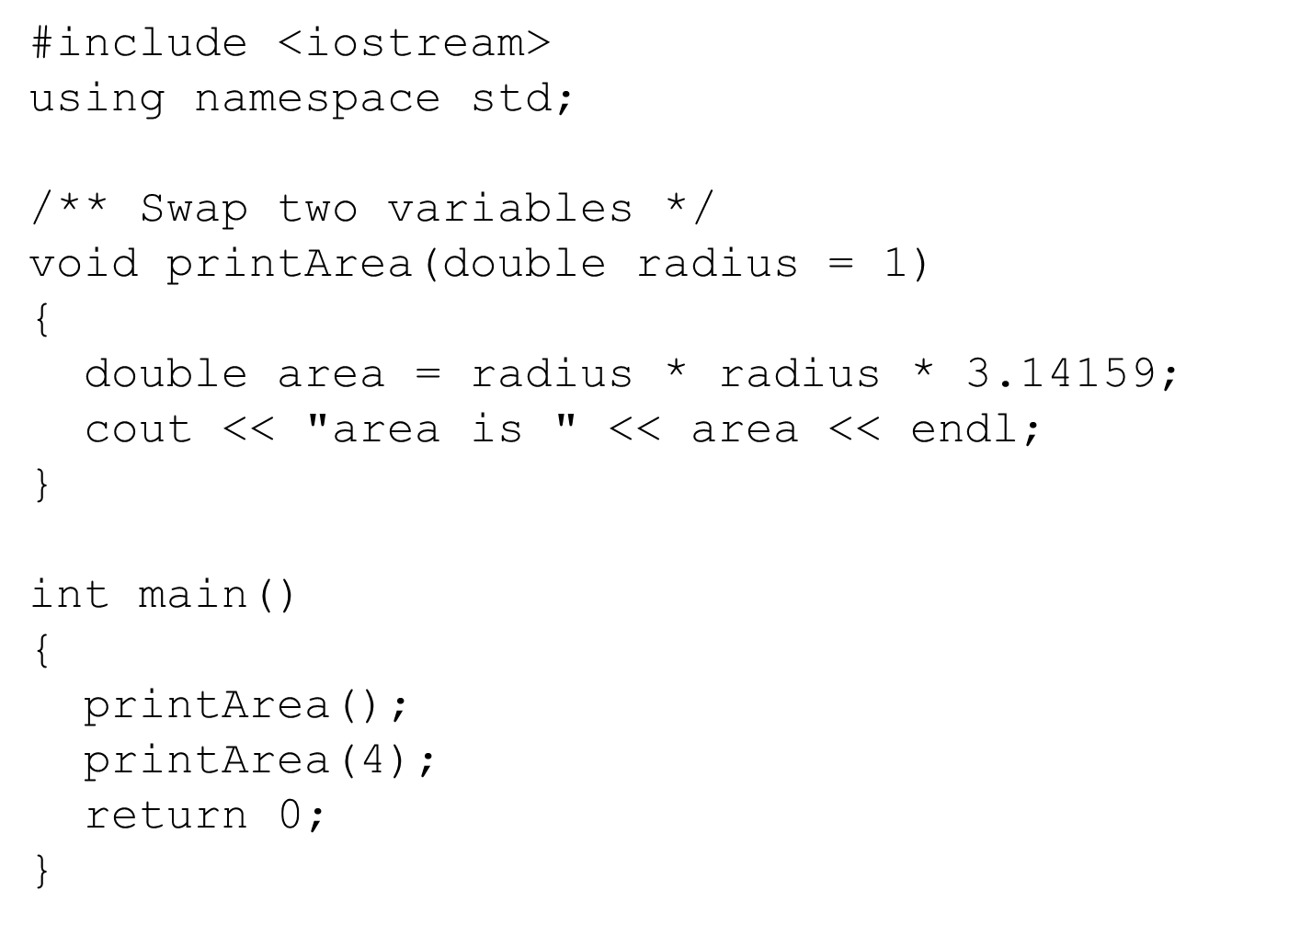
Default Arguments
C++ allows you to declare functions with default argument values. The default values are passed to the parameters when a function is invoked without the arguments.

Slide 9
Default Arguments
When a function contains a mixture of parameters with and without default values, those with default values must be declared last.
void t1(int x, int y = 0, int z);//illegal
void t2(int x = 0, int y = 0, int z);//illegal
void t3(int x, int y = 0, int z = 0);//legal
void t4(int x = 0,int y = 0, int z= 0);//legal

Slide 10
Scope of Variables
A local variable: a variable defined inside a Function.
Scope: the part of the program where the variable can be referenced.
The scope of a variable starts from its declaration and continues to the end of the block that contains the variable. A local variable must be declared before it can be used.

Slide 11
Scope of Local Variables, cont.
You can declare a local variable with the same name multiple times in different blocks in a function, but you cannot declare a local variable twice in the same block.

Slide 12
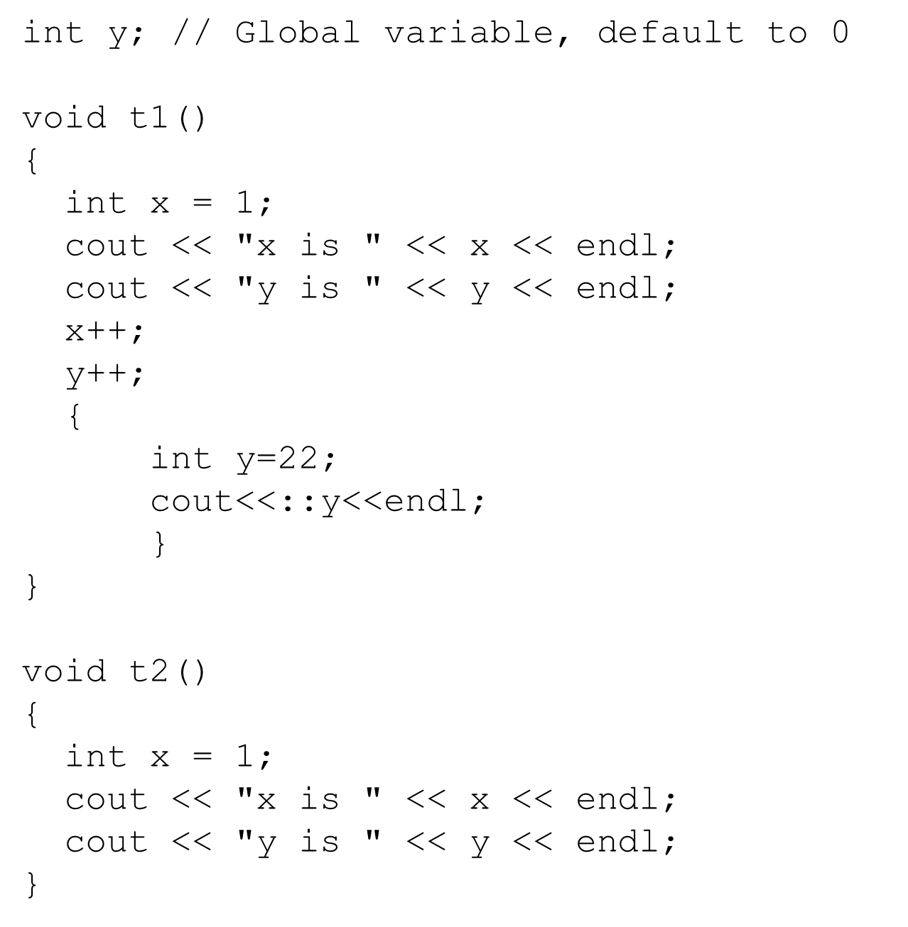
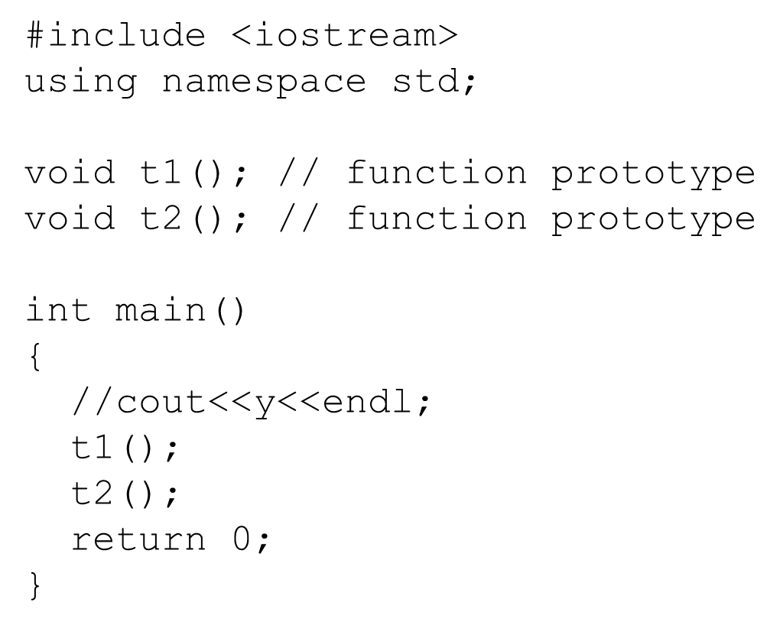
Global Variables
C++ also allows you to use global variables. They are declared outside all functions and are accessible to all functions in its scope. Local variables do not have default values, but global variables are defaulted to zero.

Slide 13
Unary Scope Resolution
If a local variable name is the same as a global variable name, you can access the global variable using ::globalVariable. The :: operator is known as the unary scope resolution. For example, the following code:
#include <iostream>
using namespace std;
int v1 = 10;
int main()
{
int v1 = 5;
cout << "local variable v1 is " << v1 << endl;
cout << "global variable v1 is " << ::v1 << endl;
return 0;
}

Slide 14

Scope of Local Variables in a for loop
A variable declared in the initial action part of a for loop header has its scope in the entire loop. But a variable declared inside a for loop body has its scope limited in the loop body from its declaration and to the end of the block that contains the variable.

Slide 15
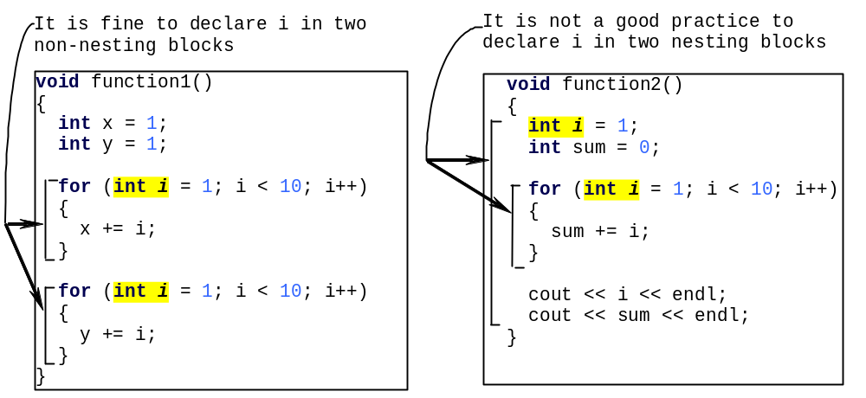
Scope of Local Variables in a for loop

Slide 16
Static Local Variables
After a function completes its execution, all its local variables are destroyed. Sometimes, it is desirable to retain the value stored in local variables so that they can be used in the next call. C++ allows you to declare static local variables. Static local variables are permanently allocated in the memory for the lifetime of the program. To declare a static variable, use the keyword static.

Slide 17
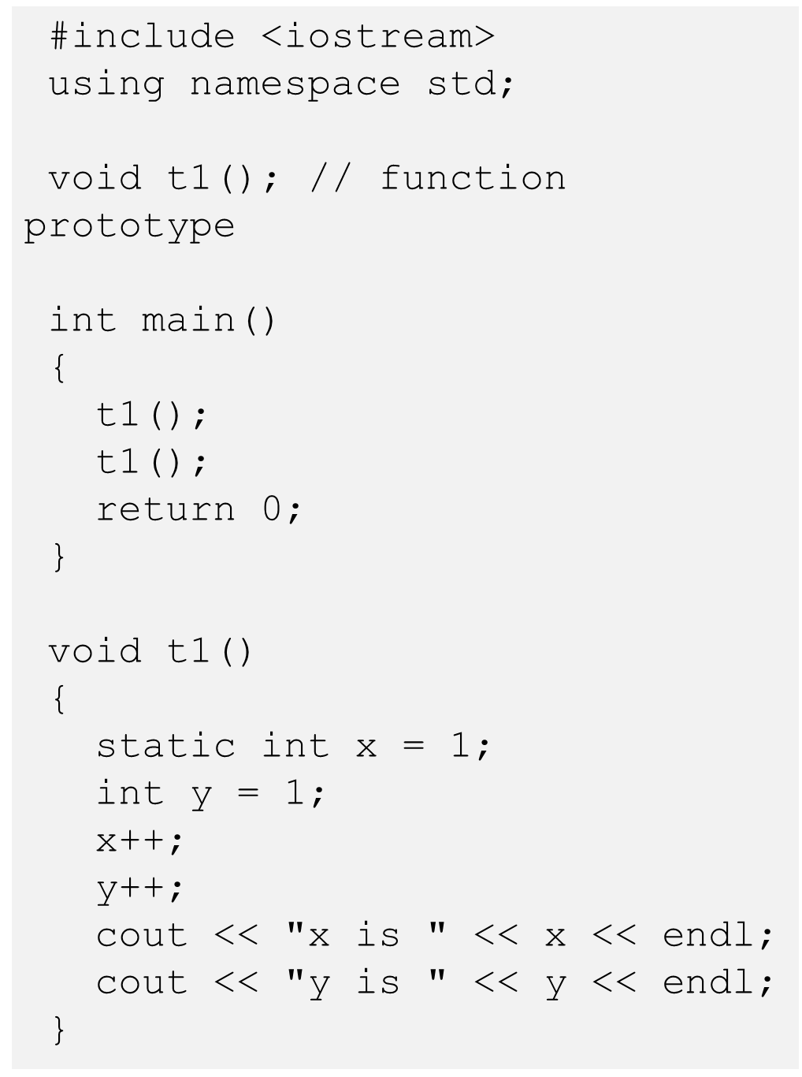
Static Local Variables

Slide 18
Reference Variables
A reference variable is a nickname, or alias, for some other variable
To delare a reference variable, we use the unary operator &
In this example, r is now a reference to n. (They are both referring to the SAME storage location in memory).

Slide 19
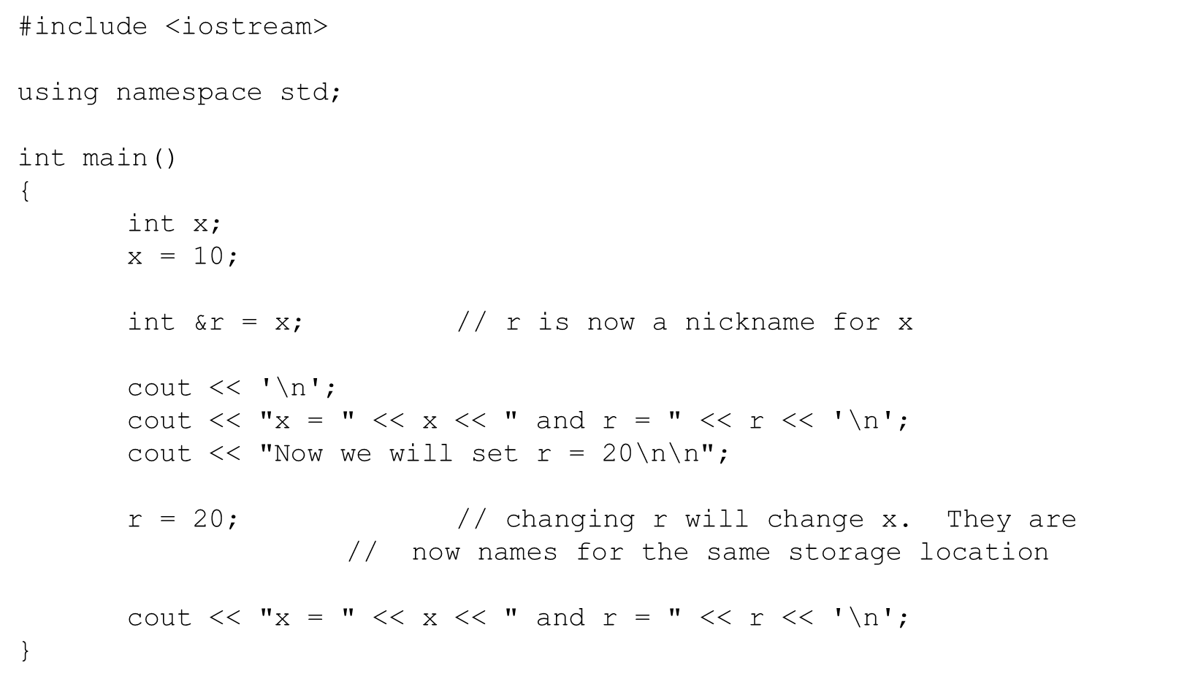
Reference Variables
While the above code example shows what a reference variable is, you will not likely use it this way!
In this example, the regular variable and the reference are in the same scope, so it seems silly. ("Why do I need to call it r when I can call it x ?")
So when are references useful? When the two variables are in different scopes (this means functions!)

Slide 20
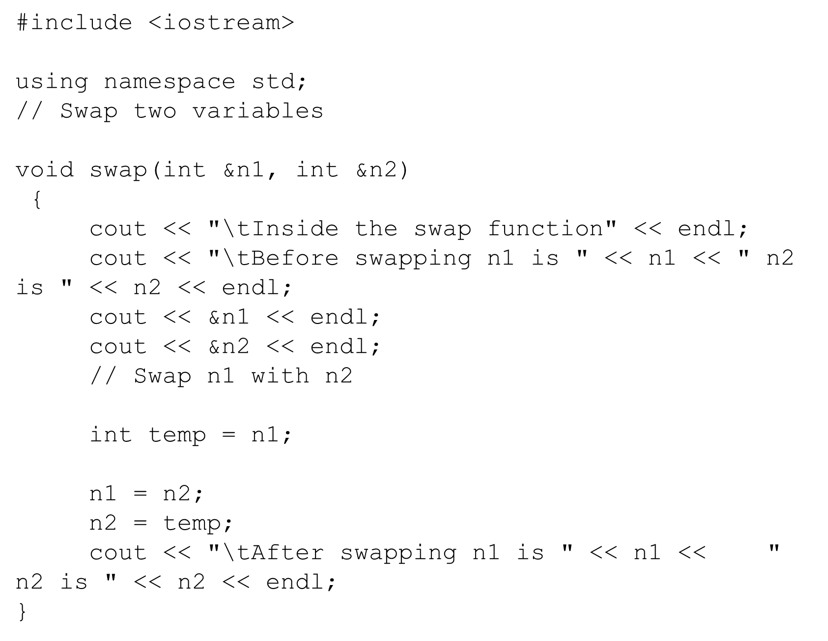
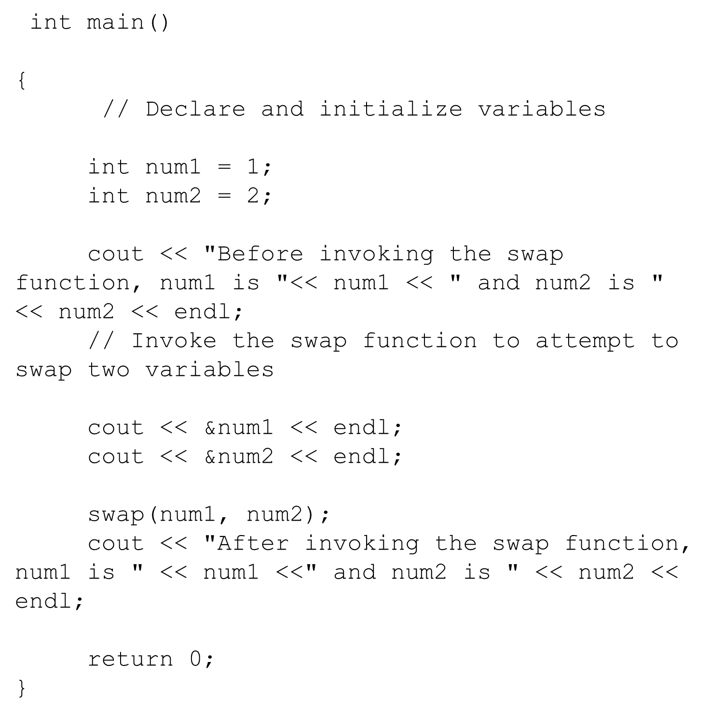
Passing Arguments By Reference

Slide 21
Exercise
Distance
Write a program which calculates the distance between two points P1(x1, y1) and P2(x2, y2).
Input
Four real numbers x1, y1, x2 and y2 are given in a line.
Output
Print the distance in real number. The output should not contain an absolute error greater than 10⁻⁴.
Sample Input
0 0 1 1
Sample Output
1.41421356

Slide 22
Exercise
Triangle
For given two sides of a triangle a and b and the angle C between them, calculate the following properties:
S: Area of the triangle
L: The length of the circumference of the triangle
h: The height of the triangle with side a as a bottom edge
Input
The length of a, the length of b and the angle C are given in integers.
Output
Print S, L and h in a line respectively. The output should not contain an absolute error greater than 10⁻⁴.
Sample Input
4 3 90
Sample Output
6.00000000
12.00000000
3.00000000

Slide 23
Exercise
Standard Deviation
You have final scores of an examination for n students. Calculate standard deviation of the scores s₁, s₂ ... s_{n}. The variance α² is defined by
α² = (∑^{n}_{i=1}(s_{i} - m)²)/n
where m is an average of s_{i}. The standard deviation of the scores is the square root of their variance.
Input
The input consists of multiple datasets. Each dataset is given in the following format:
n
s1 s2 ... sn
The input ends with single zero for n.
Output
For each dataset, print the standard deviation in a line. The output should not contain an absolute error greater than 10⁻⁴.
Constraints
n ≤ 1000
0 ≤ s_{i} ≤ 100
Sample Input
5
70 80 100 90 20
3
80 80 80
0
Sample Output
27.85677655
0.00000000

Slide 24
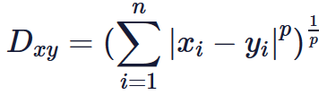

Exercise
Distance II
Your task is to calculate the distance between two n dimensional vectors x={x1,x2,...,xn} and y={y1,y2,...,yn}.
The Minkowski's distance defined below is a metric which is a generalization of both the Manhattan distance and the Euclidean distance.
It can be the Manhattan distance where p=1.
It can be the Euclidean distance where p=2.
Also, it can be the Chebyshev distance where p=∞
Input
In the first line, an integer n
is given. In the second and third line, x={x1,x2,...xn} and y={y1,y2,...yn} are given respectively. The elements in x and yare given in integers.
Output
Print the distance where p=1,2,3
and ∞ in a line respectively. The output should not contain an absolute error greater than 10⁻⁵.
Constraints
1≤n≤100，0≤xi,yi≤1000
Sample Input
3
1 2 3
2 0 4
Sample Output
4.000000
2.449490
2.154435
2.000000

