Slide 1
程序设计原理
递归
任课教师： 喻 梅
于瑞国
王建荣
李雪威
赵满坤

Slide 2
Objectives
To know what is a recursive function and the benefits of using recursive functions .
To determine the base cases in a recursive function .
To understand how recursive function calls are handled in a call stack .
To understand the relationship and difference between recursion and iteration .
To solve problems using recursion .

Slide 3
What is Recursion?
• Recursion means a function calls itself.
• A function solves a big problem by repeatedly solving smaller ones.
factorial(0) = 1;
factorial(n) = n*factorial(n-1);
Why Do We Need Recursion?
Recursion expresses complex problems in a simple and natural way.
Ideal for trees, divide-and-conquer, and mathematical definitions.（遍历文件夹）

Slide 4
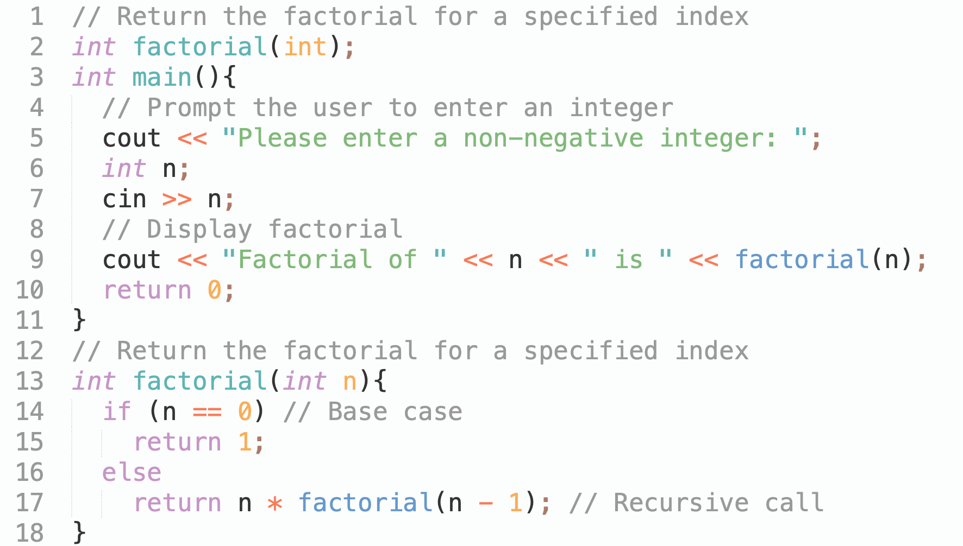
Computing Factorial
factorial(0) = 1;
factorial(n) = n*factorial(n-1);

Slide 5
Trace Recursive factorial
Executes factorial(4)

Slide 6
Trace Recursive factorial
Executes factorial(3)

Slide 7
Trace Recursive factorial
Executes factorial(2)

Slide 8
Trace Recursive factorial
Executes factorial(1)

Slide 9
Trace Recursive factorial
Executes factorial(0)

Slide 10
Trace Recursive factorial
return 1
10

Slide 11
Trace Recursive factorial
return factorial(0)

Slide 12
Trace Recursive factorial
return factorial(1)

Slide 13
Trace Recursive factorial
return factorial(2)

Slide 14
Trace Recursive factorial
return factorial(3)

Slide 15
Trace Recursive factorial
return factorial(4)

Slide 16
factorial(4) Stack Trace

Slide 17
Fibonacci Numbers
Finonacci series: 0 1 1 2 3 5 8 13 21 34 55 89…
indices: 0 1 2 3 4 5 6 7 8 9 10 11
fib(0) = 0;
fib(1) = 1;
fib(index) = fib(index -1) + fib(index -2); index >=2
fib(3) = fib(2) + fib(1) = (fib(1) + fib(0)) + fib(1) = (1 + 0) +fib(1) = 1 + fib(1) = 1 + 1 = 2

Slide 18
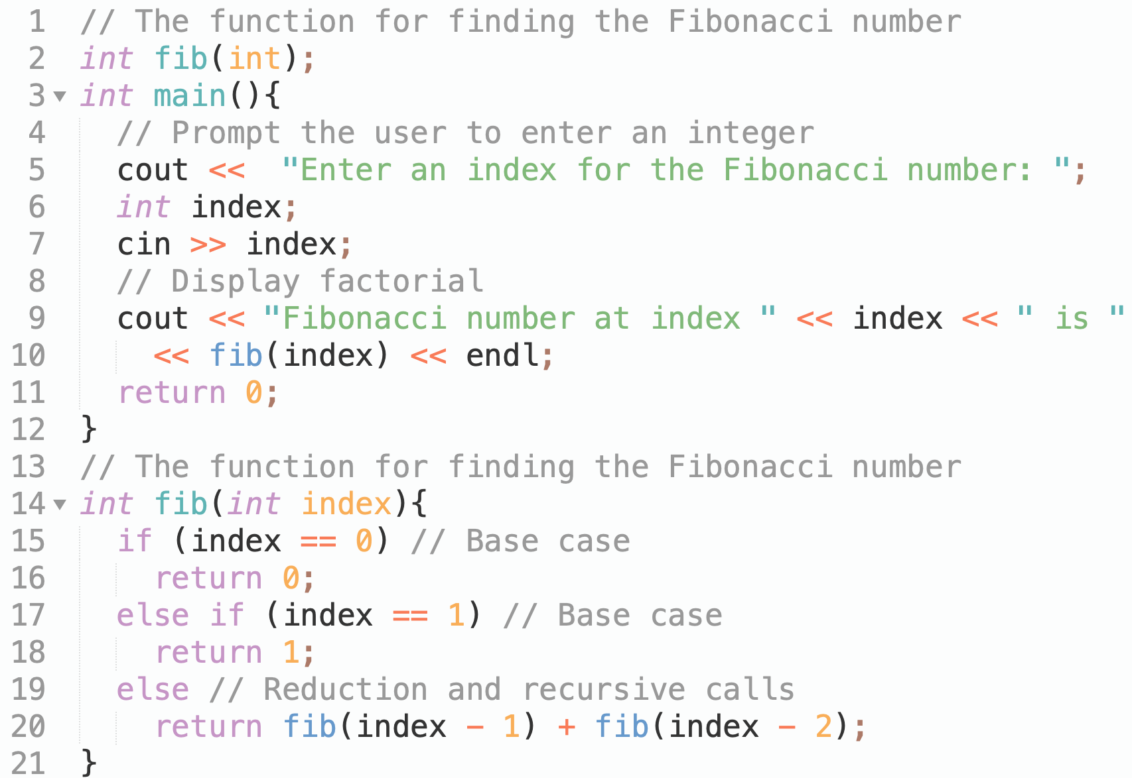
Fibonacci Numbers Function

Slide 19
Fibonnaci Numbers, cont.

Slide 20
Exercise
When invoke f(10), how many times will function f() be called?
int f(int x){
if (x <= 2) //Base case
return 1;
else
return f(x-2) + f(x-4) + 1;
}
10
15
16
20
Notes:
B

Slide 21
Characteristics of Recursion
All recursive methods have the following characteristics:
One or more base cases (the simplest case) are used to stop recursion.
Every recursive call reduces the original problem, bringing it increasingly closer to a base case until it becomes that case.
In general, to solve a problem using recursion, you break it into subproblems. If a subproblem resembles the original problem, you can apply the same approach to solve the subproblem recursively. This subproblem is almost the same as the original problem in nature with a smaller size.

Slide 22
Recursion and Iteration
In the previous sections, we studied two recursive functions that can also be implemented with simple iterative programs. This section compares the two approaches and discusses why you might choose one approach over the other in a particular situation.

Slide 23
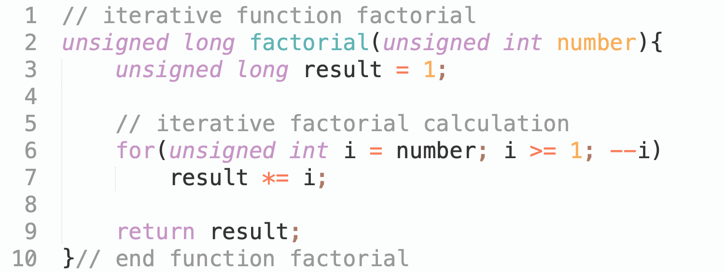
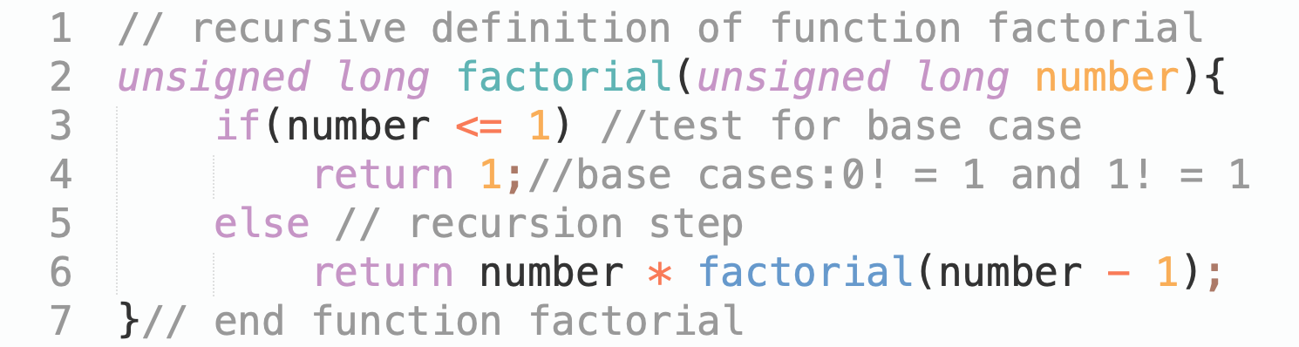
Recursion and Iteration
Factorial Implementation

Slide 24
Recursion and Iteration
Both iteration and recursion are based on a control statement: Iteration uses a repetition structure; recursion uses a selection structure.
Both iteration and recursion involve repetition: Iteration explicitly uses a repetition structure; recursion achieves repetition through repeated function calls.
Iteration and recursion each involve a termination test: Iteration terminates when the loop-continuation condition fails; recursion terminates when a base case is recognized.
Iteration with counter-controlled repetition and recursion each gradually approach termination: Iteration modifies a counter until the counter assumes a value that makes the loop-continuation condition fail; recursion produces simpler versions of the original problem until the base case is reached.
Both iteration and recursion can occur infinitely: An infinite loop occurs with iteration if the loop-continuation test never becomes false; infinite recursion occurs if the recursion step does not reduce the problem during each recursive call in a manner that converges on the base case.

Slide 25
Recursive Binary Search
Case 1: If the key is less than the middle element, recursively search the key in the first half of the array.
Case 2: If the key is equal to the middle element, the search ends with a match.
Case 3: If the key is greater than the middle element, recursively search the key in the second half of the array.

Slide 26
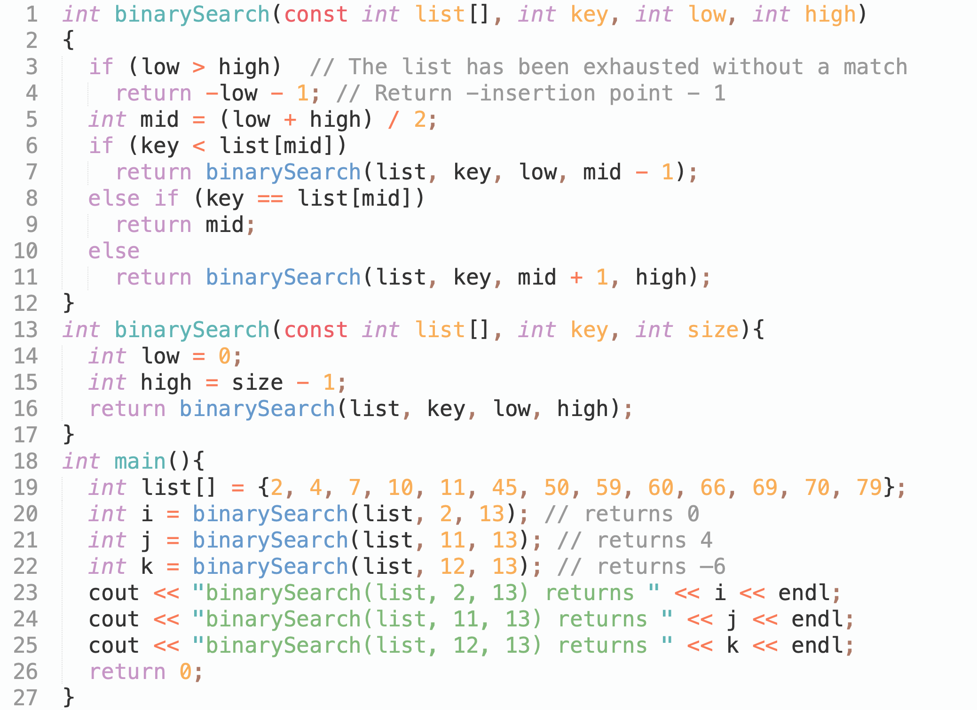
Recursive Implementation

Slide 27
Towers of Hanoi
There are n disks labeled 1, 2, 3, . . ., n, and three towers labeled A, B, and C.
No disk can be on top of a smaller disk at any time.
All the disks are initially placed on tower A.
Only one disk can be moved at a time, and it must be the top disk on the tower.

Slide 28
Towers of Hanoi, cont.

Slide 29
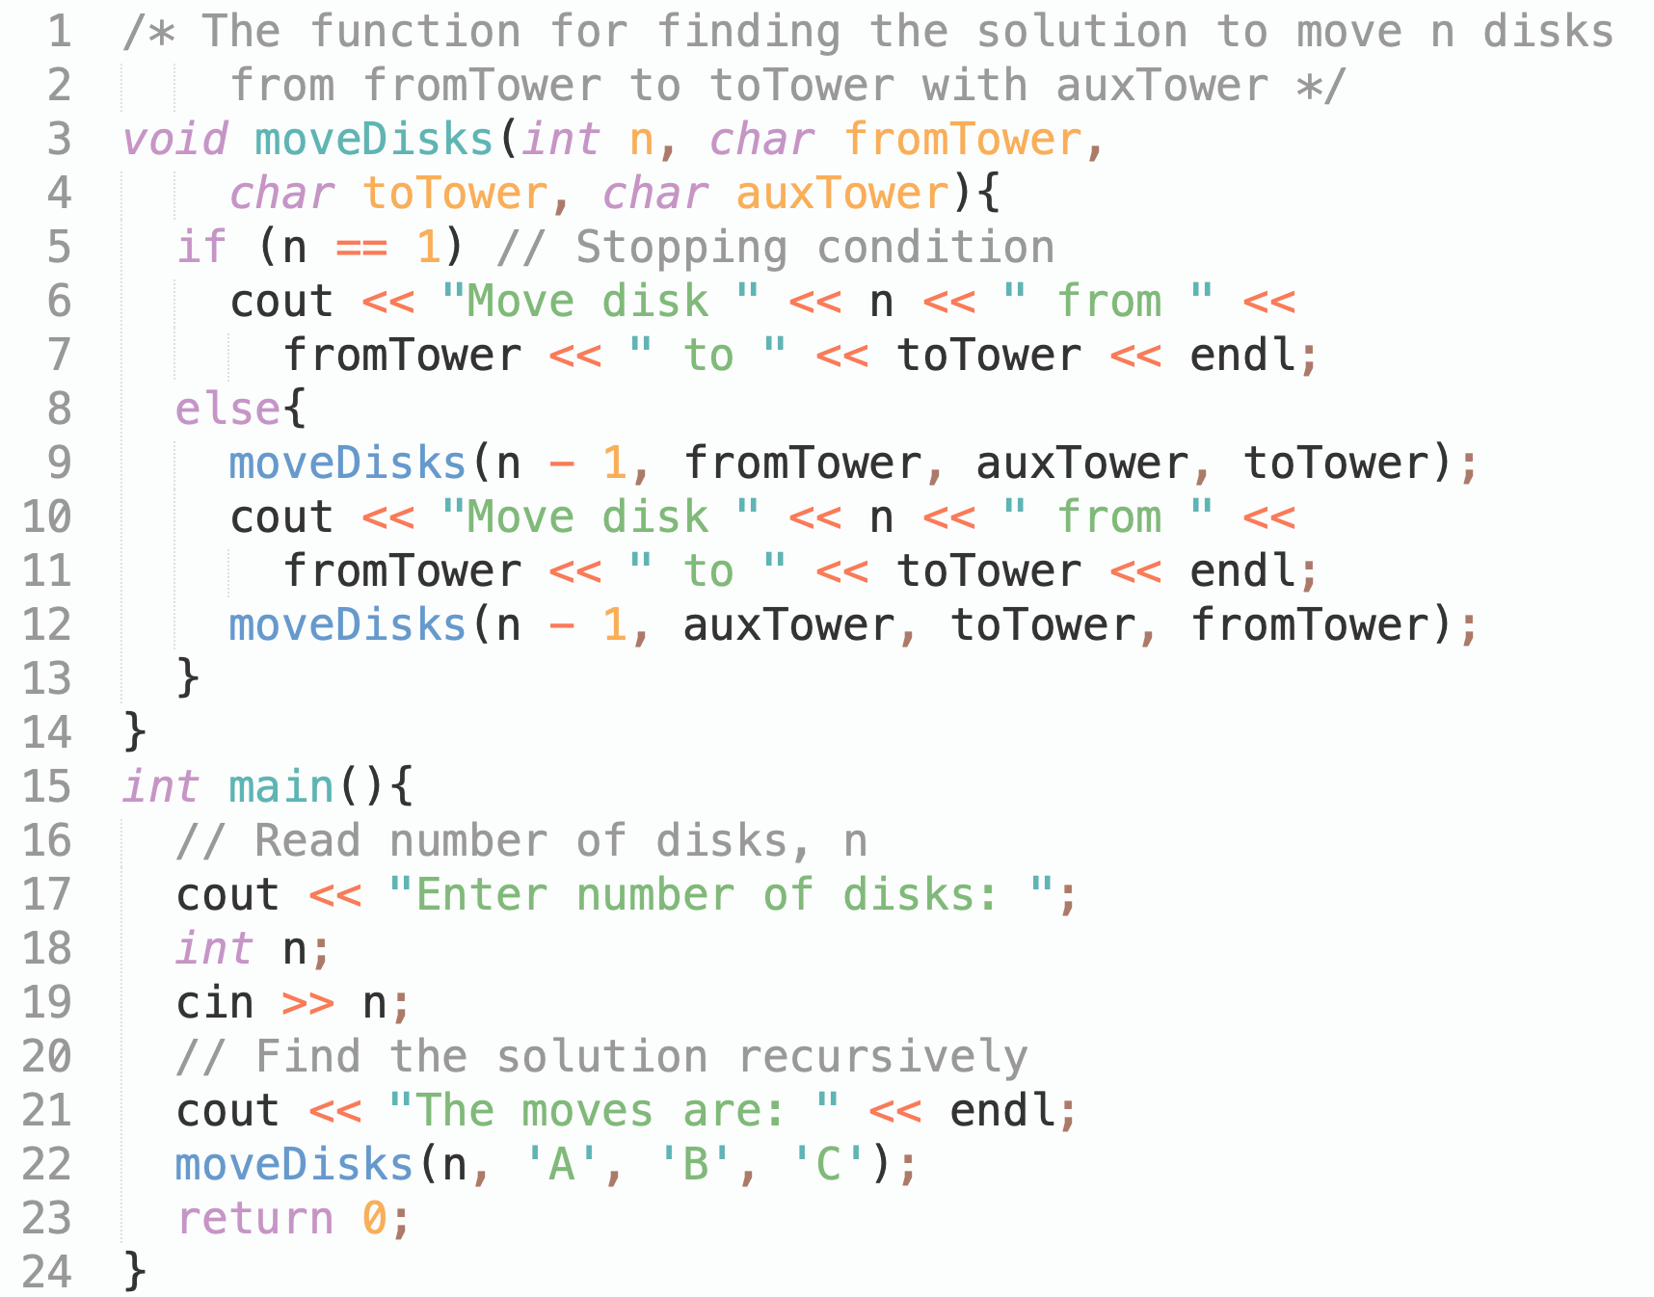
Solution to Towers of Hanoi

Slide 30
Exercise
Fill in the code to complete the following function for checking whether a string is Palindrome.
bool isPalindrome(const char * const s, int low, int high){
if (high <= low) //Base case
return true;
else if (s[low] != s[high]) //Base case
return false;
else return ________;
}
isPalindrome(s, low, high);
isPalindrome(s, low+1, high);
isPalindrome(s, low, high-1);
isPalindrome(s, low+1, high-1);

Slide 31
Exercise
Description
Find the greatest common divisor of two numbers.
You are asked to use recursive definition.
Input
The input data contains multiple test instances. Each set of data takes up a row with two positive integers n and m in each row. The input ends with 0 0.
Output
For each set of input samples, output a number that is their greatest common divisor.
Sample input
15 5
20 3
65 13
0 0
Sample output
5
1
13
Hint
1<=n,m<=10¹⁵

