Slide 1
程序设计原理
结构体
任课教师： 喻 梅
于瑞国
王建荣
李雪威
赵满坤

Slide 2
递归求最大公约数
欧几里得算法（辗转相除法）

Slide 3
扩展欧几里得
问题：假设你有一个5升的容器（容器A）和一个3升的容器（容器B）（以及充足的水源），如何精确地取出4升水来？
A装满水，倒入B将B装满，再将B的水全部倒出，继续将A的水倒入B，A空以后再将A接满，继续倒入B……
不断将A接满水倒入B，B满了就将B的水倒出，直至A中剩的水等于要求的水量
A接满2次水，B倒出2次水，最后A中剩的水为5*2-3*2=4
容器A容量为a，容器B容量为b，需要取出c升水
求ax+by=c的整数解

Slide 4
扩展欧几里得
求不定方程ax+by=c 的整数解
裴蜀定理：对任何整数a、b和它们的最大公约数d，关于未知数x和y的线性不定方程（称为裴蜀等式）：若a,b是整数,且gcd(a,b)=d，那么对于任意的整数x,y,ax+by都一定是d的倍数，特别地，一定存在整数x,y，使ax+by=d成立。
ax+by=c有整数解的充分必要条件是d=gcd(a,b)能整除c
ax+by=c有整数解，设为（x1,y1）,则ax1+by1=c，由于d为a和b的公约数，所以d也能整除c
d能整除c，设k=c/d，由于ax+by=d有解，设解为(x1,y1)，则ax1+by1=d,两边同时乘以k,则akx1+bky1=c,由于kx1和ky1都是整数，即ax+by=c存在一组整数解(kx1,ky1)。

Slide 5
扩展欧几里得
证明：一定存在整数x,y，使ax+by=d 成立（d=gcd(a,b)）
欧几里得求最大公约数的过程为(a,b)→(b,a%b)→……(d,0)的过程
当a=d,b=0时，即对于(d,0)这组数，d*x+0*y=d存在整数解x=1,y=任意整数，使得ax+by=d成立。如果能证明下面这个命题成立，那么就可以推导出ax+by=d有整数解
证明：如果bx+(a%b)y=d有整数解，那么ax+by=d有整数解
设(x1,y1)为bx+(a%b)y=d的整数解，a%b可表示为a-q*b，其中q为a/b的下取整值，代入得bx1+(a-qb)y1=d，转换得ay1+b(x1-qy1)=d，由于y1，(x1-qy1)都是整数，所以(y1,x1-qy1)是ax+by=d的一组整数解，即ax+by=d有整数解

Slide 6

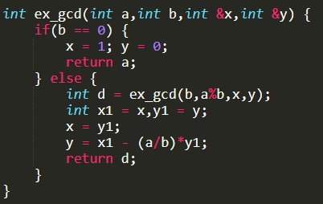
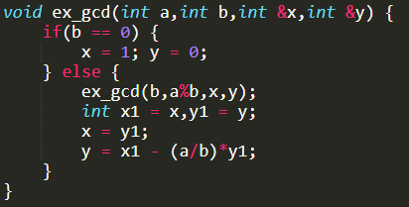
扩展欧几里得
代码实现
(y1,x1-qy1)是 ax+by=d 的一组整数解
递归过程中令x=y1,y=x1-qy1,其中q=a/b的下取整值

Slide 7
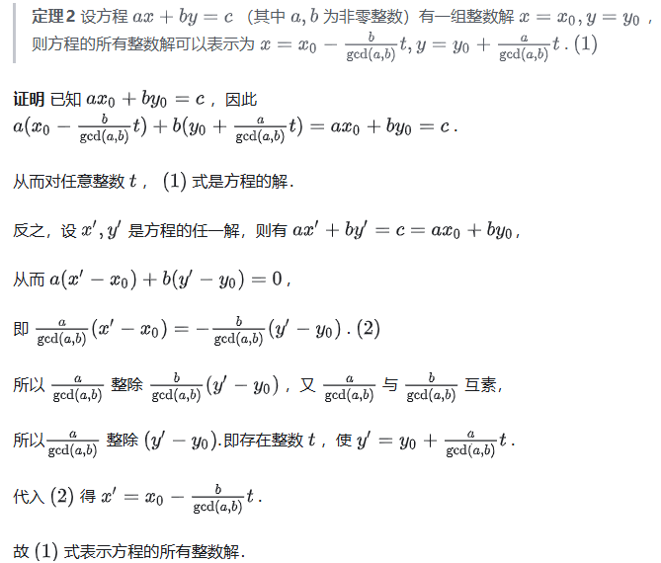
扩展欧几里得
扩展欧几里得
容器A容量为a，容器B容量为b，需要取出c升水
求ax+by=c的整数解
c需要是a和b最大公约数的倍数且c<=max(a,b)
最少接水倒水次数？|x|+|y|最小→接水次数最小
若a>b，求x>0的最小的解；否则，求y>0的最小的解
ax+by=c的通解？
若x0，y0为其一组特解
则其通解为x = x0-(b/d)t,y = y0+(a/d)t，t为任意整数

Slide 8
Structured Data Type
C++ Data Types
simple
structured
integral enum
floating
array struct union class
char short int long bool
address
float double long double
pointer reference

Slide 9
Structured Data Type
A structured data type is a type in which each value is a collection of component items
The entire collection has a single name
Each component can be accessed individually
Used to bundle together related data of various types for convenient access under the same identifier
For example . . .

Slide 10

Structured Data Type
thisAnimal
5000
.id 2037581
.name “giant panda”
.genus “Ailuropoda”
.species “melanoleuca”
.country “China”
.age 18
.weight 234.6
.health “Good”

Slide 11
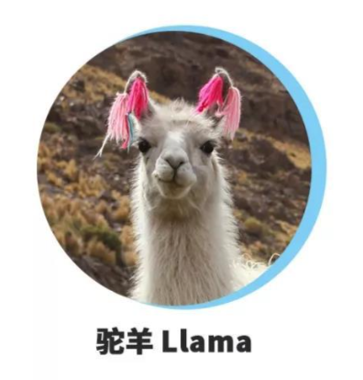
Structured Data Type
anotherAnimal
6000
.id 5281003
.name “llama”
.genus “Lama”
.species “peruana”
.country “Peru”
.age 7
.weight 278.5
.health “Excellent”

Slide 12
Struct AnimalType
struct AnimalType // Declares a struct data type
{ // does not allocate memory
long id;
string name;
string genus;
string species; struct members
string country;
int age;
float weight;
string health;
};
// Declare variables of AnimalType
AnimalType thisAnimal;
AnimalType anotherAnimal;

Slide 13
Struct Type Declaration
The struct declaration names a type and names the members of the struct
It does not allocate memory for any variables of that type!
You still need to declare your struct variables

Slide 14
More about struct type declarations
Scope of a struct
If the struct type declaration precedes all functions, it will be visible throughout the rest of the file
If it is placed within a function, only that function can use it
It is common to place struct type declarations in a (.h) header file and #include that file
It is possible for members of different struct types to have the same identifiers; also a non-struct variable may have the same identifier as a structure member

Slide 15
Struct Type Declaration
SYNTAX
struct TypeName // Does not allocate memory
{
MemberList
};
MemberList SYNTAX
DataType MemberName;
DataType MemberName;
.
.
.

Slide 16
Accessing struct Members
Dot (period) is the member selection operator
After the struct type declaration, the various members can be used in your program only when they are preceded by a struct variable name and a dot
EXAMPLES
thisAnimal.weight
anotherAnimal.country

Slide 17
Operations on struct Members
The type of the member determines the allowable operations
thisAnimal.age = 18;
thisAnimal.id = 2037581;
cin >> thisAnimal.weight;
getline (cin, thisAnimal.species);
thisAnimal.name = “giant panda”;
thisAnimal.genus[0] = toupper(thisAnimal.genus[0]);
thisAnimal.age++;

Slide 18
Aggregate struct Operations
Operations valid on struct type variables are
Assignment to another struct variable of the same type
Pass as an argument (by value or by reference)
Return as value of a function
I/O, arithmetic, and comparisons of entire struct variables are NOT ALLOWED!

Slide 19
Aggregate struct Operations
anotherAnimal = thisAnimal; // Assignment
WriteOut(thisAnimal); // Value parameter
ChangeWeightAndAge(thisAnimal); // Reference parameter
thisAnimal = GetAnimalData(); // Function return value

Slide 20
Aggregate struct Operations
void WriteOut( /* in */ AnimalType thisAnimal)
// Prints out values of all members of thisAnimal
// Precondition: all members of thisAnimal are assigned
// Postcondition:all members have been written out
{
cout << “ID # “ << thisAnimal.id
<< thisAnimal.name << endl;
cout << thisAnimal.genus << thisAnimal.species
<< endl;
cout << thisAnimal.country << endl;
cout << thisAnimal.age << “ years “ << endl;
cout << thisAnimal.weight << “ lbs. “ << endl;
cout << “General health : “<<thisAnimal.health<<endl;
}

Slide 21
Passing a struct Type by Reference
void ChangeAge(/* inout */ AnimalType& thisAnimal)
// Adds 1 to age
// Precondition: thisAnimal.age is assigned
// Postcondition:thisAnimal.age ==
// thisAnimal.age@entry + 1
{
thisAnimal.age++;
}

Slide 22
Return a struct Type
AnimalType GetAnimalData ()
// Obtains all information about an animal from keyboard
// Postcondition:
// Return value == AnimalType members entered at kbd
{
AnimalType thisAnimal;
char response;
do
{
// Have user enter members until they are correct
.
.
.
} while (response != ‘Y’);
return thisAnimal;
}

Slide 23
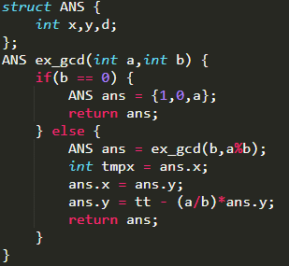
扩展欧几里得
定义一个结构体，包括需要返回的三个元素x,y,d，将结构体类型作为函数的返回值类型

Slide 24
Hierarchical Structures
The type of a struct member can be another struct type
This is called nested or hierarchical structures
Hierarchical structures are very useful when there is much detailed information in each record
For example . . .

Slide 25
struct MachineRec
Information about each machine in a shop contains:
an idNumber,
a written description,
the purchase date,
the cost,
and a history (including failure rate, number of
days down, and date of last service)

Slide 26
struct MachineRec
struct DateType
{
int month; // Assume 1 . . 12
int day; // Assume 1 . . 31
int year; // Assume 1900 . . 2050
};
struct StatisticsType
{
float failRate;
DateType lastServiced; // DateType is a struct type
int downDays;
};
struct MachineRec
{
int idNumber;
string description;
StatisticsType history; // StatisticsType is a struct
DateType purchaseDate;
float cost;
};
MachineRec machine;

Slide 27
struct type variable machine
7000
5719 “DRILLING…” 3 21 1995 8000.0
.02 1 25 2025 4
.month .day.year
.failrate .lastServiced .downdays
.month .day .year
.idNumber .description . history .purchaseDate .cost
machine.history.lastServiced.year has value 2025

Slide 28
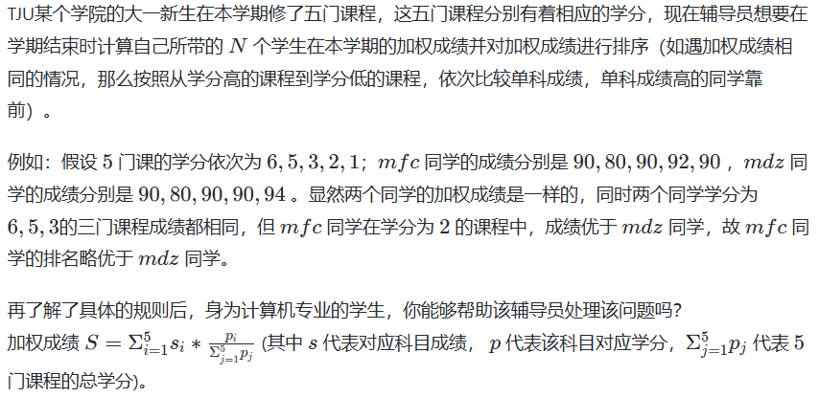
Exercise

Slide 29
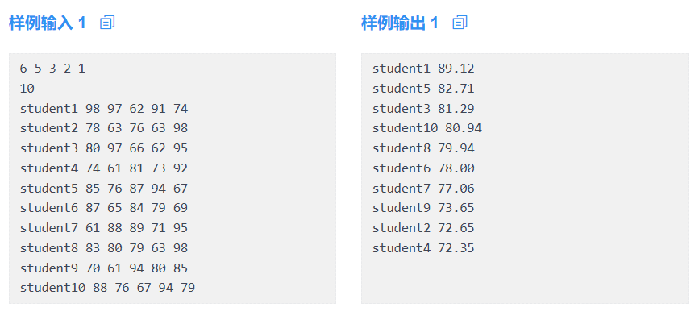
Exercise

