Slide 1
程序设计原理
文件输入输出
任课教师： 喻 梅
于瑞国
王建荣
李雪威
赵满坤

Slide 2
Objectives
To use ofstream for output and ifstream for input .
To test whether a file exists .
To test the end of a file .
To write data in a desired format .
To read and write data using the getline, get, and put functions .
To use an fstream object to read and write data .
To open a file with specified modes .
To use the eof(), fail(), bad(), and good() functions to test stream states .
2

Slide 3
Writing Data to a File
The ofstream class can be used to write primitive data type values, arrays, strings, and objects to a text file. TextFileOutput.cpp demonstrates how to write data. The program creates an instance of ofstream and writes two lines to the file “scores.txt”. Each line consists of first name (a string), middle name initial (a character), last name (a string), and score (an integer).
3

Slide 4
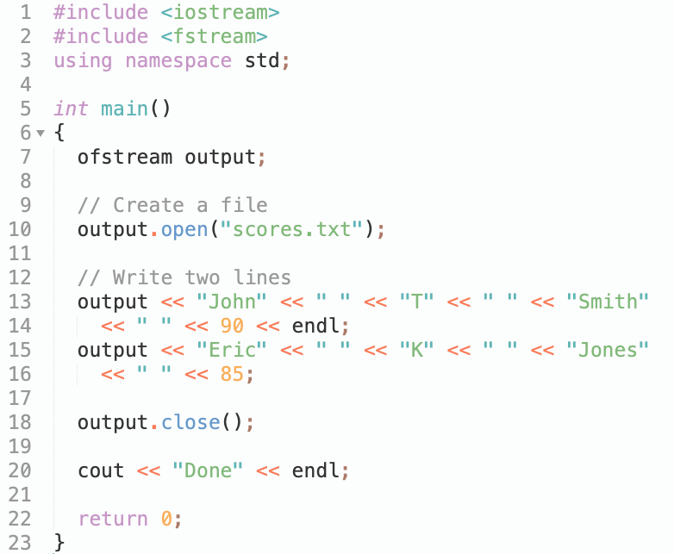
Writing Data to a File
4

Slide 5
Writing Data to a File
5

Slide 6
Close File
The close() function (line 18) must be used to close the stream for the object. If this function is not invoked, the data may not be saved properly in the file.
6

Slide 7
File Exists?
If a file already exists, the contents of the file will be destroyed without warning.
7

Slide 8
Absolute Filename
Every file is placed in a directory in the file system. An absolute file name contains a file name with its complete path and drive letter. For example, c:\example\scores.txt is the absolute file name for the file scroes.txt on the Windows operating system. Here c:\example is referred to as the directory path for the file. Absolute file names are machine-dependent. On Unix, the absolute file name may be /home/liang/example/scores.txt, where /home/liang/example is the directory path for the file scores.txt.
8

Slide 9
\ in file names
The directory separator for Windows is a backslash (\). The backslash is a special character in C++ and should be written as \\ in a string literal (see Table 2.4). For example,
output.open("c:\\example\\scores.txt");
9

Slide 10
Relative Filename
Absolute file name is platform dependent. It is better to use relative file name without drive letters. The directory of the relative filename can be specified in the IDE (Integrated Development Environment) if you use an IDE to run C++. For example, the default directory for data files is \windows\Debug_Build for Borland C++Builder.
10

Slide 11
Reading Data from a File
The ifstream class can be used to read data from a text file. TextFilein.cpp demonstrates how to read data. The program creates an instance of ifstream and reads data from the file scores.txt. scores.txt was created in the preceding example.
11

Slide 12
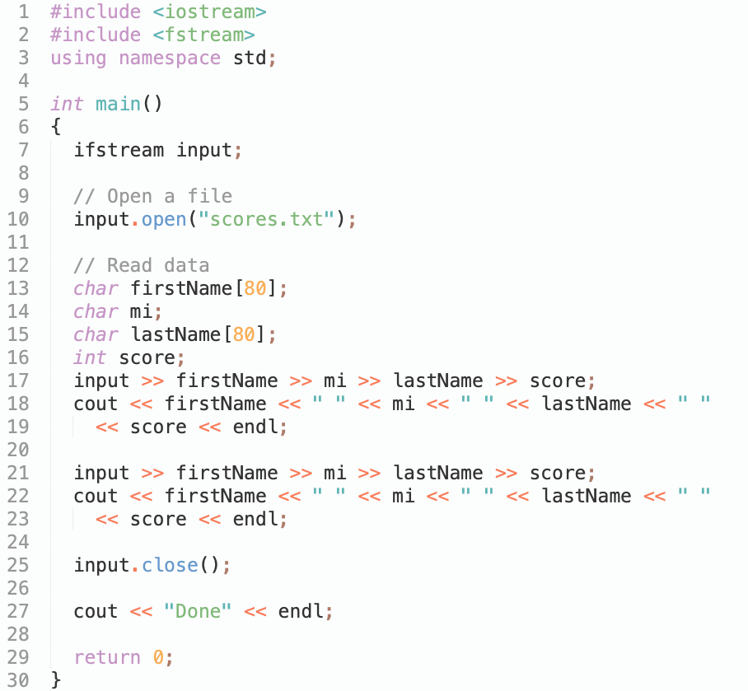
Reading Data from a File
12

Slide 13
Testing File Existence
If the file does not exist, your program will run and produce incorrect results. Can your program check whether a file exists? Yes. You can invoke the fail() function immediately after invoking the open function. If fail() returns true, it would indicate that the file does not exist.
13

Slide 14
Testing End of File
TextFilein.cpp reads two lines from the data file. If you don’t know how many lines are in the file and want to read them all, how do you know the end of file? You can invoke the eof() function on the input object to detect it. TestEndOfFile.cpp revises TextFilein.cpp to read all lines from the file scores.txt.
14

Slide 15
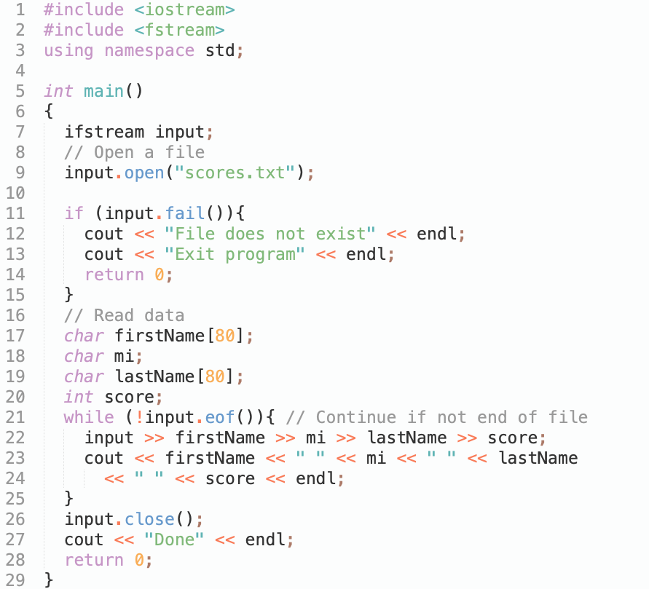
Testing End of File
15

Slide 16
Know Data Format
To read data correctly, you need to know exactly how data is stored. For example, the program in TestEndOfFile.cpp would not work if the score is a double value with a decimal point.
16

Slide 17
Formatting Output
You have used the stream manipulators to format output to the console in §3.11, “Formatting Output.” You can use the same stream manipulator to format output to a file. WriteFormatData.cpp gives an example that formats the student records to the file named formattedscores.txt.
17

Slide 18
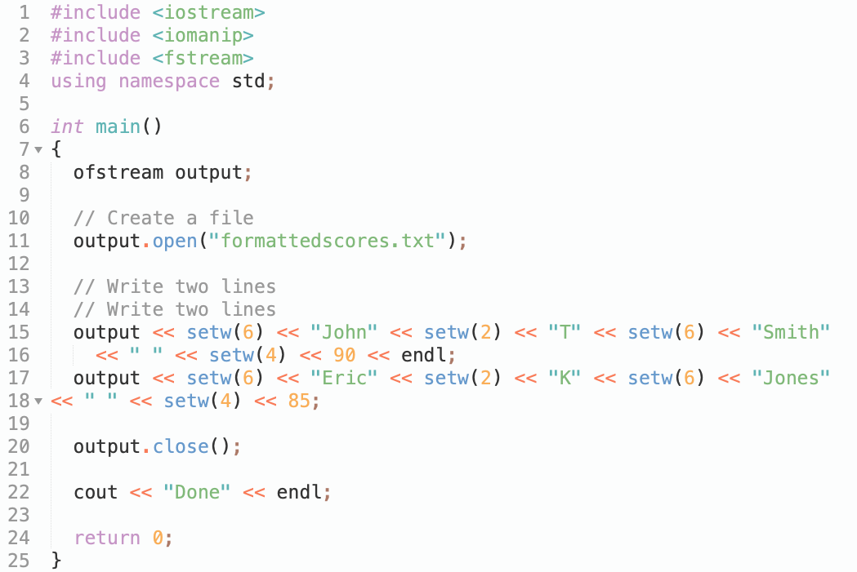
Formatting Output
18

Slide 19
getline, get and put
There is a problem to read data using the stream extraction operator (>>). Data are delimited by whitespace(space, TAB, Enter). What happens if the whitepace characters are part of a string? In §7.9.3, “Reading Strings,” you learned how to use the getline function to read a string with whitespace. You can use the same function to read strings from a file. Recall that the syntax for the getline function is
getline(char array[], int size, char delimitChar)
19

Slide 20
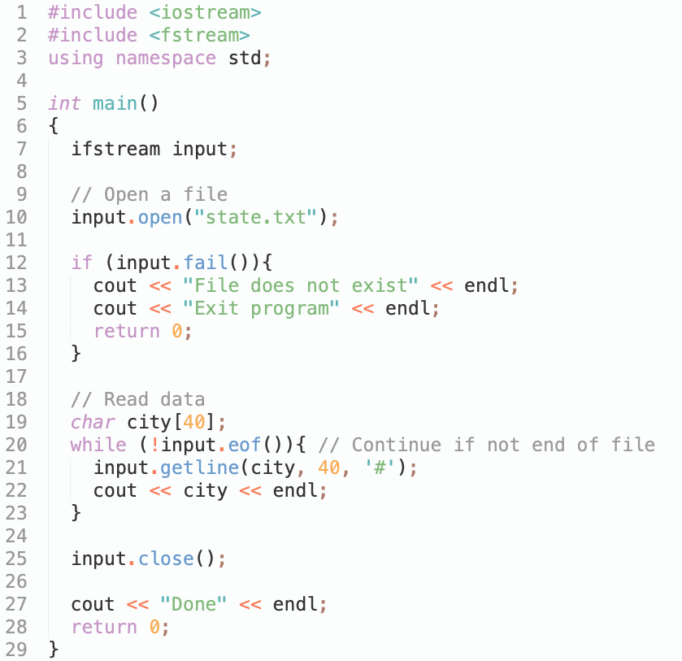
getline, get and put
20

Slide 21
getline, get and put
Two other useful functions are get and put. You can invoke the get function on an input object to read a character and invoke the put function on an output object to write a character.
21

Slide 22
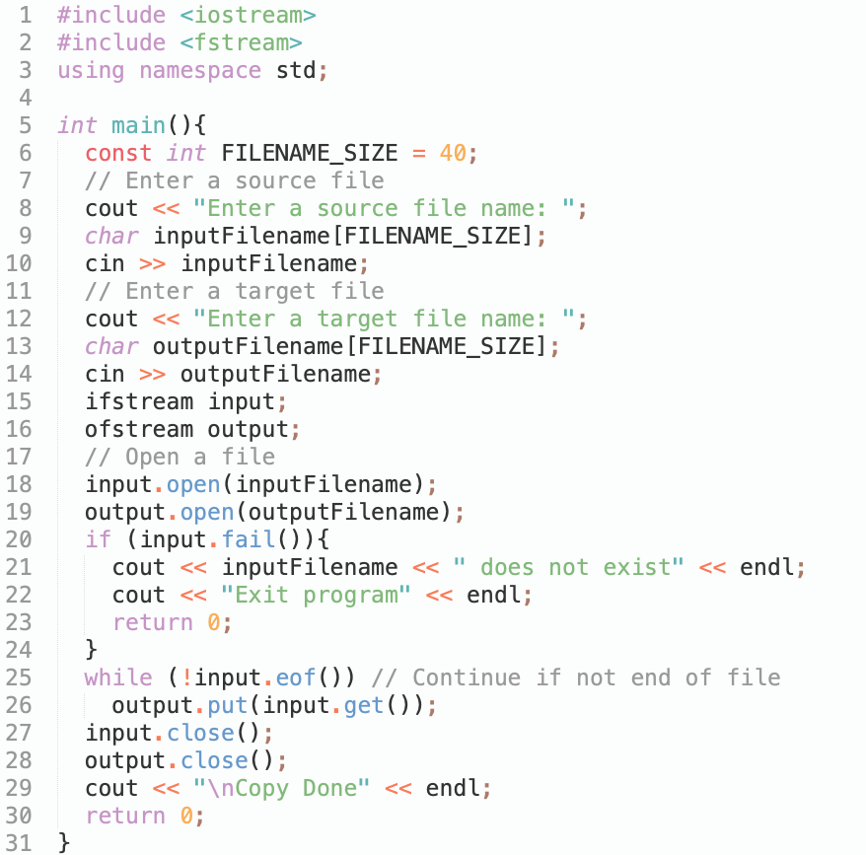
getline, get and put
22

Slide 23
getline()
getline does not skip leading whitespace characters such as blanks and newlines
getline reads successive characters (including blanks) into the string, and stops when it reaches the newline character ‘\n’
the newline is consumed by getline, but is not stored into the string variable
23

Slide 24
get()
get does not skip leading whitespace characters such as blanks and newlines
get reads successive characters (including blanks) into the array, and stops when it either has read count characters, or it reaches the newline character ‘\n’, whichever comes first
get appends the null character to str
if it is reached, newline is not consumed by get, but remains waiting in the input stream
24

Slide 25
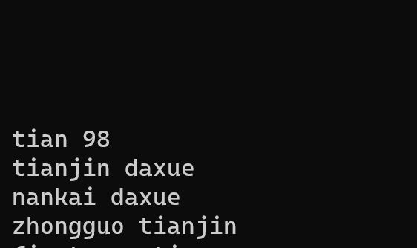
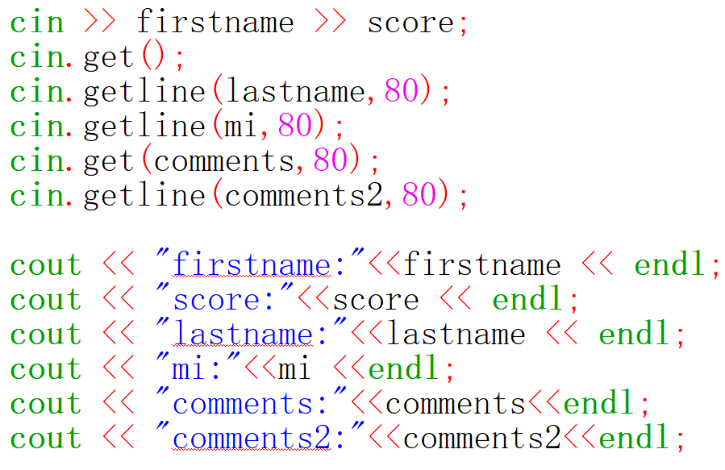
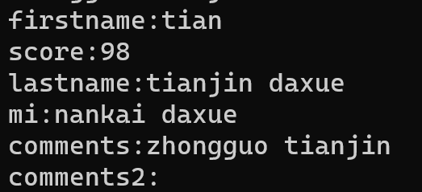
getline, get and put
25

Slide 26
fstream and File Open Modes
In the preceding sections, you used the ofstream to write data and the ifstream to read data. Alternatively, you can also use the fstream class to create an input stream or output stream. It is convenient to use fstream if your program needs to use the same stream object for both input and output. To open an fstream file, you have to specify a file mode to tell C++ how the file will be used. The file modes are listed in Table 12.1.
26

Slide 27
File Open Modes
27

Slide 28
Combining Modes
Several modes can be combined together using the | operator. This is a bitwise inclusive OR operator. See function in a derived class is called overriding a function.
Appendix D, “Bit Operations,” for more details. For example, to open an output file named city.txt for appending data, you can use the following statement:
stream.open("city.txt", ios::out | ios::app);
28

Slide 29
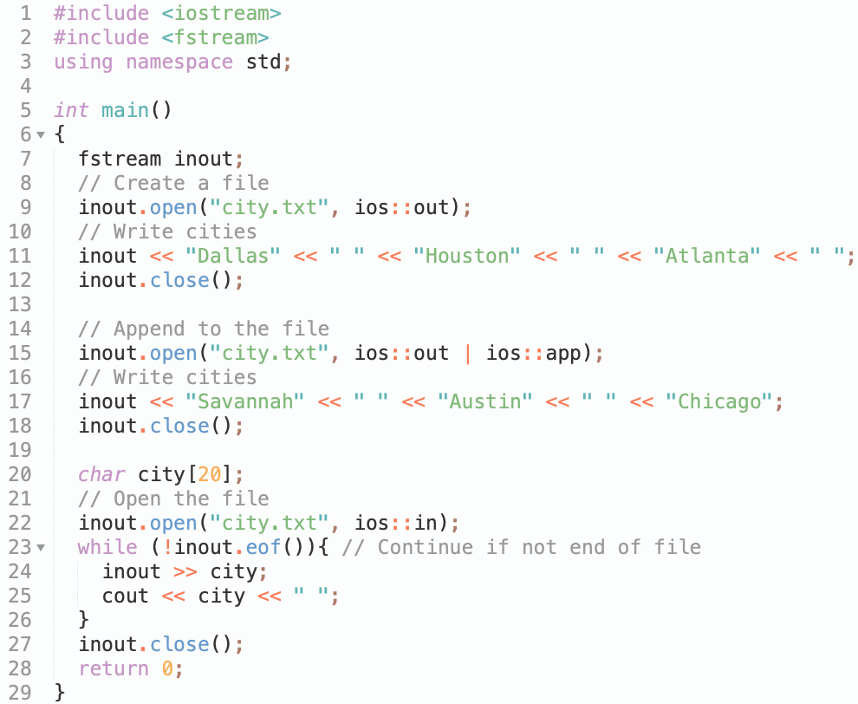
Combining Modes
29

Slide 30

Exercise
30

Slide 31
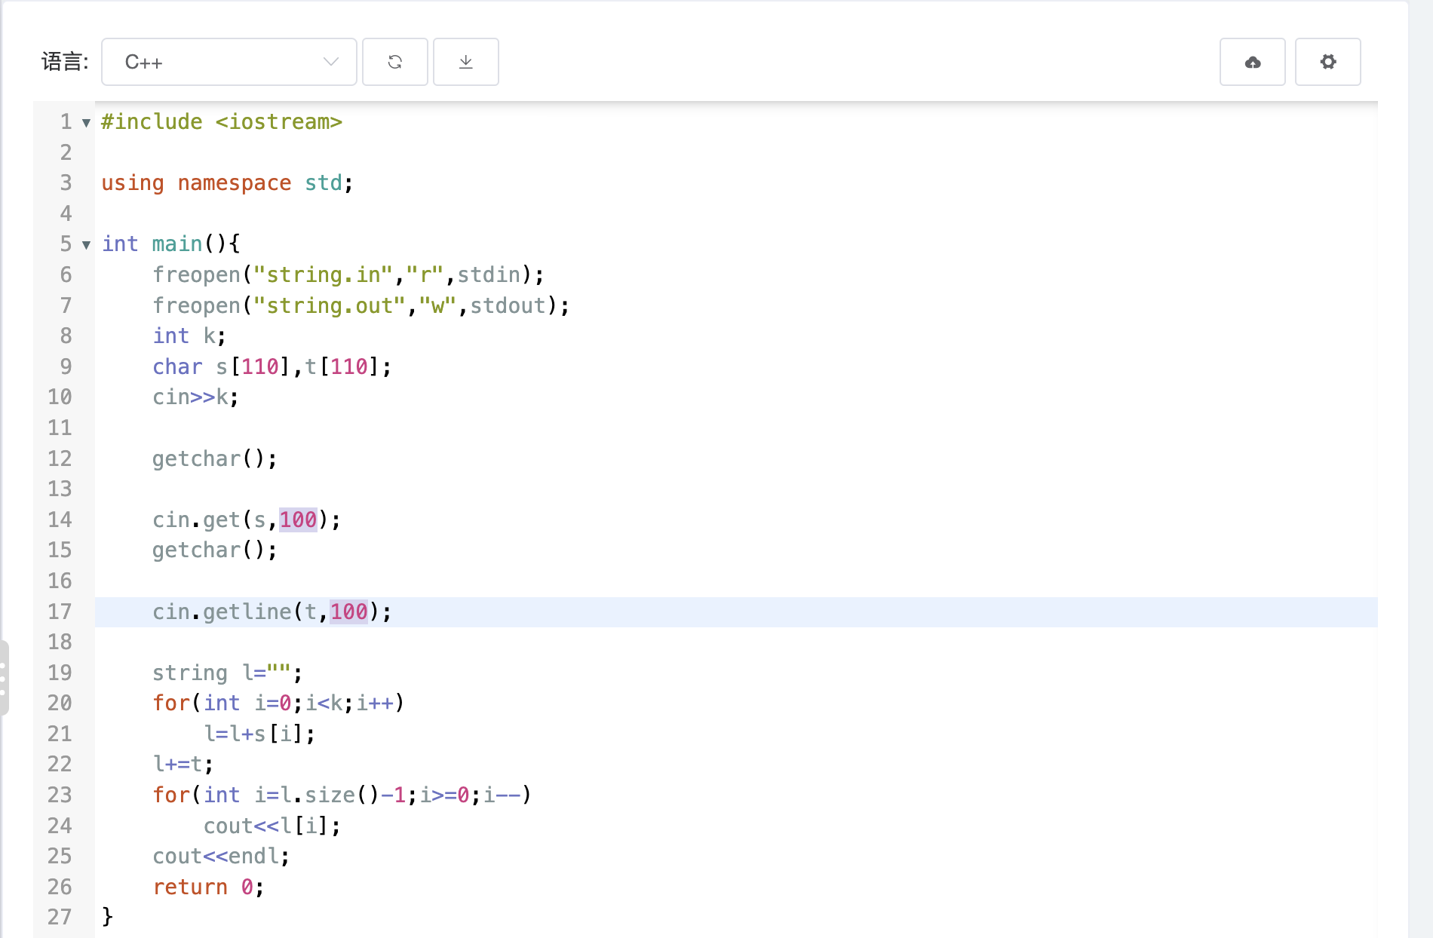
Exercise

