Slide 1
程序设计原理
模板(Templates)与向量(Vector)
任课教师： 喻 梅
于瑞国
王建荣
李雪威
赵满坤

Slide 2
Objectives
To know the motivation and benefits of templates.
To define a template function with type parameters.
To develop a generic sort function using templates.
To develop generic classes using class.
n To use the C++ vector class as a resizable array.

Slide 3

Templates Basics
Templates functions and classes enable programs to work on many different data types without being rewritten for each one.
Key
Point
Suppose you want to find the maximum of two integers, two doubles, two characters, and two strings. You might write four overloaded functions as follows:
int maxValue(int a, int b) {
if (a > b)
return a;
else
return b;
}
double maxValue(double a, double b) {
if (a > b)
return a;
else
return b;
}
char maxValue(char a, char b) {
if (a > b)
return a;
else
return b;
}
string maxValue(string a, string b) {
if (a > b)
return a;
else
return b;
}

Slide 4
Templates Basics
These four functions are almost identical, except that each uses a different type.
int maxValue(int a, int b) {
if (a > b)
return a;
else
return b;
}
double maxValue(double a, double b) {
if (a > b)
return a;
else
return b;
}
char maxValue(char a, char b) {
if (a > b)
return a;
else
return b;
}
string maxValue(string a, string b) {
if (a > b)
return a;
else
return b;
}

Slide 5
Templates Basics
You could simply define one function with a generic type as follows:
GenericType maxValue(GenericType a, GenericType b) {
if (a > b)
return a;
else
return b;
}
To define a template function for finding a maximum value between two values of a generic type:
before a function
template<typename T>
T maxValue(T a, T b) {
if (a > b)
return a;
else
return b;
}

Slide 6
Templates Basics
The definition for the function template begins with the keyword template followed by a list of parameters. Each parameter must be preceded by the interchangeable keyword typename or class in the form <typename typeParameter> or <class typeParameter>.
a list of parameters
typename T
Or class T
Template prefix (before a function)
template<typename T>
T maxValue(T a, T b) {
if (a > b)
return a;
else
return b;
}
function
Note: Occasionally, a template function may have more than one parameter. In this case, place the parameters together inside the brackets, separated by commas, such as:
<typename T1, typename T2, typename T3>

Slide 7
Templates Basics
Template prefix (before a function)
template<typename T>
T maxValue(T a, T b) {
if (a > b) return a;
else return b;
}
int main(){
cout << "Maximum between 1 and 3 is " << maxValue(1, 3) << endl;
cout << "Maximum between 1.5 and 0.3 is "
<< maxValue(1.5, 0.3) << endl;
cout << "Maximum between 'A' and 'N' is "
<< maxValue('A', 'N') << endl;
cout << "Maximum between \"NBC\" and \"ABC\" is "
<< maxValue(string("NBC"), string("ABC")) << endl;
return 0;
}
Maximum between 1 and 3 is 3
Maximum between 1.5 and 0.3 is 1.5
Maximum between 'A' and 'N' is N
Maximum between "NBC" and "ABC" is NBC

Slide 8
Example: A Generic Sort
Key
Point
Define a generic selection sort function.
Instead of writing several overloaded sort functions, you can define just one template function that works for any type.
void displayArray(int [], int );
void mySwap(int& a, int& b) {…}
void selectionSort(int list[], int size) {…}
void displayArray(int list[], int size) {…}
int main() {
int list[] = {2, 9, 5, 4, 8, 1, 6};
selectionSort(list, 7);
return 0;
}

Slide 9
Class Templates
Key
Point
You can define generic types for a class.
Combine class definition and class implementation into one file.
For definition:
Place the template prefix before the class definition.
The type parameter can be used in the class just like any regular data type.
For implementation:
Place the template prefix before the constructor and function header in the implementation and use the type parameter (T) to replace the regular data type in the function.
Class name before the scope resolution operator :: is ClassName<T>
template prefix:
template<typename T>

Slide 10
Class Templates
Combine class definition and class implementation into one file.
For definition:
Place the template prefix before the class definition.
The type parameter can be used in the class just like any regular data type.
For implementation:
Place the template prefix before the constructor and function header in the implementation.
Class name before the scope resolution operator :: is ClassName<T>
Stack.h
1
2
3
4
5
6
7
8
9
10
11
12
13
14
15
//Definition
template<typename T>
class Stack{
public:
Stack();
bool isEmpty() const;
T peek() const;
void push(T value);
T pop();
int getSize() const;
void display() const;
private:
T elements[100];
int size;
};
//Implementation
…

Slide 11
Class Templates
Combine class definition and class implementation into one file.
For definition:
Place the template prefix before the class definition.
The type parameter can be used in the class just like any regular data type.
For implementation:
Place the template prefix before the constructor and function header in the implementation.
Class name before the scope resolution operator :: is ClassName<T>
Stack.h
1
…
3
15
16
18
19
20
21
21
22
23
24
25
26
27
28
…
//Definition
template<typename T>
class Stack{
…
};
//Implementation
template<typename T>
Stack<T>::Stack(){
size = 0;
}
template<typename T>
T Stack<T>::peek() const {
return elements[size-1];
}
template<typename T>
void Stack<T>::push(T value){
elements[size ++] = value;
}
…

Slide 12
The C++ vector Class
C++ contains a generic vector class for storing a list of objects.
Key
Point
vector<elementType> vectorName;
vector<int> intVector;
vector<string> stringVector;
#include <vector>
using namespace std;
int main() {
vector<int> intVector;
for (int i = 0; i < 10; i++)
intVector.push_back(i + 1);
intVector.pop_back(); // Remove the last element
return 0;
}

Slide 13
程序设计原理
Standard Template Libraries
Instructor: Mei Yu
Ruiguo Yu
Jianrong Wang
Xuewei Li
Xiang Ying

Slide 14
Objectives
Introduction to Standard Template Library (STL)
Introduction to Containers
Templated data structure
vector, list, deque; set, multiset, map, multimap; stack, queue, priority_queue
Introduction to Iterators
Access the elements of STL containers
Introduction to Algorithms
Program with many STL algorithms
equal, size, find, remove, replace, min, max, swap, basic searching, sorting algorithms

Slide 15
Introduction to the Standard Template Library (STL)
The Standard Template Library (STL) defines powerful, template-based, reusable components that implement many common data structures and algorithms used to process those data structures.
algorithms + data structures = programs
15

Slide 16
Introduction to the Standard Template Library (STL)
The Standard Template Library (STL) defines powerful, template-based, reusable components.
Implement many common data structures and algorithms used to process those data structures.
The STL was conceived and designed for performance and flexibility.
STL has three key components
containers (popular templatized data structures)
iterators (to access the elements of STL containers)
algorithms (searching, sorting, comparing etc)
16

Slide 17
Advantage of STL
Data structures.
linked lists, queues, stacks and trees.
objects are linked together with pointers.
Pointer-based code is complex
the slightest omission or oversight can lead to serious memory-access violations and memory-leak errors with no compiler complaints.
Implementing additional data structures, such as deques, priority queues, sets and maps, requires substantial extra work.
An advantage of the STL is that you can reuse the STL containers, iterators and algorithms
implement common data structures and manipulations project-wide.
17

Slide 18
STL Containers
Each STL container has associated member functions.
A subset of these member functions is defined in all STL containers.
Example of STL containers
vector (a dynamically resizable array)
list (a doubly linked list)
deque (a double-ended queue, pronounced “deck”).
Double-ended queues are sequence containers with dynamic sizes that can be expanded or contracted on both ends (either its front or its back).
individual elements are accessed directly through random access iterators
18

Slide 19
STL Iterators
STL iterators
properties similar to those of pointers
used by programs to manipulate the STL-container elements.
Standard arrays can be manipulated by STL algorithms
using standard pointers as iterators.
Manipulating containers with iterators is convenient
provides tremendous expressive power combined with STL algorithms
reduce many lines of code to a single statement.
19

Slide 20
STL Algorithms
STL algorithms are functions that perform common data manipulations
searching, sorting and comparing elements (or entire containers) etc.
Each algorithm has minimum requirements for the types of iterators that can be used with it.
Each first-class container supports specific iterator types, some more powerful than others.
A container’s supported iterator type determines whether the container can be used with a specific algorithm.
20

Slide 21
Containers
The STL containers are divided into three major categories
sequence containers
associative containers
container adapters
21

Slide 22
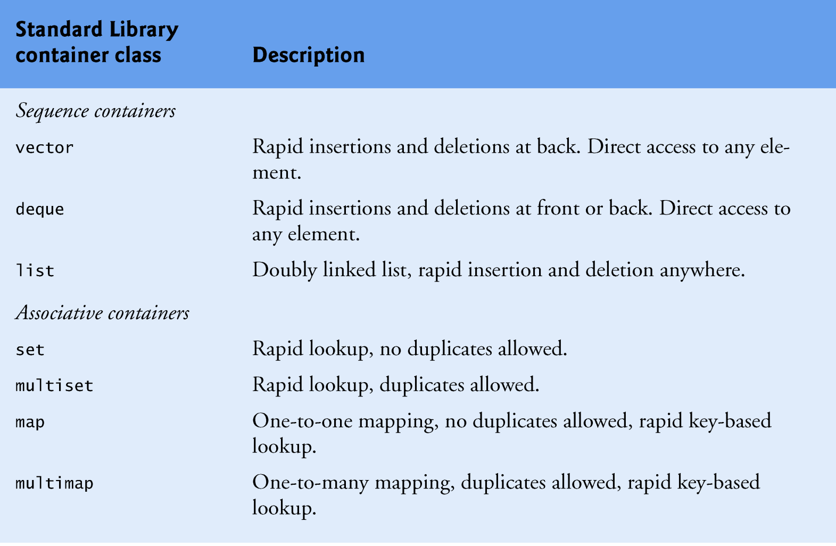
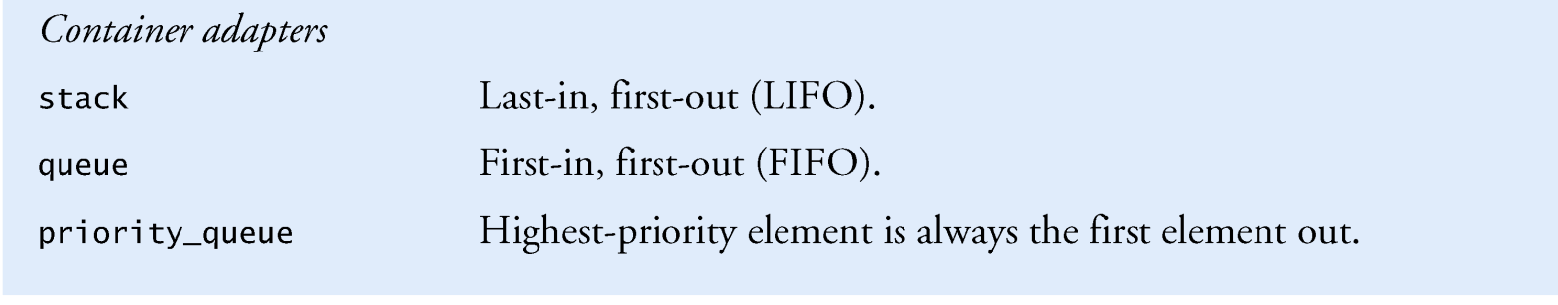
Containers Types and Examples

Slide 23
Containers Types
The sequence containers represent linear data structures
vectors and linked lists.
The associative containers are nonlinear containers
locate elements stored in the containers quickly
store sets of values or key/value pairs.
Stacks and queues actually are constrained versions of sequential containers.
STL implements stacks and queues as container adapters
enable a program to view a sequential container in a constrained manner.
23

Slide 24
Containers’ Common Member Functions
Most STL containers provide similar functionality.
Many generic operations, such as member function size, apply to all containers
other operations apply to subsets of similar containers.
encourages extensibility of the STL with new classes.
24

Slide 25
Introduction to Iterators
Iterators have many similarities to pointers
point to first-class container elements.
Certain iterator operations are uniform across containers.
For example, the dereferencing operator (*) dereferences an iterator
get the element to which it points.
The ++ operation on an iterator moves it to the container’s next element
25

Slide 26
Iterators
STL first-class containers provide member functions begin and end.
Function begin returns an iterator pointing to the first element of the container.
Function end returns an iterator pointing to the first element past the end of the container (an element that doesn’t exist).
26

Slide 27
Iterators
Iterator i points to a particular element
++i points to the “next” element
*i refers to the element pointed to by i
The iterator resulting from end is typically used in an equality or inequality comparison
determine whether the “moving iterator” (i in this case) has reached the end of the container.
An object of type iterator refers to a container element that can be modified.
An object of type const_iterator refers to a container element that cannot be modified.
27

Slide 28
Introduction to Algorithms
STL algorithms can be used generically across a variety of containers.
STL provides many algorithms to manipulate containers.
inserting, deleting, searching, sorting etc.
The algorithms operate on container elements only indirectly through iterators.
Many algorithms operate on sequences of elements defined by pairs of iterators
one pointing to the first element of the sequence
one pointing to one element past the last element
28

Slide 29
Introduction to Algorithms
Algorithms often return iterators that indicate the results of the algorithms.
Algorithm find
locates an element and returns an iterator to that element.
If the element is not found, find returns the “one past the end” iterator.
The find algorithm can be used with any first-class STL container.
Some algorithms demand powerful iterators; e.g., sort demands random-access iterators.
29

Slide 30
Vector
Provides an alternative to the built in array.
A vector is self grown.
Use It instead of the built in array!

Slide 31
Defining a new vector
Syntax: vector<of what>
For example :
vector<int> - vector of integers. vector<string> - vector of strings. vector<int * > - vector of pointers to integers. vector<Shape> - vector of Shape objects. Shape is a user defined class.

Slide 32
The vector Container
Constructors
vector<T> v, // empty vector
v1(100), // 100 elements of type T
v2(100, val), // 100 copies of val
v3(fptr,lptr); // contains copies of
// elements in memory // locations fptr to lptr
32

Slide 33
vector Operations
Information about a vector's contents
v.size()
v.empty()
v.capacity()//expand by doubling its size
v.reserve()//grow its capacity to para
Adding, removing, accessing elements
v.push_back()
v.pop_back()
v.front()//return a reference to v’s first item
v.back()
33

Slide 34
Using Vector
#include <vector>
Two ways to use the vector type:
Array style.
STL style

Slide 35
Using vector – Array Style
We mimic the use of built-in array.
void simple_example() { const int N = 10; vector<int> ivec(N);
for (int i=0; i < 10; ++i)
cin >> ivec[i];
int ia[N]; for ( int j = 0; j < N; ++j) ia[j] = ivec[j]; }

Slide 36
Using vector – STL style
We define an empty vector vector<string> svec; we insert elements into the vector using the method push_back.
string word; while ( cin >> word ) //the number of words is unlimited.
{ svec.push_back(word); }

Slide 37
Insertion
void push_back(const T& x);
Inserts an element with value x at the end of the controlled sequence.
svec.push_back(str);

Slide 38
Size
unsigned int size();
Returns the length of the controlled sequence (how many items it contains).
unsigned int size = svec.size();

Slide 39
Class Exercise 1
Write a program that read integers from the user, sorts them, and print the result.

Slide 40
Solving the problem
Easy way to read input.
A “place” to store the input
A way to sort the stored input.

Slide 41
Using STL
int main() { int input; vector<int> ivec; /* rest of code */ }

Slide 42
STL - Input
while ( cin >> input ) ivec.push_back(input);

Slide 43
STL - Sorting
sort(ivec.begin(), ivec.end());
Sort Prototype: void sort(Iterator first, Iterator last);

Slide 44
STL - Output
for ( int i = 0; i < ivec.size(); ++i ) cout << ivec[i] << " "; cout << endl;
Or (more recommended)
vector<int>::iterator it; for ( it = ivec.begin(); it != ivec.end(); ++it ) cout << *it << " "; cout << endl;

Slide 45
Iterators
Given a vector which has had values placed in the first 4 locations:
v.begin() will return the iterator value for the first slot,
v.end() for the next empty slot
vector<int> v
9 | 4 | 15 | 3
v.begin()
v.end()
45

Slide 46
STL - Include files
#include <iostream> // I/O #include <vector> // container #include <algorithm> // sorting //using namespace std;

Slide 47
Putting it all together
int main() { int input; vector<int> ivec; // input while (cin >> input ) ivec.push_back(input); // sorting sort(ivec.begin(), ivec.end()); // output vector<int>::iterator it; for ( it = ivec.begin(); it != ivec.end(); ++it ) { cout << *it << " "; } cout << endl; return 0; }

Slide 48
Operations on vector
iterator begin();
iterator end();
bool empty();
void push_back(const T& x);
iterator erase(iterator it);
iterator erase(iterator first, iterator last);
void clear();
….

Slide 49
vector
Dynamic array of variables, struct or objects.
Insert data at the end.
#include <iostream>
#include <vector>
using namespace std;
int main () {
vector<int> v; // Template!
for (int i=1; i<=10 ; i++)
v.push_back(i);
v.erase (v.begin()+5);
v.erase (v.begin(),v.begin()+3);
v.pop_back();
for (int i=0; i<v.size(); i++)
cout << v[i] << " ";
return 0;
}
4 5 7 8 9

Slide 50
Using iterator
#include <iostream>
#include <vector>
using namespace std;
int main () {
vector<int> v1 (3,100);
vector<int>::iterator it;
it = v1.begin();
it = v1.insert (it,200);
v1.insert (it,2,300);
it = v1.begin();
vector<int> v2 (2,150);
v1.insert( it+3, v2.begin(), v2.end());
int a1 [] = { 501,502,503 };
v1.insert (v1.begin(), a1, a1+3);
for (it=v1.begin();it<v1.end(); it++)
cout << *it << " ";
cout << endl;
return 0;
}
501 502 503 300 300 200 150 150 100 100 100

Slide 51
Exercise
Vector I
For a dynamic array A={a₀,a₁,…} of integers, perform a sequence of the
following operations;
· pushBack(x): add element x at the end of A
· randomAccess(p): print element a_{p}
· popBack(x): delete the last element of A
A is a 0-orign array and it is empty in the initial state.
Input
The input is given in the following format.
Q
Query₁
Query₂
Each query query_{i} is given by 0 x or 1 p or 2
Where the first digits 0,1 and 2 represent pushback, randomAccess and popBack operations respectively.
randomAccess and popback operations will not be given for an empty array.

Slide 52
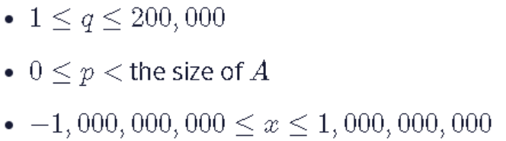
Exercise
Output
Constraints
Sample Input
8
0 1
0 2
0 3
2
0 4
1 0
1 1
1 2
Sample Output
1
2
4
52

Slide 53
Exercise
Vector II
For n dynamic arrsays A_{i} (i=0,1,…n-1),perform a sequence of the following operations;
· pushback(t,x): Add element x at the end of A_{t}.
· dump(t): print all elements in A_{t}.
· clear(t): clear A_{t} if A_{t} is empty, do nothing.
A_{i} is a 0-orign array and it is empty in the initial state.
Input
The input is given in the following format.
Q
Query₁
Query₂
Each query query_{i} is given by 0 t x or 1 t or 2 t
Where the first digits 0,1 and 2 represent pushback, dump and clear operations respectively.
53

Slide 54
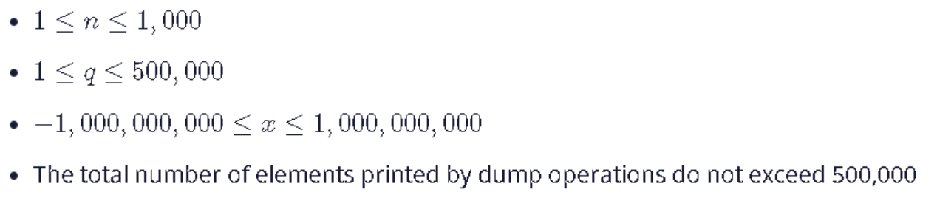
Exercise
Constraints
Sample Input
3 13
0 0 1
0 0 2
0 0 3
0 1 -1
0 2 4
0 2 5
1 0
1 1
1 2
2 1
1 0
1 1
1 2
Sample Output
1 2 3
-1
4 5
1 2 3
4 5

