Slide 1
程序设计原理
变量声明与基本运算
任课教师： 喻 梅
于瑞国
王建荣
李雪威
赵满坤

Slide 2
Constants
const datatype CONSTANTNAME = VALUE;
A constant must be declared and initialized in the same statement.
#include <iostream>
using namespace std;
int main()
{
const int LENGTH = 10;
const int WIDTH = 5;
const char NEWLINE = '\n';
int area;
area = LENGTH * WIDTH;
cout << area;
cout << NEWLINE;
return 0;
}

Slide 3
Constants
#define identifier value
#include <iostream>
using namespace std;
#define LENGTH 10
#define WIDTH 5
#define NEWLINE '\n'
int main()
{
int area;
area = LENGTH * WIDTH;
cout << area;
cout << NEWLINE;
return 0;
}

Slide 4
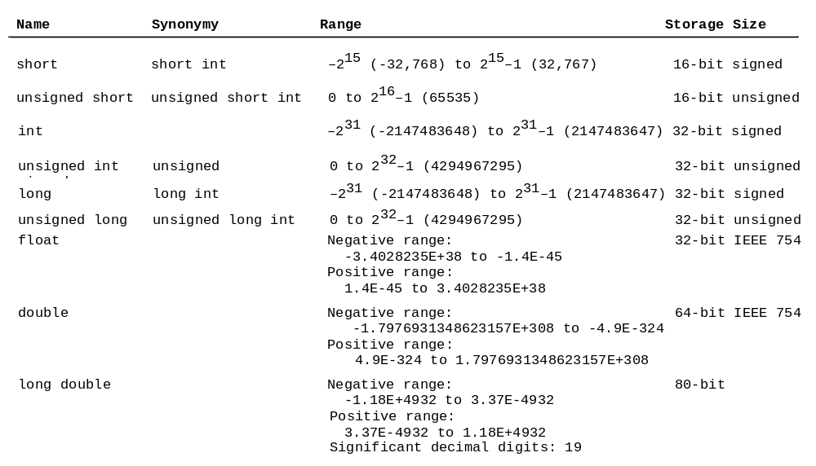
Numerical Data Types and Operations

Slide 5
Overflow
When a variable is assigned a value that is too large to be stored, it causes overflow. For example, executing the following statement causes overflow, because the largest value that can be stored in a variable of the short type is 32767. 32768 is too large.
short value = 32767 + 1;

Slide 6
Underflow
When a variable is assigned a value that is too small to be stored, it causes underflow. For example, executing the following statement causes underflow, because the smalles value that can be stored in a variable of the short type is -32768. -32769 is too small.
short value = -32769;

Slide 7

Numeric Operators

Slide 8
Integer Division
+, -, *, /, and %
5 / 2 yields an integer 2.
5.0 / 2 yields a double value 2.5
5 % 2 yields 1 (the remainder of the division)

Slide 9

Remainder Operator
Remainder is very useful in programming. For example, an even number % 2 is always 0 and an odd number % 2 is always 1. So you can use this property to determine whether a number is even or odd. Suppose today is Saturday and you and your friends are going to meet in 10 days. What day is in 10 days? You can find that day is Tuesday using the following expression:

Slide 10
Formatting Console Output
double amount = 12618.98;
double interestRate = 0.0013;
double interest = amount * interestRate;
cout << "Interest is:"<<interest<<endl;
Interest is: 16.4047
cout << "Interest is:" <<fixed<<setprecision(2)<<interest<<endl;
Interest is: 16.40

Slide 11
Conversion Rules
When performing a binary operation involving two operands of different types, C++ automatically converts the operand based on the following rules:
If one of the operands is long double, the other is converted into long double.
Otherwise, if one of the operands is double, the other is converted into double.
Otherwise, if one of the operands is float, the other is converted into float.
Otherwise, if one of the operands is unsigned long, the other is converted into unsigned long.
Otherwise, if one of the operands is long, the other is converted into long.
Otherwise, if one of the operands is unsigned int, the other is converted into unsigned int.
Otherwise, both operands are converted into int.

Slide 12
Type Casting
Implicit casting
double d = 3; (type widening)
Explicit casting
int i = static_cast<int>(3.0); (type narrowing)
int i = (int)3.9; (Fraction part is truncated)
Casting does not change the variable being cast. For example, d is not changed after casting in the following code:
double d = 4.5;
int i = static_cast<int>(d); // d is not changed

Slide 13
Augmented Assignment Operators
Operator Example Equivalent
+= i += 8 i = i + 8
-= f -= 8.0 f = f - 8.0
*= i *= 8 i = i * 8
/= i /= 8 i = i / 8
%= i %= 8 i = i % 8

Slide 14
Increment and Decrement Operators
Operator Name Description
++var preincrement The expression (++var) increments var by 1 and evaluates to the new value in var after the ncrement.
var++ postincrement The expression (var++) evaluates to the original value in var and increments var by 1.
--var predecrement The expression (--var) decrements var by 1 and evaluates to the new value in var after the ecrement.
var-- postdecrement The expression (var--) evaluates to the original value in var and decrements var by 1.

Slide 15
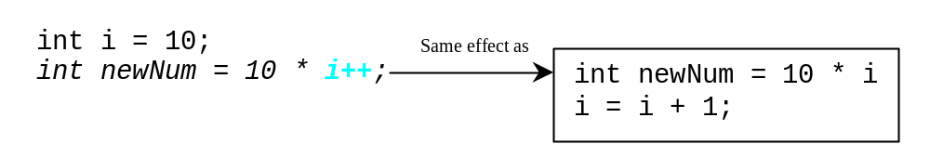
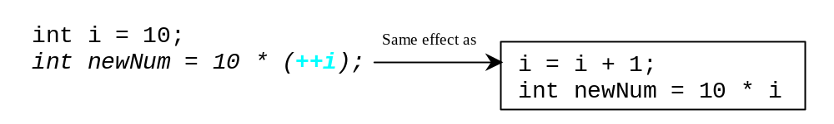
Increment and Decrement Operators

Slide 16
Increment and Decrement Operators
Using increment and decrement operators makes expressions short, but it also makes them complex and difficult to read. Avoid using these operators in expressions that modify multiple variables, or the same variable for multiple times such as this: int k = ++i + i. (Undefined behavior in the standard)

Slide 17
Exercise
A/B Problem
Write a program which reads two integers a and b, and calculates the following values:
a ÷ b: d (in integer)
remainder of a ÷ b: r (in integer)
a ÷ b: f (in real number)
Input
Two integers a and b are given in a line.
Output
Print d, r and f separated by a space in a line. For f, the output should not contain an absolute error greater than 10⁻⁵.
Constraints
1 ≤ a, b ≤ 10⁹
Sample Input 1
3 2
Sample Output 1
1 1 1.50000

Slide 18
Exercise
X Cubic
Write a program which calculates the cube of a given integer x.
Input
An integer x is given in a line.
Output
Print the cube of x in a line.
Constraints
1 ≤ x ≤ 100
Sample Input 1
2
Sample Output 1
8
Sample Input 2
3
Sample Output 2
27

Slide 19
Exercise
Rectangle
Write a program which calculates the area and perimeter of a given rectangle.
Input
The length a and breadth b of the rectangle are given in a line separated by a single space.
Output
Print the area and perimeter of the rectangle in a line. The two integers should be separated by a single space.
Constraints
1 ≤ a, b ≤ 100
Sample Input 1
3 5
Sample Output 1
15 16

Slide 20
Exercise
Watch
Write a program which reads an integer S [second] and converts it to h:m:s where h,m,s denote hours, minutes (less than 60) and seconds (less than 60) respectively.
Input
An integer S is given in a line.
Output
Print h,m and s separated by ':'. You do not need to put '0' for a value, which consists of a digit.
Constraints
0≤S≤86400
Sample Input 1
46979
Sample Output 1
13:2:59

Slide 21
Exercise
Circle
Write a program which calculates the area and circumference of a circle for given radius r.
Input
A real number r is given.
Output
Print the area and circumference of the circle in a line. Put a single space between them. The output should not contain an absolute error greater than 10⁻⁵.
Constraints
0 < r < 10000
Sample Input 1
2
Sample Output 1
12.566371 12.566371
Sample Input 2
3
Sample Output 2
28.274334 18.849556

