Slide 1
程序设计原理
字符变量与逻辑运算
任课教师： 喻 梅
于瑞国
王建荣
李雪威
赵满坤

Slide 2
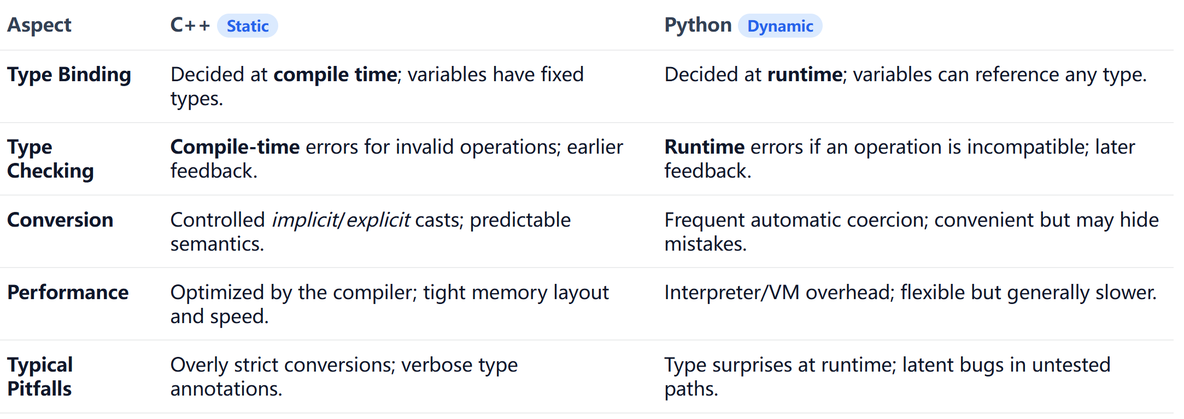
Data Type
Static vs Dynamic Data Types
How types are bound and checked strongly shapes what operations are valid and how fast programs run.
In static typing, the compiler knows the shape of data and the valid operations ahead of time.
In dynamic typing, flexibility is traded for potential runtime surprises.

Slide 3
Data Type
A data type defines both how data is stored and which operations are valid on it
Different data types support different sets of operations.
Some data types can be converted to others, while some cannot.
These choices affect valid expressions and their semantics.
Today we focus on a special type char which behaves like both a number and a symbol.
“The char type is one of the most interesting types in C++ because it connects the numeric world with the textual world.”

Slide 4
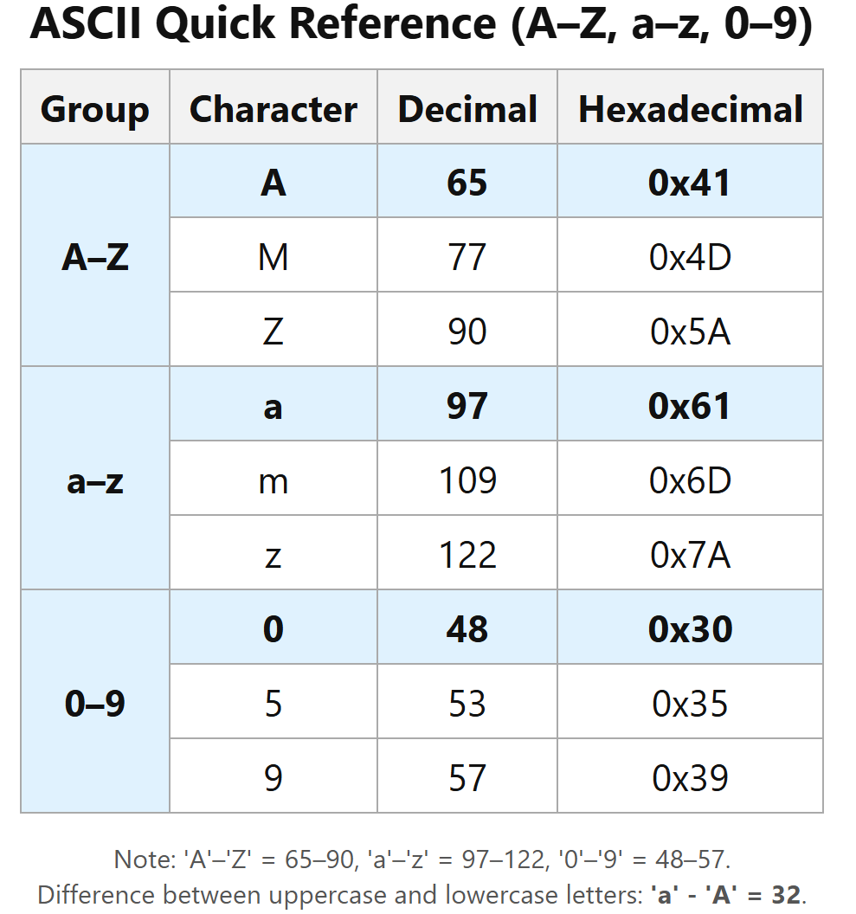

ASCII Character Set, cont.
ASCII Character Set is a subset of the Unicode from \u0000 to \u007f

Slide 5

Character Data Type
A char occupies 1 byte at the underlying level and is an integer type.
It has a one-to-one correspondence with ASCII codes.
So it can participate in arithmetic and relational operations such as addition, subtraction, and comparison.
char ch = 'A';
cout << ch << " " << int(ch) << endl;
ch++;
cout << ch << " " << int(ch) << endl;
Note: 'A'–'Z' = 65–90, 'a'–'z' = 97–122, '0'–'9' = 48–57.
Difference between uppercase and lowercase letters: 'a' - 'A' = 32.

Slide 6
Casting between char and Numeric Types
int i = 'a'; // Same as int i = (int)'a';
char c = 97; // Same as char c = (char)97;
char c = 0xFF41;
cout<<c<<endl;
char c = 65.25;
cout<<c<<endl;
int i = ‘A’;
cout<<i;

Slide 7
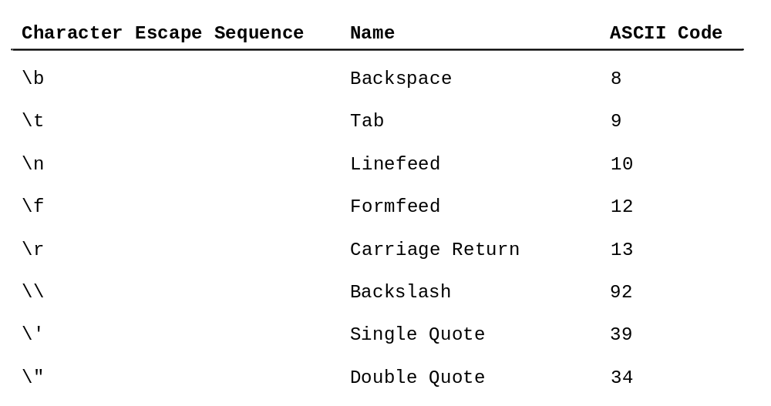
Escape Sequences for Special Characters
cout<<“He said \"programming is fun!\""<<endl;
cout<<"\\t is a tab character"<<endl;
cout << "A\tB\tC\n1\t2\t3\n";

Slide 8
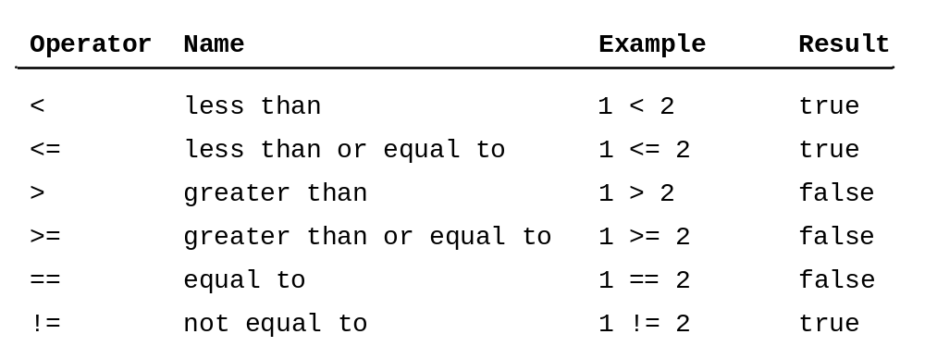
Relation Operators

Slide 9
The bool Data Type
Boolean value :true or false
A variable that holds Boolean value is known as a Boolean variable. The bool data type is used to declare Boolean variable.
For example:
bool lightOn = true;
Internally , C++ use 1 to represent true and 0 for false.
int a = 5, b = 3;
bool b_test=5;
cout << (a > b) << endl;
cout << (a == b) << endl;
cout << b_test << endl;

Slide 10
Logical Operators
Operator Name
! not logical negation
&& and logical conjunciton
|| or logical disjunction

Slide 11
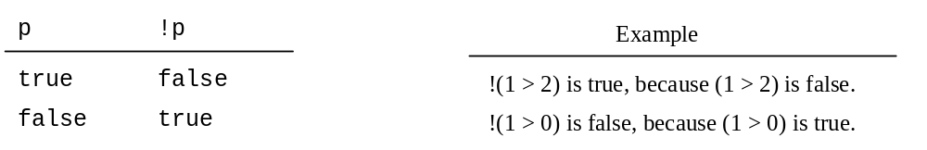
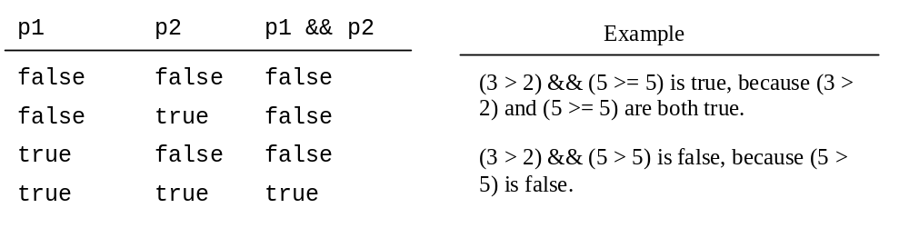
Logical Operators

Slide 12
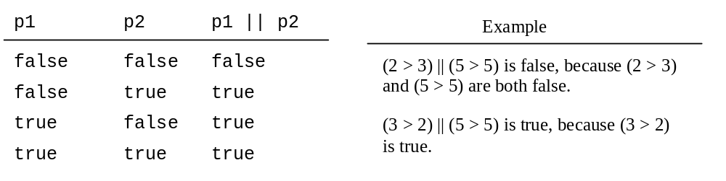
Logical Operators

Slide 13
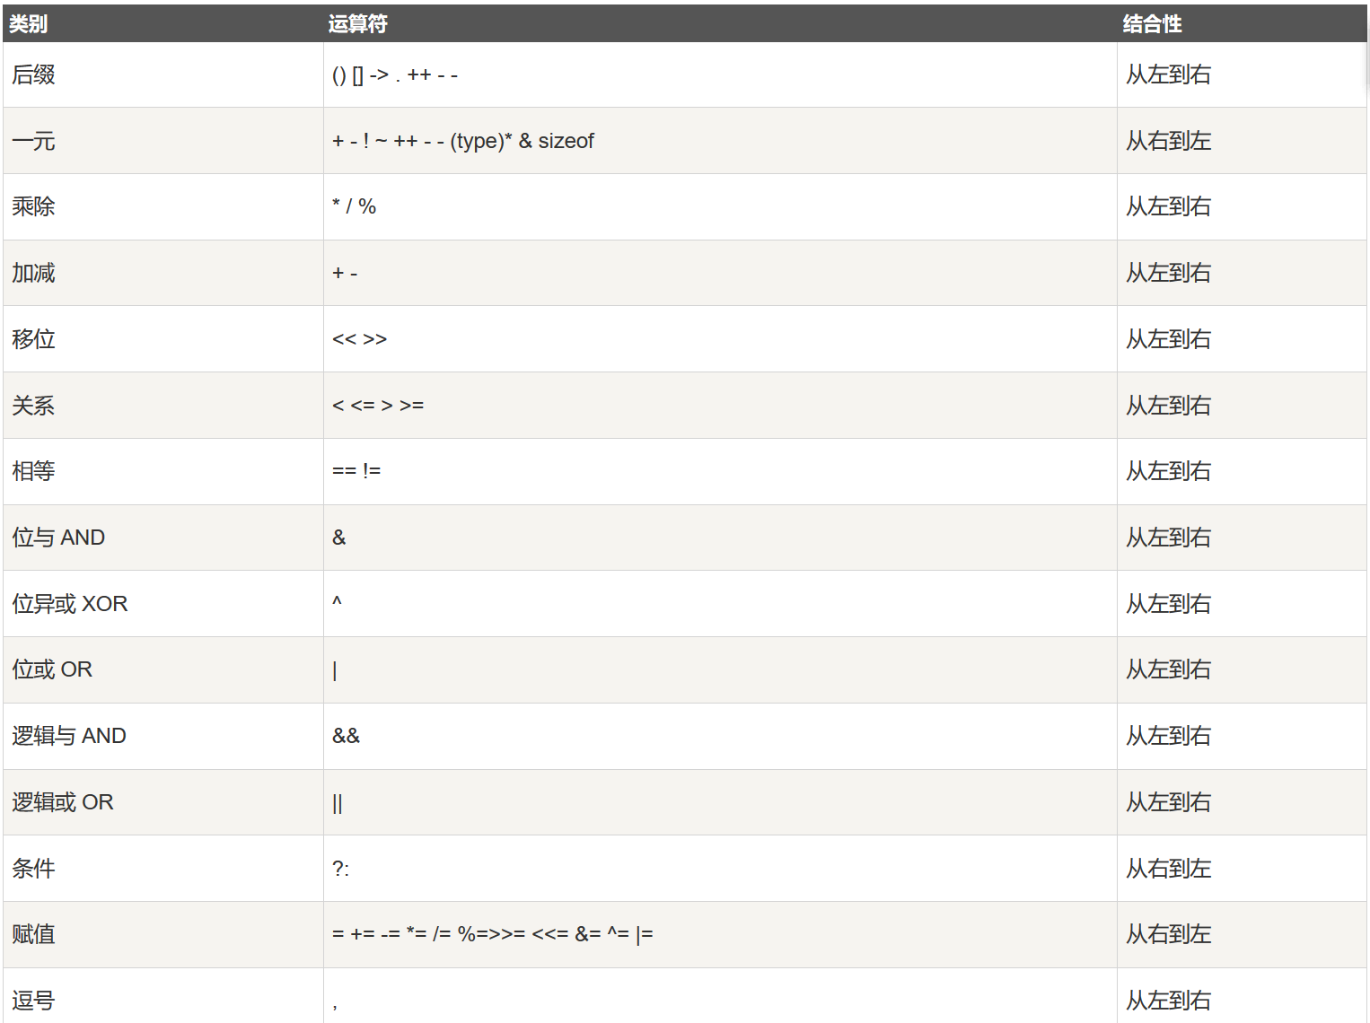
Operator Precedence

Slide 14
Operator Precedence
#include <iostream>
int main() {
int a = 5;
int b = 3;
int c = 2;
int d = a + b * c -!a && c++ % a;
std::cout << "d = " << d << std::endl;
std::cout << "c after evaluation = " << c << std::endl;
return 0;
}
int d =(a + (b*c) - (!a))&& ((c++)%a);

