Slide 1
程序设计原理
分支结构
任课教师： 喻 梅
于瑞国
王建荣
李雪威
赵满坤

Slide 2
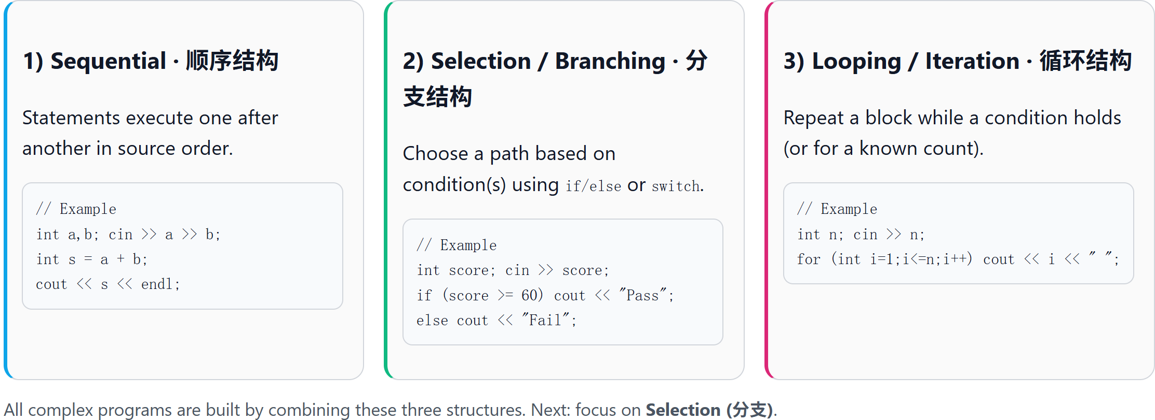
Three Basic Control Structures of Programs
All programs can be composed from these three structures.

Slide 3
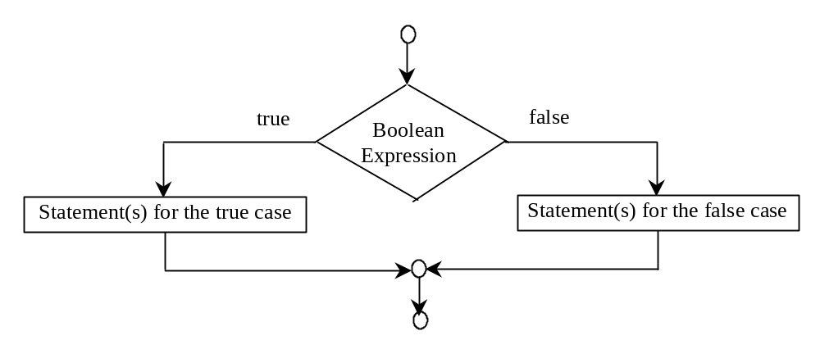
Selection: if-else Statements
if (booleanExpression) {
statement(s)-for-the-true-case;
}
else {
statement(s)-for-the-false-case;
}

Slide 4
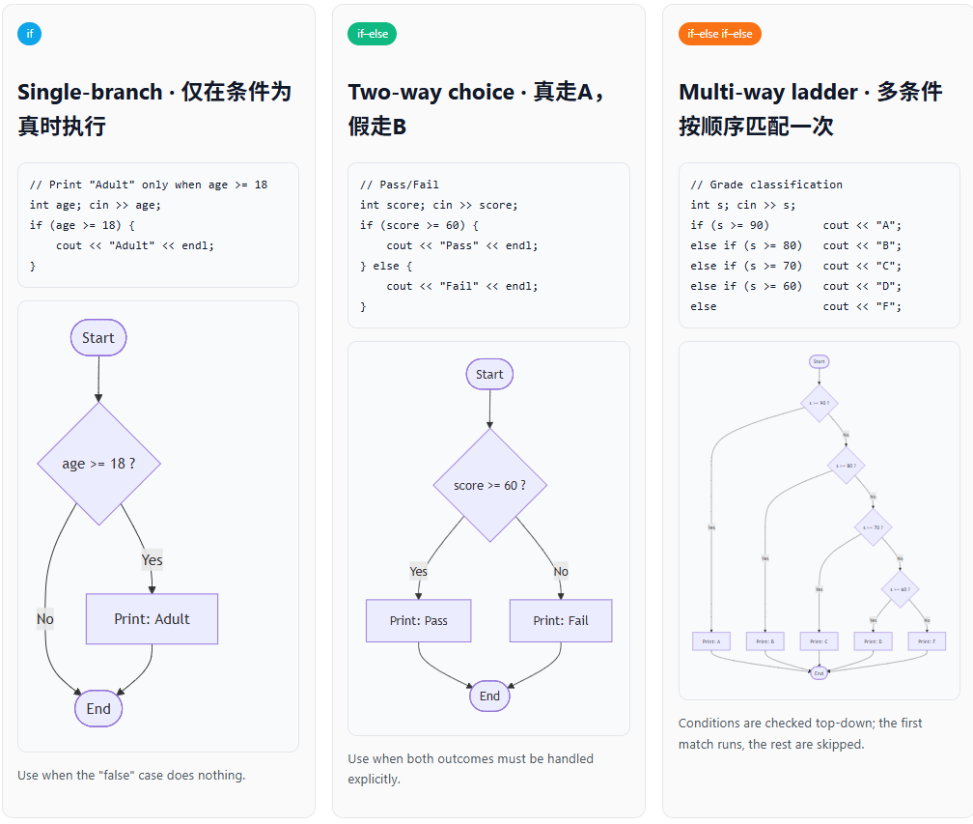
Selection: if-else Statements

Slide 5
Selection: if Statements
#include <iostream>
using namespace std;
int main ()
{
int m = 100;
// check boolean expression
if( m < 20 ) {
// if the condition is true
cout << “m 小于 20" << endl;
}
cout << “m 的值是 " << m << endl;
return 0;
}

Slide 6
Selection: if-else Statements
#include <iostream>
using namespace std;
int main ()
{
int m = 100;
// check boolean expression
if( m < 20 ) {
//if the condition is true
cout << “m 小于 20" << endl;
}
else {
// if the condition is false
cout << “m 大于 20" << endl;
}
cout << “m 的值是 " << m << endl;
return 0;
}

Slide 7
Selection: if - else if - else Statements
#include <iostream>
using namespace std;
int main()
{
int a = 20;
if (a<60){
cout<<"Poor!"<<endl;
}
else if(a<70){
cout<<"Fair!"<<endl;
}
else if(a<80){
cout<<"Good!"<<endl;
}
else if(a<80){
cout<<"Good!"<<endl;
}
else if(a<90){
out<<"VeryGood!"<<endl;
}
else{
cout<<"Excellent!"<<endl;
}
return 0;
}

Slide 8
Comparing and Testing Characters
if (ch >= 'A' && ch <= 'Z')
cout << ch << "is an uppercase letter" <<endl;
else if (ch >='a' && ch <='z')
cout << ch << "is a lowercase letter" <<endl;
else if (ch >= '0' && ch <= '9')
cout << ch << "is a numeric character" <<endl;

Slide 9
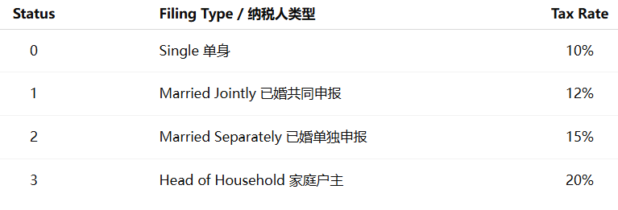
switch Statements
In real life, different people may be taxed at different rates depending on their filing status.We can use a switch statement to handle these categories more clearly than using many if statements.

Slide 10
switch Statements
switch (status) {
case 0: compute taxes for single filers;
break;
case 1: compute taxes for married file jointly;
break;
case 2: compute taxes for married file separately;
break;
case 3: compute taxes for head of household;
break;
default: cout << “Error: invalid statud!”;
}

Slide 11
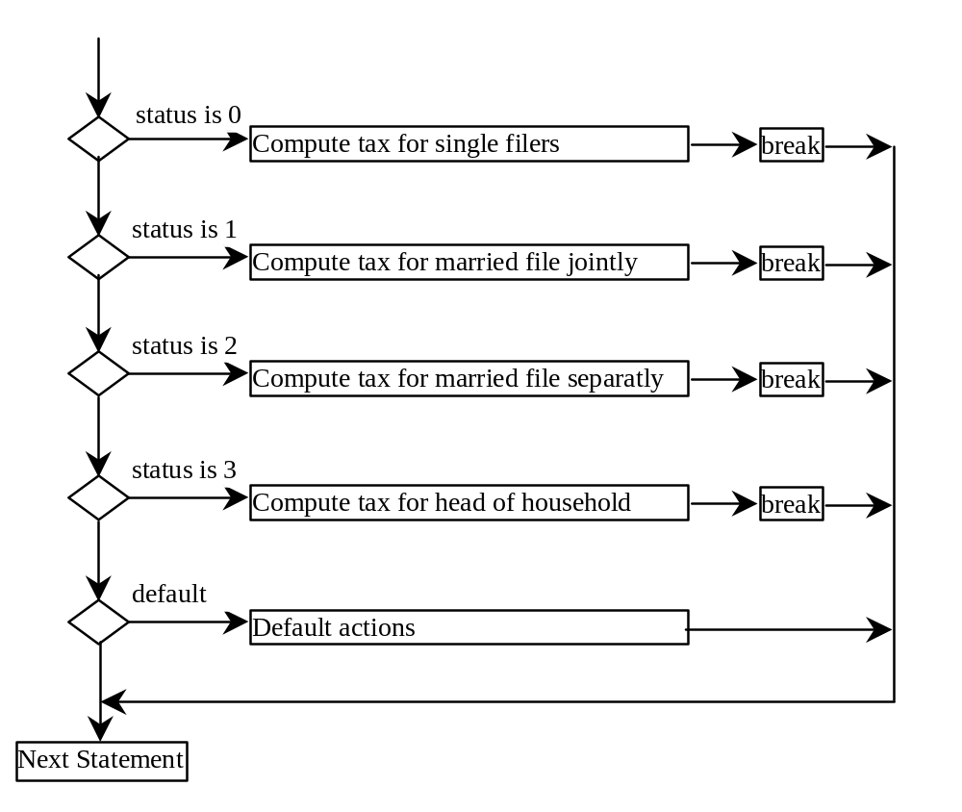
switch Statement Flow Chart

Slide 12
switch Statement Rules
The switch-expression must yield a value of char, short, or int type and must always be enclosed in parentheses.
switch (switch-expression) {
case value1: statement(s)1;
break;
case value2: statement(s)2;
break;
…
case valueN: statement(s)N;
break;
default: statement(s)-for-default;
}
The value1, ..., and valueN must have the same data type as the value of the switch-expression. The resulting statements in the case statement are executed when the value in the case statement matches the value of the switch-expression. Note that value1, ..., and valueN are constant expressions, meaning that they cannot contain variables in the expression, such as 1 + x.

Slide 13
switch Statement Rules
The keyword break is optional, but it should be used at the end of each case in order to terminate the remainder of the switch statement. If the break statement is not present, the next case statement will be executed.
switch (switch-expression) {
case value1: statement(s)1;
break;
case value2: statement(s)2;
break;
…
case valueN: statement(s)N;
break;
default: statement(s)-for-default;
}
The default case, which is optional, can be used to perform actions when none of the specified cases matches the switch-expression.
The case statements are executed in sequential order, but the order of the cases (including the default case) does not matter. However, it is good programming style to follow the logical sequence of the cases and place the default case at the end.

Slide 14
Trace switch statement
char ch = 'a';
switch (ch) {
case 'a': cout << ch;
case 'b': cout << ch;
case 'c': cout << ch;
}
aaa

Slide 15
switch Statement
switch (ch) {
case 'a': cout << "aaaaaa"<<endl;
break;
default: cout<< "default!";
case 'b': cout << "bbbbbb"<<endl;
break;
case 'c': cout << "cccccc"<<endl;
}

Slide 16
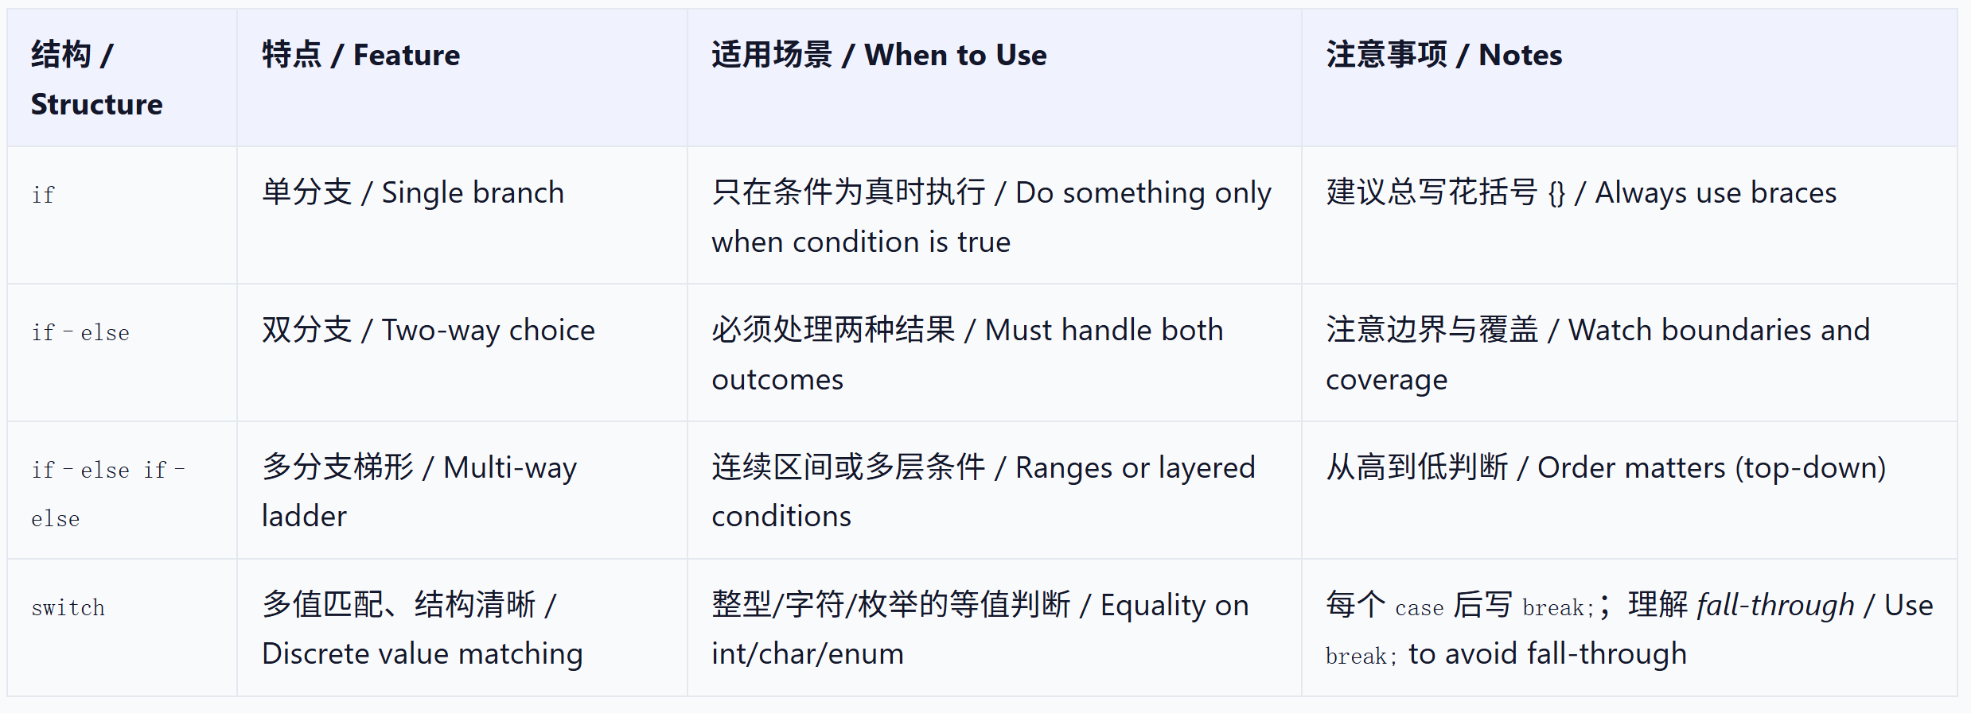
Summary
Understand the purpose of branching: choose execution paths by conditions.
Master the syntax and flow of if / if–else / if–else if–else.
Use switch properly, including label matching and use cases.
Understand fall-through and when to use break;.
Select appropriate control structures to solve real problems.

Slide 17
Exercise
Small, Large, or Equal
Write a program which prints small/large/equal relation of given two integers a and b.
Input
Two integers a and b separated by a single space are given in a line.
Output
For given two integers a and b, print
a < b
if a is less than b,
a > b
if a is greater than b, and
a == b
if a equals to b.
Constraints
-1000 ≤ a, b ≤ 1000
Sample Input 1
1 2
Sample Output 1
a < b
Sample Input 2
4 3
Sample Output 2
a > b
Sample Input 3
5 5
Sample Output 3
a == b

Slide 18
Exercise
Range
Write a program which reads three integers a, b and c, and prints "Yes" if a<b<c, otherwise "No".
Input
Three integers a, b and c separated by a single space are given in a line.
Output
Print "Yes" or "No" in a line.
Constraints
0 ≤ a, b, c ≤ 100
Sample Input 1
1 3 8
Sample Output 1
Yes
Sample Input 2
3 8 1
Sample Output 2
No

Slide 19
Exercise
Sorting Three Numbers
Write a program which reads three integers, and prints them in ascending order.
Input
Three integers separated by a single space are given in a line.
Output
Print the given integers in ascending order in a line. Put a single space between two integers.
Constraints
1 ≤ the three integers ≤ 10000
Sample Input 1
3 8 1
Sample Output 1
1 3 8

Slide 20
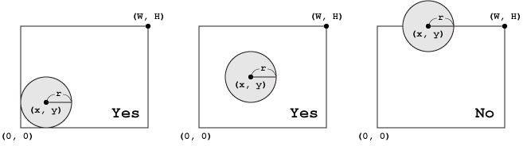
Exercise
Circle in a Rectangle
Write a program which reads a rectangle and a circle, and determines whether the circle is arranged inside the rectangle. As shown in the following figures, the upper right coordinate (W,H) of the rectangle and the central coordinate (x,y) and radius r of the circle are given.

Slide 21
Exercise
Input
Five integers W, H, x, y and r separated by a single space are given in a line.
Output
Print "Yes" if the circle is placed inside the rectangle, otherwise "No" in a line.
Constraints
−100≤x,y≤100 0<W,H,r≤100
Sample Input 1
5 4 2 2 1
Sample Output 1
Yes
Sample Input 2
5 4 2 4 1
Sample Output 2
No

