Slide 1
程序设计原理
循环结构
任课教师： 喻 梅
于瑞国
王建荣
李雪威
赵满坤

Slide 2
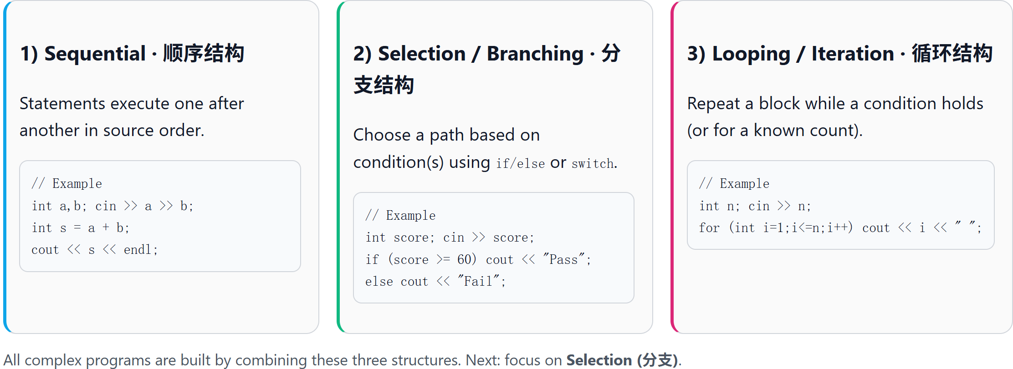
Three Basic Control Structures of Programs
All programs can be composed from these three structures.

Slide 3
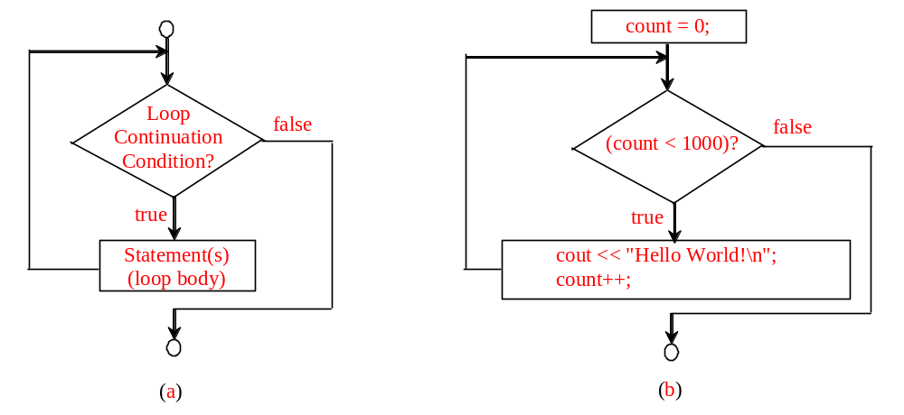
while Loop Flow Chart
while (loop-continuation-condition)
{
// loop-body;
Statement(s);
}
int count = 0;
while (count < 1000)
{
cout << “Hello World!\n";
count++;
}

Slide 4
The While Loop
int sum = 0, i = 1;
while(i<10)
{ sum = sum + i;
i++;
}
cout << "sum is " << sum;
int sum = 0, i = 1;
while(i<10)
{
sum = sum + i;
}
cout << "sum is " << sum;
infinite loop

Slide 5
The While Loop
int count = 0;
while (count<=100)
{
cout<<"Welcom to C++!\n";
count++;
}
The loop execute 101 times.

Slide 6
Caution
Don’t use floating-point values for equality checking in a loop control. Since floating-point values are approximations, using them could result in imprecise counter values and inaccurate results. This example uses int value for data. If a floating-point type value is used for data, (data != 0) may be true even though data is 0.
  double item = 1; double sum = 0;
  while (item != 0)
  { sum += item;
  item -= 0.1;
  }
  cout << sum << endl;
1.789
1.7890000343322753906250000000000000000
1.7889999999999999236166559057892300188541412353515625000000000000000000000000

Slide 7
Example
输入一个整数n，计算1到n的数字之和。
#include <iostream>
using namespace std;
int main() {
return 0;
}
int n, sum = 0, i = 1;
cin >> n;
// 使用while循环计算1到n的和
while (i <= n) {
sum += i; // 将i累加到sum
i++; // i增加1
}
cout << "1到" << n << "的和是：" << sum << endl;

Slide 8
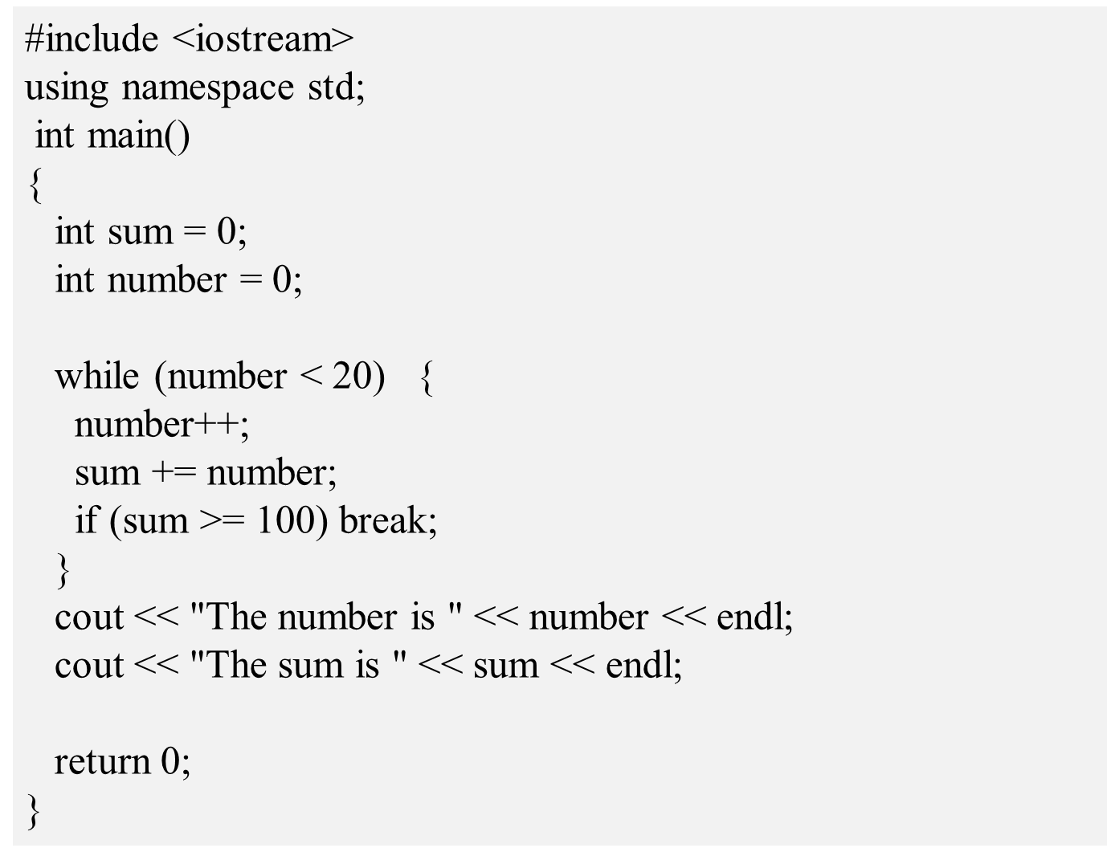
Using break and continue

Slide 9
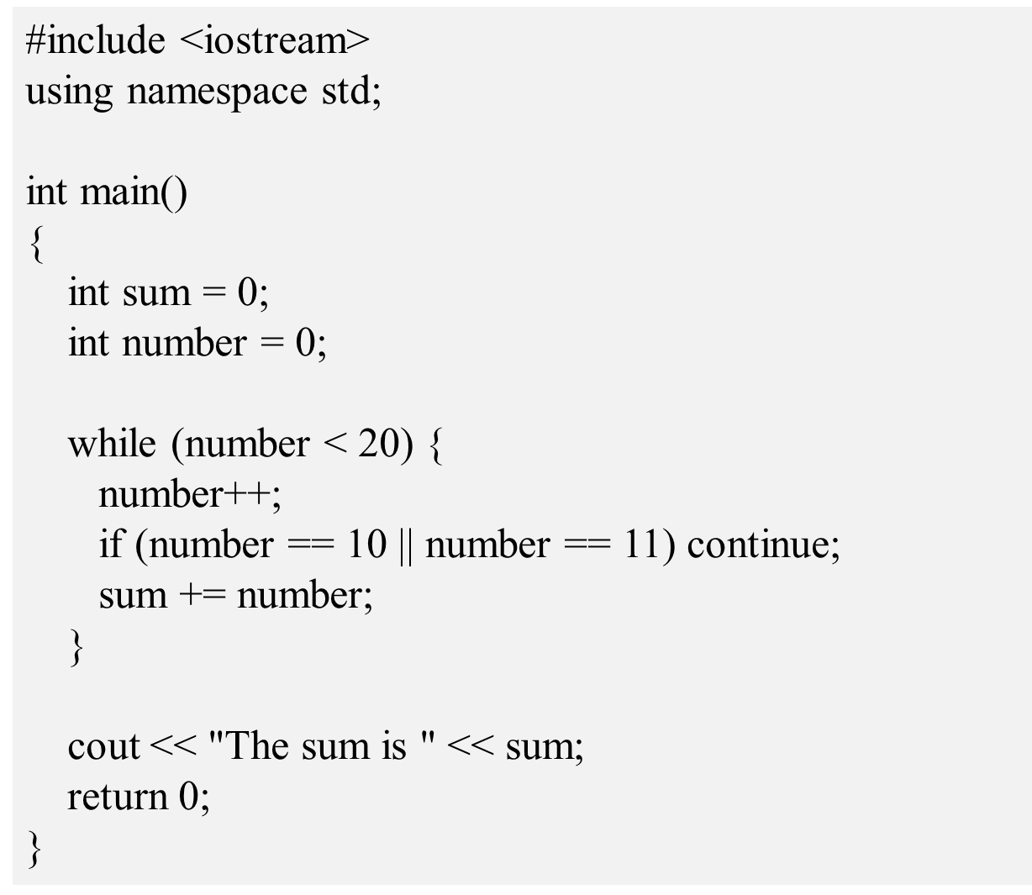
Using break and continue

Slide 10
Exercise
Print Test Cases
In the online judge system, a judge file may include multiple datasets to check whether the submitted program outputs a correct answer for each test case. This task is to practice solving a problem with multiple datasets.
Write a program which reads an integer x and print it as is. Note that multiple datasets are given for this problem.
Input
The input consists of multiple datasets. Each dataset consists of an integer x in a line.
The input ends with an integer 0. You program should not process (print) for this terminal symbol.

Slide 11
Exercise
Sample Input
3
5
11
7
8
19
0
Sample Output
Case 1: 3
Case 2: 5
Case 3: 11
Case 4: 7
Case 5: 8
Case 6: 19
Output
For each dataset, print x in the following format:
Case i: x
where i is the case number which starts with 1. Put a single space between "Case" and i. Also, put a single space between ':' and x.
Constraints
1 ≤ x ≤ 10000
The number of datasets ≤ 10000

Slide 12
Exercise
Swapping Two Numbers
Write a program which reads two integers x and y, and prints them in ascending order.
Input
The input consists of multiple datasets. Each dataset consists of two integers x and y separated by a single space.
The input ends with two 0 (when both x and y are zero). Your program should not process for these terminal symbols.
Output
For each dataset, print x and y in ascending order in a line. Put a single space between x and y.
Constraints
0 ≤ x, y ≤ 10000,the number of datasets ≤ 3000
Sample Input
3 2
2 2
5 3
0 0
Sample Output
2 3
2 2
3 5

Slide 13
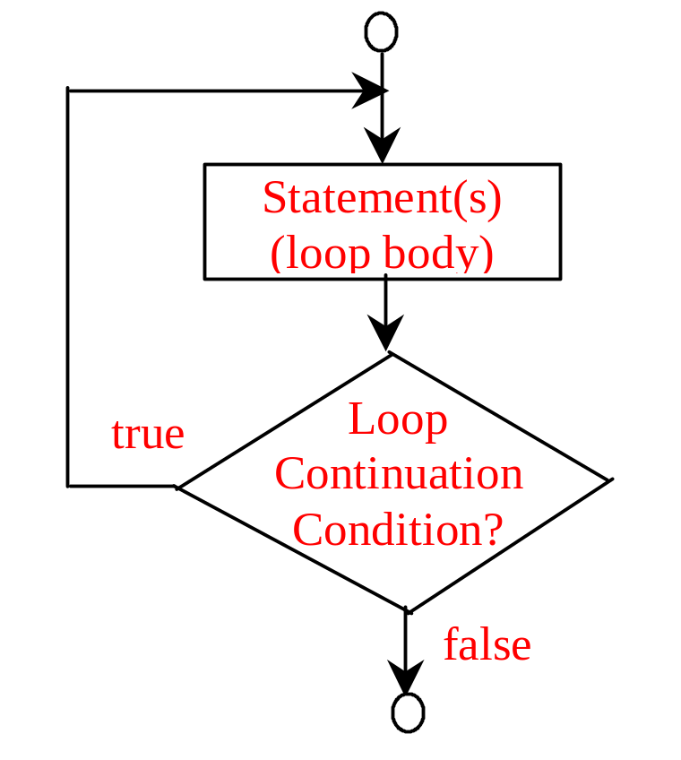
do-while Loop
do
{
// Loop body;
Statement(s);
} while (loop-continuation-condition);

Slide 14
Example
While Solution
int sum=0;
int counter=1;
while(counter<=n)
{
sum=sum+counter;
counter++;
}
Do-While Solution
int sum=0;
int counter=1;
do
{
sum=sum+counter;
counter++;
} while(counter<=n);
Notes:
新增

Slide 15
while Loop
int count ;
count = 4;
while (count > 0);
{
cout << count << endl ;
count -- ;
}
cout << “Done” << endl ;
infinite loop

Slide 16
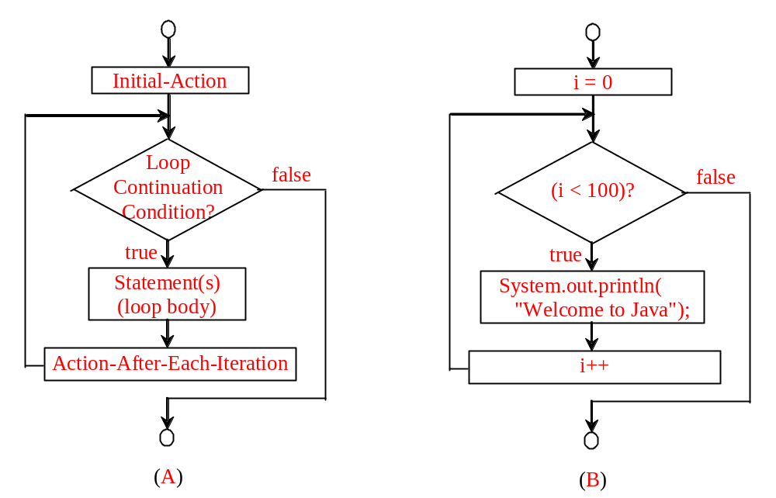
for Loops
for (initial-action; loop-continuation-condition; action-after-each-iteration)
{
// loop body;
Statement(s);
}
int i;
for (i = 0; i < 100; i++)
{
cout << "Welcome to C++!\n";
}

Slide 17
Note
The initial-action in a for loop can be a list of zero or more comma-separated expressions. The action-after-each-iteration in a for loop can be a list of zero or more comma-separated statements. Therefore, the following two for loops are correct. They are rarely used in practice, however.
  for (int i = 1; i < 100; cout << (i++));
  for (int i = 0, j = 0; (i + j < 10); i++, j++) {
  // Do something
  }

Slide 18
Example
输入一个整数n，计算1到n的数字之和。
#include <iostream>
using namespace std;
int main() {
return 0;
}
int n, sum = 0;
cin >> n;
cout << "1到" << n << "的和是：" << sum << endl;
// 使用for循环，计算1到n的和
for (int i = 1; i <= n; i++) {
sum += i;
}

Slide 19
Exercise
How Many Divisors?
Write a program which reads three integers a, b and c, and prints the number of divisors of c between a and b.
Input
Three integers a, b and c are given in a line separated by a single space.
Output
Print the number of divisors in a line.
Constraints
1 ≤ a, b, c ≤ 10000
a ≤ b
Sample Input 1
5 14 80
Sample Output 1
3

Slide 20
Exercise
Simple Calculator
Write a program which reads two integers a, b and an operator op, and then prints the value of a op b.
The operator op is '+', '-', '*' or '/' (sum, difference, product or quotient). The division should truncate any fractional part.
Input
The input consists of multiple datasets. Each dataset is given in the following format.
a op b
The input ends with a dataset where op = '?'. Your program should not process for this dataset.
Output
For each dataset, print the value in a line.
Constraints
0 ≤ a, b ≤ 20000
No divisions by zero are given.
Sample Input 1
1 + 2
56 - 18
13 * 2
100 / 10
27 + 81
0 ? 0
Sample Output 1
3
38
26
10
108

Slide 21
Exercise
Min, Max and Sum
Write a program which reads a sequence of n integers a_{i}(i=1,2,...n), and prints the minimum value, maximum value and sum of the sequence.
Input
In the first line, an integer n is given. In the next line, n integers a_{i} are given in a line.
Output
Print the minimum value, maximum value and sum in a line. Put a single space between the values.
Constraints
0<n≤10000
−1000000≤ai≤1000000
Sample Input
5
10 1 5 4 17
Sample Output
1 17 37

