Slide 1
程序设计原理
循环结构
任课教师： 喻 梅
于瑞国
王建荣
李雪威
赵满坤

Slide 2
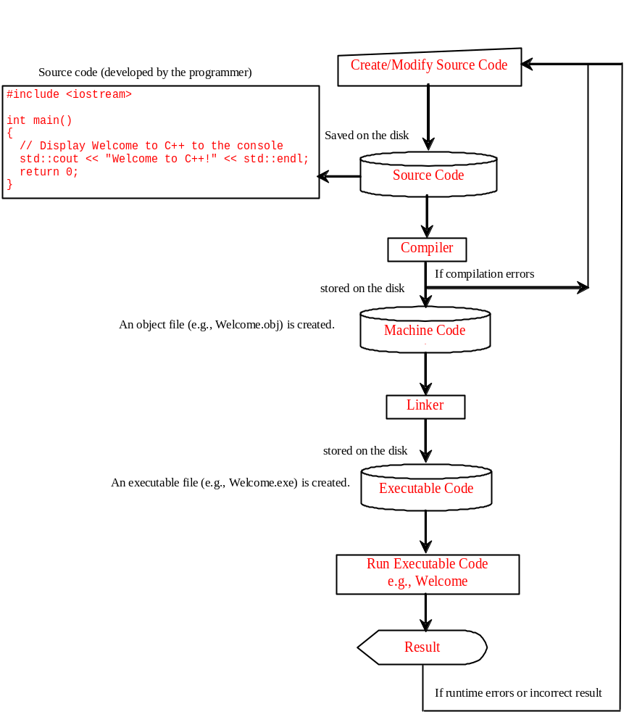
Program running process

Slide 3
Programming Errors
Syntax Errors: Errors that are detected by the compiler are called syntax errors or compile errors. Syntax errors result from errors in code construction, such as mistyping a keyword, omitting necessary punctuation, or using an opening brace without a corresponding closing brace.
#include <iostream>
using namespace std
int main()
{
cout << "Programming is fun << endl;
return 0;
}

Slide 4
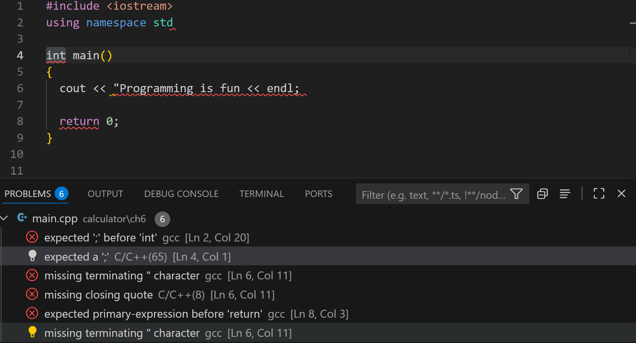
Programming Errors

Slide 5
Programming Errors
Runtime Errors: cause a program to terminate abnormally. They occur while an application is running if the environment detects an operation that is impossible to carry out. Such as input errors, division by zero.
#include <iostream>
using namespace std;
int main()
{
int i = 4;
int j = 0;
cout << i / j << endl;
return 0;
}

Slide 6
Programming Errors
Logic Errors: when a program does not perform the way it was intended.
#include <iostream>
using namespace std;
int main()
{
cout << "Celsius 35 is Fahrenheit degree " << endl;
cout << (9 / 5) * 35 + 32 << endl;
return 0;
}

Slide 7
Common Errors
Common Error 1: Missing Braces
#include <iostream>
using namespace std;
int main()
{
cout << "Welcome to C++!" << endl;
cout << "Welcome to C++.NET!" << endl;
cout << "Welcome to C++ Compiler!" << endl;
return 0;
Missing Brace

Slide 8
Common Errors
Common Error 2: Missing a semicolon
#include <iostream>
using namespace std;
int main()
{
cout << "Welcome to C++!" << endl;
cout << "Welcome to C++.NET!" << endl;
cout << "Welcome to C++ Compiler!" << endl;
return 0
}
Missing a semicolon

Slide 9
Common Errors
Common Error 3: Missing a quotation mark
#include <iostream>
using namespace std;
int main()
{
cout << "Welcome to C++!" << endl;
cout << "Welcome to C++.NET!" << endl;
cout << "Welcome to C++ Compiler!<< endl;
return 0;
}
Missing a quotation mark

Slide 10
Common Errors
Common Error 4: Spelling Error
#include <iostream>
using namespace std;
int Main()
{
cout << "Welcome to C++!" << endl;
cout << "Welcome to C++.NET!" << endl;
cout << "Welcome to C++ Compiler! " << endl;
return 0;
}
Spelling Error

Slide 11
Exercise
Swapping Two Numbers
Write a program which reads two integers x and y, and prints them in ascending order.
Input
The input consists of multiple datasets. Each dataset consists of two integers x and y separated by a single space.
The input ends with two 0 (when both x and y are zero). Your program should not process for these terminal symbols.
Output
For each dataset, print x and y in ascending order in a line. Put a single space between x and y.
Constraints
0 ≤ x, y ≤ 10000,the number of datasets ≤ 3000
Sample Input
3 2
2 2
5 3
0 0
Sample Output
2 3
2 2
3 5

Slide 12
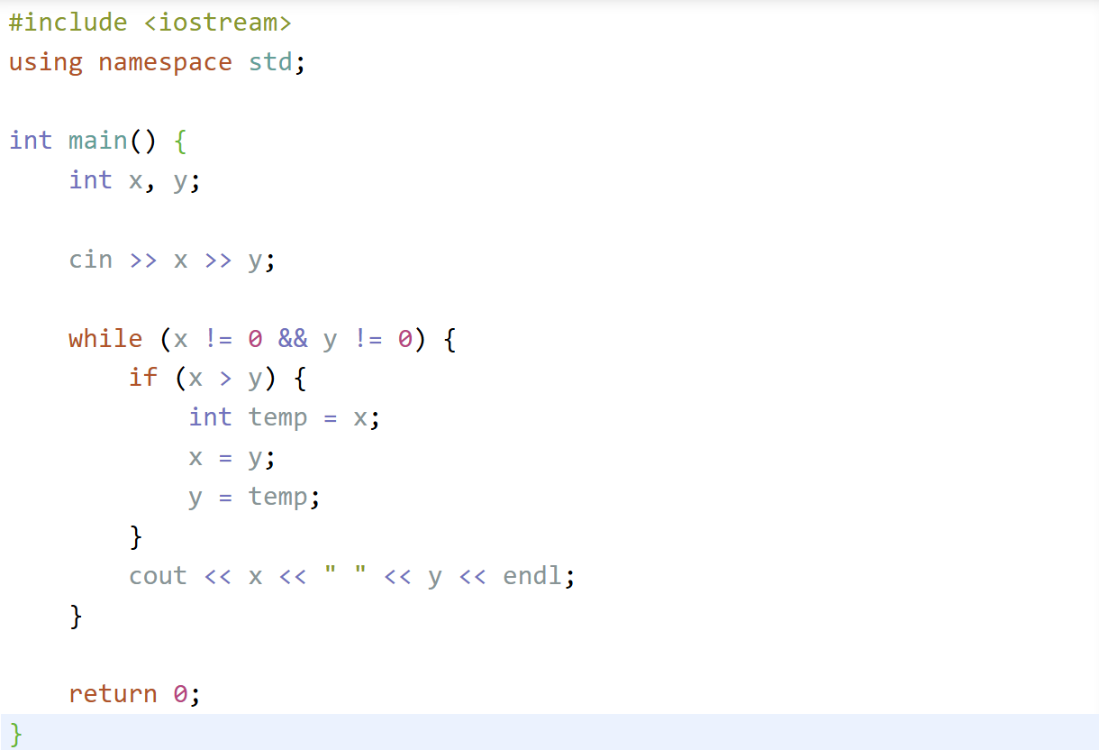


Slide 13


Slide 14
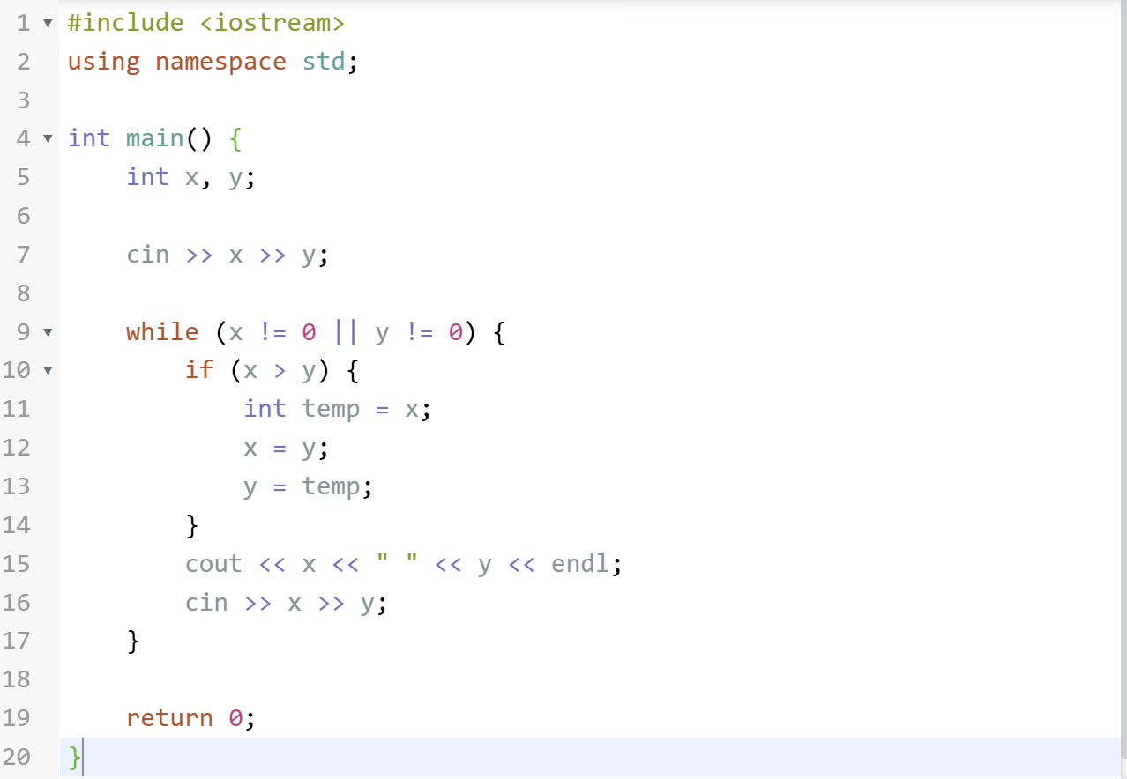

Slide 15
Exercise
Print a Rectangle
Draw a rectangle which has a height of H cm and a width of W cm. Draw a 1-cm square by single '#'.
Input
The input consists of multiple datasets. Each dataset consists of two integers H and W separated by a single space.
The input ends with two 0 (when both H and W are zero).
Output
For each dataset, print the rectangle made of H × W '#'.
Print a blank line after each dataset.
Constraints
1 ≤ H ≤ 300
1 ≤ W ≤ 300
Sample Input
3 4
5 6
2 2
0 0
Sample Output
####
####
####
######
######
######
######
######
##
##

Slide 16
Exercise
Print a Frame
Draw a frame which has a height of H cm and a width of W cm. For example, the following figure shows a frame which has a height of 6 cm and a width of 10 cm.
##########
#........#
#........#
#........#
#........#
##########
Input
The input consists of multiple datasets. Each dataset consists of two integers H and W separated by a single space.
The input ends with two 0 (when both H and W are zero).
Output
For each dataset, print the frame made of '#' and '.'.
Print a blank line after each dataset.

Slide 17
Exercise
Constraints
3 ≤ H ≤ 300
3 ≤ W ≤ 300
Sample Input
3 4
5 6
3 3
0 0
Sample Output
####
#..#
####
######
#....#
#....#
#....#
######
###
#.#
###

Slide 18
Exercise
Print a Chessboard
Draw a chessboard which has a height of H cm and a width of W cm. For example, the following figure shows a chessboard which has a height of 6 cm and a width of 10 cm.
#.#.#.#.#.
.#.#.#.#.#
#.#.#.#.#.
.#.#.#.#.#
#.#.#.#.#.
.#.#.#.#.#
Note that the top left corner should be drawn by '#'.
Input
The input consists of multiple datasets. Each dataset consists of two integers H and W separated by a single space.
The input ends with two 0 (when both H and W are zero).
Output
For each dataset, print the chessboard made of '#' and '.'.
Print a blank line after each dataset.

Slide 19
Exercise
Constraints
1 ≤ H ≤ 300
1 ≤ W ≤ 300
Sample Input
3 4
5 6
3 3
2 2
1 1
0 0
Sample Output
#.#.
.#.#
#.#.
#.#.#.
.#.#.#
#.#.#.
.#.#.#
#.#.#.
#.#
.#.
#.#
#.
.#
#

Slide 20
Exercise
Structured Programming
In programming languages like C/C++, a goto statement provides an unconditional jump from the "goto" to a labeled statement. For example, a statement "goto CHECK_NUM;" is executed, control of the program jumps to CHECK_NUM. Using these constructs, you can implement, for example, loops.
Note that use of goto statement is highly discouraged, because it is difficult to trace the control flow of a program which includes goto.
Write a program which does precisely the same thing as the following program (this example is wrtten in C++). Let's try to write the program without goto statements.
void call(int n){
int i = 1;
CHECK_NUM:
int x = i;
if ( x % 3 == 0 ){
cout << " " << i;
goto END_CHECK_NUM;
}
INCLUDE3:
if ( x % 10 == 3 ){
cout << " " << i;
goto END_CHECK_NUM;
}
x /= 10;
if ( x ) goto INCLUDE3;
END_CHECK_NUM:
if ( ++i <= n ) goto CHECK_NUM;
cout << endl;
}

Slide 21
Exercise
Input
An integer n is given in a line.
Output
Print the output result of the above program for given integer n.
Constraints
3 ≤ n ≤ 10000
Sample Input
30
Sample Output
3 6 9 12 13 15 18 21 23 24 27 30
Put a single space character before each element.

