Slide 1
程序设计原理
一维数组
任课教师： 喻 梅
于瑞国
王建荣
李雪威
赵满坤
Notes:
补充程序控制结构的总结（顺序、分支、循环），用流程图说明（先讲解流程图的表示着重说明程序的逻辑性与处理顺序）。
接下来的内容概括（本章内容，数据表示，数组、结构体、等等）

Slide 2
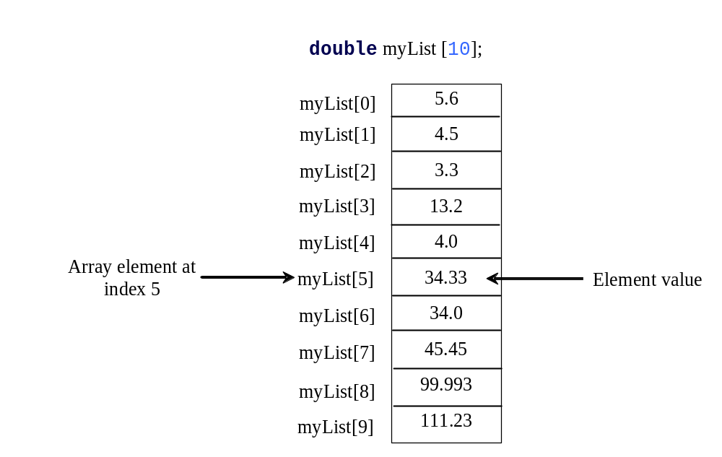
Array
Array is a data structure that represents a collection of the same types of data.
Notes:
存储位置，地址和名字之间的关系。下标从0开始。

Slide 3
Declaring Array Variables
datatype arrayRefVar[arraySize];
Example: double myList[10];
C++ requires that the array size used to declare an array must be a constant expression. For example, the following code is illegal:
int size = 4;
double myList[size]; // Wrong
But it would be OK, if size is a constant as follow:
const int size = 4;
double myList[size]; // Correct
double list1[10],list2[10];
Notes:
老版本不支持，但是新版本可以

Slide 4
Declaring Array Variables
int n;
cin >> n;
double arr[n]; // ✅ 某些编译器能通过，但这不是标准 C++
//“If the constant-expression (that specifies the bound) is not an integral constant expression, the program is ill-formed.”
Note: Some compilers support variable-length arrays (VLAs) as an extension, but they are not part of the C++ standard.
Tips:
In standard C++, the array size must be known at compile time.
To create arrays with runtime size, use new or std::vector.
Some compilers allow double myList[size]; (Variable Length Array), but it’s not portable.
Notes:
老版本不支持，但是新版本可以

Slide 5
Accessing Array Elements
Example: double myList[10];
The array elements are accessed through the index. Array indices are 0-based; that is, they start from 0 to arraySize-1. For example, the following code adds the value in myList[0] and myList[1] to myList[2].
  myList[2] = myList[0] + myList[1];
  myList[9] represents the last element in the array myList.

Slide 6
Accessing Array Elementary
No Bound Checking
C++ does not check array’s boundary. So, accessing array elements using subscripts beyond the boundary (e.g., myList[-1] and myList[11]) does not does cause syntax errors, but the operating system might report a memory access violation.

Slide 7
Arbitrary Initial Values
When an array is created, its elements are assigned with arbitrary values.
#include <iostream>
using namespace std;
int main() {
int a[5]; // 未初始化
for (int i = 0; i < 5; i++){
cout << a[i] << " ";
}
return 0;
}
32767 0 -4 105 12
-858993460 -858993460 -858993460 -858993460 -858993460
Notes:
有的编译器会默认为0，但是建议大家进行规范的初始化，以增加程序的可读性，并避免不可预料的错误。

Slide 8
Array Initializers
Declaring, creating, initializing in one step:
dataType arrayName[arraySize] = {value0, value1, ..., valuek};
double myList[4] = {1.9, 2.9, 3.4, 3.5};
This shorthand notation is equivalent to the following statements:
double myList[4];
myList[0] = 1.9;
myList[1] = 2.9;
myList[2] = 3.4;
myList[3] = 3.5;

Slide 9
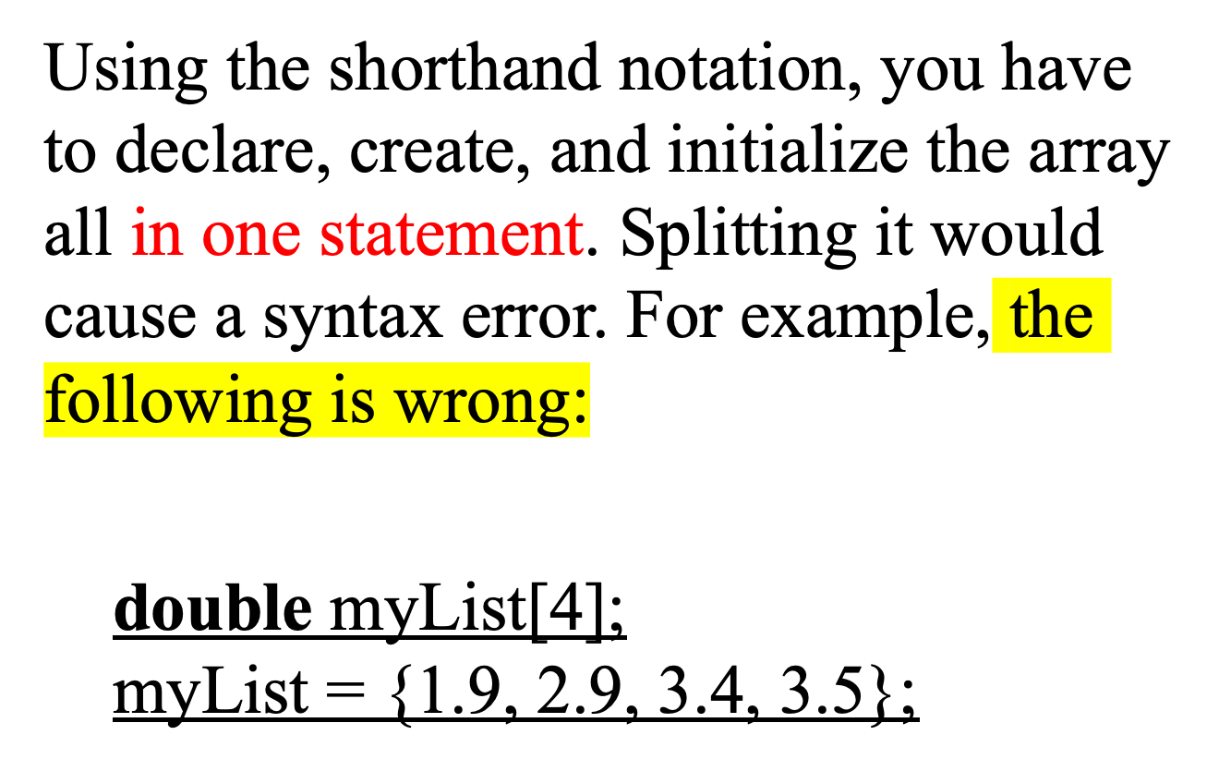
Array Initializers

Slide 10
Array Initializes
Implicit Size
C++ allows you to omit the array size when declaring and creating an array using an initilizer. For example, the following declaration is fine:
double myList[] = {1.9, 2.9, 3.4, 3.5};
C++ automatically figures out how many elements are in the array.

Slide 11
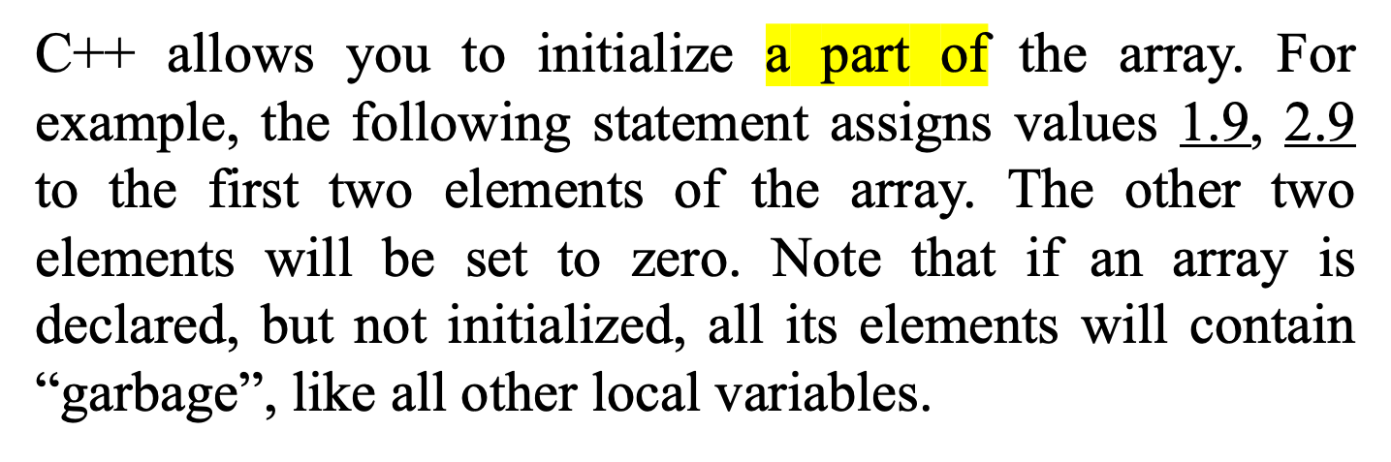
Array Initializes
Partial Initialization
double myList[4] = {1.9, 2.9};

Slide 12
Processing Arrays
Initializing Arrays with input value
const int ARRAY_SIZE = 10;
double myList[ARRAY_SIZE];
cout << "Enter" << ARRAY_SIZE << " values:";
for (int i = 0; i<ARRAY_SIZE;i++)
cin >> myList[i];

Slide 13
Processing Arrays
Printing arrays
To print an array, you have to print each element in the array using a loop like the following:
for (int i = 0; i < ARRAY_SIZE; i++)
{
cout << myList[i] << " ";
}

Slide 14
Processing Arrays
Copying Arrays
Can you copy array using a syntax like this?
list = myList;
This is not allowed in C++. You have to copy individual elements from one array to the other as follows:
for (int i = 0; i < ARRAY_SIZE; i++)
{
list[i] = myList[i];
}

Slide 15
Processing Arrays
Summing All Elements
Use a variable named total to store the sum. Initially total is 0. Add each element in the array to total using a loop like this:
double total = 0;
for (int i = 0; i < ARRAY_SIZE; i++)
{
total += myList[i];
}

Slide 16
Processing Arrays
Finding the Largest Element
Use a variable named max to store the largest element. Initially max is myList[0]. To find the largest element in the array myList, compare each element in myList with max, update max if the element is greater than max.
double max = myList[0];
for (int i = 1; i < ARRAY_SIZE; i++)
{
if (myList[i] > max) max = myList[i];
}

Slide 17
Processing Arrays
Finding the smallest index of the largest element
double max = myList[0];
int indexOfMax = 0;
for (int i = 1; i < ARRAY_SIZE; i++)
{
if (myList[i] > max)
{
max = myList[i];
indexOfMax = i;
}
}

Slide 18
Example
1 1
2 4
3 9
4 16
5 25
6 36
7 49
8 64
9 81
10 100
Process returned 0 (0x0) execution time : 0.339 s
Press any key to continue.
#include <iostream>
#include <iomanip>
using namespace std;
int main()
{
int a[10]={1,2,3,4,5,6,7,8,9,10};
for(int i=0;i<10;i++){
a[i] = i + 1;
}
for(int i=0;i<10;i++){
cout<<setw(5)<<left<<a[i]<<setw(6)<<left<<a[i]*a[i]<<endl;
}
return 0;
}

Slide 19
Exercise
Reversing Numbers
Write a program which reads a sequence and prints it in the reverse order.
Input
The input is given in the following format:
n
a1 a2 . . . an
n is the size of the sequence and ai is the ith element of the sequence.
Output
Print the reversed sequence in a line. Print a single space character between adjacent elements (Note that your program should not put a space character after the last element).
Constraints
n ≤ 100
0 ≤ ai < 1000
Sample Input 1
5
1 2 3 4 5
Sample Output 1
5 4 3 2 1
Sample Input 2
8
3 3 4 4 5 8 7 9
Sample Output 2
9 7 8 5 4 4 3 3

Slide 20
Exercise
Finding Missing Cards
Taro is going to play a card game. However, now he has only n cards, even though there should be 52 cards (he has no Jokers).
The 52 cards include 13 ranks of each of the four suits: spade, heart, club and diamond.
Input
In the first line, the number of cards n (n ≤ 52) is given.
In the following n lines, data of the n cards are given. Each card is given by a pair of a character and an integer which represent its suit and rank respectively. A suit is represented by 'S', 'H', 'C' and 'D' for spades, hearts, clubs and diamonds respectively. A rank is represented by an integer from 1 to 13.
Output
Print the missing cards. The same as the input format, each card should be printed with a character and an integer separated by a space character in a line. Arrange the missing cards in the following priorities:
Print cards of spades, hearts, clubs and diamonds in this order.
If the suits are equal, print cards with lower ranks first.

Slide 21
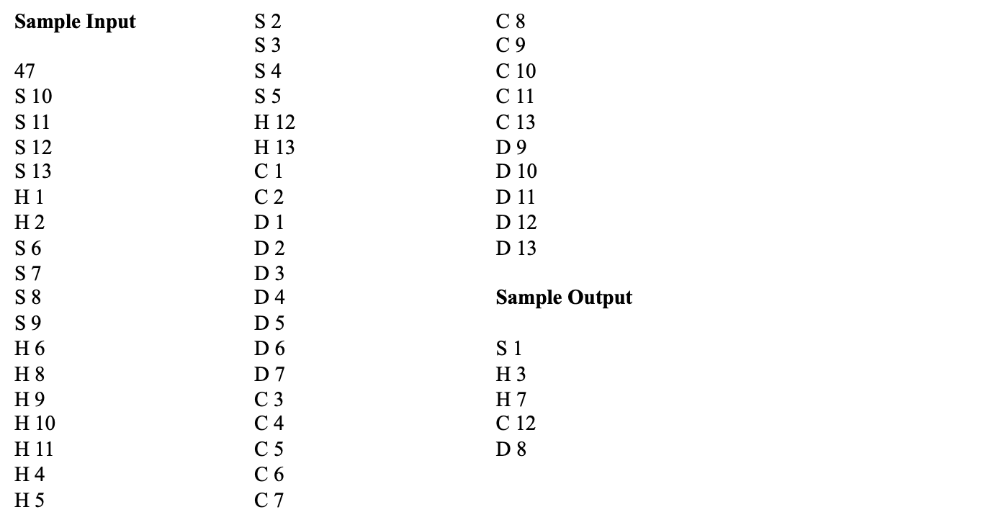
Exercise

