Slide 1
程序设计原理
多维数组
任课教师： 喻 梅
于瑞国
王建荣
李雪威
赵满坤

Slide 2
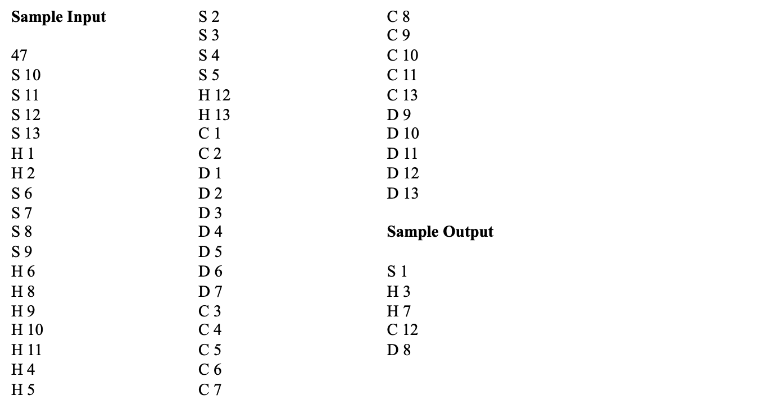
Exercise

Slide 3
Two-dimensional Arrays
// Declare array ref var
elementType arrayName[rowSize][columnSize];
int matrix[5][5];

Slide 4
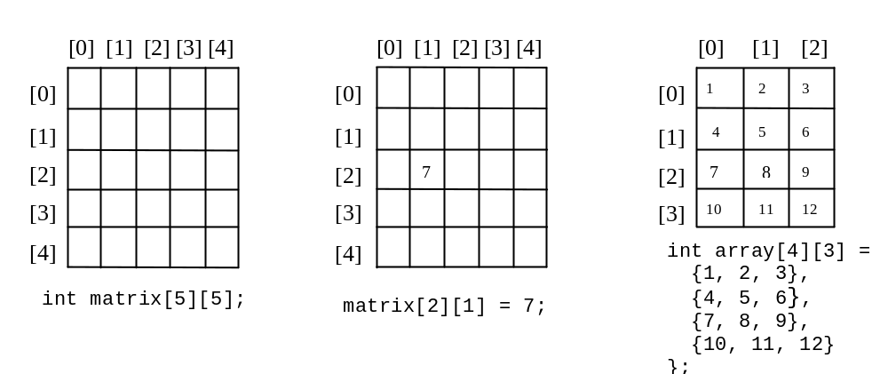
Two-dimensional Array Illustration
int array[][3] = { {1,2,3}, {4,5,6} };
多维数组必须从右往左保证后续维度已知

Slide 5
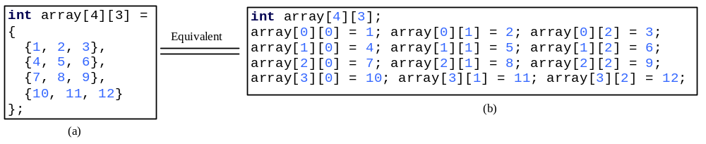
Declaring, Creating, and Initializing Using Shorthand Notations
You can also use an array initializer to declare, create and initialize a two-dimensional array. For example,

Slide 6
Printing Arrays
int matrix[5][5];
To print a two-dimensional array, you have to print each element in the array using a loop like the following:
for (int row = 0; row < rowSize; row++)
{
for (int column = 0; column < columnSize; column++)
{
cout << matrix[row][column] << " ";
}
cout << endl;
}

Slide 7
Summing Elements by Column
For each column, use a variable named total to store its sum. Add each element in the column to total using a loop like this:
for (int column = 0; column < columnSize; column++)
{
int total = 0;
for (int row = 0; row < rowSize; row++)
total += matrix[row][column];
cout << "Sum for column " << column << " is " << total << endl;
}

Slide 8
Exercise

Slide 9
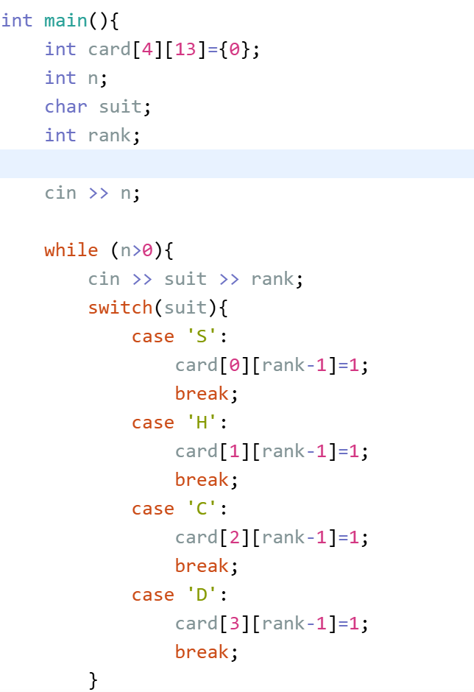
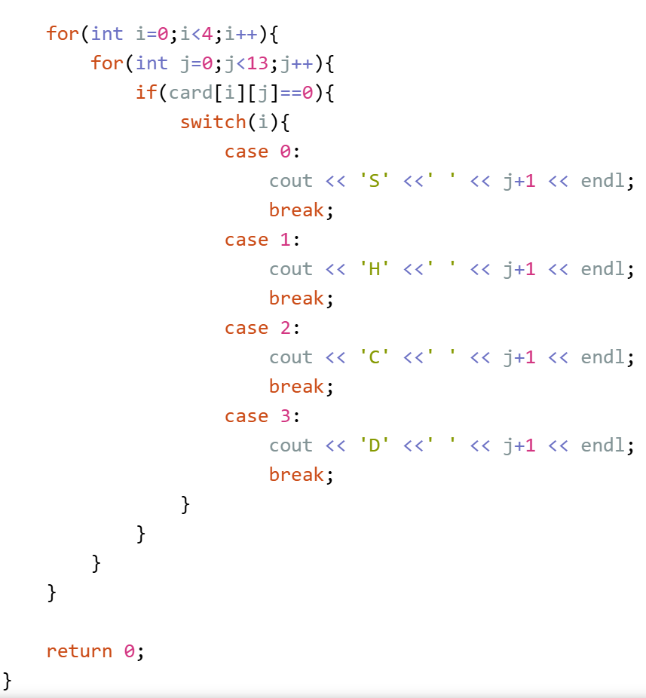
Exercise

Slide 10
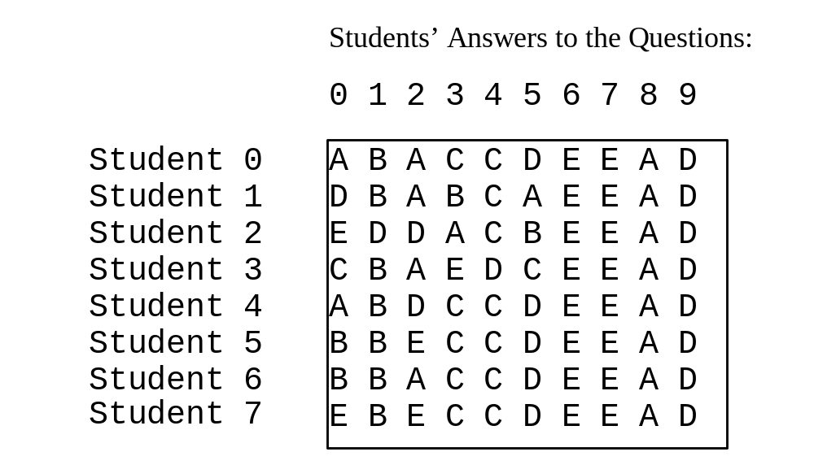
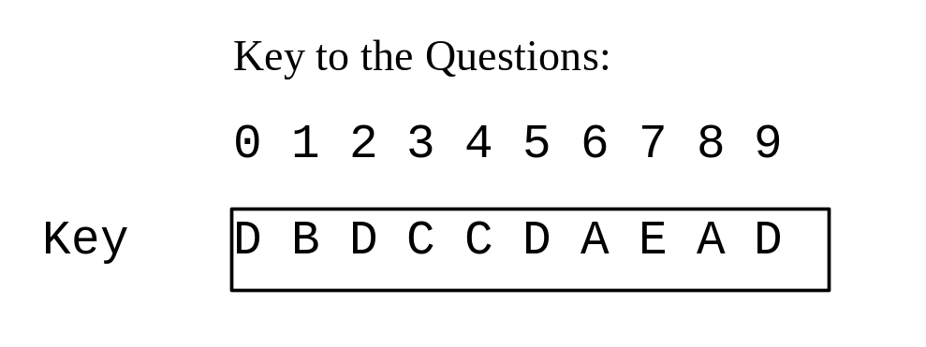
Example: Grading Multiple-Choice Test
Objective: write a program that grades multiple-choice test.

Slide 11
Example: Grading Multiple-Choice Test
#include <iostream>
using namespace std;
int main(){
const int NUMBER_OF_STUDENTS = 8;
const int NUMBER_OF_QUESTIONS = 10;
// Students' answers to the questions
char answers[NUMBER_OF_STUDENTS][NUMBER_OF_QUESTIONS] =
{
{'A', 'B', 'A', 'C', 'C', 'D', 'E', 'E', 'A', 'D'},
{'D', 'B', 'A', 'B', 'C', 'A', 'E', 'E', 'A', 'D'},
{'E', 'D', 'D', 'A', 'C', 'B', 'E', 'E', 'A', 'D'},
{'C', 'B', 'A', 'E', 'D', 'C', 'E', 'E', 'A', 'D'},
{'A', 'B', 'D', 'C', 'C', 'D', 'E', 'E', 'A', 'D'},
{'B', 'B', 'E', 'C', 'C', 'D', 'E', 'E', 'A', 'D'},
{'B', 'B', 'A', 'C', 'C', 'D', 'E', 'E', 'A', 'D'},
{'E', 'B', 'E', 'C', 'C', 'D', 'E', 'E', 'A', 'D'}
};
// Key to the questions
char keys[] = {'D', 'B', 'D', 'C', 'C', 'D', 'A', 'E', 'A', 'D'};
// Grade all answers
for (int i = 0; i < NUMBER_OF_STUDENTS; i++)
{
// Grade one student
int correctCount = 0;
for (int j = 0; j < NUMBER_OF_QUESTIONS; j++)
{
if (answers[i][j] == keys[j])
correctCount++;
}
cout << "Student " << i << "'s correct count is " <<
correctCount << endl;
}
return 0;
}

Slide 12
Multidimensional Arrays
In the preceding section, you used a two-dimensional array to represent a matrix or a table. Occasionally, you will need to represent n-dimensional data structures. In C++, you can create n-dimensional arrays for any integer n.
The way to declare two-dimensional array can be generalized to declare n-dimensional array for n >= 3. For example, the following syntax declares a three-dimensional array scores.
double scores[10][5][2];

Slide 13
Multidimensional Arrays
int a[][2][3] = {
{ {1,2,3}, {4,5,6} },
{ {7,8,9}, {10,11,12} }
};
✔️
int a[2][][3] = { { {1,2,3}, {4,5,6} } }; // ❌ 错误
int a[][][3] = { ... }; // ❌ 错误

Slide 14
Exercise
Official House
You manage 4 buildings, each of which has 3 floors, each of which consists of 10 rooms. Write a program which reads a sequence of tenant/leaver notices, and reports the number of tenants for each room.
For each notice, you are given four integers b, f, r and v which represent that v persons entered to room r of fth floor at building b. If v is negative, it means that −v persons left.
Assume that initially no person lives in the building.
Input
In the first line, the number of notices n is given. In the following n lines, a set of four integers b, f, r and v which represents ith notice is given in a line.
Output
For each building, print the information of 1st, 2nd and 3rd floor in this order. For each floor information, print the number of tenants of 1st, 2nd, .. and 10th room in this order. Print a single space character before the number of tenants. Print "####################" (20 '#') between buildings.

Slide 15
Exercise
Constraints
No incorrect building, floor and room numbers are given.
0 ≤ the number of tenants during the management ≤ 9
Sample Input
3
1 1 3 8
3 2 2 7
4 3 8 1
Sample Output
0 0 8 0 0 0 0 0 0 0
0 0 0 0 0 0 0 0 0 0
0 0 0 0 0 0 0 0 0 0
####################
0 0 0 0 0 0 0 0 0 0
0 0 0 0 0 0 0 0 0 0
0 0 0 0 0 0 0 0 0 0
####################
0 0 0 0 0 0 0 0 0 0
0 7 0 0 0 0 0 0 0 0
0 0 0 0 0 0 0 0 0 0
####################
0 0 0 0 0 0 0 0 0 0
0 0 0 0 0 0 0 0 0 0
0 0 0 0 0 0 0 1 0 0

Slide 16
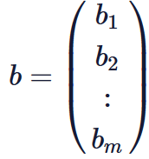
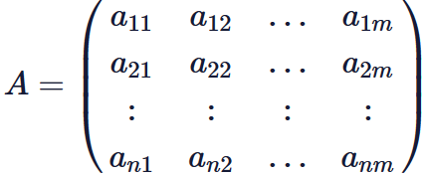

Exercise
Matrix Vector Multiplication
Write a program which reads a n×m matrix A and a m×1 vector b, and prints their product Ab.
A column vector with m elements is represented by the following equation.
A n×m matrix with m column vectors, each of which consists of n elements, is represented by the following equation.
i-th element of a m×1 column vector b is represented by b_{i} (i=1,2,...,m), and the element in i-th row and j-th column of a matrix A is represented by a_{ij} (i=1,2,...,n, j=1,2,...,m).
The product of a n×m matrix A and a m×1 column vector b is a n×1 column vector c, and c_{i} is obtained by the following formula:

Slide 17
Exercise
Input
In the first line, two integers n
and m are given. In the following n lines, a_{ij} are given separated by a single space character. In the next m lines, b_{i} is given in a line.
Output
The output consists of n lines. Print c_{i} in a line.
Constraints
1≤n,m≤100 0≤bi,aij≤1000
Sample Input
3 4
1 2 0 1
0 3 0 1
4 1 1 0
1
2
3
0
Sample Output
5
6
9

