Slide 1

Restaurant stars prediction
Jiahao Shao js5954
Peixuan Song ps3193
Rong Xu rx2180

Slide 2
Aim & Work Flow
AIM: Predict the stars of restaurants based on the accessible data
Work Flow:
Data insights
Data cleaning
Data visualization
Model training
Predication

Slide 3
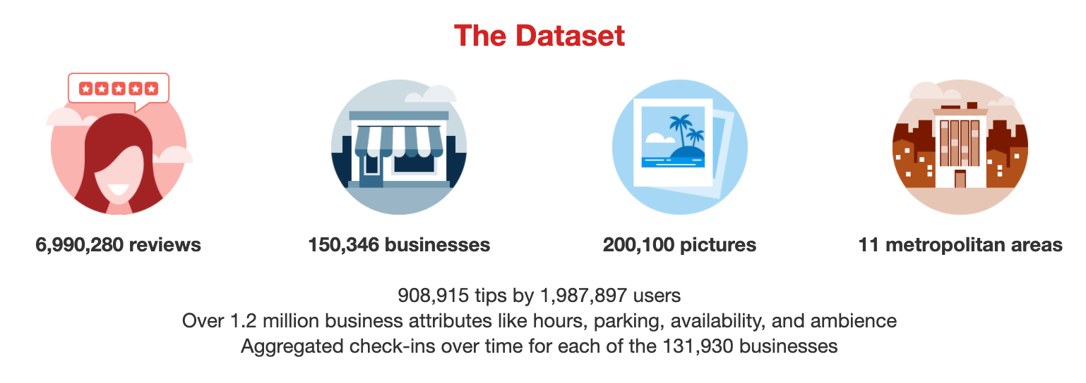
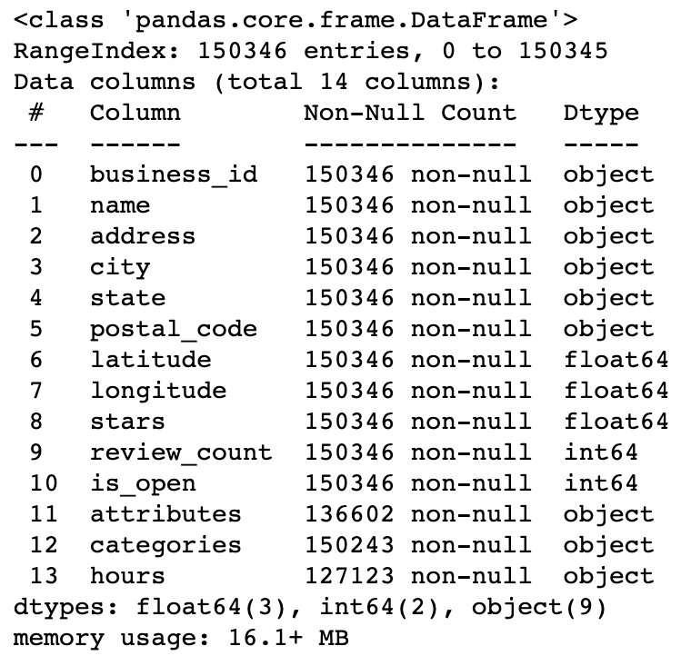
Data Cleaning
Compressed Columns
Redundant information
Missing data
Meaningless Dtype
Business other than restaurant
Data Source https://www.yelp.com/dataset/documentation/main

Slide 4
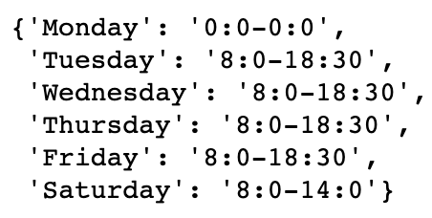
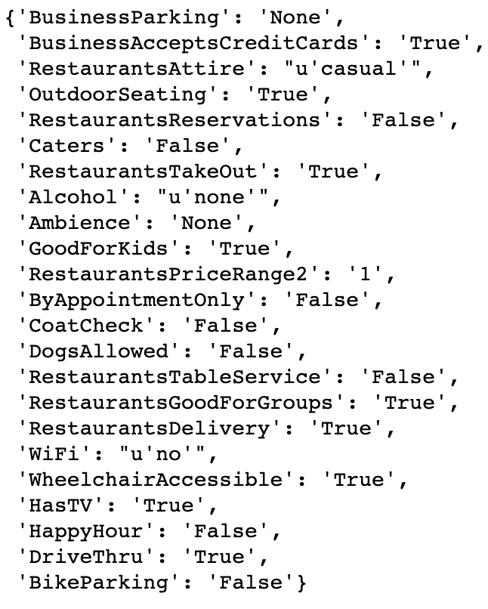
Sparse daily open and close time into 4 columns :
Average weekday open time
Average weekday close time
Average weekend open time
Average weekend close time
Sparse attributes into different columns and only keep those who are related to restaurant.
Hours
Attributes

Slide 5
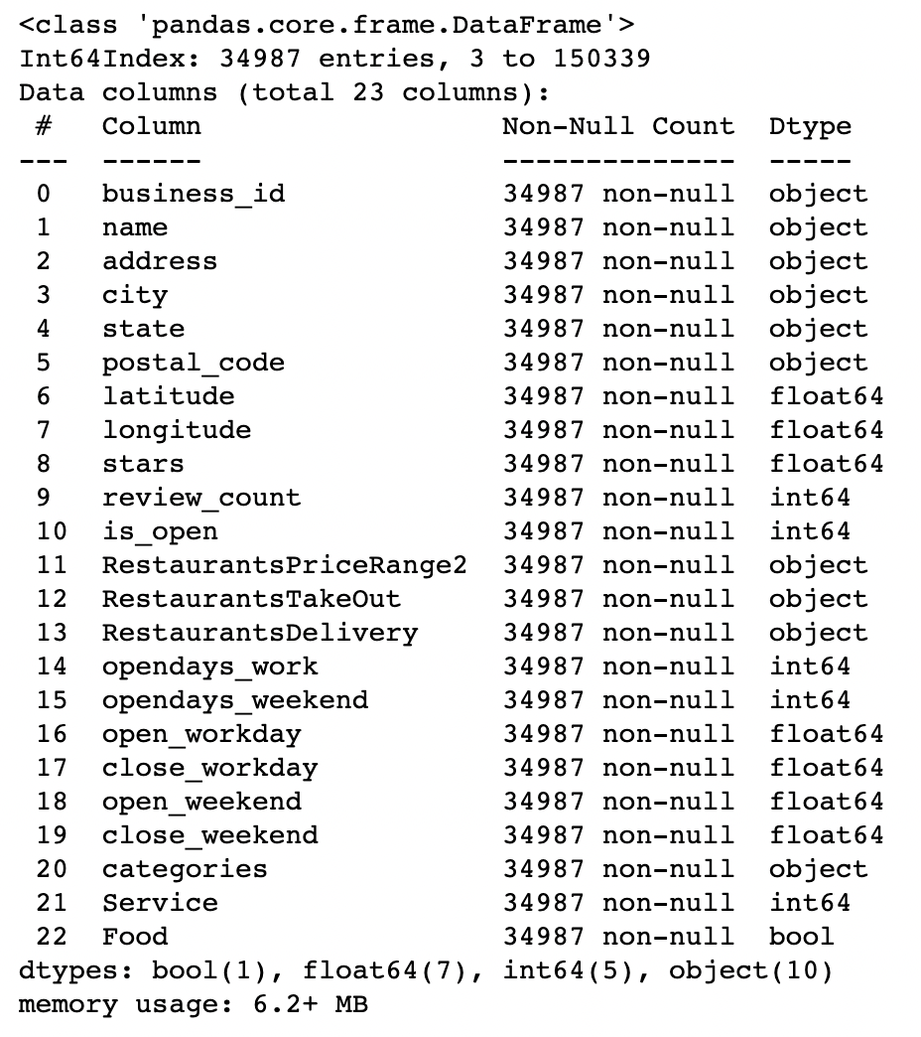
Is_open = True
Is restaurant = True
Drop meaningless and duplicate columns
Fill in missing data
For service, if the service column is None, suppose the restaurant does no have the certain service.
For opening time, if none, suppose open at 24 and close at 0

Slide 6
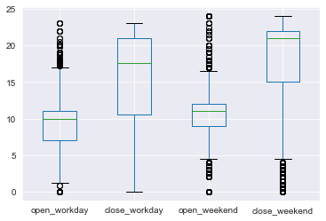
DATA VISUALIZATION Service Time

Slide 7
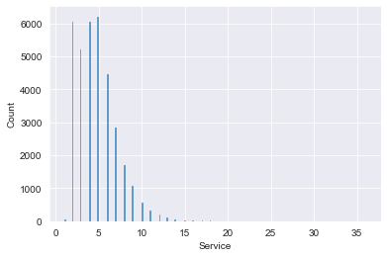
DATA VISUALIZATION Service Type I

Slide 8
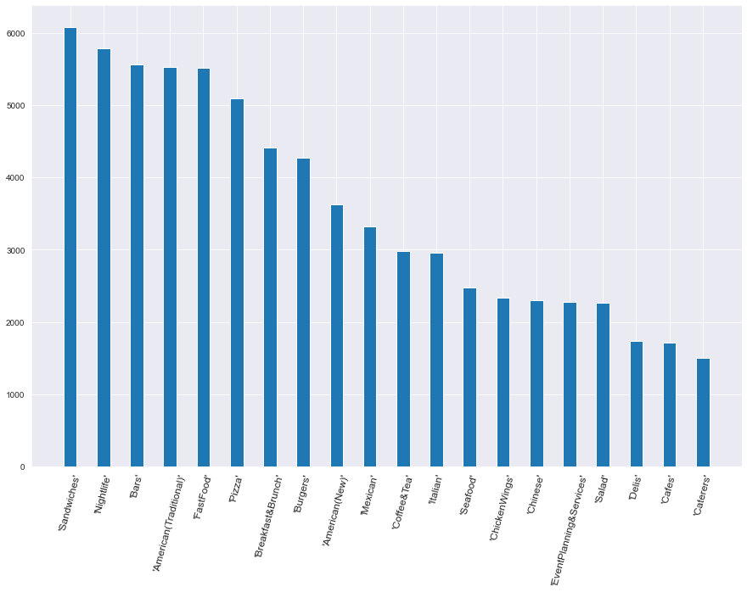
DATA VISUALIZATION Service Type II
Sandwiches Nightlife Bars American(Traditional) FastFood
Pizza Breakfast&Brunch Burgers American(New) Mexican
Coffee&Tea Italian Seafood ChickenWings Chinese
EventPlanning&Services Salad Delis Cafes

Slide 9
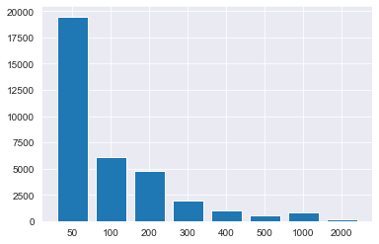
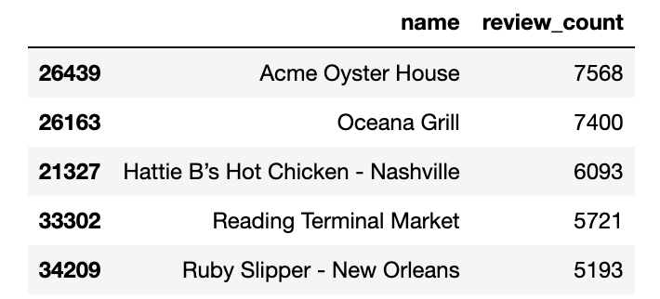
DATA VISUALIZATION REVIEWS

Slide 10
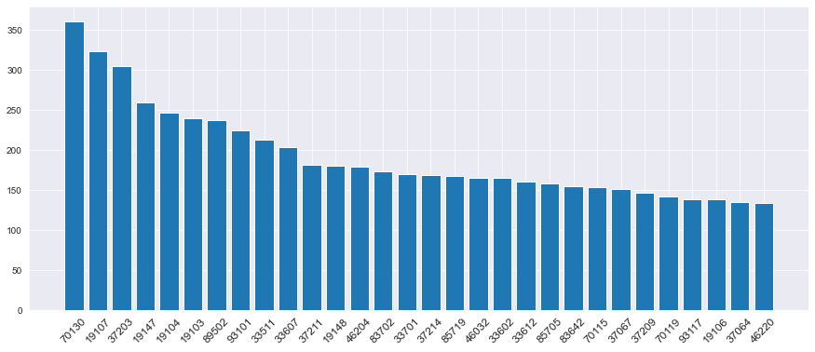
DATA VISUALIZATION LOCATIONS
70130 New Orleans, LA, California
19107 Philadelphia, Pennsylvania
37203 Nashville, Tennessee
19147 Philadelphia, Pennsylvania
19104 Philadelphia, Pennsylvania
19103 Philadelphia, Pennsylvania
89502 Reno, NV
93101 Santa Barbara, California
33511 Hillsborough County, Florida
33607 Tampa, Florida
37211 Nashville, Tennessee
19148 Philadelphia, Pennsylvania
46204 Indianapolis, Indiana
83702 Ada County, Idaho
33701 St. Petersburg, Florida
37214 Nashville, Tennessee
85719 Tucson, Arizona
46032 Hamilton County, Indiana
33602 Tampa, Florida
33612 Hillsborough County, Florida
85705 Pima County, Arizona
83642 Ada County, Idaho
70115 New Orleans, LA, California
37067 Williamson County, Tennessee
37209 Nashville, Tennessee
70119 New Orleans, Louisiana
93117 Santa Barbara County, California
19106 Philadelphia, Pennsylvania
37064 Williamson County, Tennessee
46220 Marion County, Indiana

Slide 11
Methods
Linear Regression
Decision Tree Regression
Gradient Boosting Regressor
Stacking Regressors
Gradient Boosting Classifiers
Random Forest Classifiers

Slide 12
Linear Regression
Package: a R like package statsmodels
Variables:
Response: Stars
Predictor variables: state, review_count, RestaurantsDelivery, RestaurantsPriceRange2, RestaurantsTakeOut, opendays_work, opendays_weekend, open_workday, open_weekend, Service.
We deleted some variables like close_weekday, and close_weekend to avoid high correlation towards X.
Fit a linear model using the variables

Slide 13
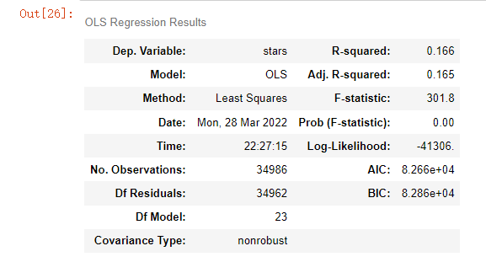
Results
R-squared is 0.166

Slide 14
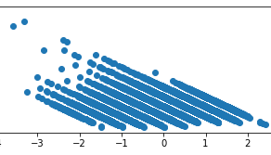
Diagnostics
Residual plot

Slide 15
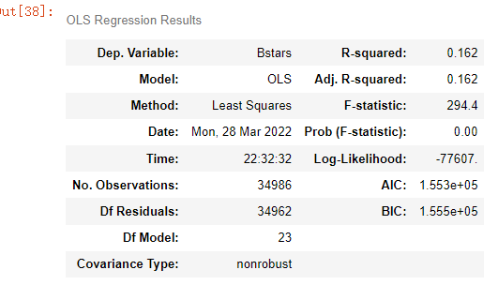
Results
Apply Boc-Cox Method to y, λ is 1.873
R-squared is 0.162

Slide 16
Decision Tree Regression
First, we use one-hot coding to convert categorical variables like state to numerical 0/1, and normalize all the variables.
Then, split the dataset to training set and test set. 80% in the training set and 20% in the test set.
Since the max depth of the tree matters, we write a loop to find the depth with the maximum prediction score (R^2).
We find that the depth with the best prediction score is 8, with R^2 = 0.32. So we train the model using that depth.
score_store = np.array(' ')​
for dep in range(3,20):​
dtr0 = DecisionTreeRegressor(max_depth=dep)​
dtr0.fit(X_train,y_train)​
score_store = np.append(score_store,dtr0.score(X_test,y_test))​
score_store

Slide 17
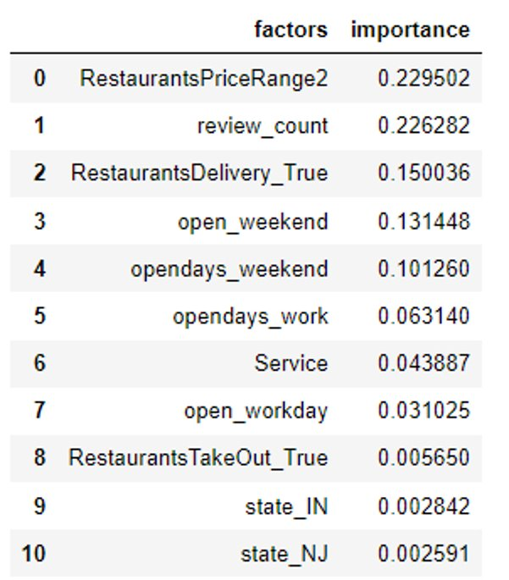
Results
Top 10 important features

Slide 18
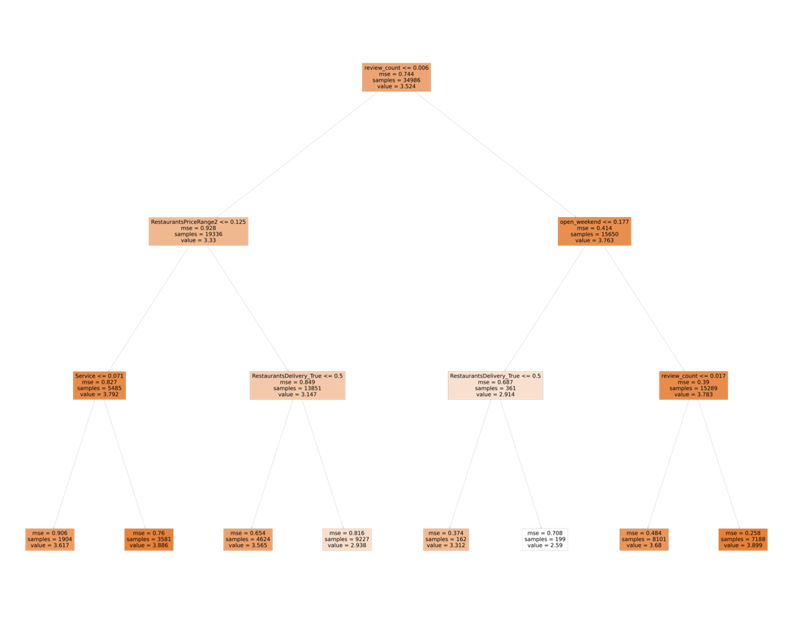
Results
Sample tree with max depth = 3.

Slide 19
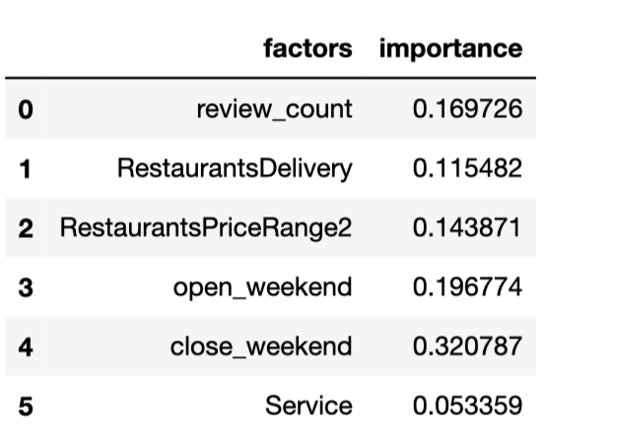
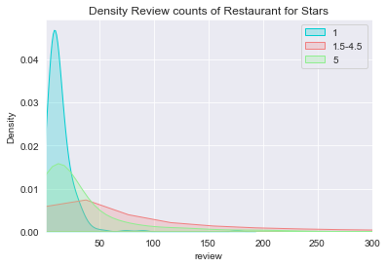
Feature Selection

Slide 20
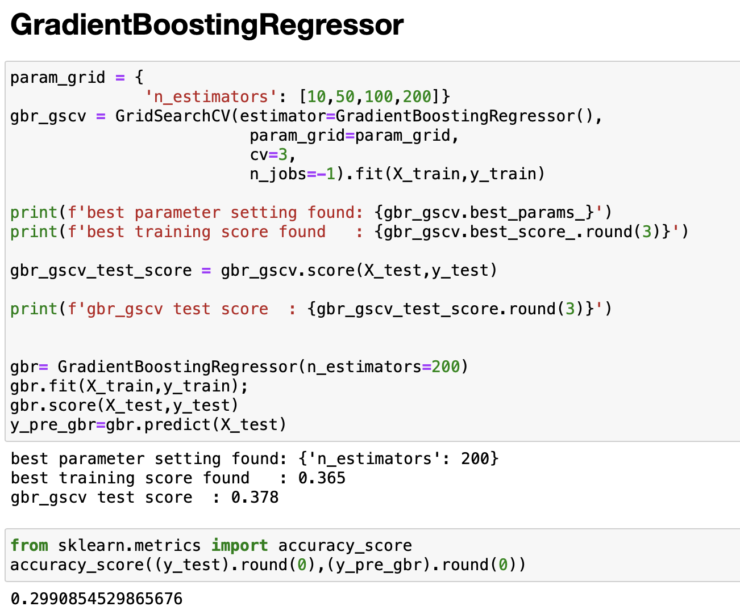
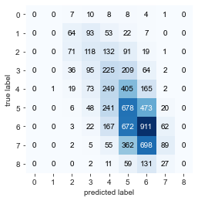
Gradient Boosting Regressors With 9 Classes 1.0 1.5 2.0 2.5 3.0 3.5 4.0 4.5 5.0

Slide 21
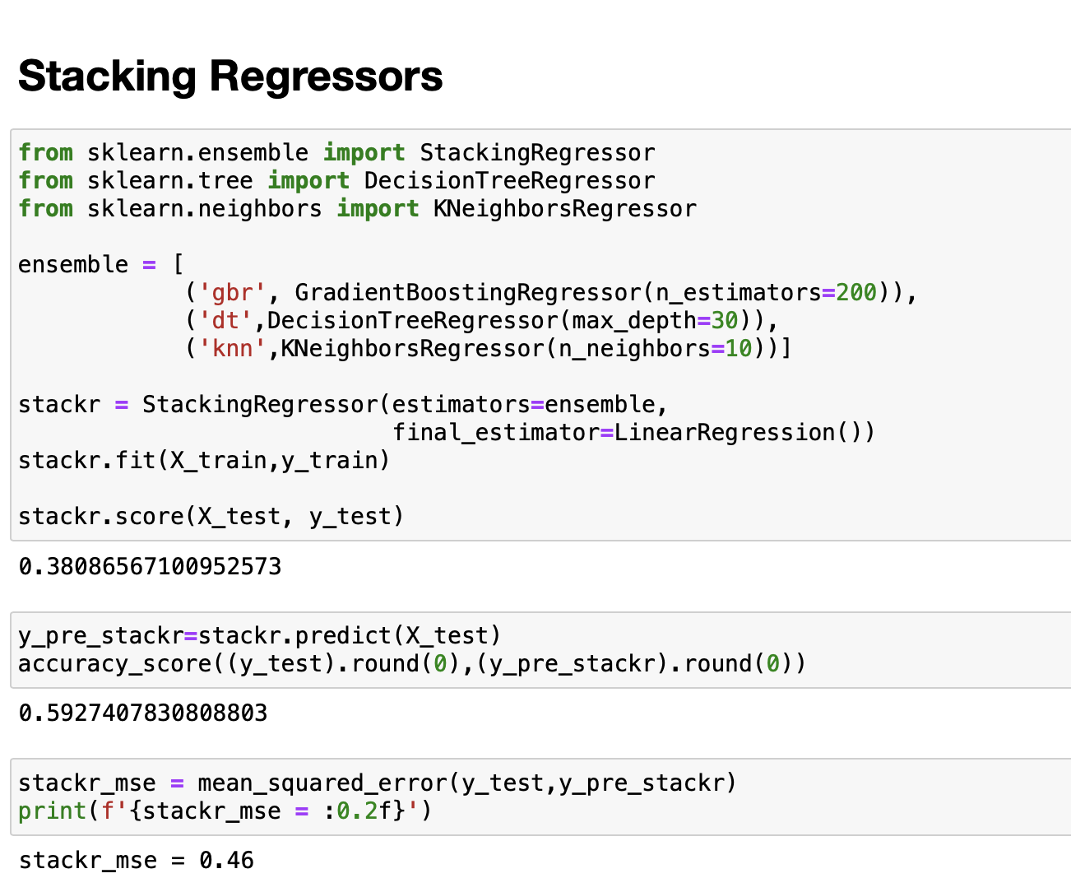
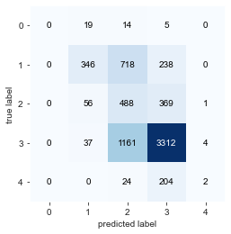
Stacking Regressors With 5 Classes 1.0 2.0 3.0 4.0 5.0

Slide 22
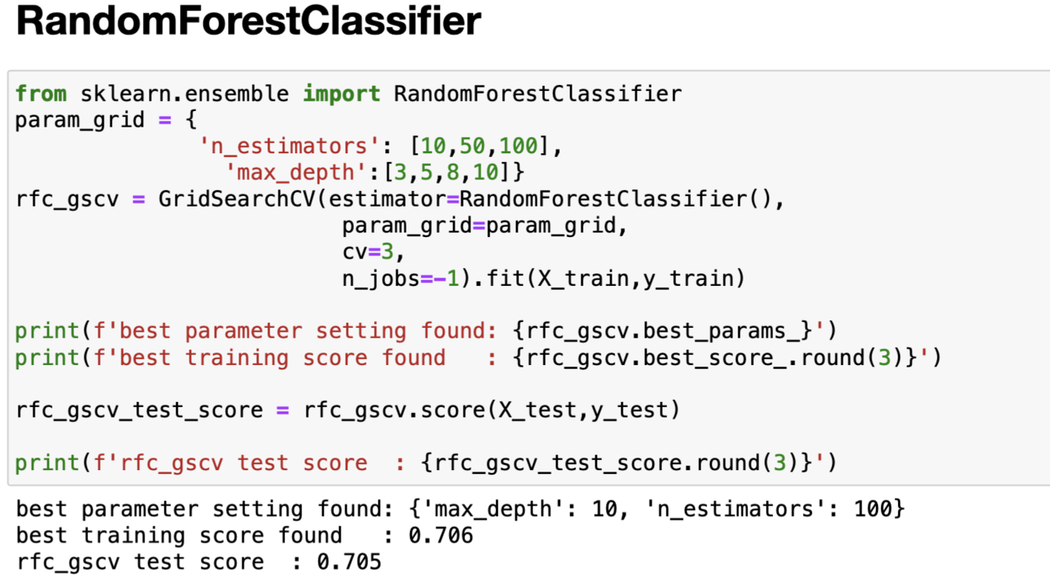
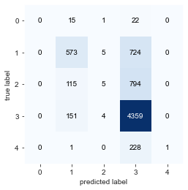
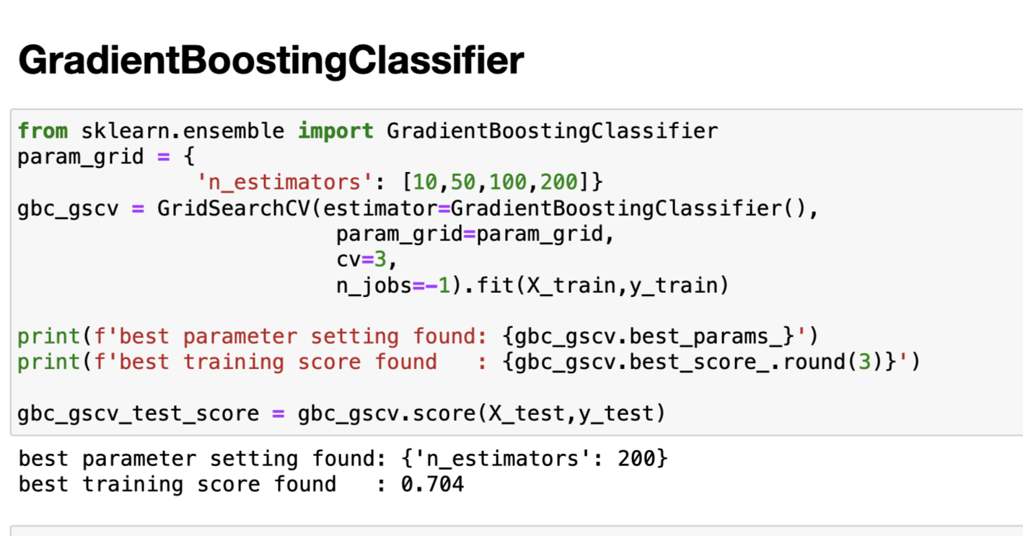

Classifiers With 5 Classes 1.0 2.0 3.0 4.0 5.0

Slide 23
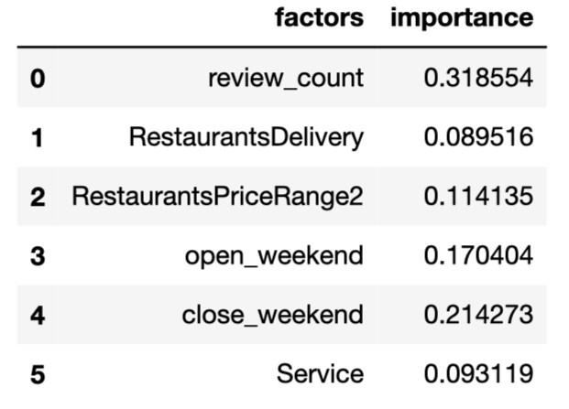
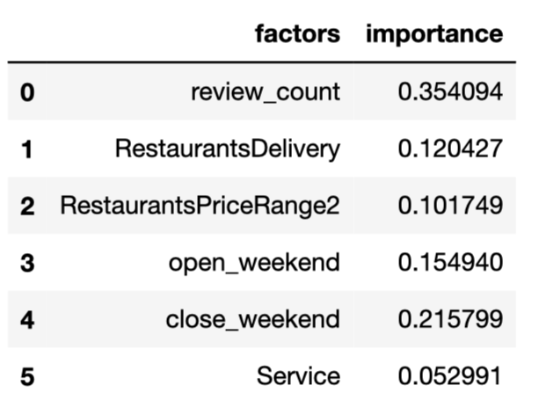
Conclusion classifiers have better performance with 5 Classes
Random Forest Classifiers
Gradient Boosting Classifiers
Restaurants should pay more attention to the above factors when they are trying to build reputation and get higher score. The most important factor is review counts followed by close time at weekend and open time at weekend.

Slide 24
Thanks for your listening

