Slide 1
Assignment 1 : Spell Checker Evaluation
11th Aug, 2013
Aman Madaan
Tarun Jain
Naman Gupta
CS 626 – Speech, NLP and the Web

Slide 2
Techniques Implemented
Edit Distance Based
Kernighan, Chruch and Gale's Approach
Trigram Similarity Measure

Slide 3
Spell Checking Through Edit Distance

Slide 4
Spell Checking : Edit Distance
Language Model
  Bi-gram Model
    P(C) = P(c1,c2,c3.....c_{n}) = P(c₂/c₁)*P(c₃/c₂)......P(c_{n}/c_{n-1})
  Frequency Model
    P(C) = Frequency Count of word 'C' in the corpus.
C = Suggested Word

Slide 5
Spell Checking : Edit Distance
Error Model :
  Offset Scores
    Insertion : 1
    Deletion : 1
    Transposition : .5
    Substitution : .5
    Substitution (2 chars) : .25

Slide 6
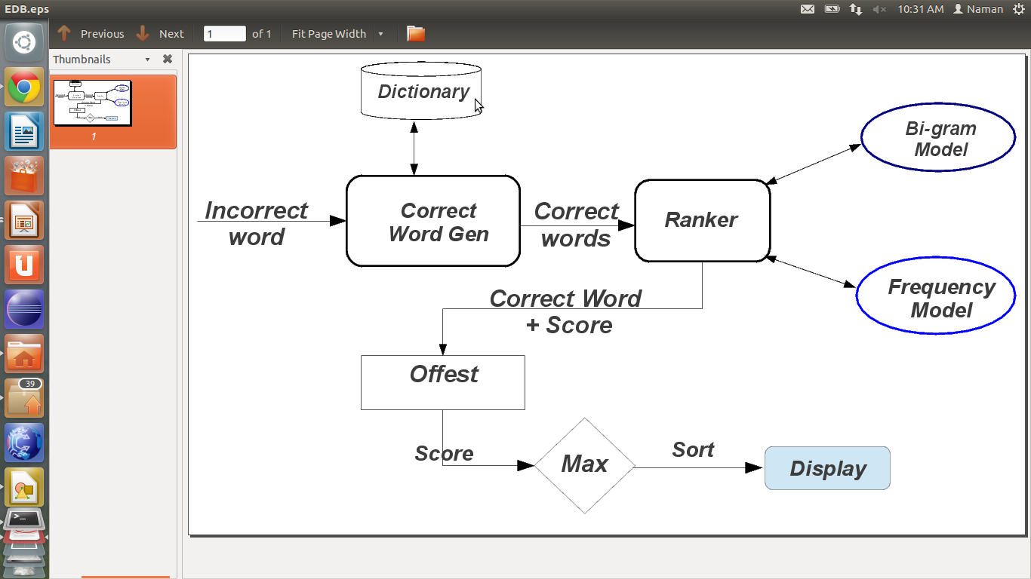
Edit Distance : Overview

Slide 7
Kernighan, Church and Gale Approach

Slide 8
Kernighan, Church and Gale Approach
Obtaining Matrices
  Wiki list
  (4479 misspelling – correction pairs)

Slide 9
Kernighan, Church and Gale Approach
Obtaining Matrices
  Wiki list
  (4479 misspelling – correction pairs)
  List by norvig
  (7841 misspellings, 39709 corrections)

Slide 10
Kernighan, Church and Gale Approach
Obtaining Matrices
  Wiki list
  (4479 misspelling – correction pairs)
  List by norvig
  (7841 misspellings, 39709 corrections)
Preprocessing

Slide 11
Kernighan, Church and Gale Approach
Obtaining Matrices
  Wiki list
  (4479 misspelling – correction pairs)
  List by norvig
  (7841 misspellings, 39709 corrections)
Preprocessing
Verifying Correctness

Slide 12
Kernighan, Church and Gale Approach
Normalizing values

Slide 13
Kernighan, Church and Gale Approach
Normalizing values
  Dividing by total number of operations

Slide 14
Kernighan, Church and Gale Approach
Normalizing values
  Dividing by total number of operations
  Dividing by the frequency

Slide 15
Kernighan, Church and Gale Approach
Normalizing values
  Dividing by total number of operations
  Dividing by the frequency
Both approaces lead to comparable results

Slide 16
Kernighan, Church and Gale Approach
Ranking Results

Slide 17
Kernighan, Church and Gale Approach
Ranking Results
Ideal case : we find the correct word

Slide 18
Kernighan, Church and Gale Approach
Ranking Results
Ideal case : we find the correct word
In case there is no decisive winner, need to supply some score that will make sense to users

Slide 19
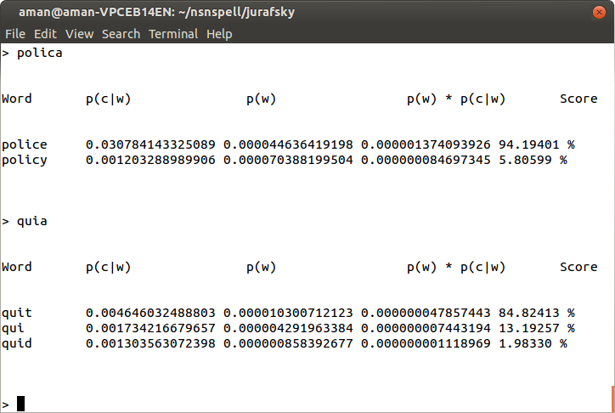
Kernighan, Church and Gale Approach

Slide 20
Spell Checking Using Trigram Similarity Measure

Slide 21
Spell Checking Using Trigram Similarity Measure
Inspects the dictionary to identify the most similar word.
Similarity is calculated using similarity coefficient involving number of TRIGRAMS common to a word in the dictionary and the misspelling.
Let N1 : # of Trigrams in Incorrect word.
N2 : # of Trigrams in Suggested Word.
C : # of Common Trigrams.

Slide 22
Spell Checking Using Trigram Similarity Measure
Score = 2 * C / (N1 + N2)
Example :
Incorrect Word : abanddon
Suggested Word : abandon , abandoned
Score of abandon = 2*4/(6+5) = .727272
Score of abandoned = 2*4/(6+7) = .615384

Slide 23
Incorrect word | Suggested Correction
abanddon | abandon
Trigrams | Trigrams
aba | aba
ban | ban
and | and
ndd | -
- | ndo
ddo | -
don | don
Incorrect word | Suggested Correction
abanddon | abandoned
Trigrams | Trigrams
aba | aba
ban | ban
and | and
ndd | -
- | ndo
ddo | -
don | don
- | one
- | ned
N1 = 6
N2 = 5
C = 4
Score = ( 2*4)/(5+6) = 0.727272
N1 = 6
N2 = 7
C = 4
Score = ( 2*4)/(6+7) = 0.615384

Slide 24
References
'Automatic spelling correction using a trigram similarity measure' Richard C. Angel , George E.Freund and Peter Willett
'A Spelling Correction program based on a noisy channel model' Mark D. Kernighan , Kenneth W. Church , William A. Gale
norvig.com/spell-correct.html
http://en.wikipedia.org/wiki/Wikipedia:Lists_of_common_misspellings/For_machines

Slide 25
Thank You

