Slide 1
NLP Topic Modeling of Amazon Reviews
28.09.2023

Slide 2
Topic and Research Question
Topic
Topic Modeling of Amazon Reviews for Software Category
RQ1
Can topic modeling techniques such as LDA (Latent Dirichlet Allocation), NMF (Non-Negative Matrix Factorization), and BERTopic be effectively applied to Amazon review data to identify and categorize the prevalent themes and subjects of consumer feedback?

Slide 3
Data
Amazon Review Data (2018)
Raw review data (34 Gb) - all 233.1 million reviews
Per-category data with the chosen category “Software” includes 459,436 reviews
reviewerID - ID of the reviewer, e.g. A2SUAM1J3GNN3B
asin - ID of the product, e.g. 0000013714
reviewerName - name of the reviewer
vote - helpful votes of the review
style - a disctionary of the product metadata, e.g., "Format" is "Hardcover"
reviewText - text of the review
overall - rating of the product
summary - summary of the review
unixReviewTime - time of the review (unix time)
reviewTime - time of the review (raw)
image - images that users post after they have received the product

Slide 4
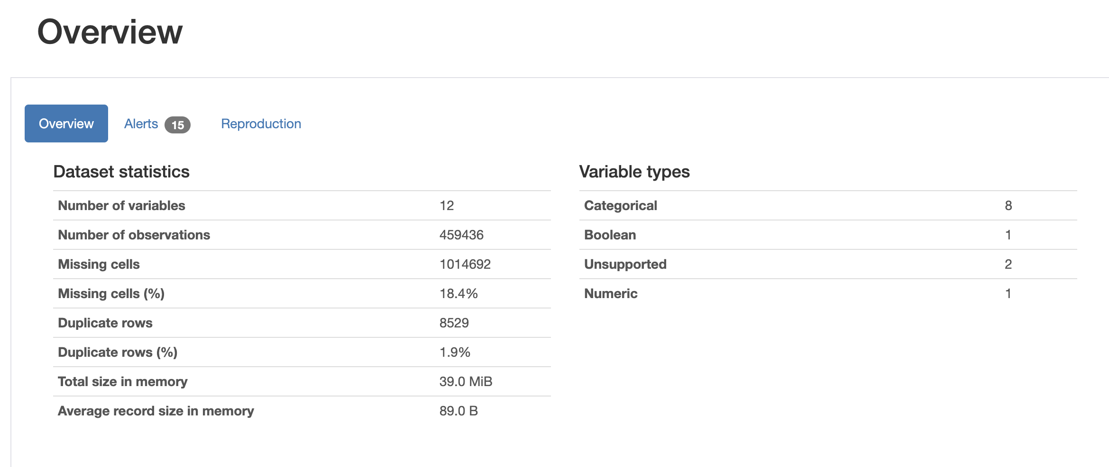
Statistical Analysis

Slide 5
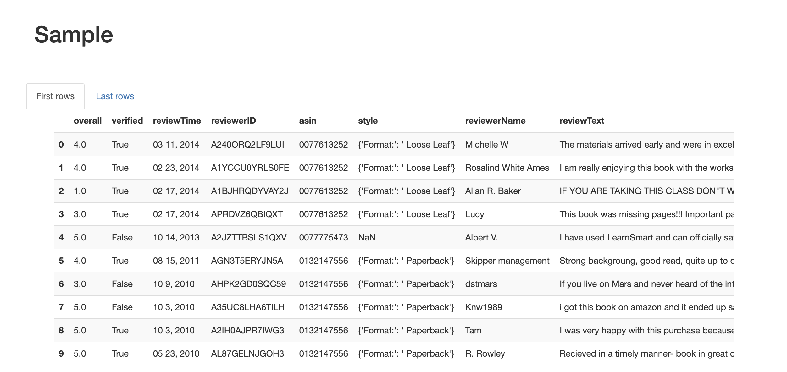
Sample Review

Slide 6
Expected Output
Topic Distribution
For each review, topics that are most relevant will be generated.
This can be represented as a distribution of topics for each review, showing the likelihood or weight
of each topic in that review. (For instance, a review might be 70% related to the "product quality”
topic and 30% related to the "customer service" topic.
Visualization
Word clouds, bar charts, or heatmap visualizations can be used to illustrate the most representative
words in each topic
Evaluation Metrics
For performance assessment of LDA and NMF, evaluation metrics such as coherence score or topic purity
can be used.

