Slide 1
NLP
Topic Modeling of Amazon Reviews for Software Products
Frauscher ,Ginda, Ismail & Salletmayer

Slide 2
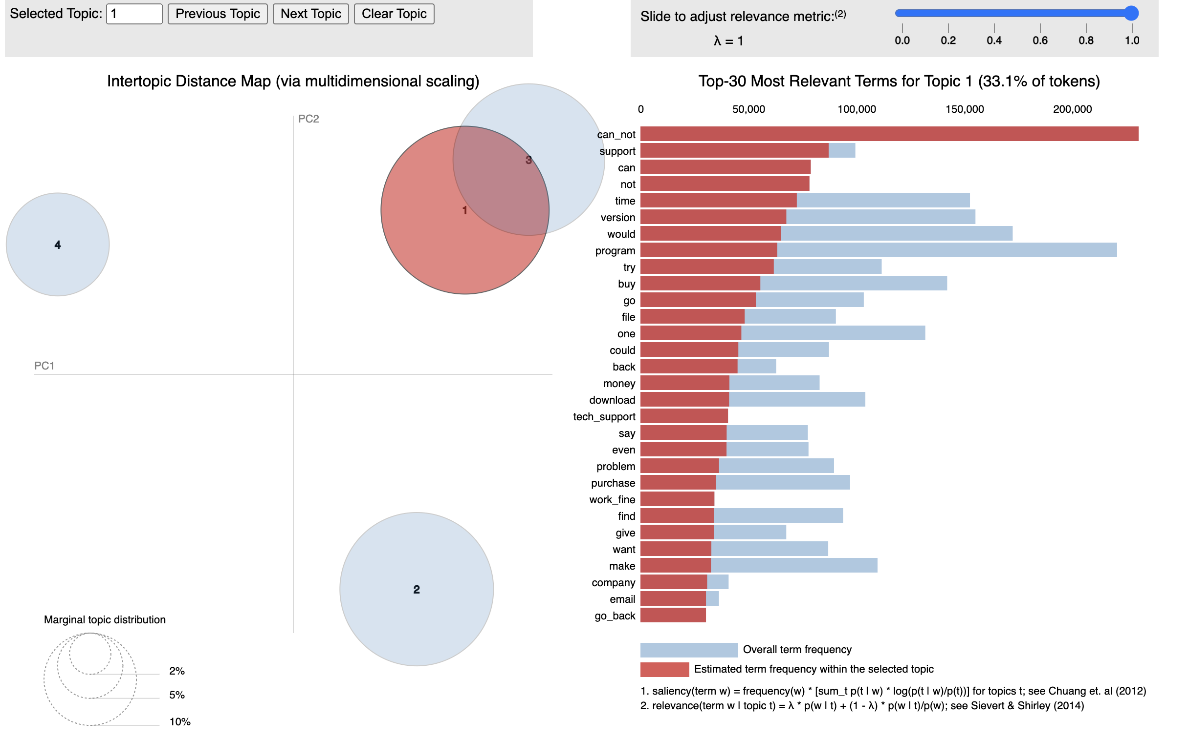
LDA (Latent Dirichlet Allocation)
The left panel, labeled Intertopic Distance Map, circles represent different topics and the distance between them. Similar topics appear closer and the dissimilar topics farther.
The right panel, include the bar chart of the top 30 terms.

Slide 3
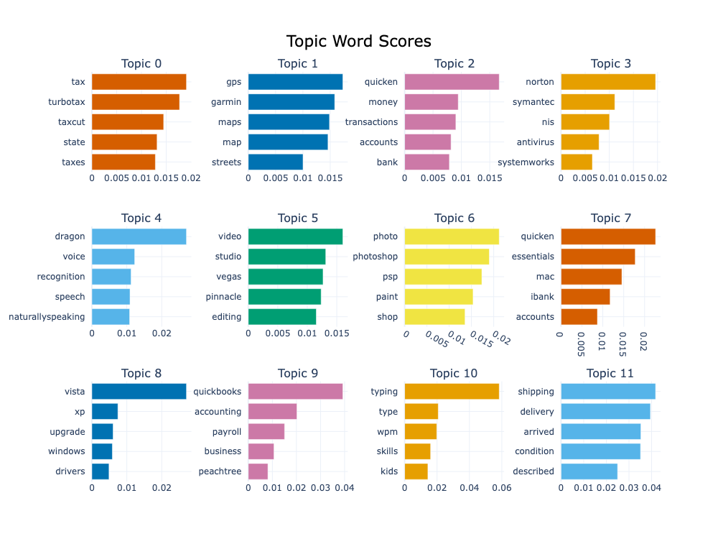
BERTopic
BERTopic on a subset of your data, run on the first 100,000 rows.
total: 1h58s with GoogleColab (V100 High RAM)
For dimensionality reduction UMAP is used. (Uniform Manifold Approximation and Projection)

Slide 4
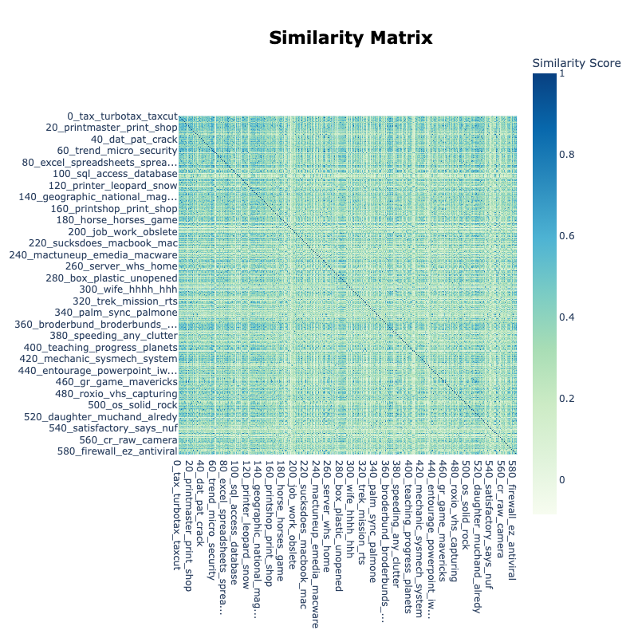
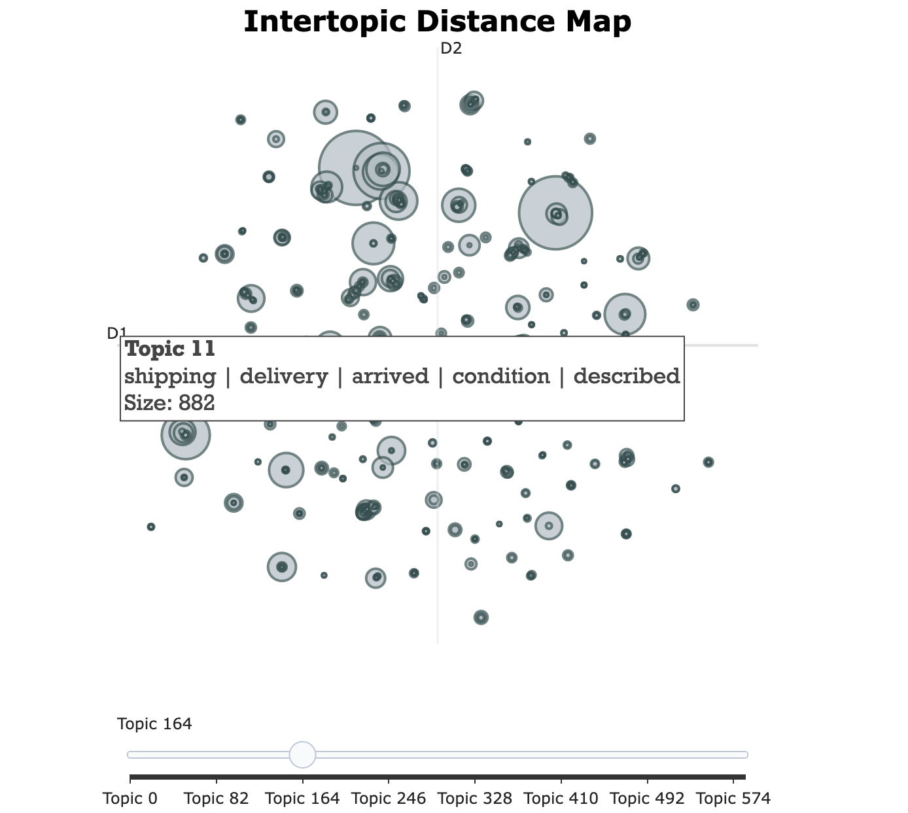
BERTopic

Slide 5
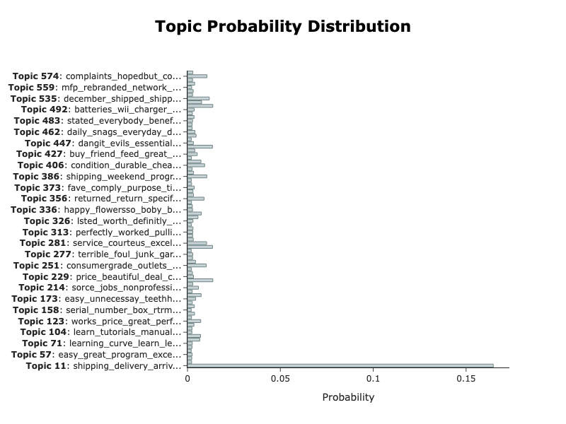
BERTopic

