Slide 1
NLP - Preprocessing
Topic Modeling of Amazon Reviews for Software Products

Slide 2
Preprocessing Steps
reviews.isna().sum()
reviewerName 24
reviewText 66
summary 56
dtype: int64
1) Handle Missing Values
Final Dataset Reduced to
459296 rows
Removed 140 rows
2) Handle contradictions
3) Lowercasing
4) Removal of stop words (nltk.corpus)
The materials arrived early and were in excellent condition. However for the money spent they really should've come with a binder and not just loose leaf.
materials arrived early excellent condition however money spent really come binder loose leaf
5) Tokenize with Gensim

Slide 3
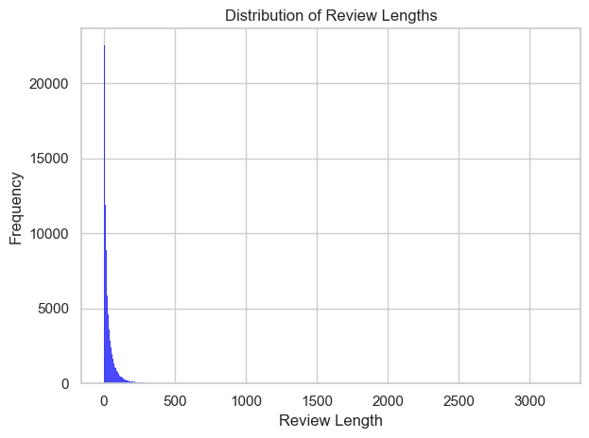
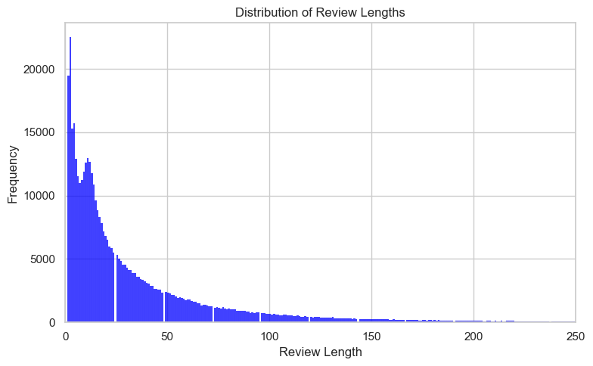
Distribution of Review Lengths
Remove reviews with 0 token length.
562 rows removed.
min: 1
max: 3198
mean: 38.67146320089638

Slide 4
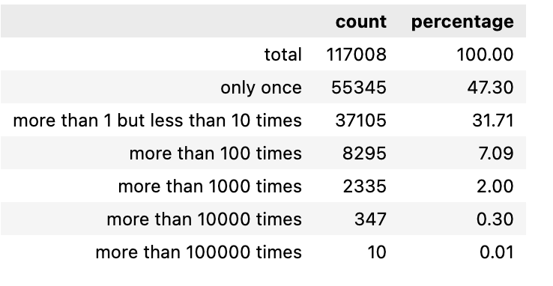
Summary of Word Frequency Statistics
Summary of word frequency statistics to analyze the distribution of word occurrences

Slide 5
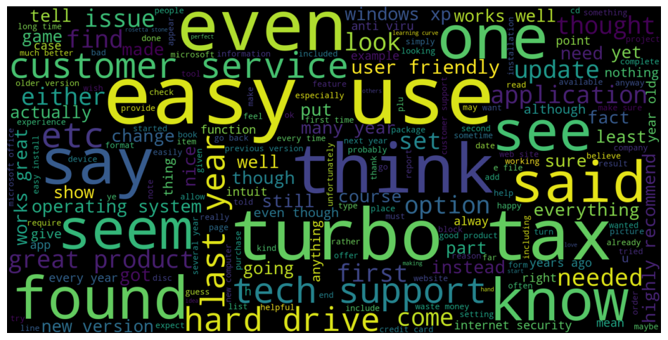
WordCloud

Slide 6
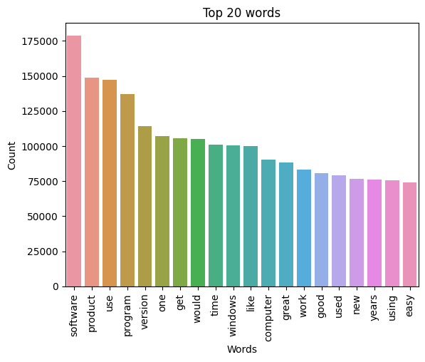
Top 20 Used Words
software
product
use
program
version
one
get
would
time
windows
.
.
.

