Slide 1
Reinforcement Learning Based Automatic Vehical Parking
何天墨 518261910040

Slide 2
1. Automatic Parking with Reinforcement Control
Main parameters:
vehState = [x; y; theta; steerAng; speed];
(x, y) = The coordinates of the midpoint of the connection of Rear-wheels.
theta = The angle between the central axis of the vehicle and the x-axis(θ).
steerAng = The angle between the front wheel of the vehicle and the x-axis(Φ)/ The vehicle steering angle.
speed : The speed of the vehicle.
vehState = VehDynamics(vehState, steerAngIn, speedIn, dt, vehL, steerVel, speedAcc)
Input : SteerAngIn([-1/5pi, 1/5pi]), speedIn, steerVel(degree/s), speedAcc(m/s^2).
Constant: dt(The time of evolution between two states), vehL(The length of the vehicle).

Slide 3
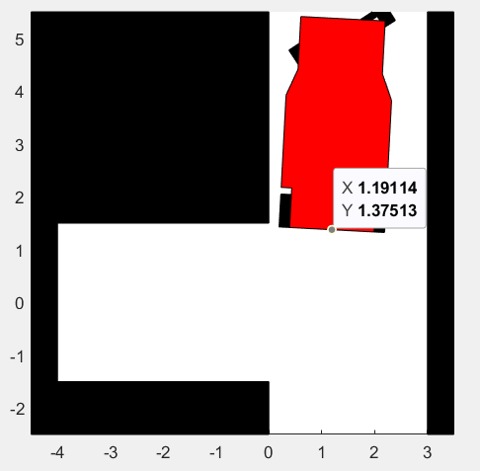
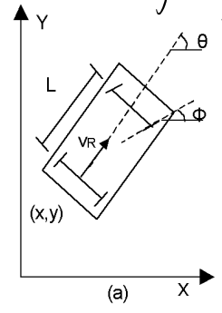
1.Automatic Parking with Reinforcement Control

Slide 4
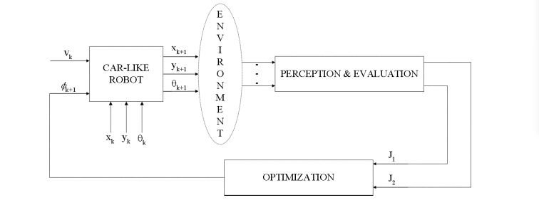
2.a method based on the perception planning-action cycle_x0002_
(x_d, y_d) : The final position. θ_d : The desired orientation.
Two performance functions: J_1, J_2
J_1 = 0.5 * ((vehState(1) - x_d)^2 + (vehState(2) - y_d)^2);
J_2 = 0.5 * (vehState(3) - theta_d)^2;;

Slide 5
2.a method based on the perception planning-action cycle
While driven by a negative constant speed, we aime at minimizing both performance indices:
steerAng_diff = -μ_1 * diff(J_1, vehState(4)) - μ_2 * diff(J_2, vehState(4));
The discrete-time version of the control law:
Φ_k+1 = Φ_k - -μ_1 * diff(J_1, vehState(4)) - μ_2 * diff(J_2, vehState(4));
What is important: The sign and module of vehicle steering angle depends on the gradients of both performanc functions of J_1 and J_2.

Slide 6
3.Model-Free Behavior
Our vehicle acts as a model free agent, immerse in a dynamic environment. The control actions rely on the direct and instantaneous information gathered from the environment:
δJ_1 / δΦ = (J_1(k) - J_1(k-1))/(Φ(k)-Φ(k - 1))
δJ_2 / δΦ = (J_2(k) - J_2(k-1))/(Φ(k)-Φ(k - 1))
The secret of excellent result lies in two elements:
1. The objective functions evaluating its performance
2. The action strategy based on the optimization of the performance functions.

