Slide 1

Instructor Kick-off
Analyze A/B Test Results
© 2019 Udacity. All rights reserved.

Slide 2
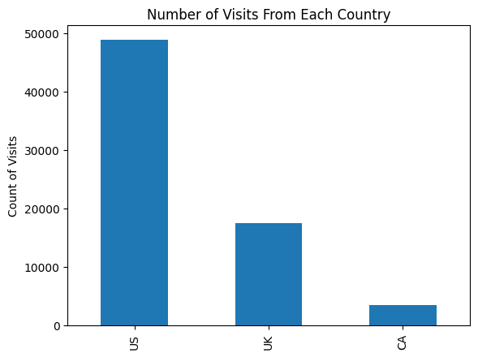
How Was The Experiment Implemented?​
Total Variant Visitors: 35211 35211
Total Control Participants:​ 34678

Slide 3
Conversion Rates
 | U.S. | U.K. | CA
Control | 10.7% | 10.1% | 9.4%
Treatment | 15.8% | 14.8% | 15.4%
Executive Summary: Data shows that the treatment leads to higher conversion rates but the degree of improvement differs for each country

Slide 4
Experiment Results
Treatment Conversion Rate: 15.5%
Control Conversion Rate:​ 10.5%
Delta in Treatment vs. Control Conversion Rate:​ 5%
p-value:​ 0%
Conclusion:​ The conversion rate difference between the treatment and control is statistically significant (p = 0.0), suggesting the treatment has a real effect. Thus, have sufficient evidence to reject the null hypothesis and use the new page instead of the old one. From a practical perspective, the prices of creating each one should also be put into consideration however it is clear that the increase in success is worth it.

Slide 5
Country Results
Conclusion:​ There aren’t any conversion rates that are statistically significant both, as the p-values exceed the 0.05 threshold thus we don’t have enough evidence to reject the null hypothesis.
Even though they’re statistically insignificant they can still hold practical relevance, the US seems to have a relatively stronger signal so it is wiser to explore expansion in the US before the UK & Canada for the highest success.

