Slide 1
TOP 10 MEMES DE WBNS
WUAZA XD

Slide 2
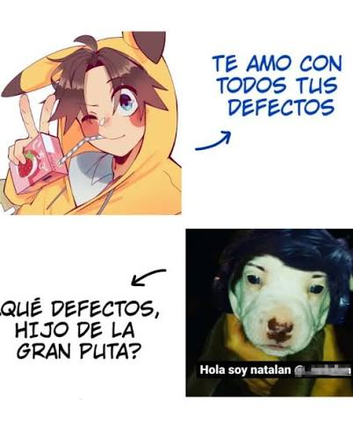
TOP 10:

Slide 3

TOP 9:

Slide 4

TOP 8:

Slide 5

TOP 7:

Slide 6

TOP 6:

Slide 7

TOP 5:

