Slide 1



Generate Report
In Word
Using Excel table

Slide 2
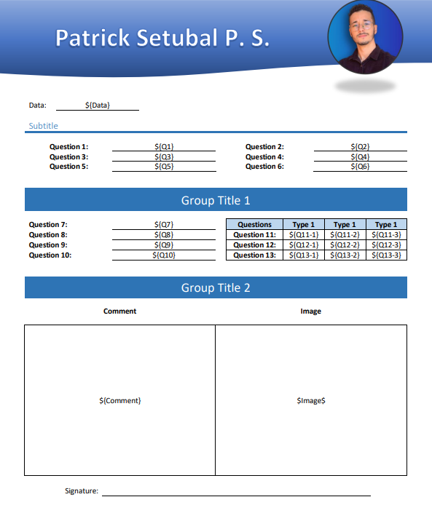
Define Template and Variables

Slide 3
Define the table
Each Line will be a report
...

